Slide 1
Ahtanum Creek Reach Assessment Rivermiles 9-26
Yakama Reservation Watershed Project
Project #26-1497

Slide 2
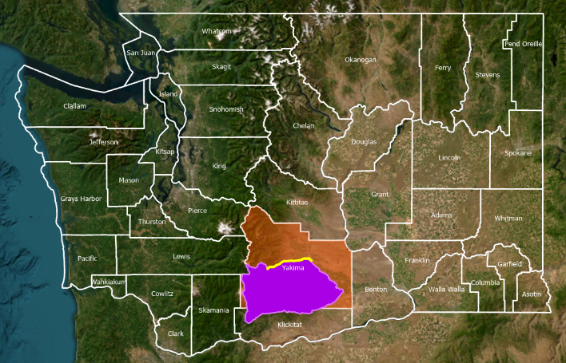
Project Location
Notes:
Map showing the location of Yakima County and the Yakama Nation Reservation relative to other counties in the state.

Slide 3
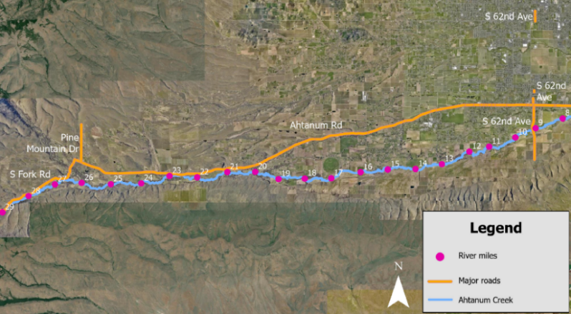
Project Location
Notes:
Map specifically showing the proposed project area. South 62nd Ave is approximately at river mile 9 and Pine Mountain Drive is approximately at river mile 26.

Slide 4
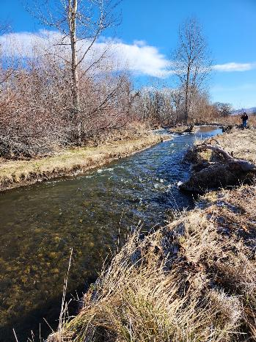
Limiting Factors for Fish in Ahtanum Creek
Fish passage
Channel conditions.
Removal of large trees has affected large woody debris recruitment over time.
Riparian conditions.
Lack of bank stabilizing vegetation.
Invasive species present.
Low summer flows.
Summer baseflows reach 8-10 CFS.

Slide 5
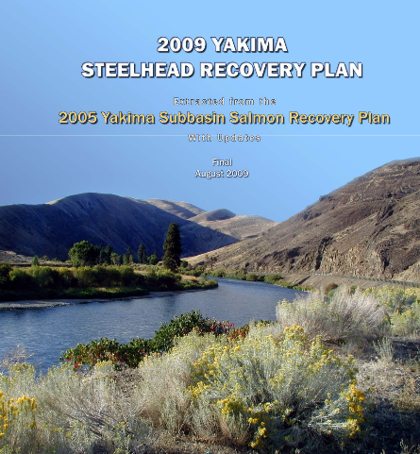

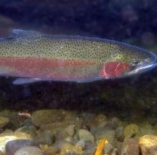
Recovery Plans and Projects
Our reach assessment aligns with actions in the Steelhead Recovery Plan and Bull Trout Action Plan.

Slide 6
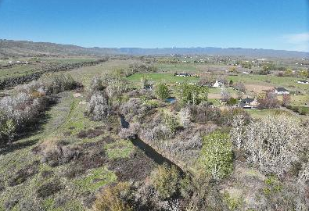
What is a reach assessment? Why is it important?
Evaluation of past, present, and potential future conditions of riparian and freshwater habitat.
Tool for identifying areas for habitat enhancement and where limiting factors can be addressed.
Provides a prioritized list of projects to inform sequencing of restoration actions in Ahtanum Creek.
Builds on previous assessments.
WDFW Fish Passage Barrier Assessment (2018).
Ahtanum Watershed Assessment (2004)
Ahtanum Creek Watershed Analysis (1998)

Slide 7
Reach Assessment Goals
Assess current habitat conditions for steelhead, lamprey, bull trout, and other salmonid species in rivermiles 9-26 of Ahtanum Creek.
Analyze hydraulic conditions in Ahtanum Creek and identify areas of concern that are impacting habitat availability.
Produce a list of prioritized projects that will improve habitat abundance and quality.

Slide 8
Reach Assessment Components
Characterizing the assessment area
Past projects and studies
Biophysical setting
Fish use and status
Human disturbance
Field Assessment
Forest Service Level II Habitat survey
Geomorphology assessment
Vegetation survey
Site Analyses
Sediment transport analysis
Floodplain surface mapping
Vegetation analysis
Hydraulic modeling (2D HEC-RAS)
Evaluation, Project Identification and Prioritization
Development of Reach Based Ecosystem Indicators (REI metrics)
Identification of potential projects in assessment area
Identification of conservation areas.
Prioritization of identified projects

Slide 9
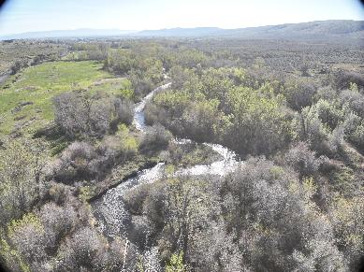
Outcomes and Benefits
Improved understanding of habitat quality along river miles 9-26 of Ahtanum Creek for steelhead, lamprey, bull trout, and other resident fish.
Identified and prioritized habitat enhancement projects in Ahtanum Creek.
Recommendations on sequencing of future project implementation.

Slide 10
Funding Breakdown

