Slide 1
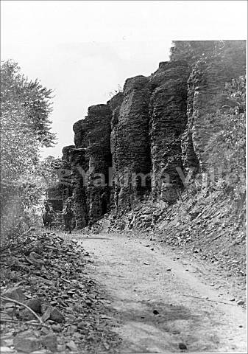


Ahtanum Village Restoration
SRFB Targeted Investments
Project #24-1122/Project #26-1314
Project #19-1446 (design)
Yakima Basin Fish and Wildlife Recovery Board
Salmon Recovery Funding Board – April 14th, 2026
John Marvin – Yakama Nation Fisheries

Slide 2
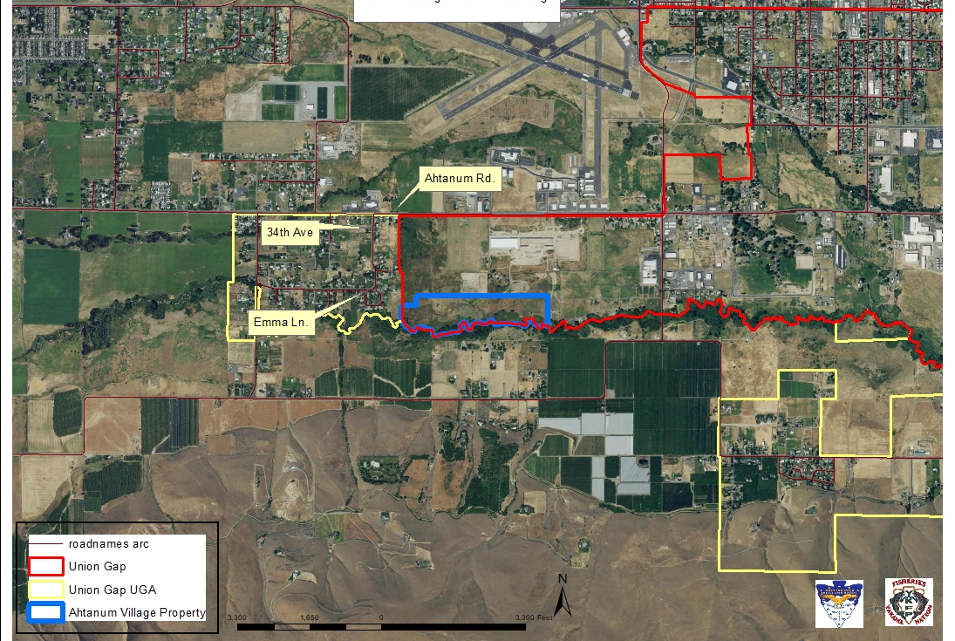
Ahtanum Village Restoration Project # 26-1314
Acquired by YN in 2017
54 acres
93 a/f surface water rights
Within City of Union Gap
Development Agreement
Zoned Industrial

Slide 3
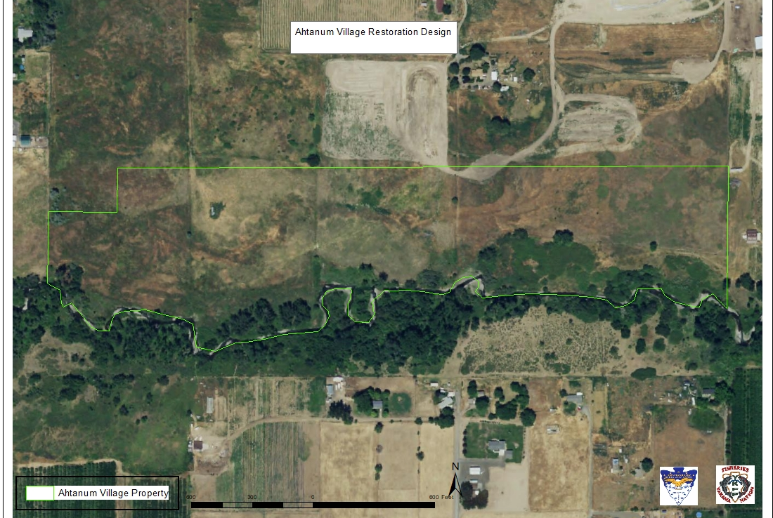
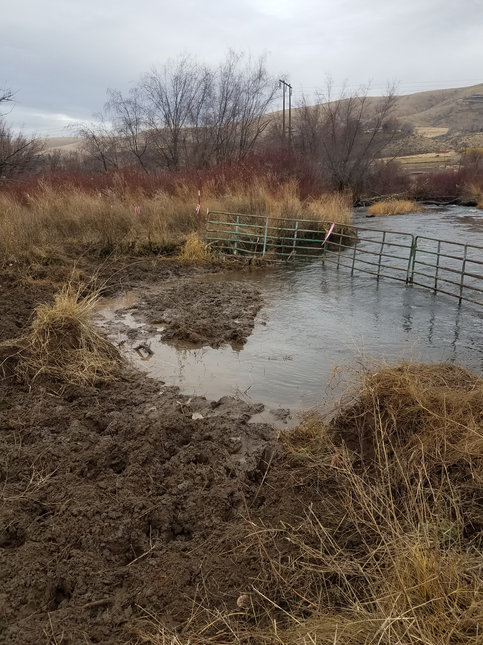
Ahtanum Village Restoration Project # 26-1314
Historically utilized for Agriculture.
  Grazing and hay

Slide 4
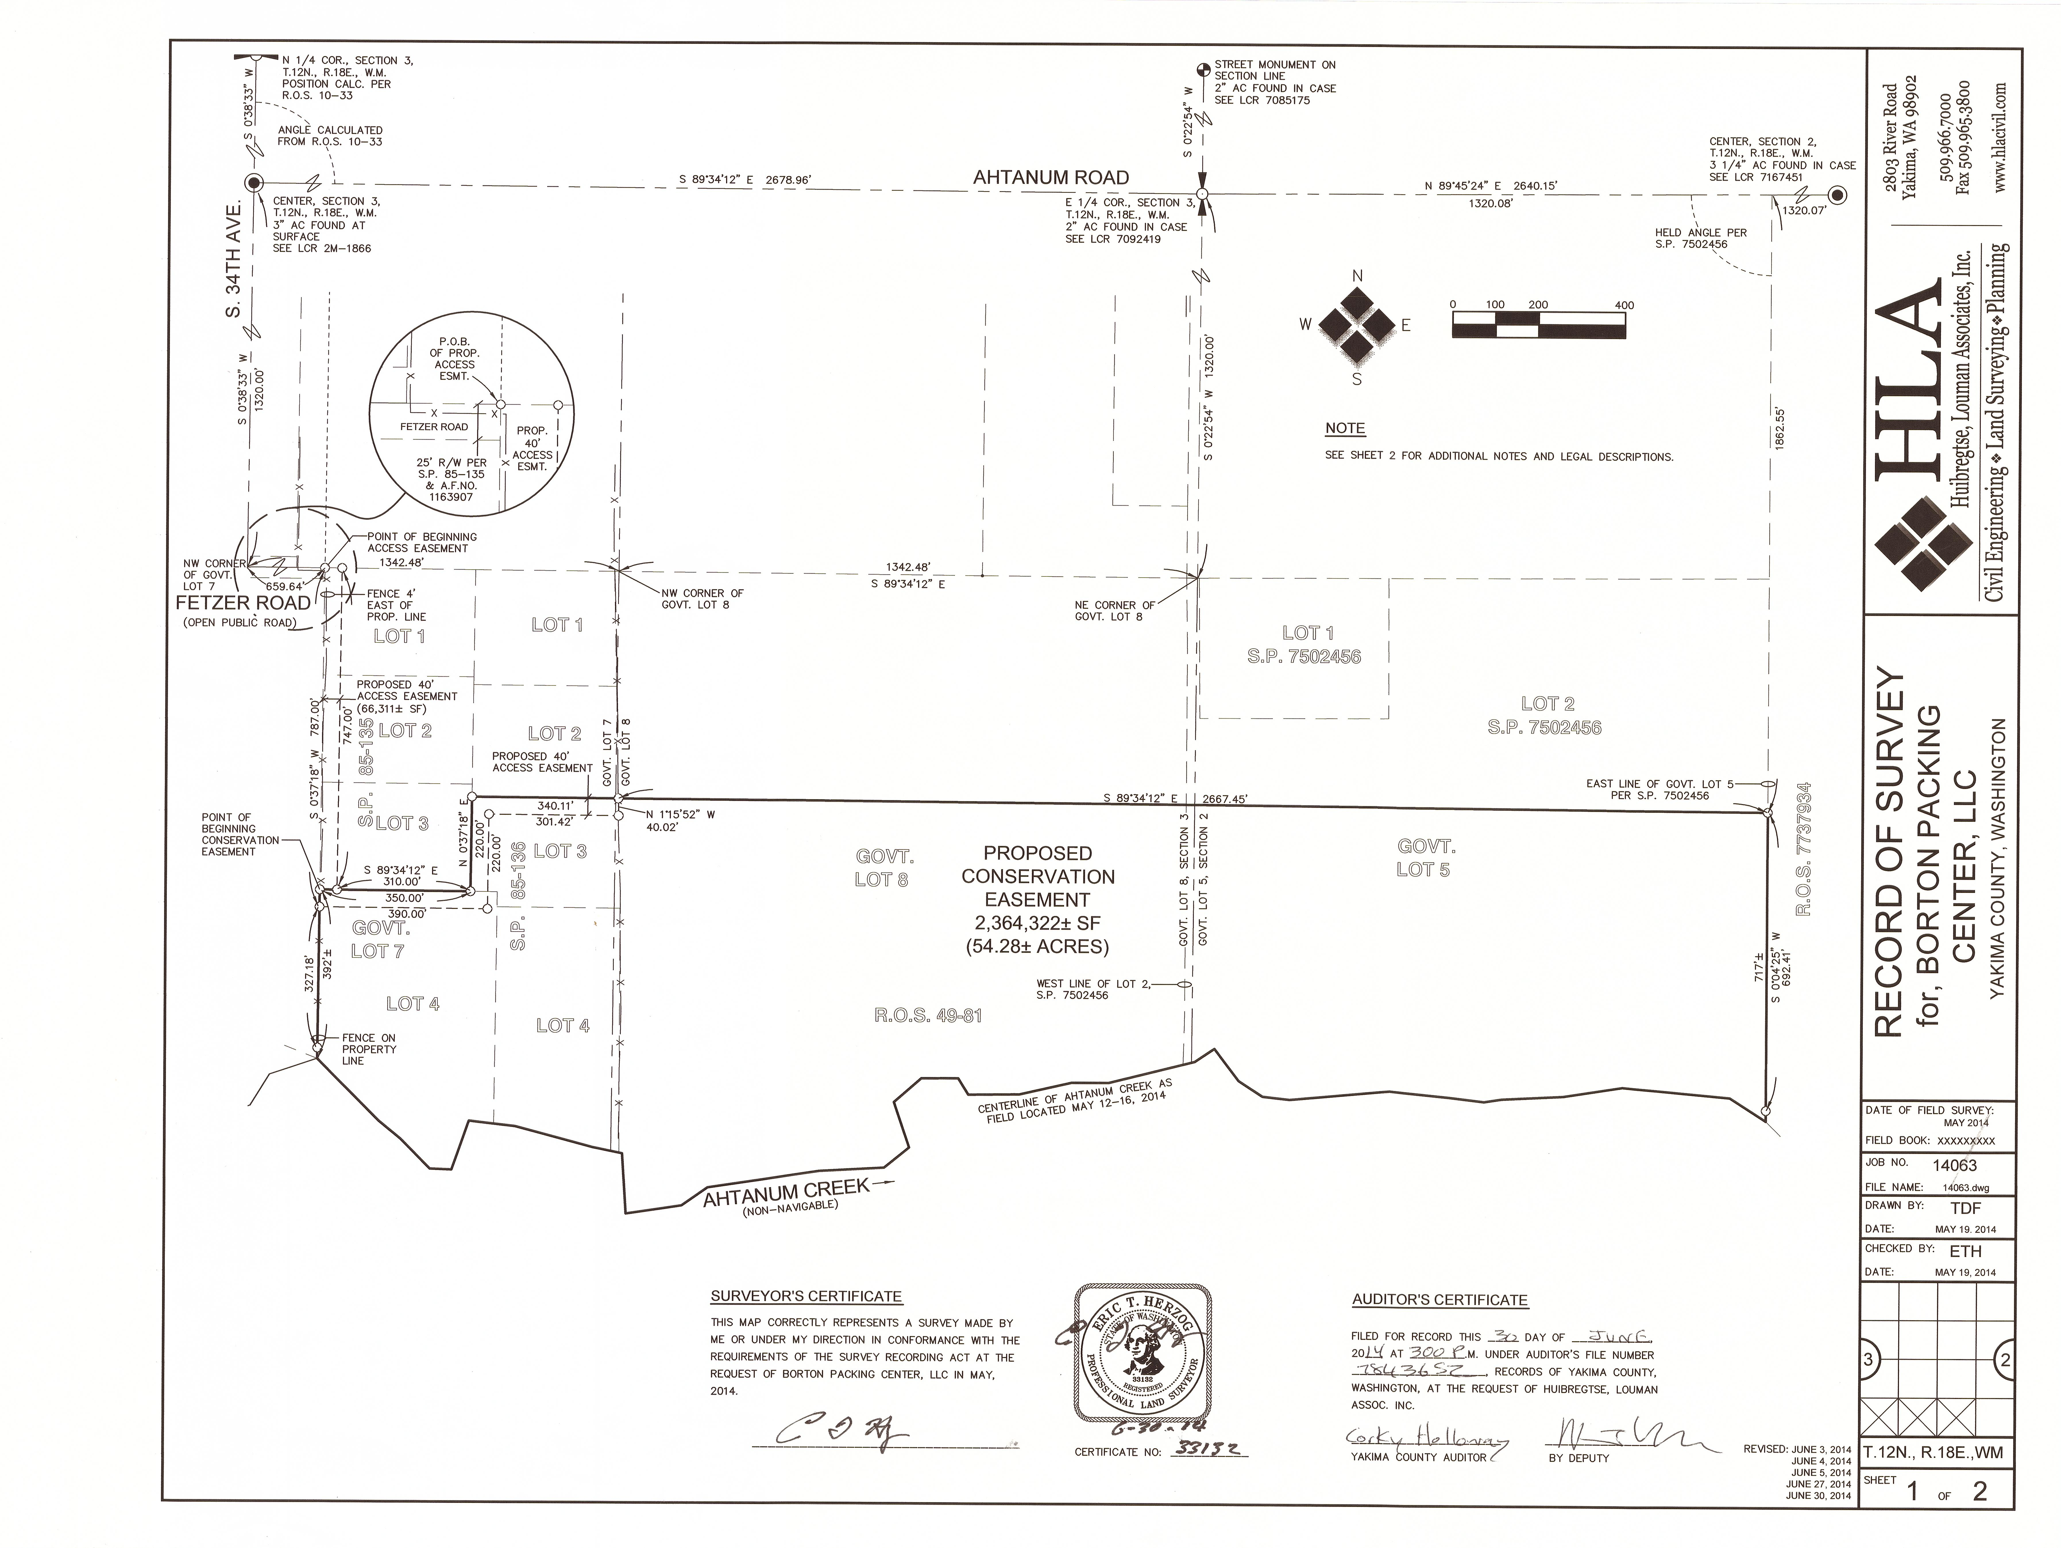
Ahtanum Village Restoration Project # 26-1314
BPA Funded Acquisition
BPA Conservation Easement
Open/Open Space tax program

Slide 5
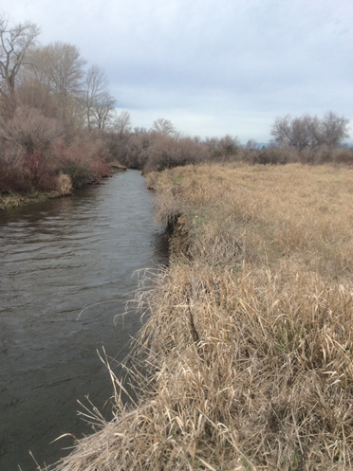
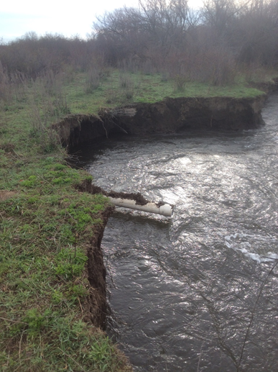
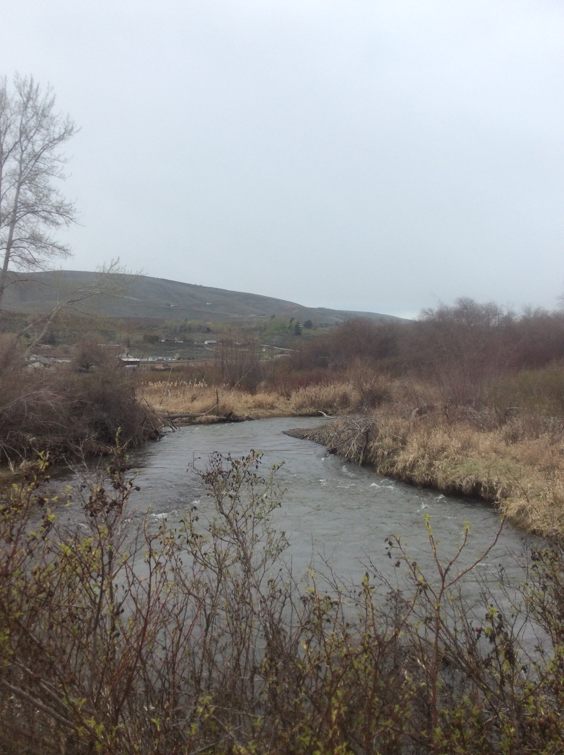
Ahtanum Village Restoration Project # 26-1314
  Limiting Factors for salmon recovery:
  Degraded Channel Structure/Complexity.
  Degraded Habitat Diversity/Quality.
  Degraded riparian/floodplain habitat;
    Diminished LWD Recruitment.

Slide 6
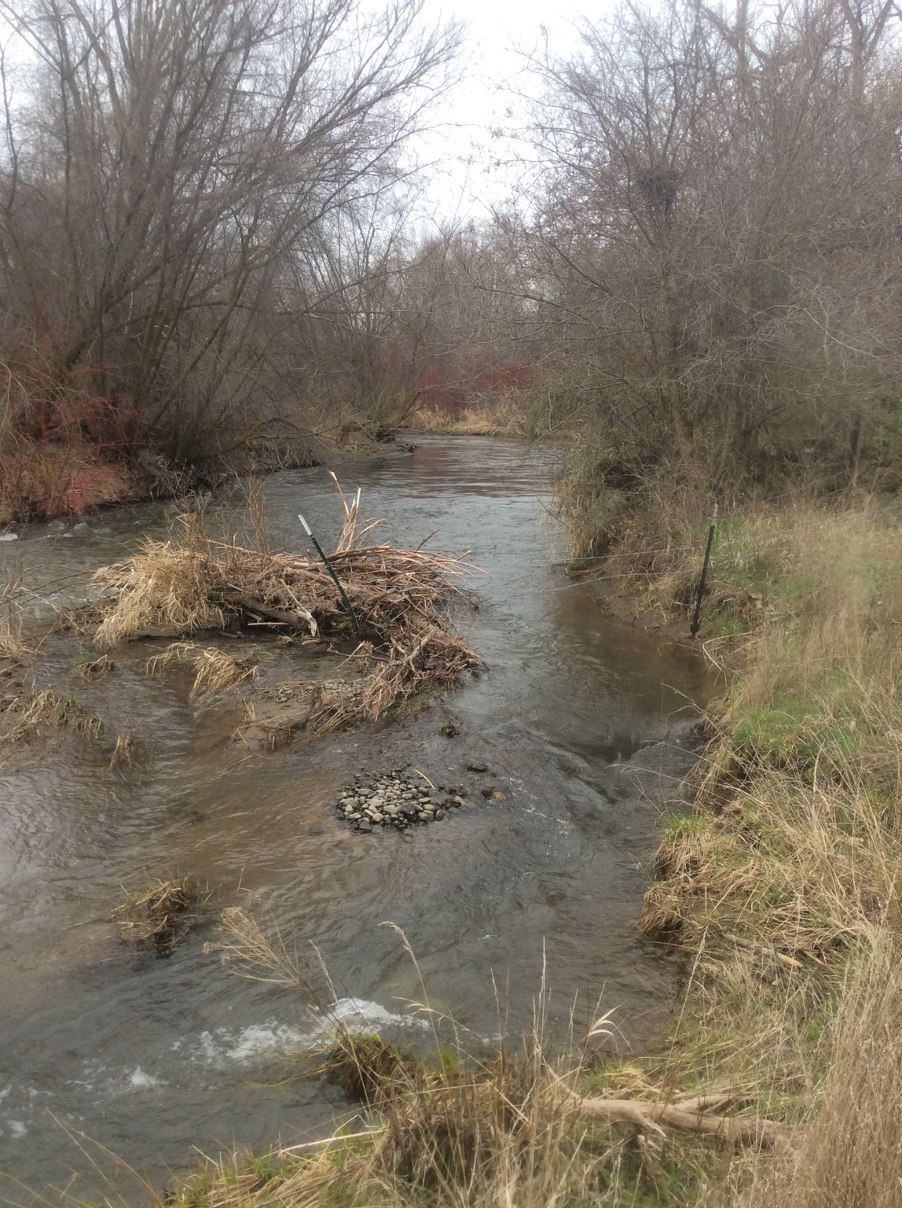
Ahtanum Village Restoration Project # 26-1314
The 2009 Yakima Basin Steelhead Recovery Plan:
  “floodplain constriction and development” as one of the main threats to the Naches distinct population segment of the ESA listed Middle Columbia River Steelhead.
  Naches Action #27 Ahtanum Creek Floodplain and Side Channel Restoration.
    TAG Focus Project #10 - Restoration projects that reduce incision and increase complexity of mainstem Ahtanum Creek and the North Fork below the Middle Fork.
  Yakama Nation Acquisition:
    Naches Action #28 Protect Ahtanum Creek riparian areas to lessen development.
    Naches Action #29 Reduce livestock impacts on Ahtanum Creek riparian areas.

Slide 7
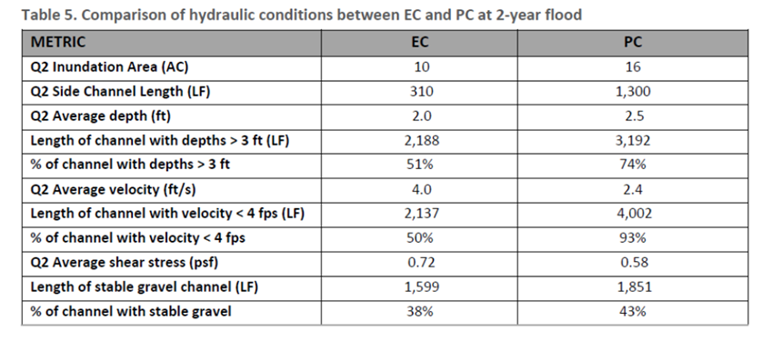
Ahtanum Village Restoration Project # 26-1314
The proposed restoration will focus on restoring natural geomorphic processes and historic wood loading, to directly address the key limiting factors impairing spawning, rearing and migration habitat for anadromous species, including ESA listed steelhead.
The restoration goals of the project are to:
  Increase the frequency and quality of pool habitat,
  Increase riparian cover,
  Increase instream woody material,
  Increase channel length,
  reducing hydraulic energy by increasing channel roughness to increase retention of spawning gravels,
  Increase floodplain function (e.g., increase groundwater recharge to improve baseflows, reduce peak flows, reduce stream temperatures, improve habitat for invertebrates and restore a self-sustaining and species-rich riparian corridor).

Slide 8
Ahtanum Village Restoration Project # 26-1314
To address the restoration goals, the project will:
Install 18 in-channel wood structures (with 20 logs per structure + racking, slash, ballast), 125 individual un-anchored root balls and spawning sediment placements (5 cy/structure extra placed on channel margins). Placing and securing large wood in the channel will reintroduce roughness to decrease stream energy and retain gravels, increase hydraulic complexity and instream cover, and force formation of +/- 140 pools.
Excavating 2 side channel reconnections to add over 990 ft. of side-channel habitat and inset floodplain excavation to create over 6 ac of new floodplain.
Main channel re-meander will add 400 feet of new channel length, in addition to
Riparian revegetation of 15 acres with over 28,000 plants.

Slide 9
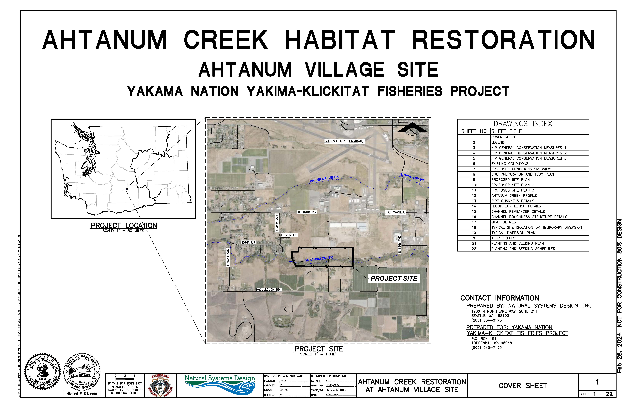
Ahtanum Village Restoration PROJECT: 24-1122

Slide 10
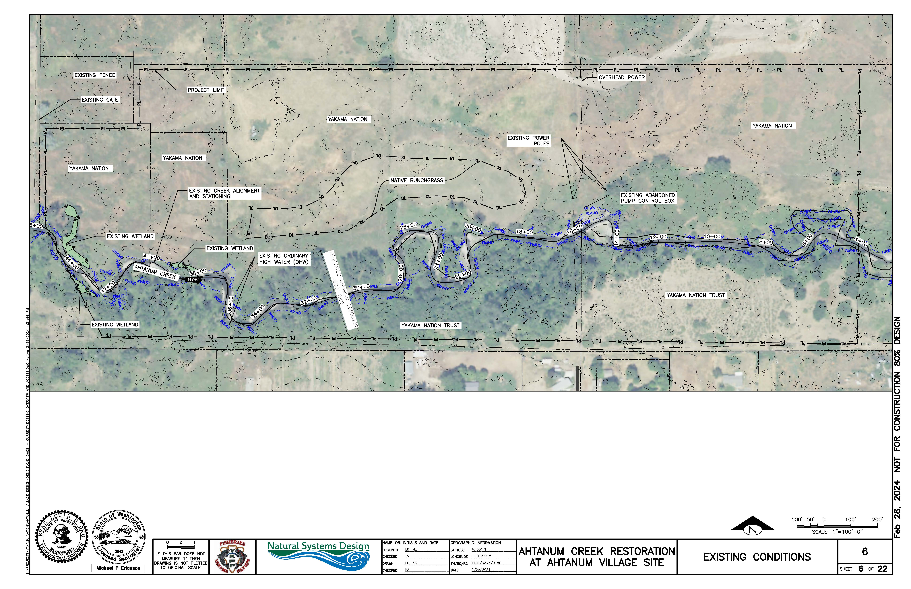
Ahtanum Village Restoration PROJECT: 24-1122

Slide 11
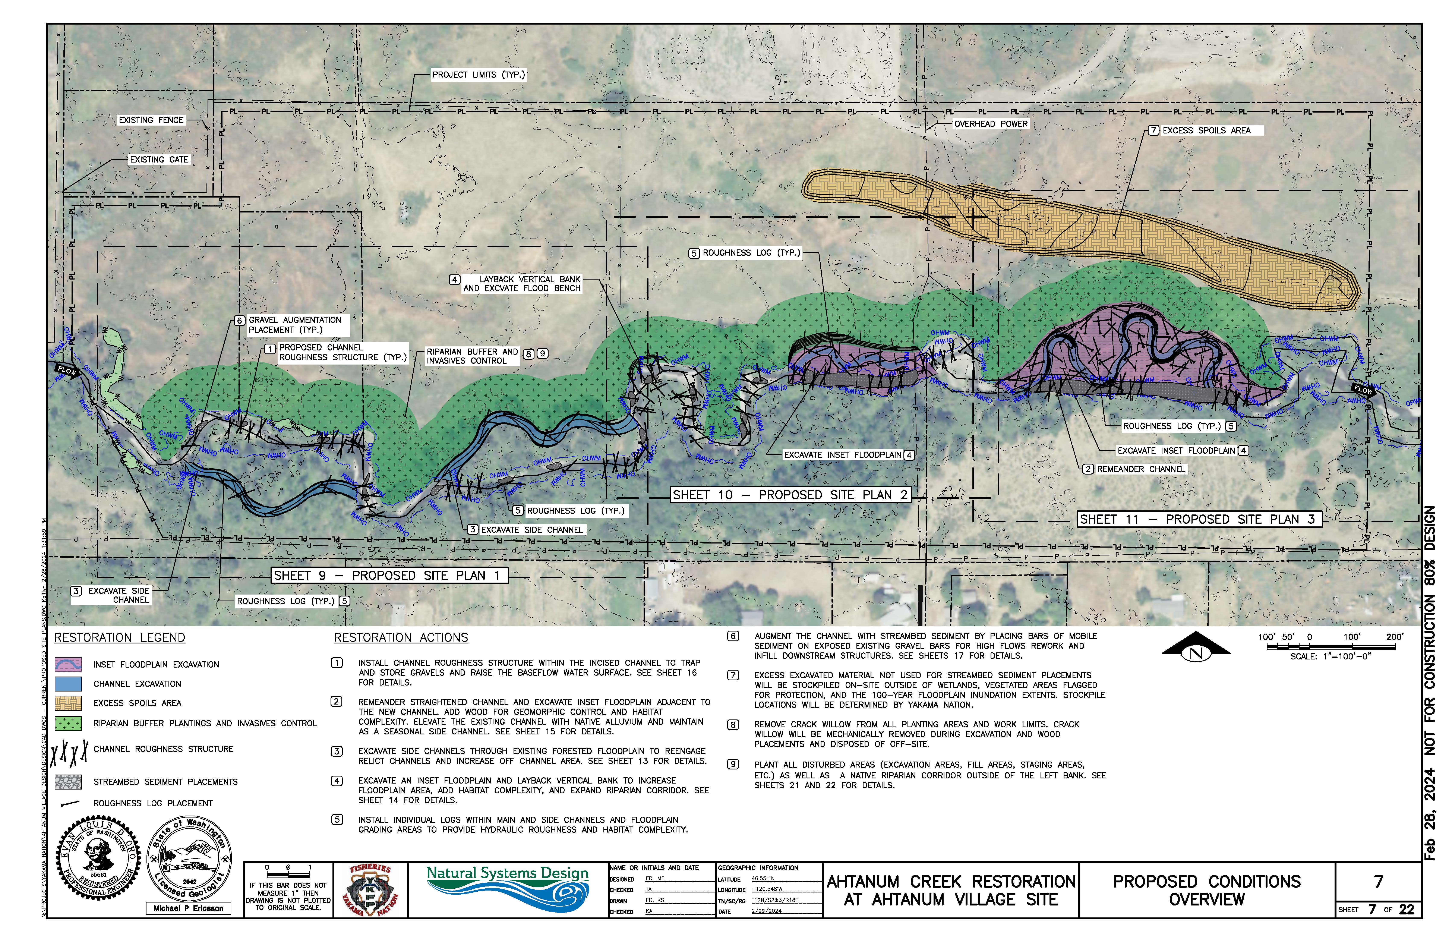
Ahtanum Village Restoration PROJECT: 24-1122

Slide 12
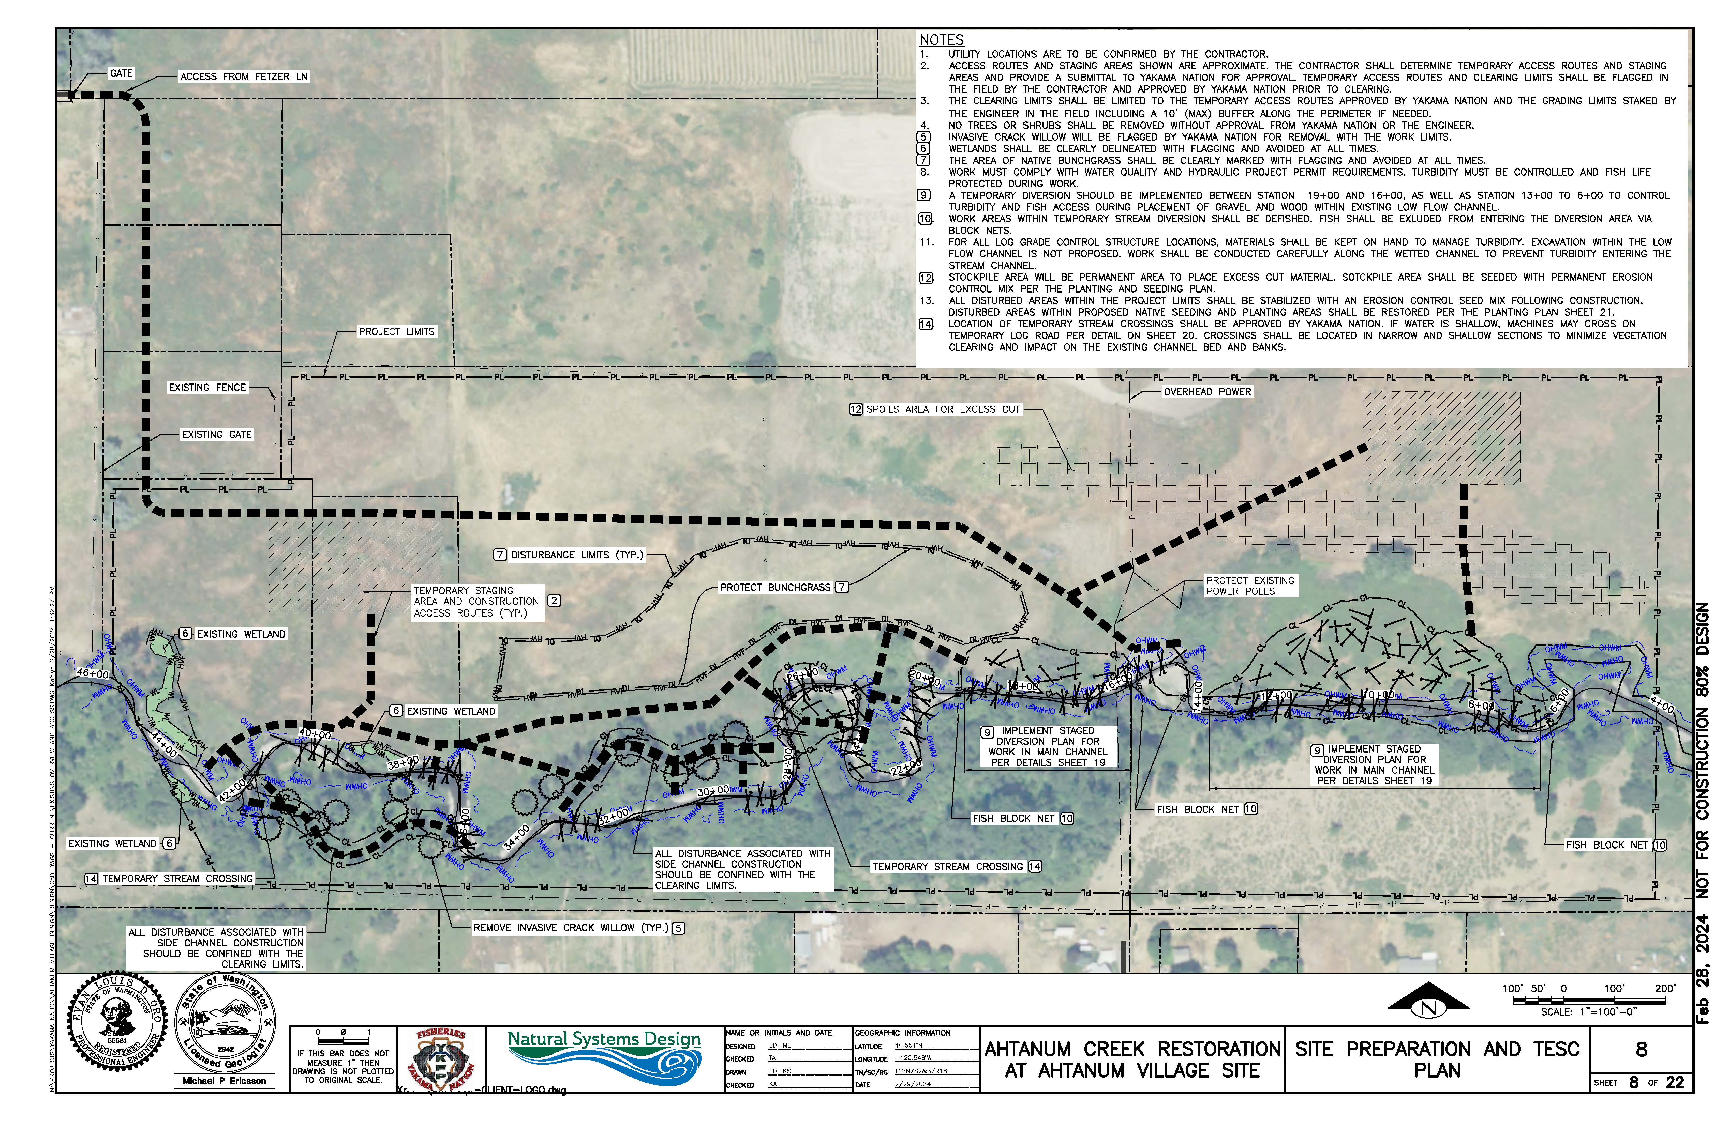
Ahtanum Village Restoration PROJECT: 24-1122

Slide 13
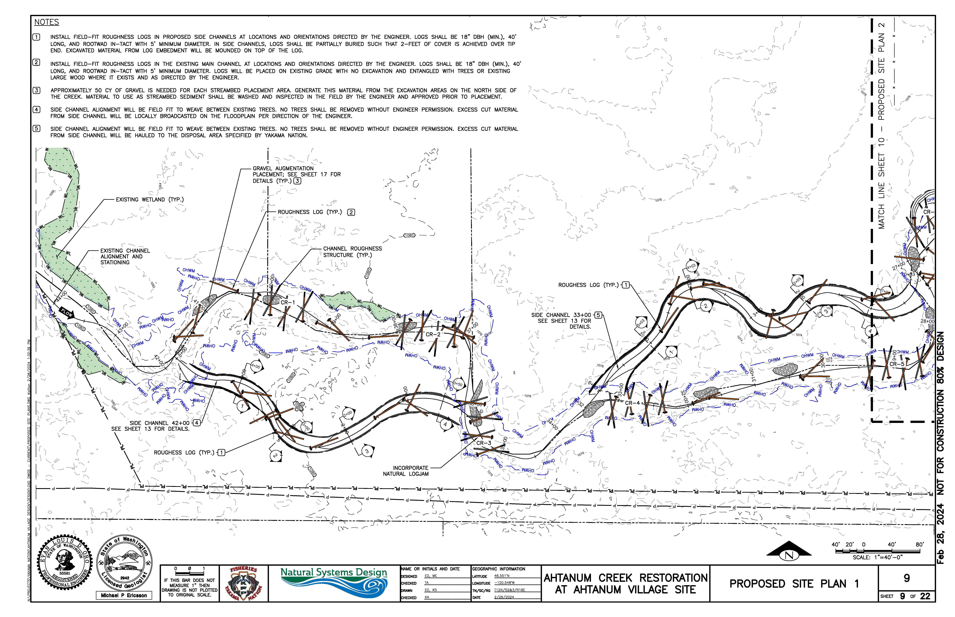
Ahtanum Village Restoration PROJECT: 24-1122
To addess low flow concerns, the side channel inlets and outlets have been designed to activate when flow in the main stem channel reaches roughly the 50% exceedance flow (23-cfs), flowing 6-8 months of the year.

Slide 14
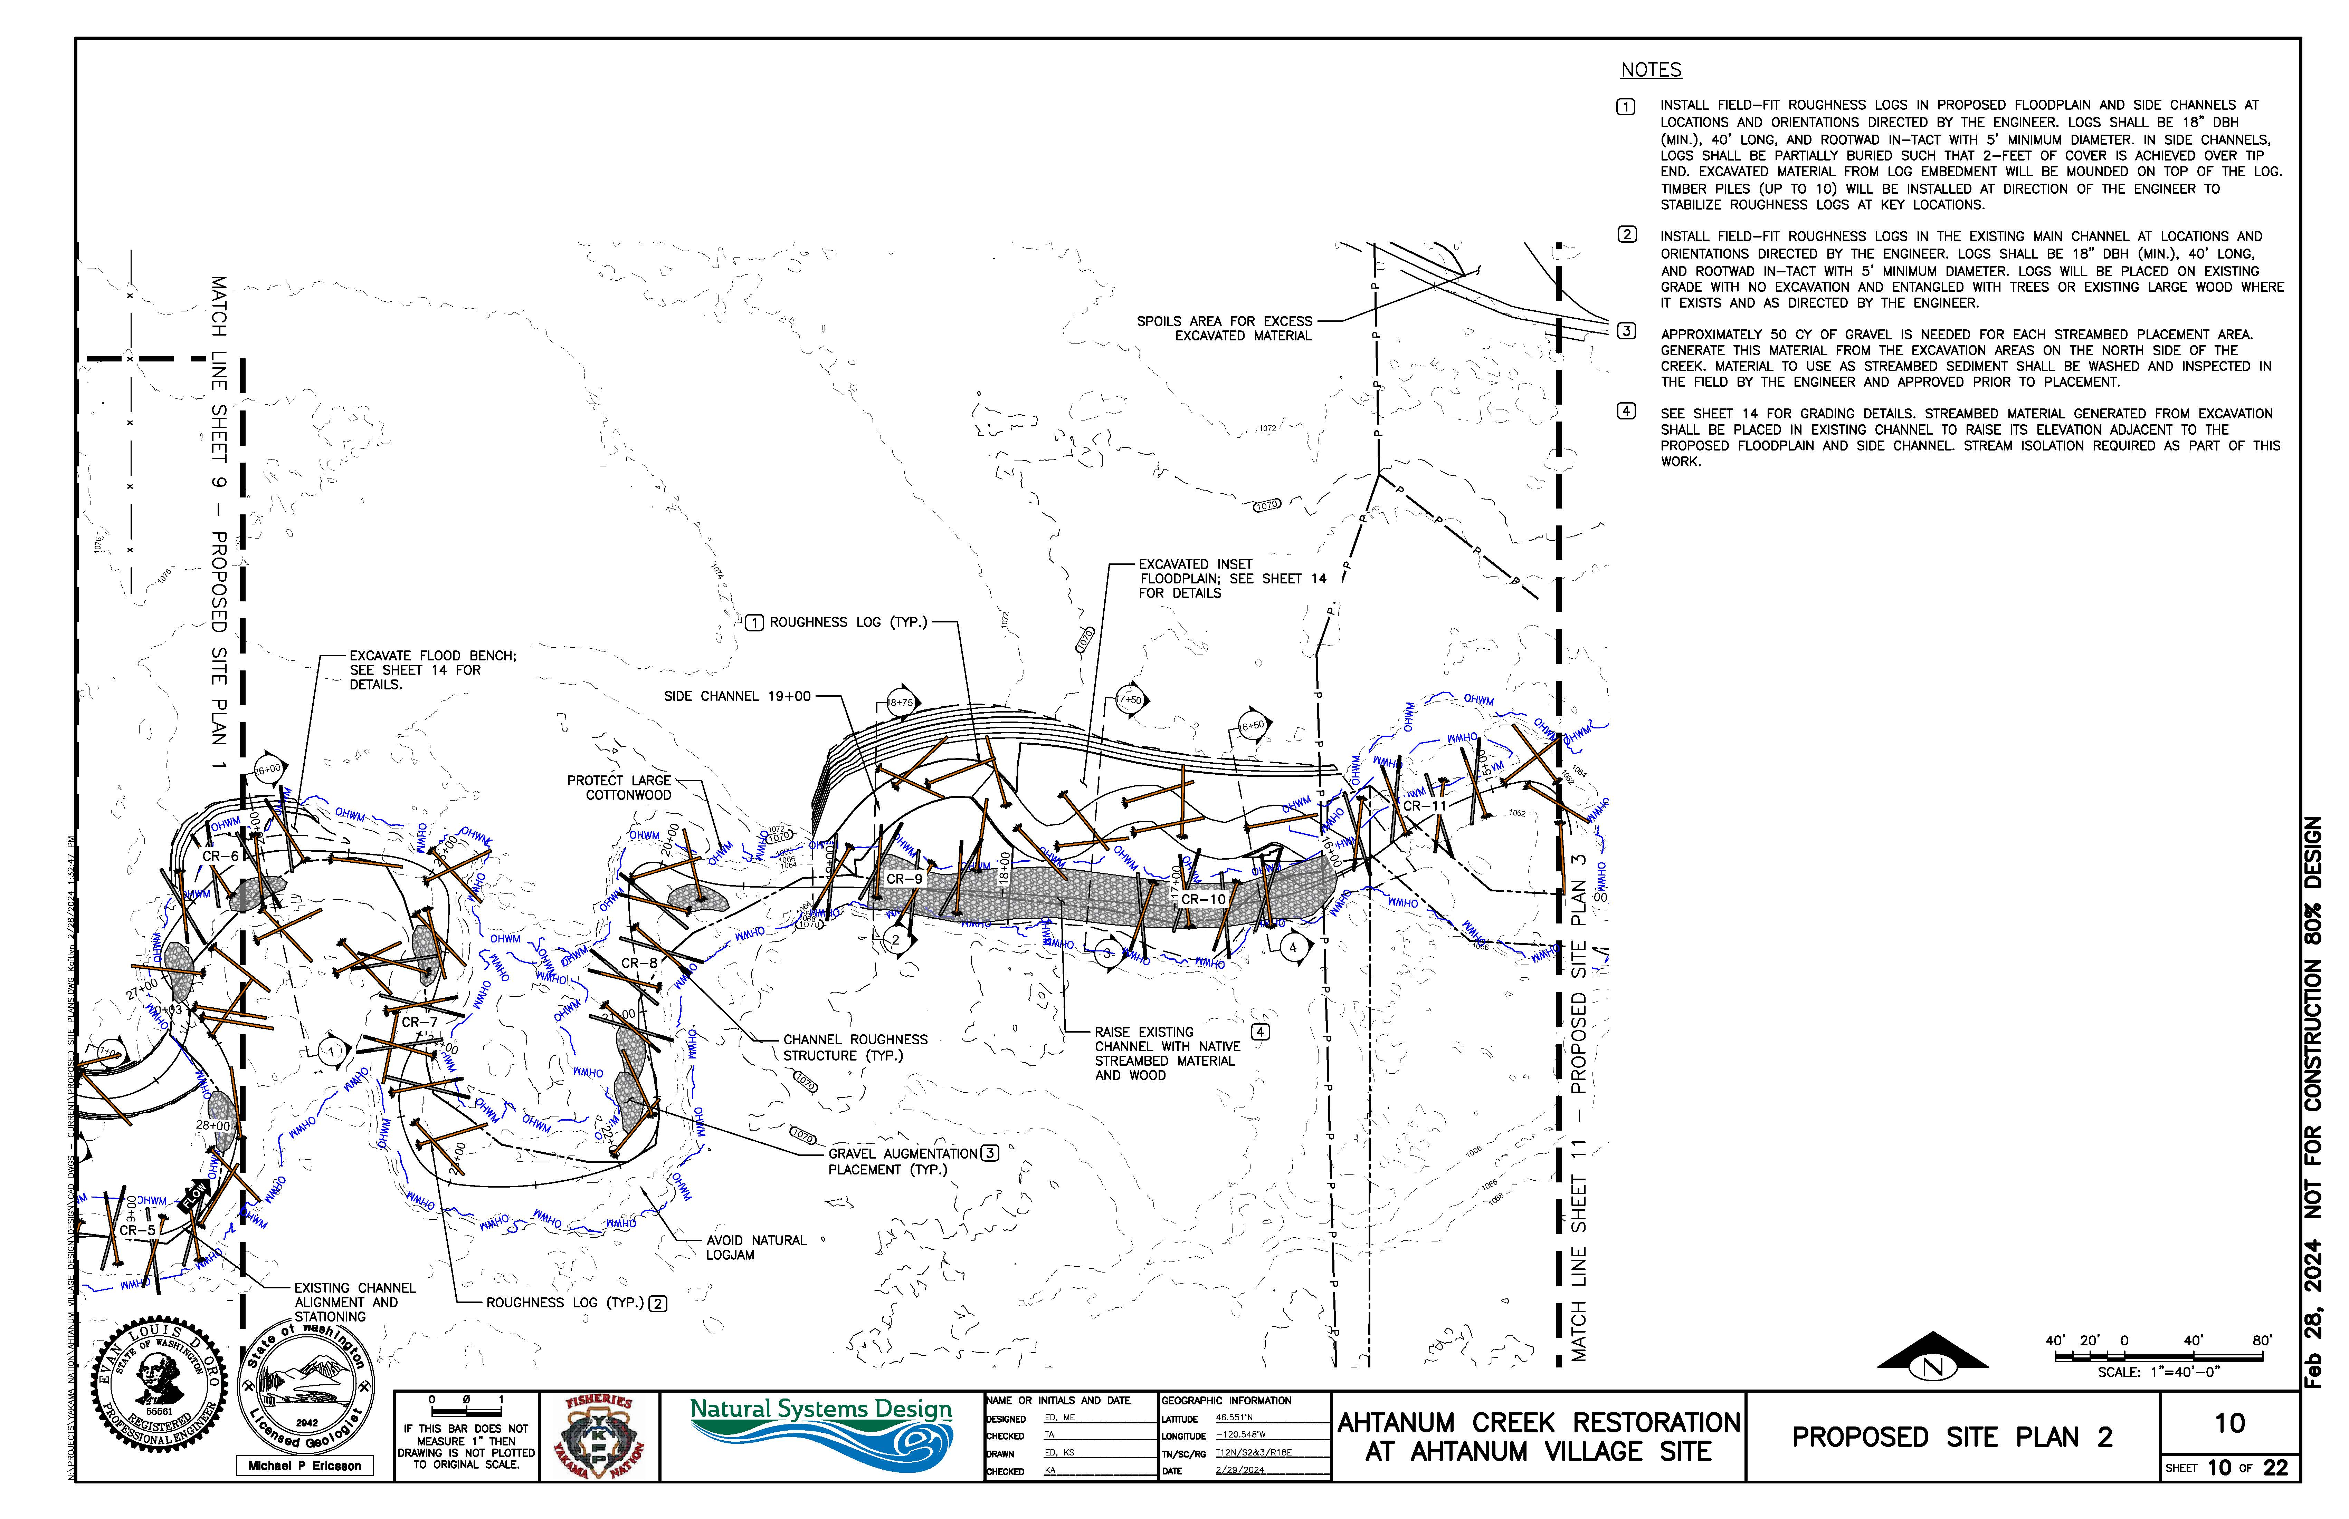
Ahtanum Village Restoration PROJECT: 24-1122

Slide 15
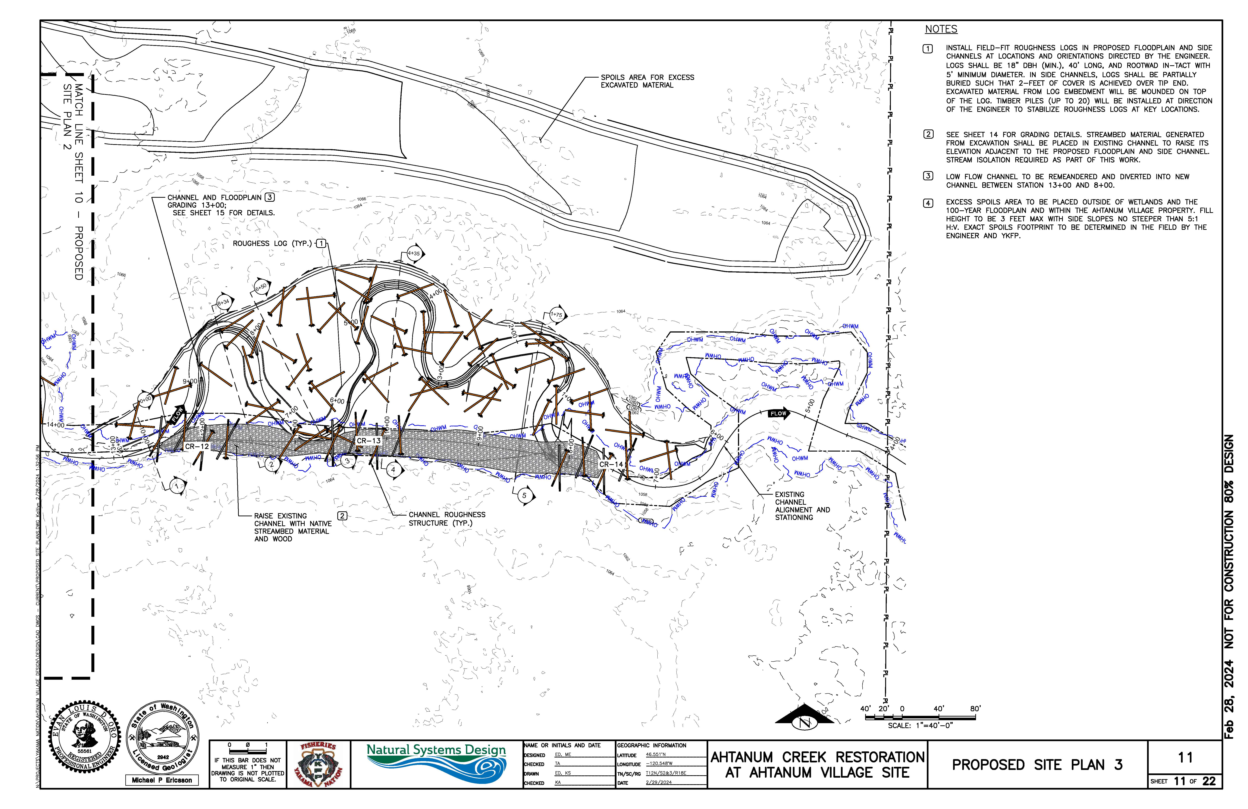
Ahtanum Village Restoration PROJECT: 24-1122

Slide 16
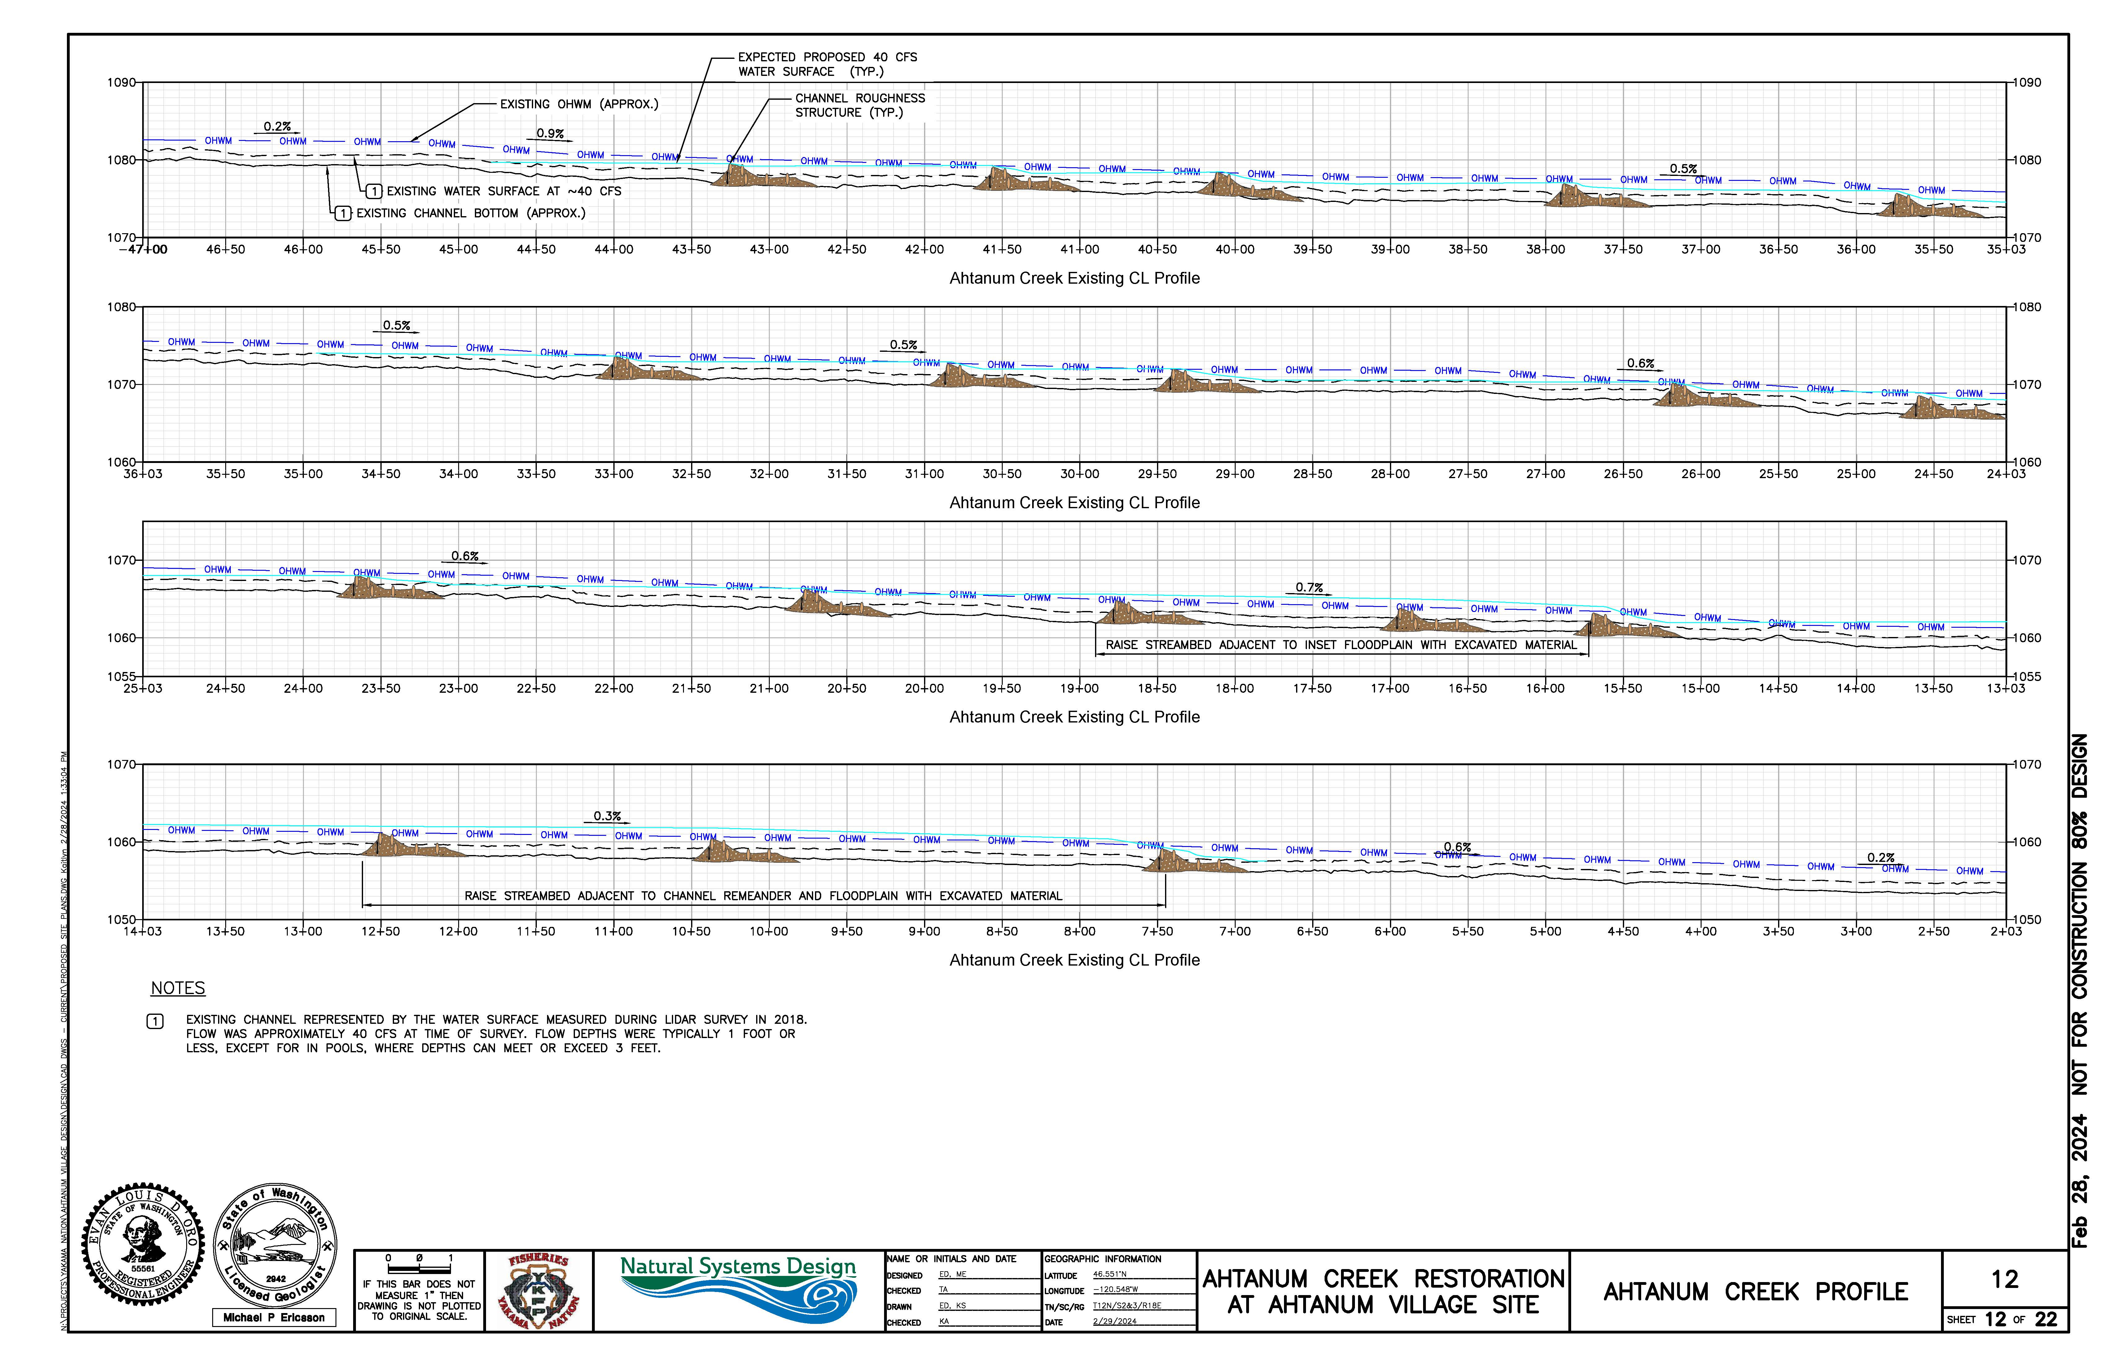
Ahtanum Village Restoration PROJECT: 24-1122

Slide 17
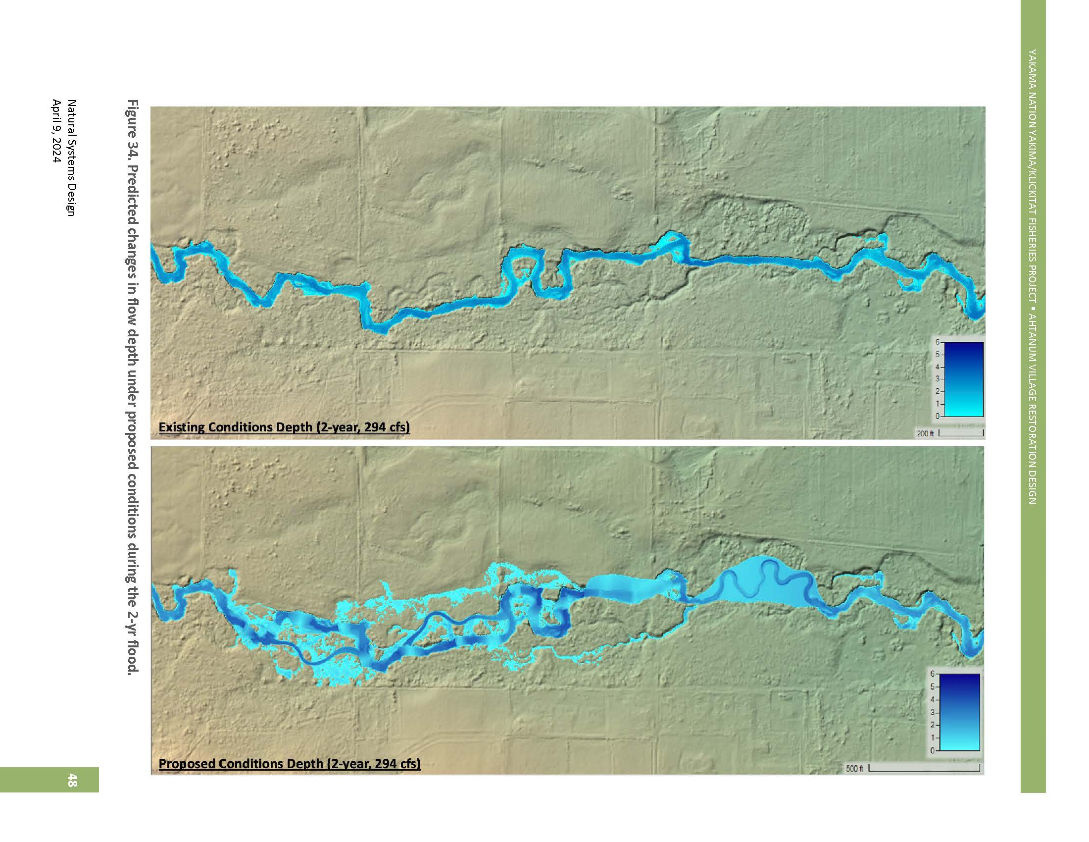
Ahtanum Village Restoration PROJECT: 24-1122

Slide 18
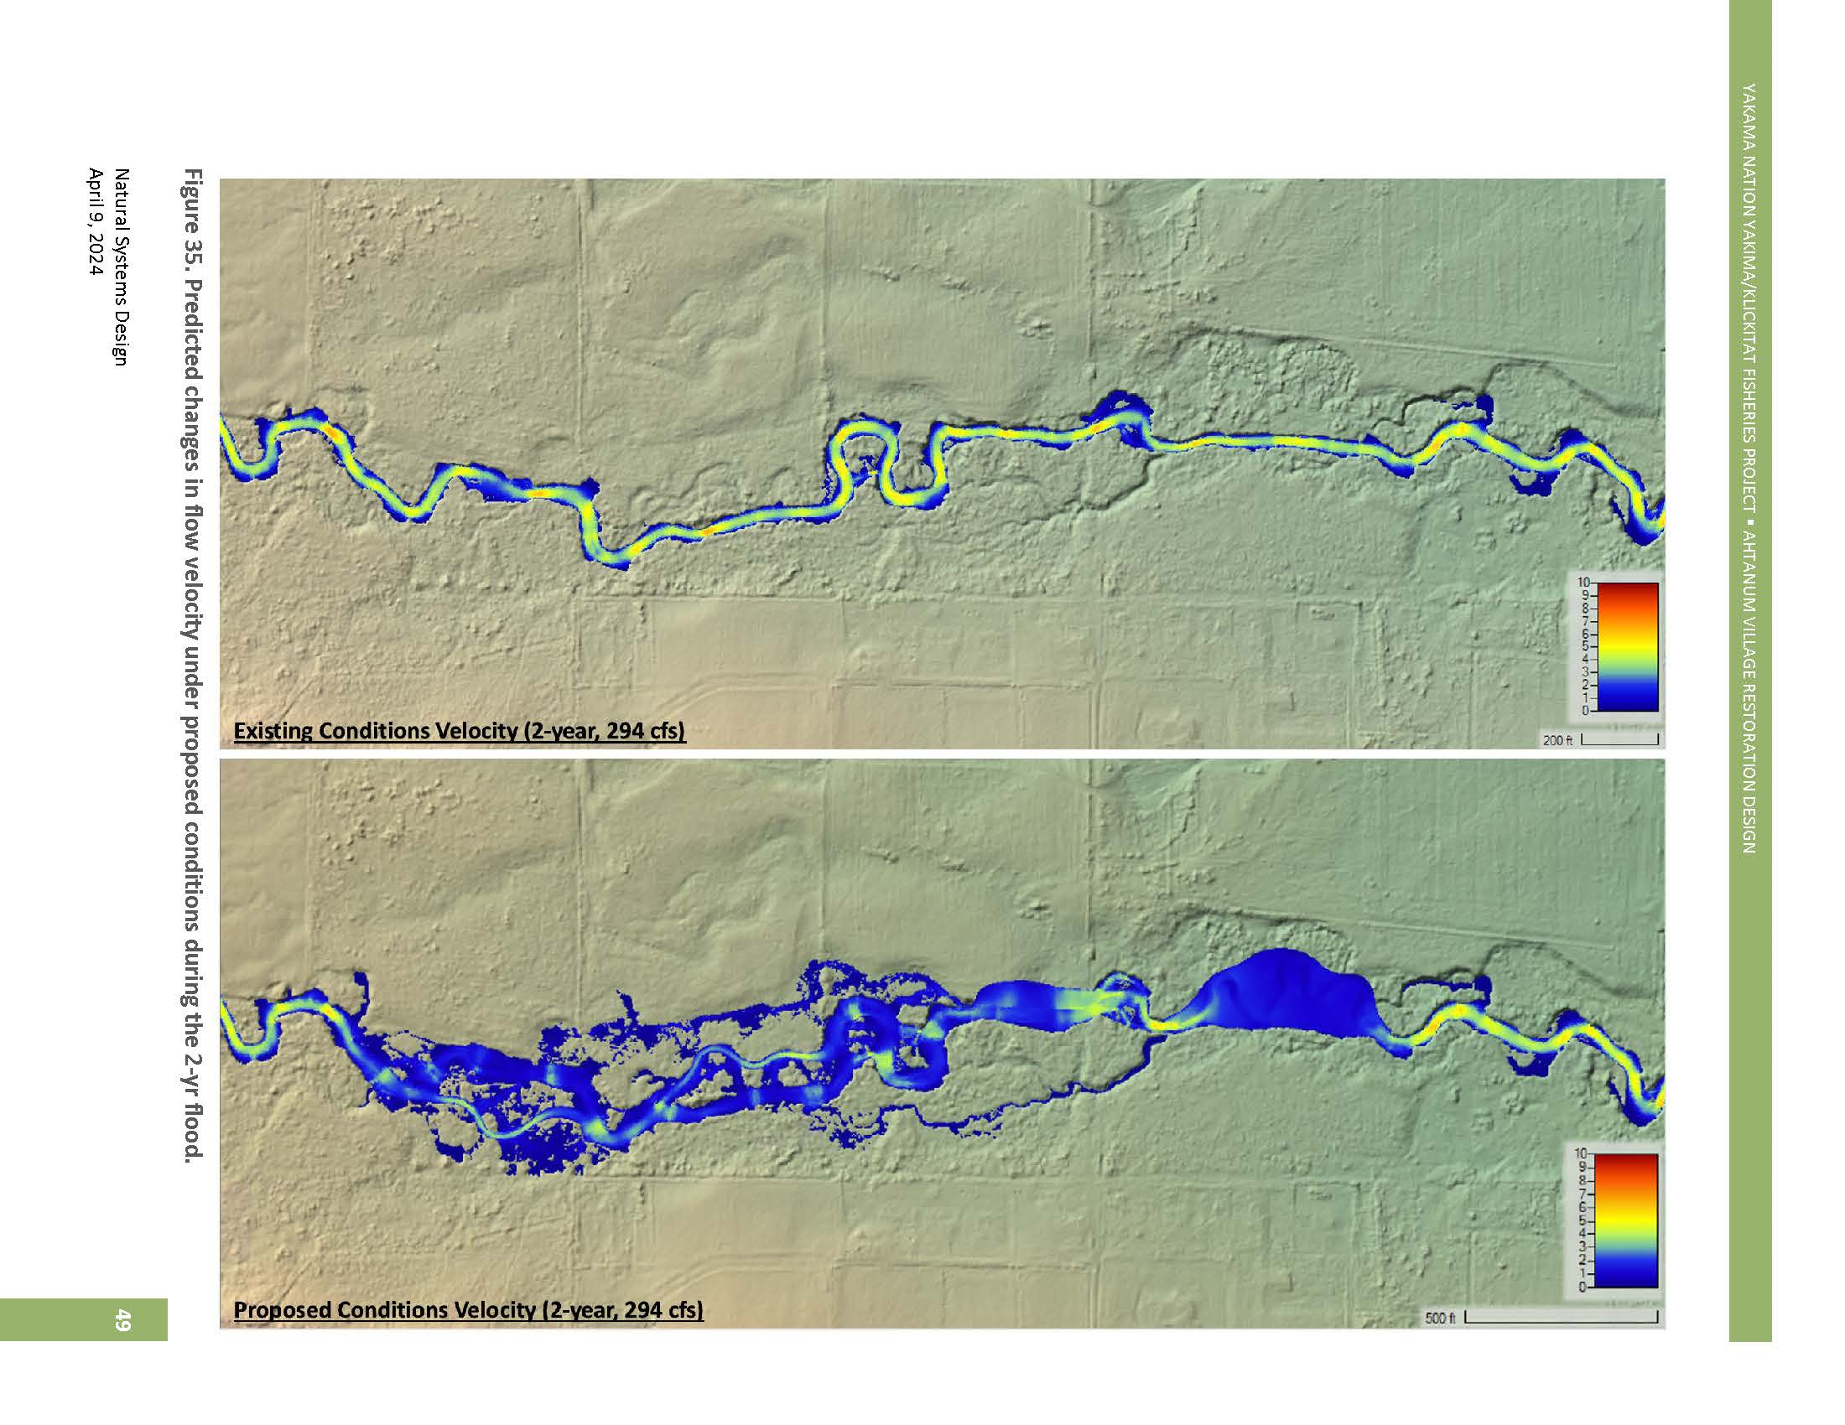
Ahtanum Village Restoration PROJECT: 24-1122

Slide 19
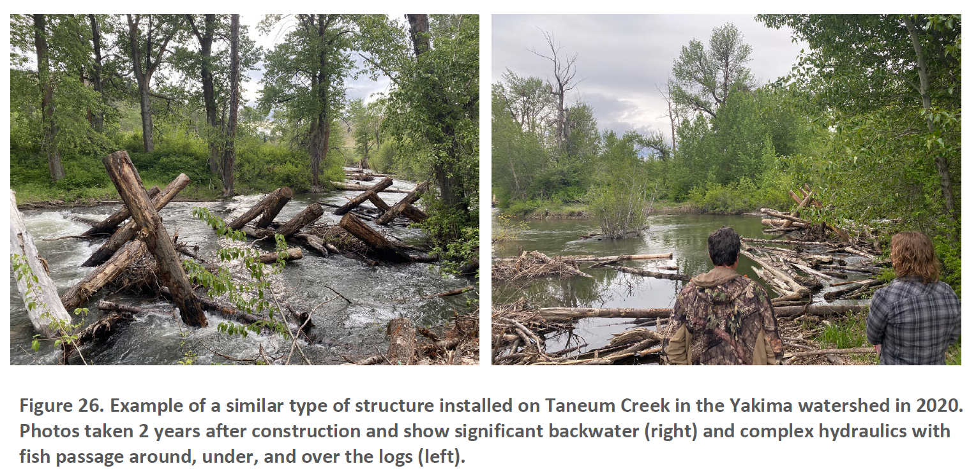
Ahtanum Village Restoration PROJECT: 24-1122

Slide 20
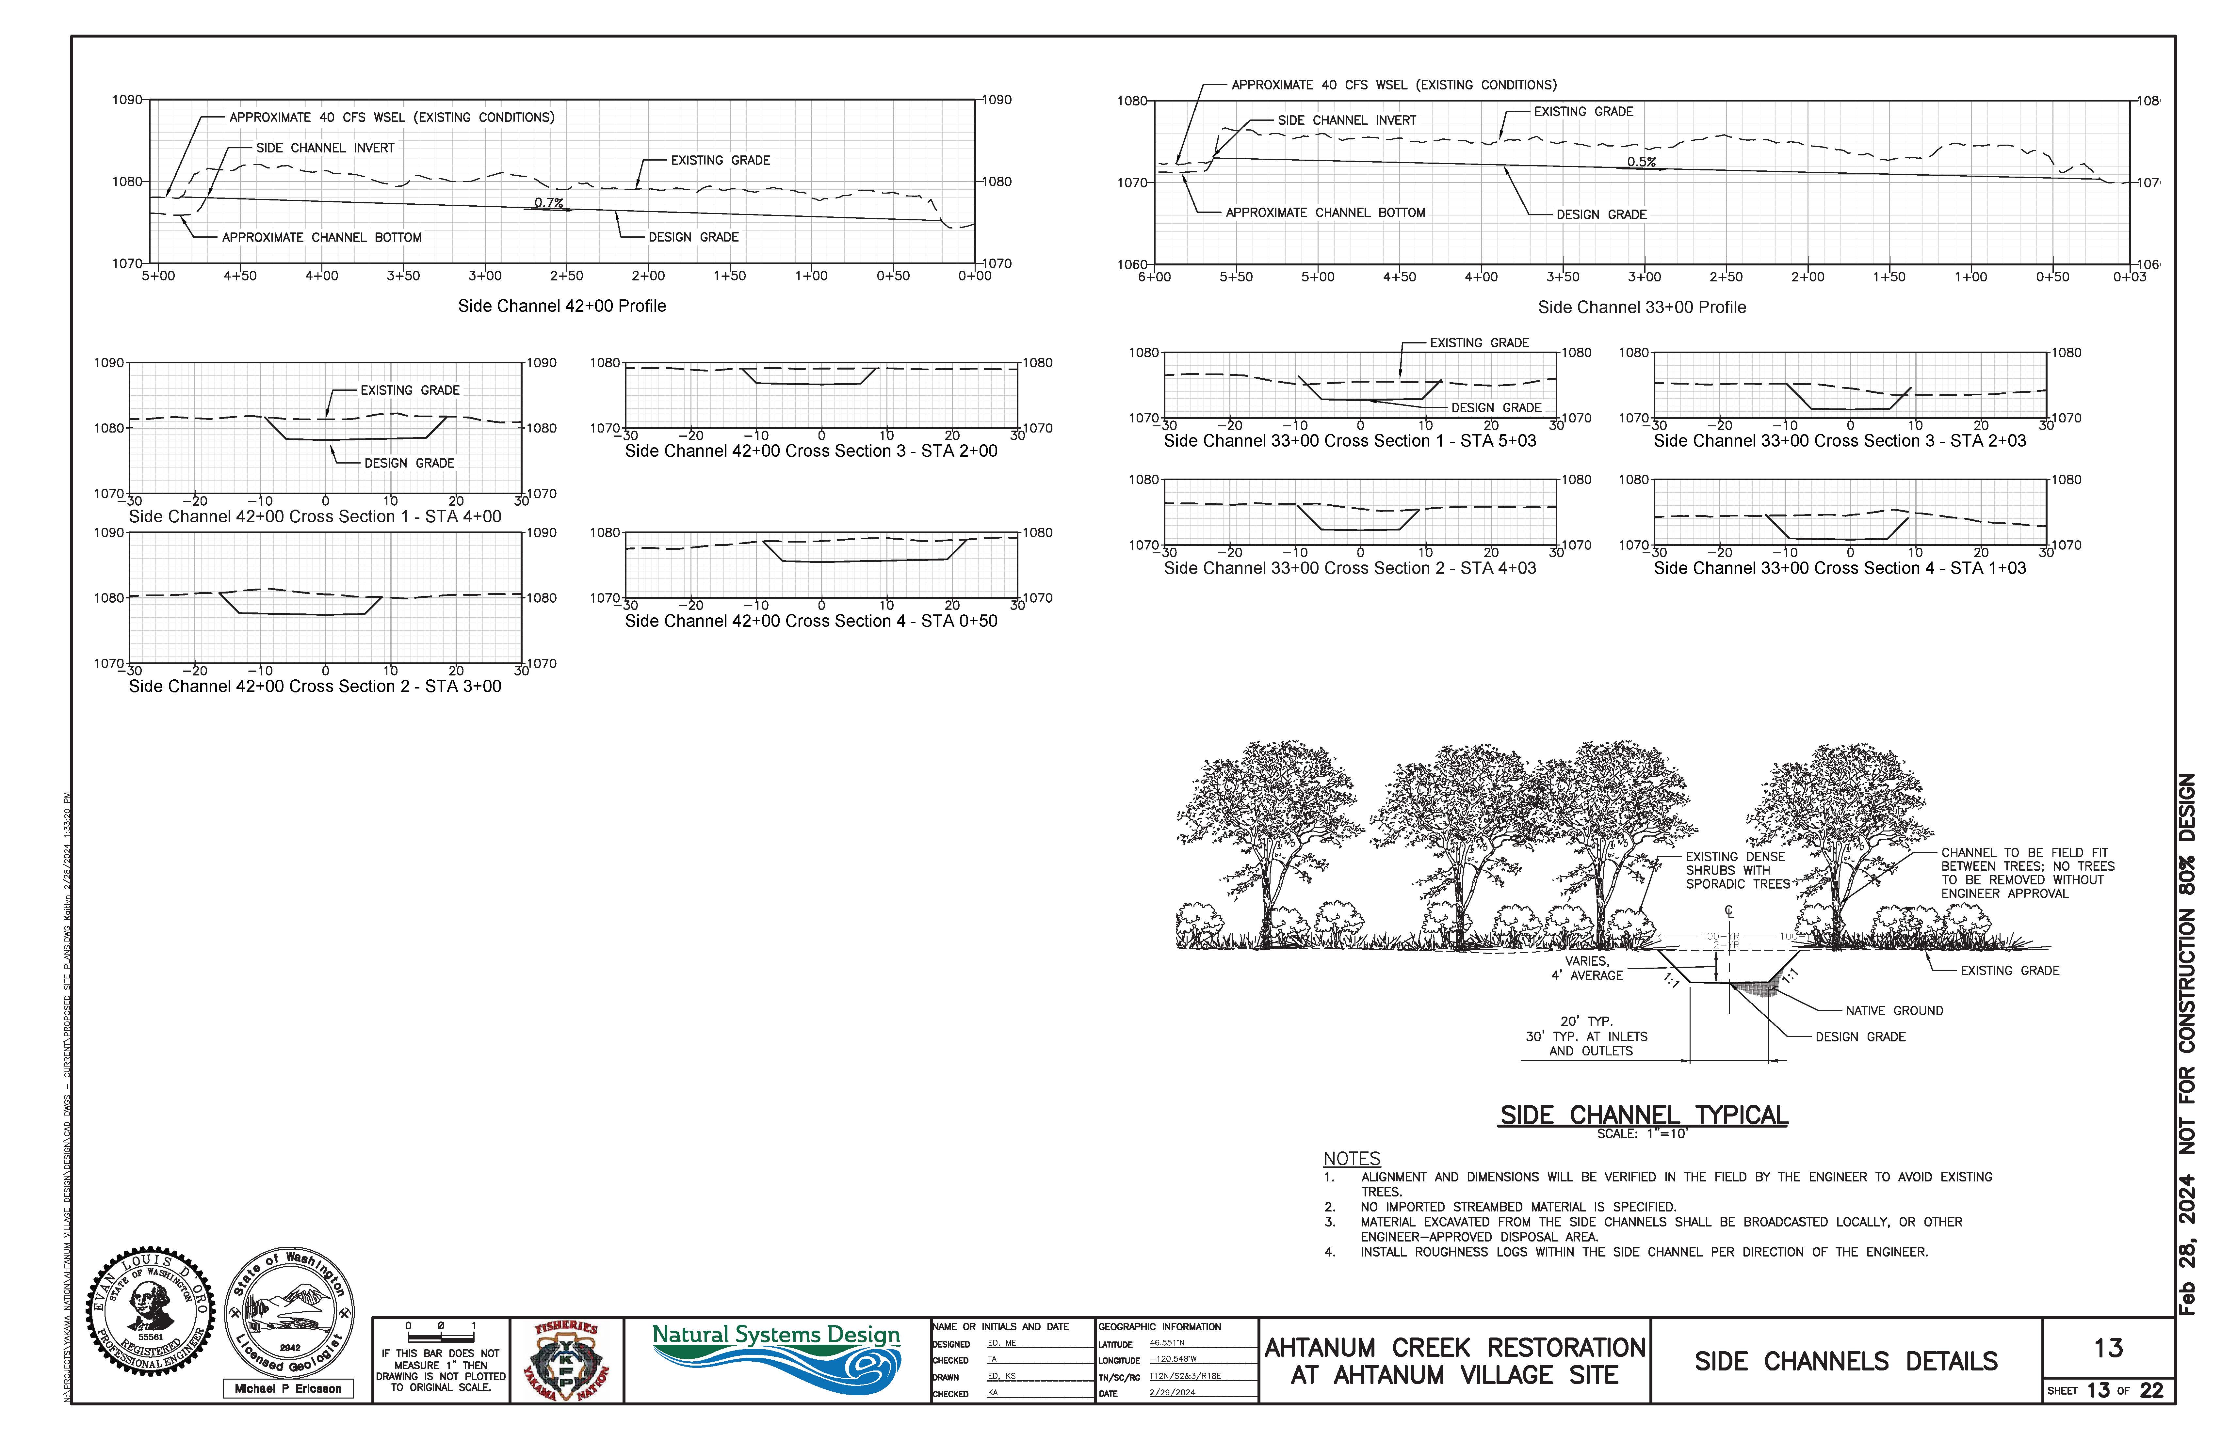
Ahtanum Village Restoration PROJECT: 24-1122

Slide 21
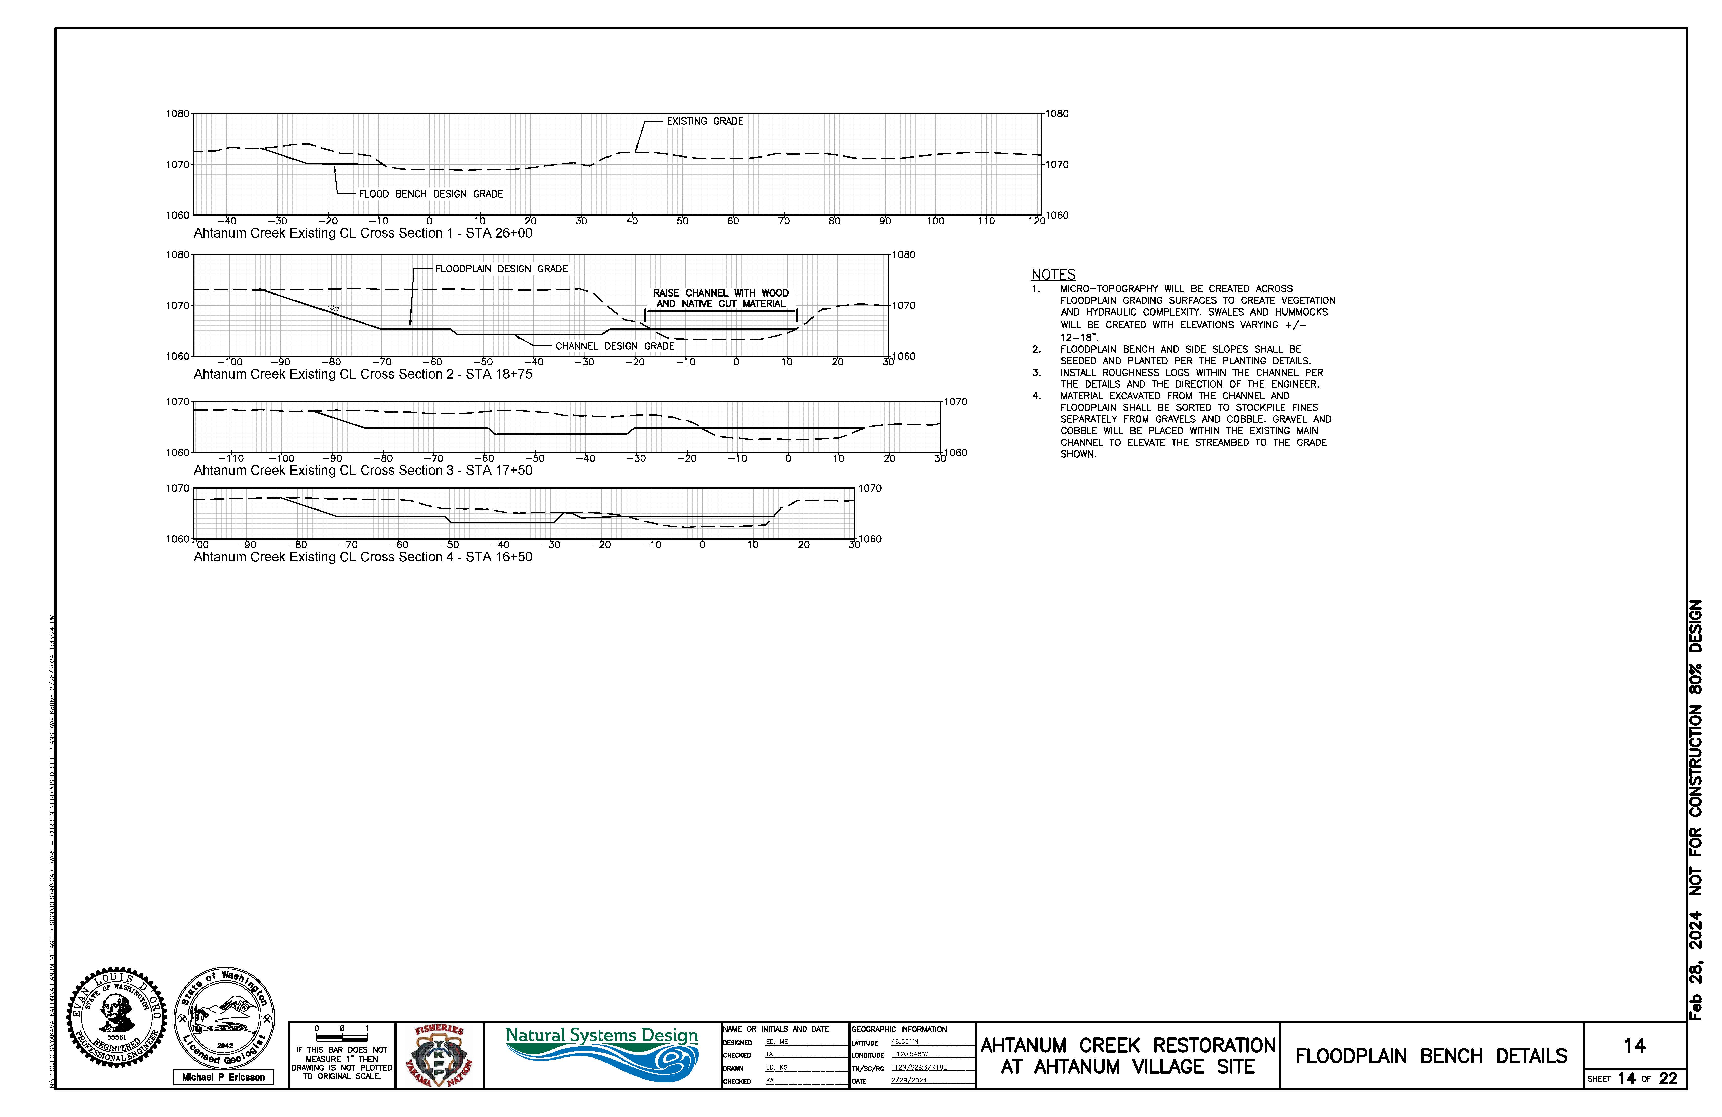
Ahtanum Village Restoration PROJECT: 24-1122

Slide 22
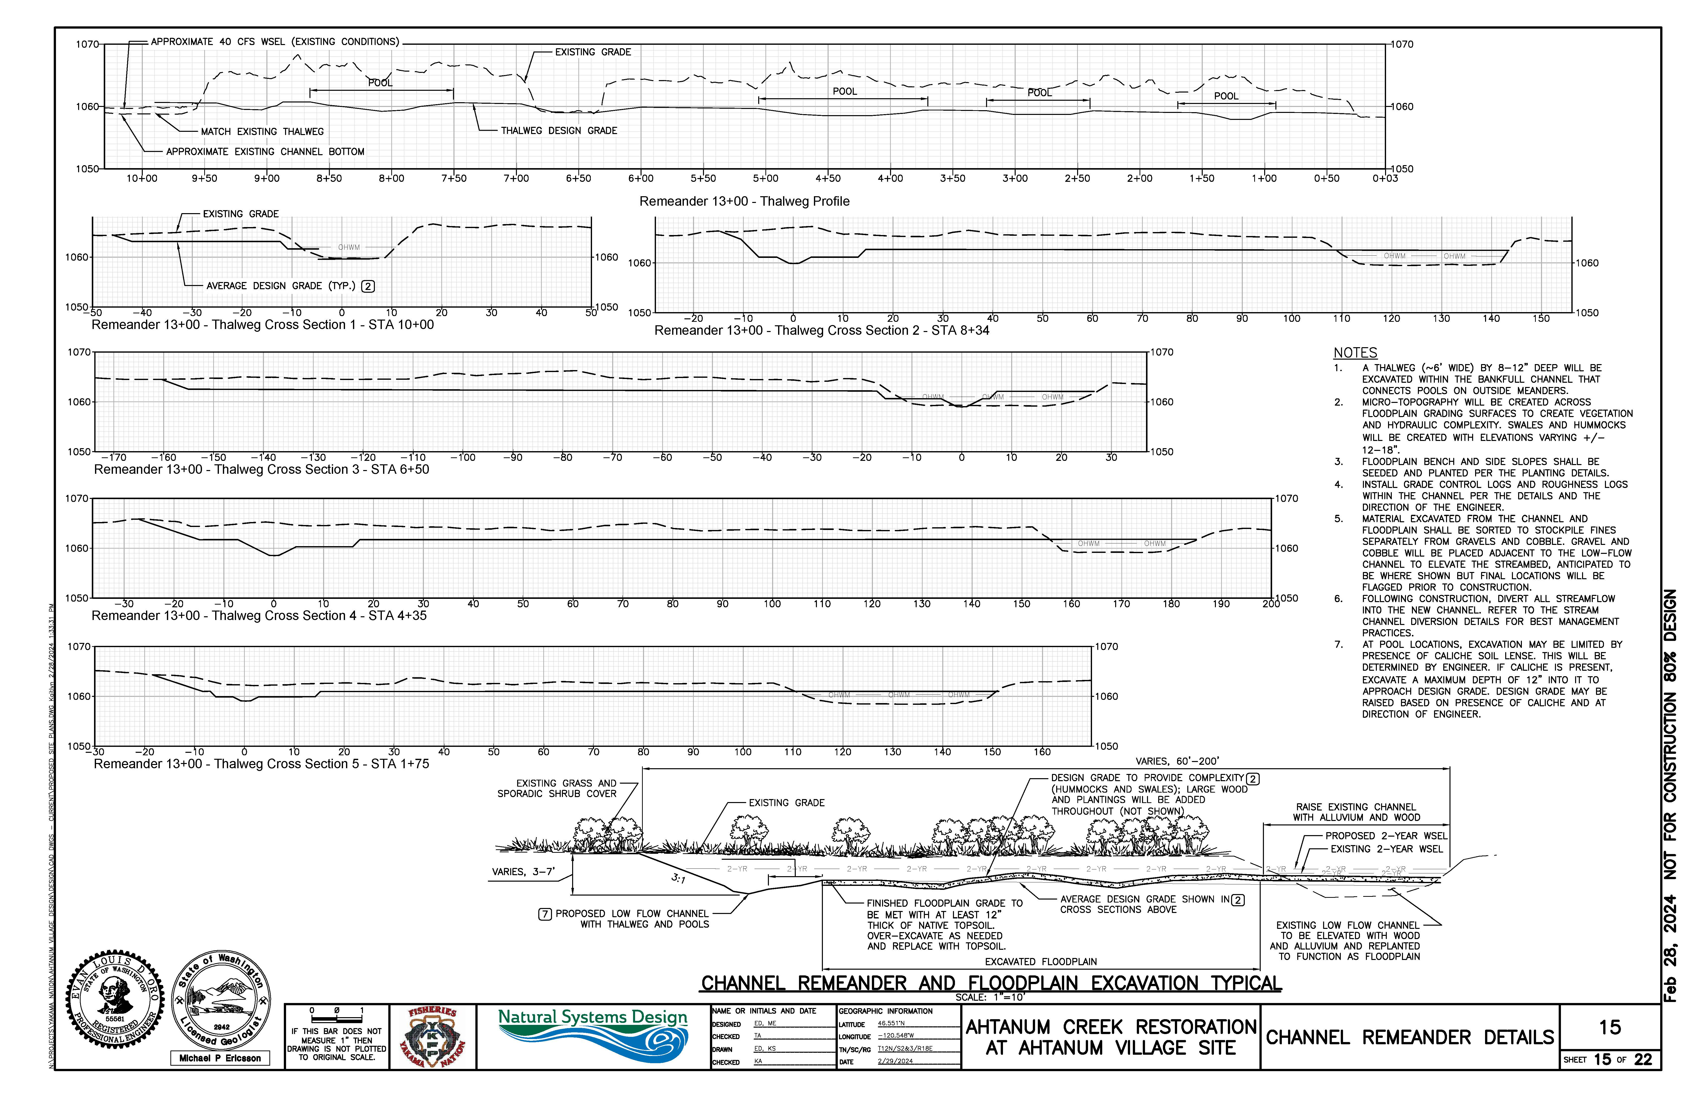
Ahtanum Village Restoration PROJECT: 24-1122

Slide 23
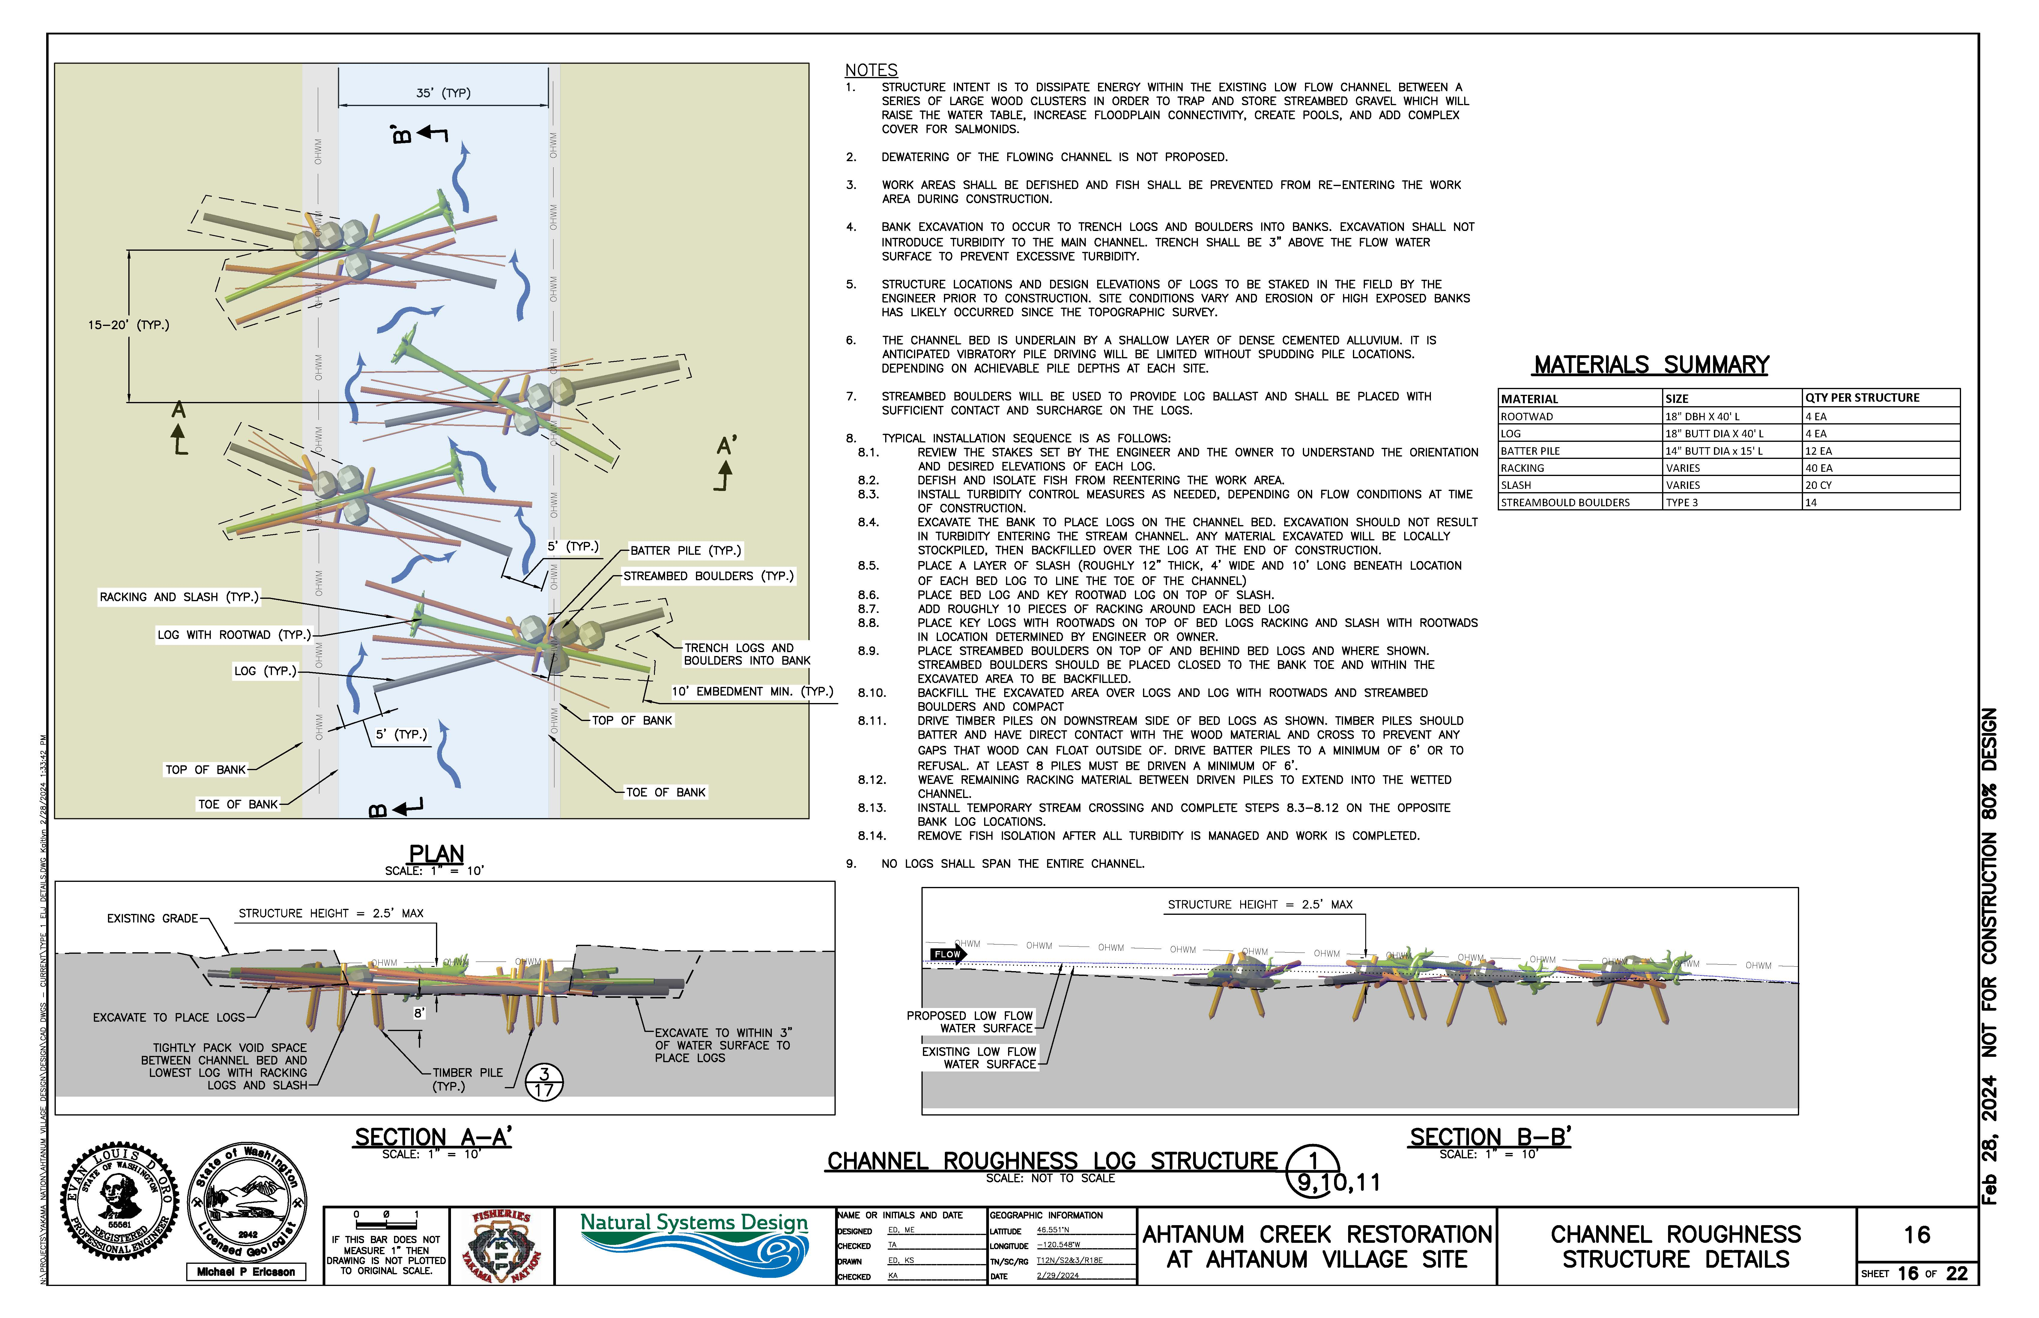
Ahtanum Village Restoration PROJECT: 24-1122

Slide 24
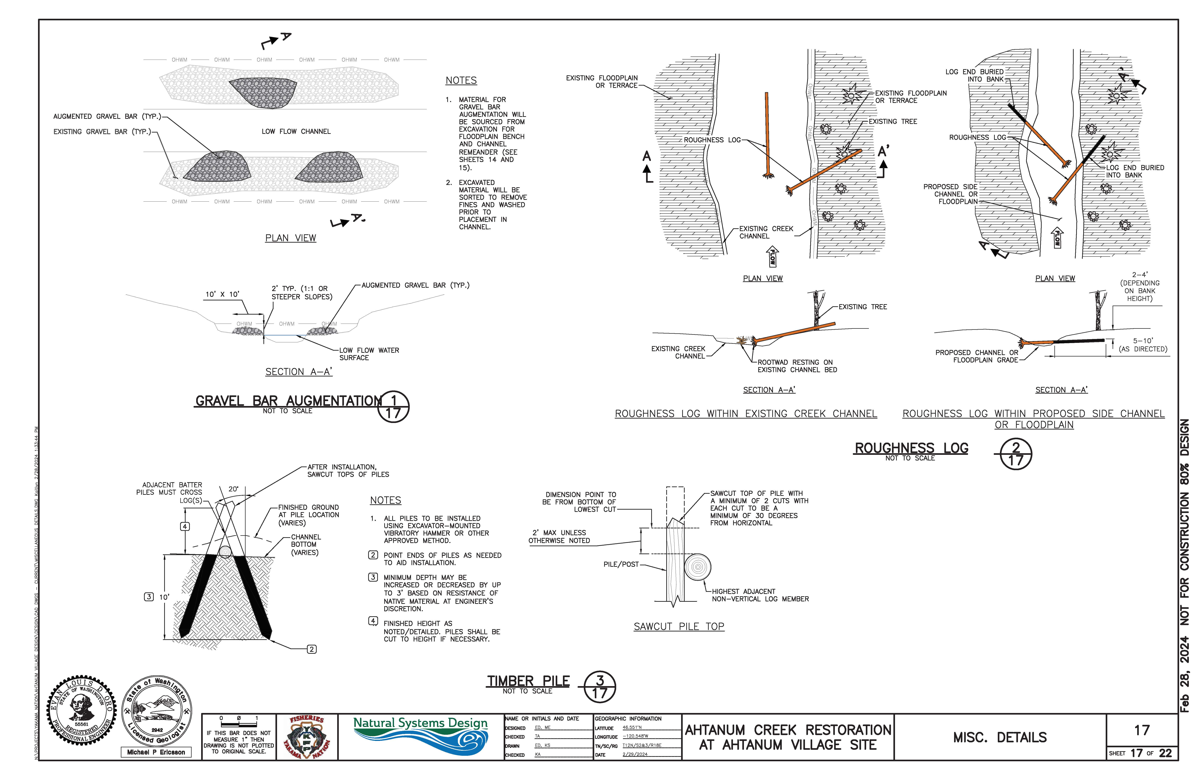
Ahtanum Village Restoration PROJECT: 24-1122

Slide 25
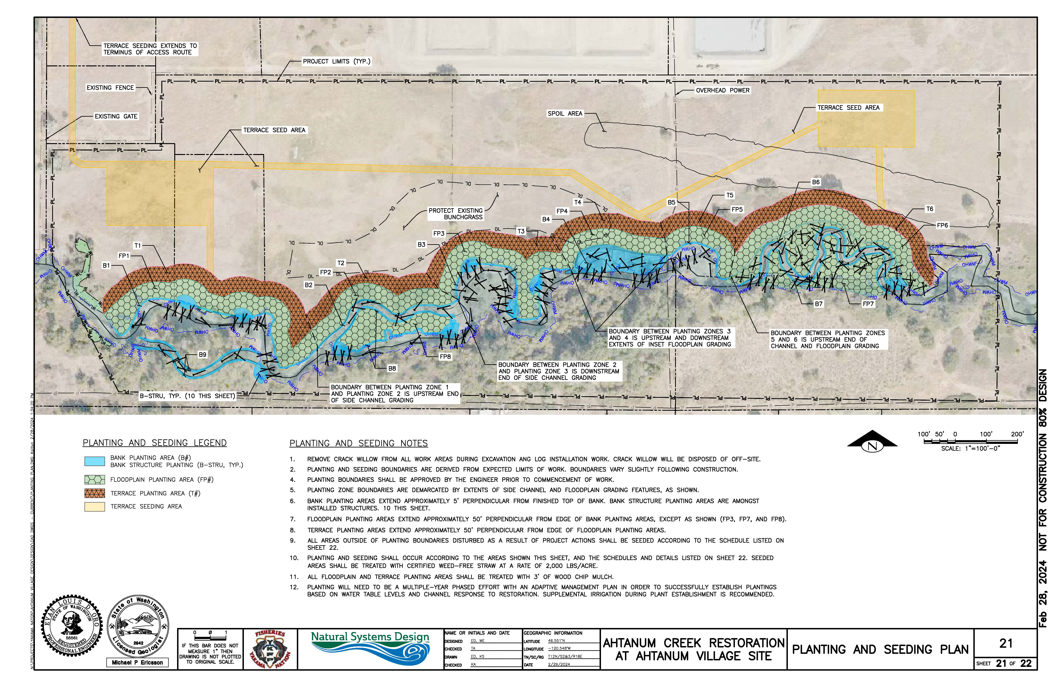
Ahtanum Village Restoration PROJECT: 24-1122

Slide 26
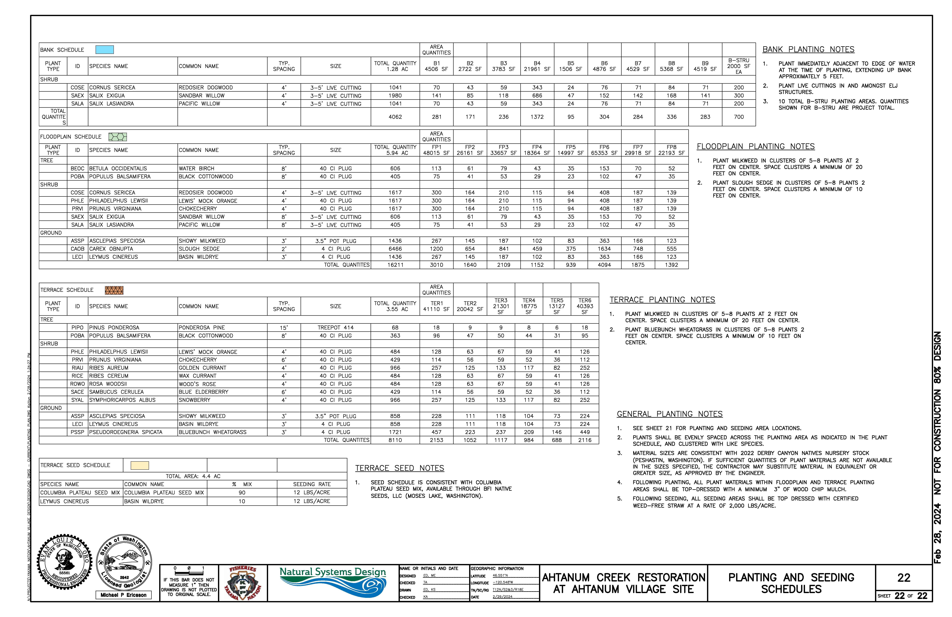
Ahtanum Village Restoration PROJECT: 24-1122

Slide 28
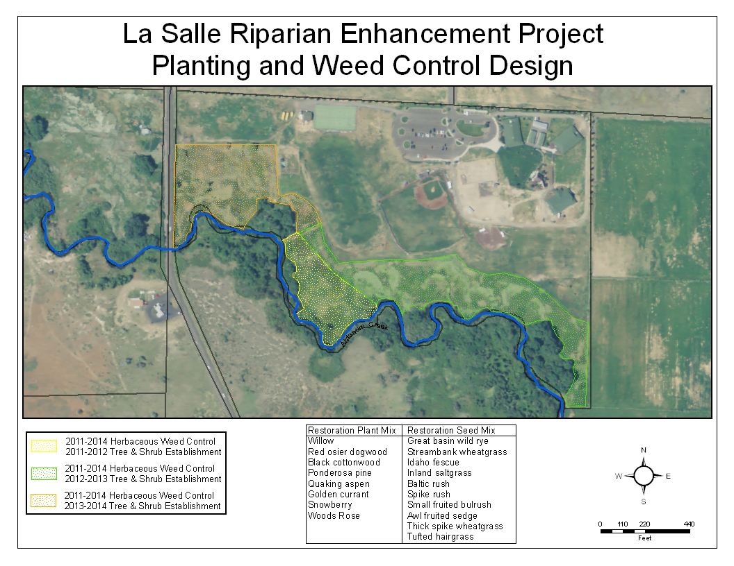
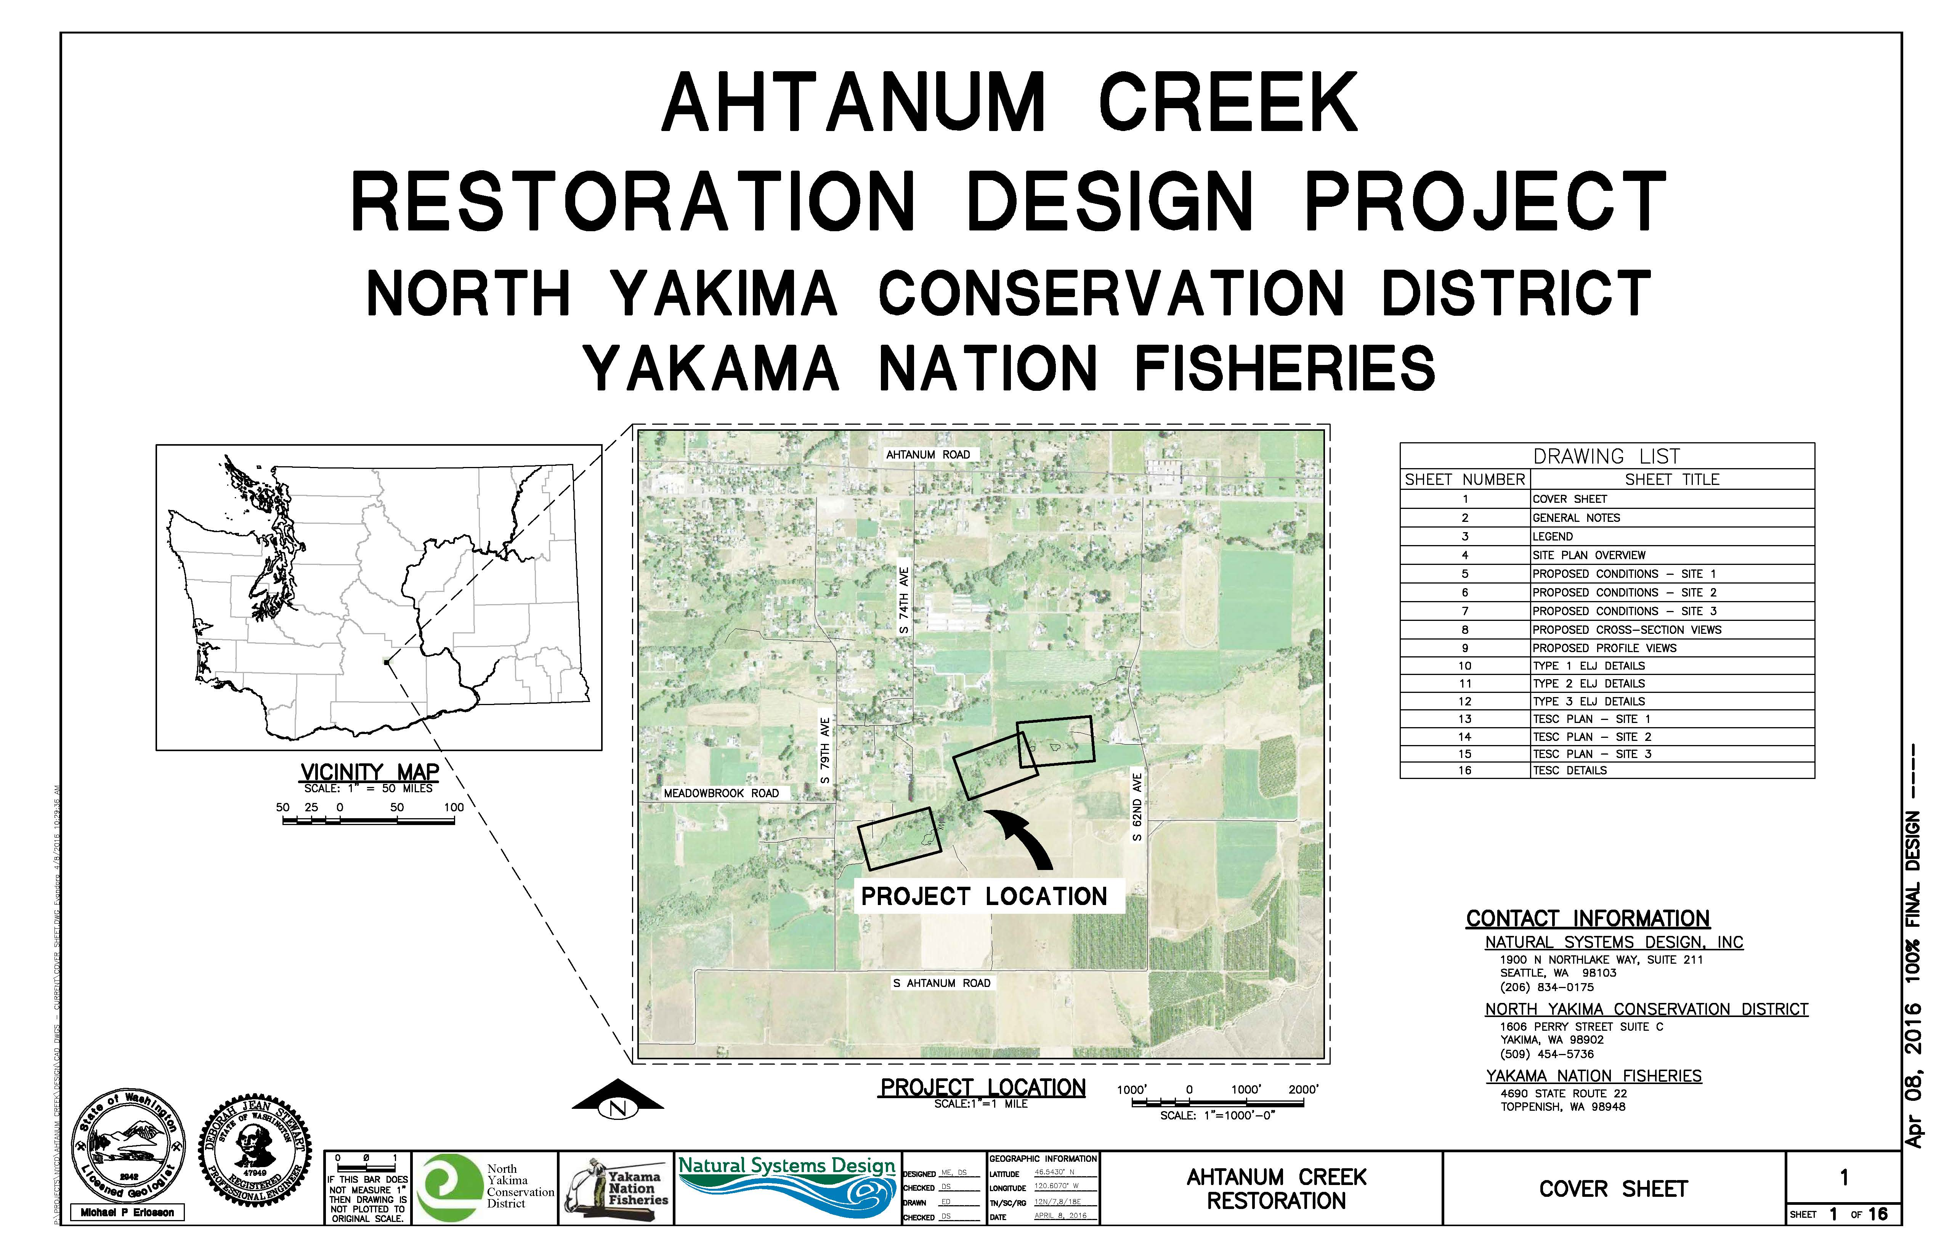
Ahtanum Village Restoration Design
La Salle High School Riparian Enhancement - Project #10-1753
Ahtanum Creek Restoration Survey and DESIGN 2014 - Project #14-1222 $120,000/$105,000 BPA.

Slide 29
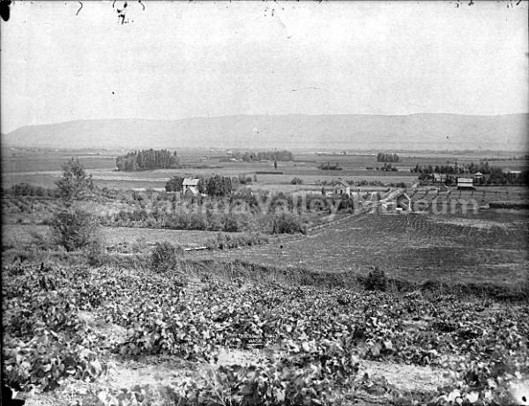
Ahtanum Village Restoration
Project # 26-1314
Questions???
Yakima Basin Fish and Wildlife Recovery Board
Salmon Recovery Funding Board – April 14th, 2026
John Marvin – Yakama Nation Fisheries

