Slide 1
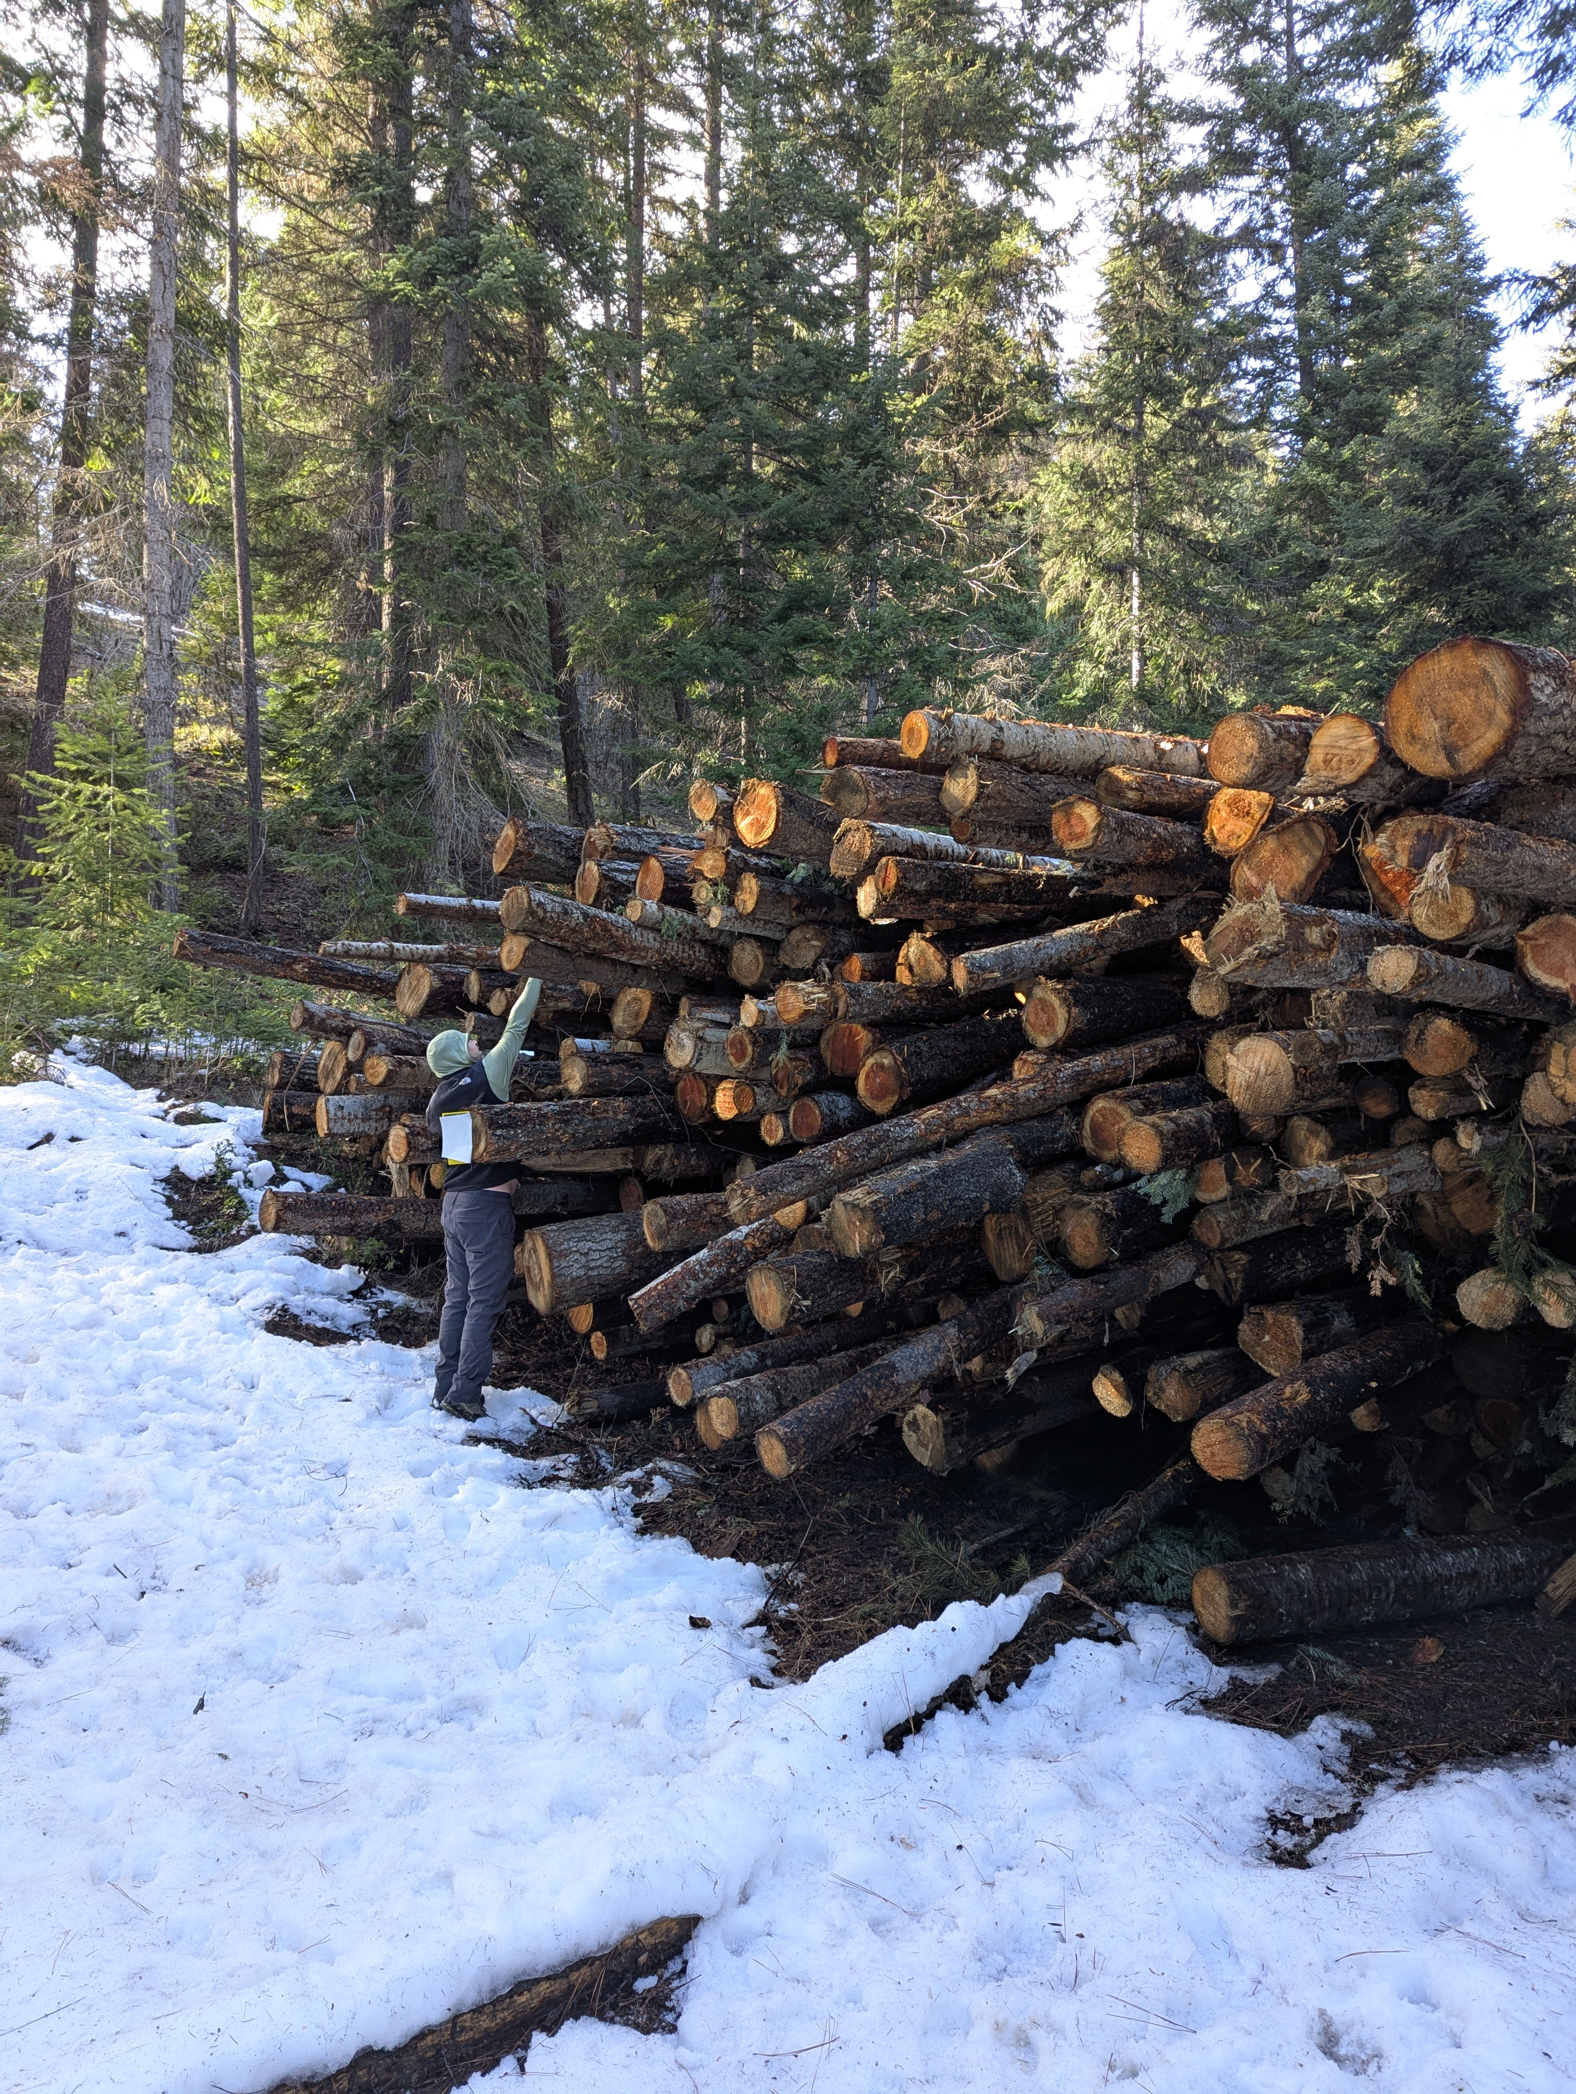
Iron Creek Wood Replenishment
Mid-Columbia Fisheries Enhancement Group
In partnership with USFS Okanogan-Wenatchee National Forest and Yakama Nation
Rebecca Wassell, MCF and Jeff Nelson, USFS
SRFB Project 26-1492 | Salmon State Projects
Notes:
Title slide. Introduce yourself: Rebecca Wassell, Mid-Columbia Fisheries Enhancement Group. Mention Margaret Neuman is also available for questions. Note the partnership with USFS Okanogan-Wenatchee National Forest and Yakama Nation fisheries staff. Project 26-1492 under Salmon State Projects program.

Slide 2
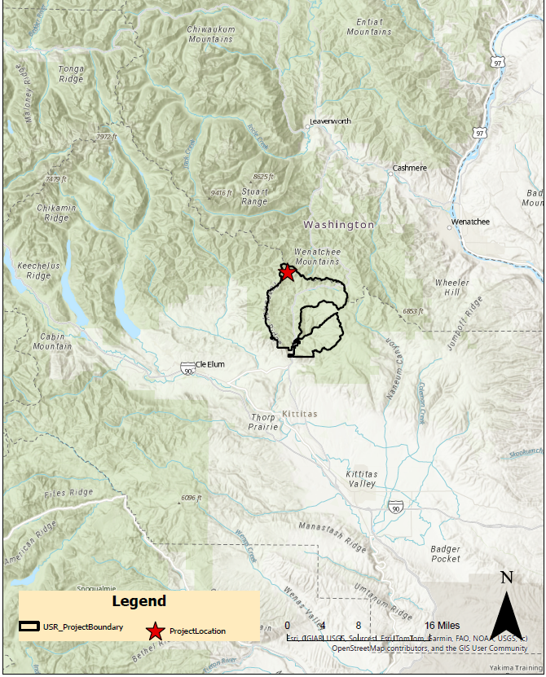
Project Location
Swauk Creek Watershed Kittitas County, WA
WRIA 39 FS Road 9714 West of Highway 97 Okanogan-Wenatchee
National Forest
USFS Upper Swauk Environmental Assessment Project Area
2
Notes:
Orient the audience: The project is located in the Swauk Creek watershed in Kittitas County, Washington, within the Iron Creek and Hovey Creek subbasins of the Upper Yakima River watershed (WRIA 39). The project site is along Forest Service Road 9714, west of Highway 97. All project work occurs on U.S. Forest Service land within the Okanogan-Wenatchee National Forest. The red star marks the project location within the Upper Swauk Project Boundary.

Slide 3
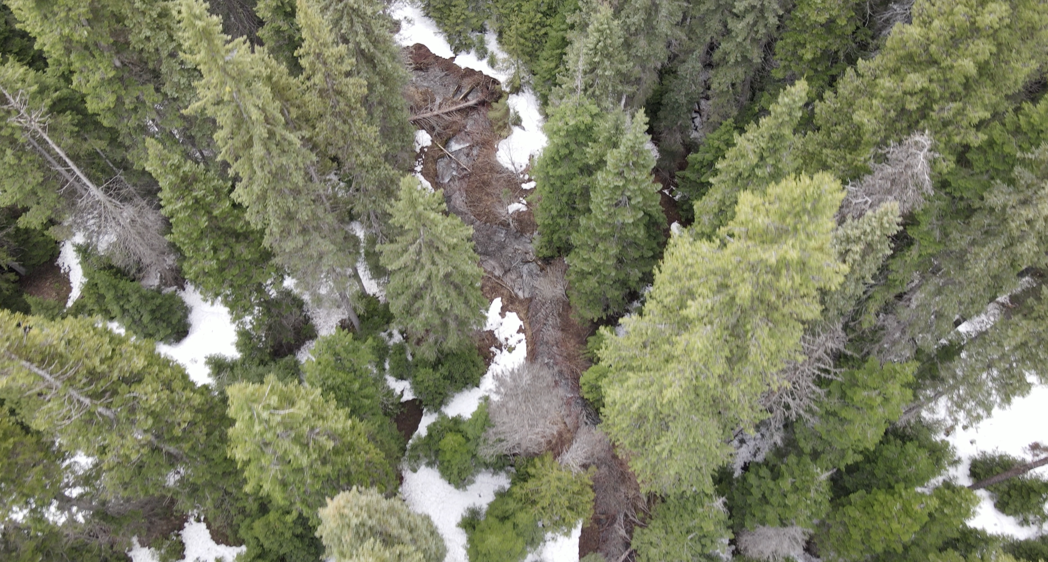
Project Streams: 3.5 Miles of Habitat Restoration
Iron Creek 2.0 mi
West Fork Iron Creek 1.0 mi
Hovey Creek 0.5 mi
3
Notes:
Zoom into the project area. Three forested headwater tributary streams on USFS land, totaling 3.5 miles of treatment. These are small to moderate gradient tributary channels. Historical impacts from timber harvest, mining, road construction, and beaver removal have simplified these channels. Point out this is an aerial/drone view showing the forested stream corridor.

Slide 4
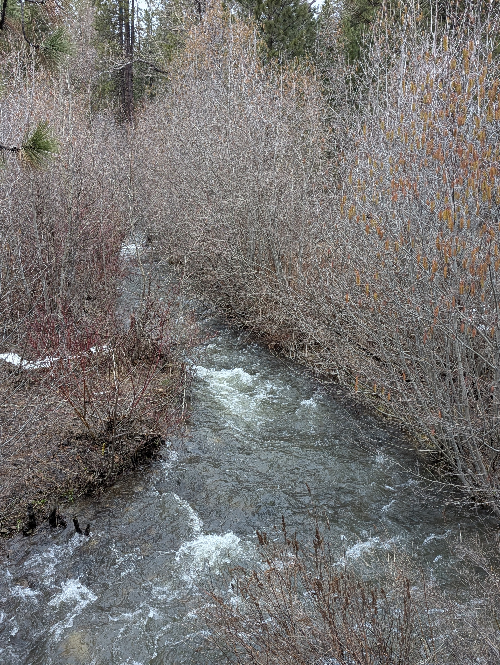
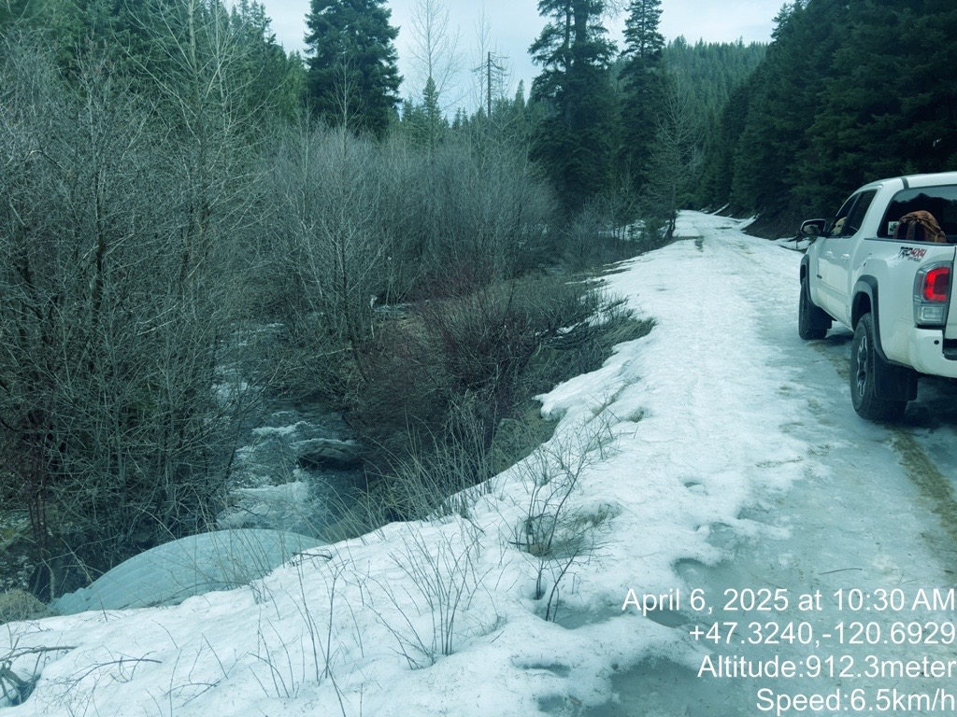
Current conditions lack wood and habitat complexity
Iron Creek - constrained, simplified channel
Iron Creek adjacent to Iron Creek Road
4
Notes:
Show the current site conditions. Left photo: Iron Creek flowing through a simplified, constrained channel with bare banks and minimal wood. Right photo: Iron Creek running directly adjacent to Iron Creek Road, showing how road infrastructure constrains the stream. Note the lack of large wood, reduced pool frequency, poor cover, and disconnection from the floodplain. These conditions limit spawning and rearing habitat for salmonids.

Slide 5
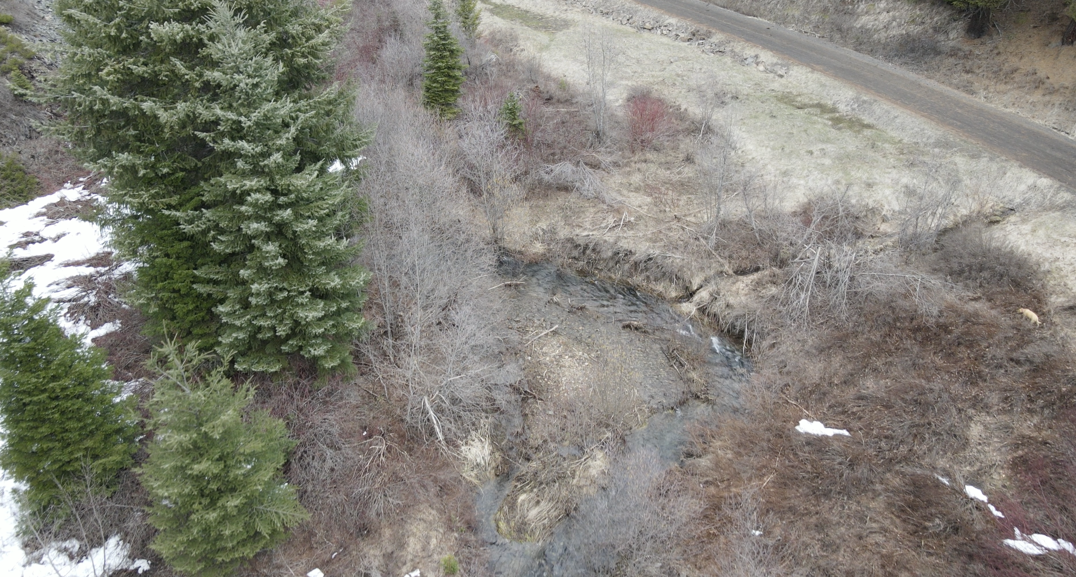
Simplified channels with limited floodplain connectivity
5
Notes:
Aerial drone perspective showing how the road constrains the stream. Note the channel incision visible from above, the limited riparian function, and the road running directly adjacent to the creek. Point out the bare, eroded banks and the lack of instream wood. This is what simplified, wood-depleted streams look like from above - straight, simple channels without the complexity that salmon need.

Slide 6
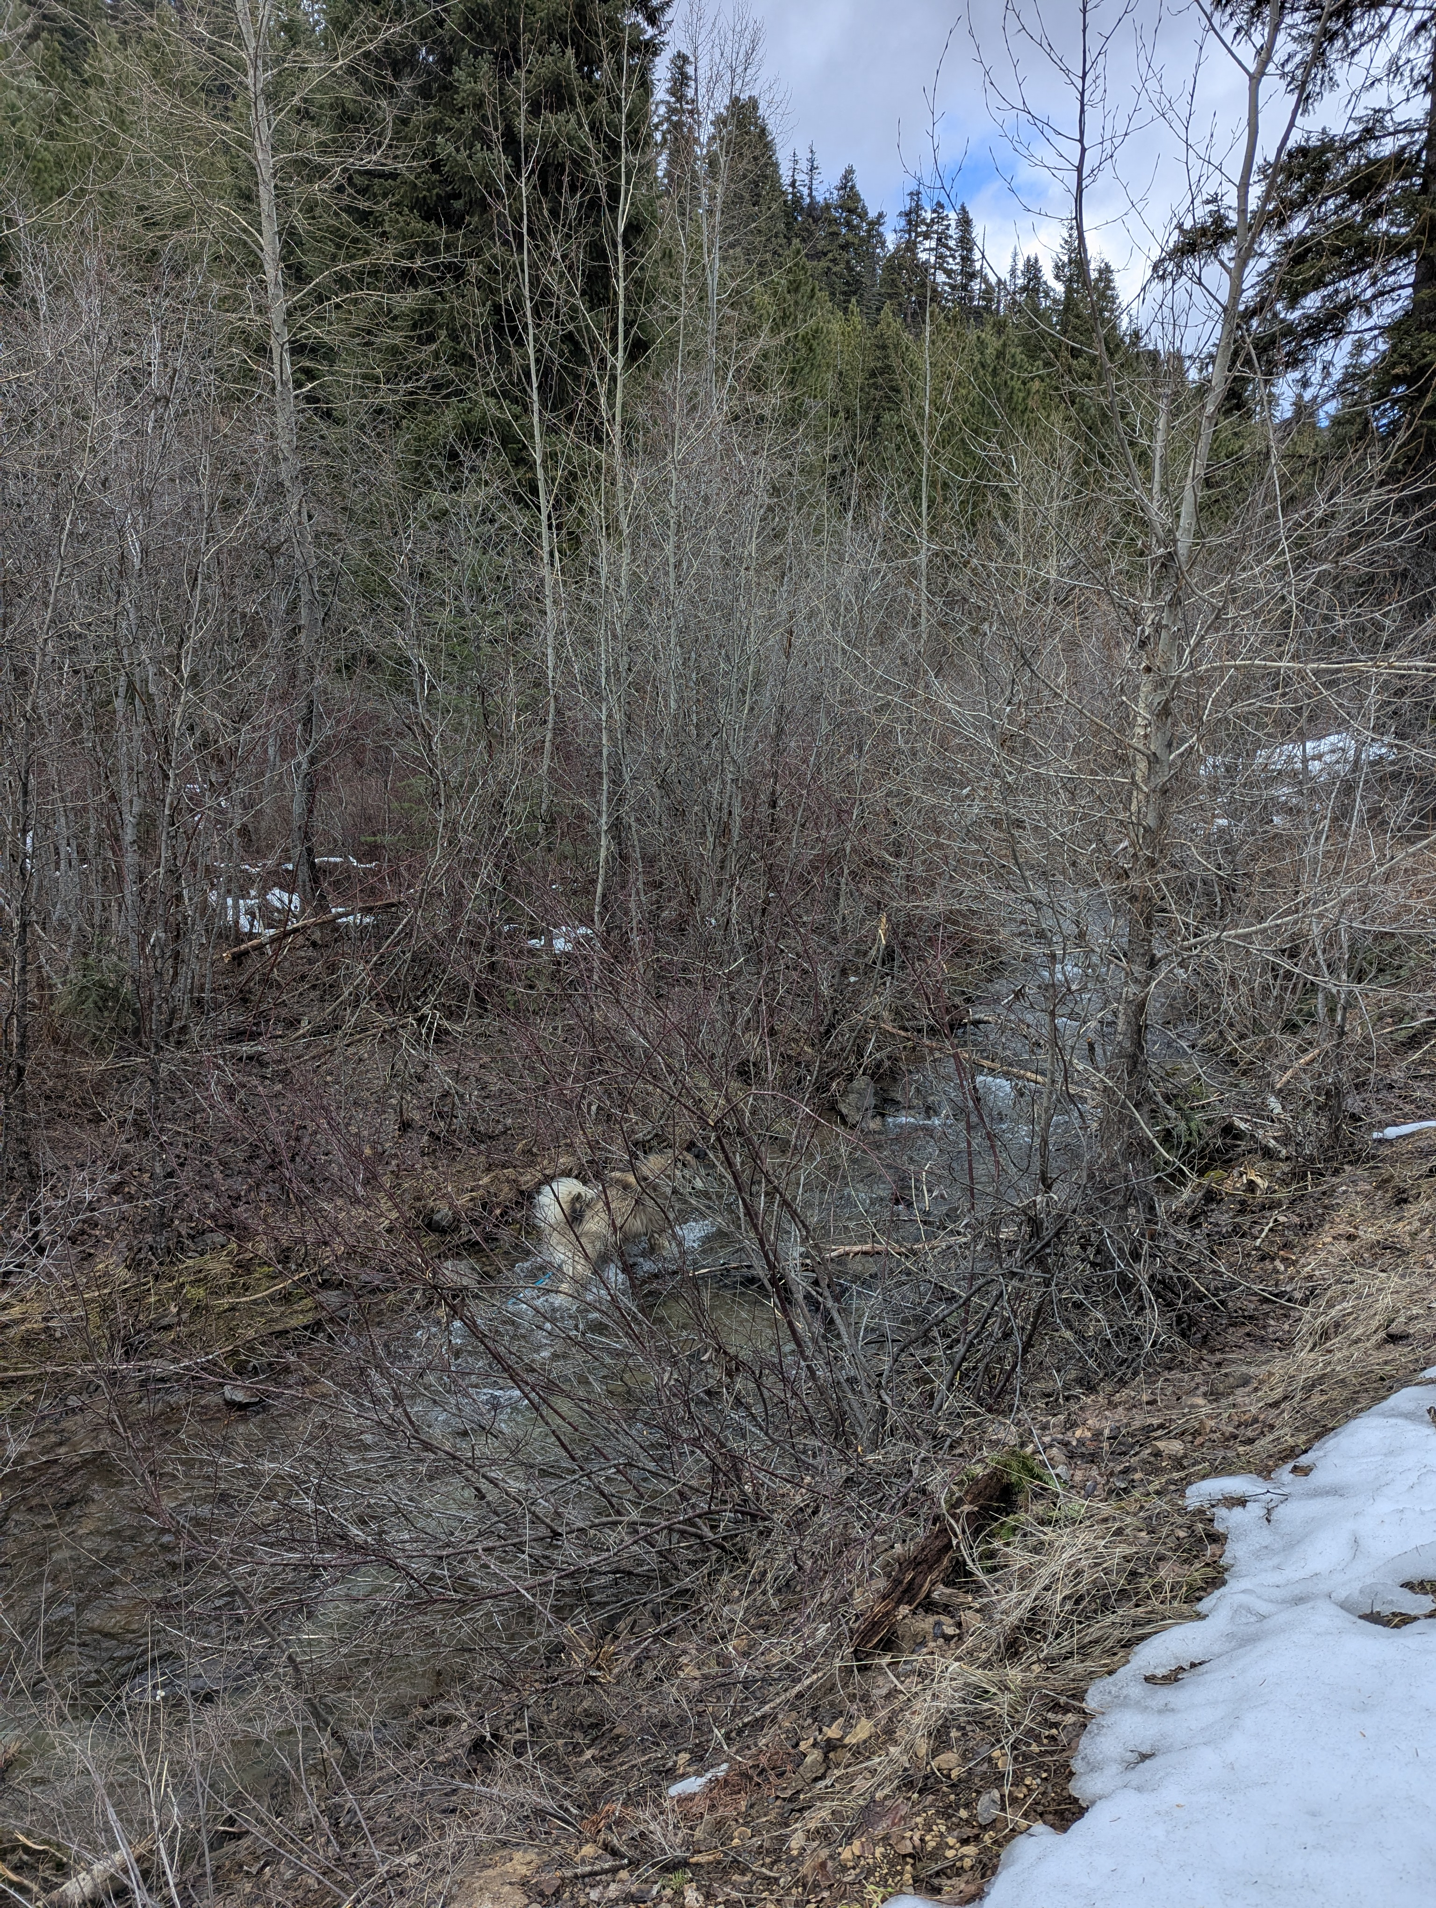
Historical land use has degraded salmon habitat
Timber harvest, mining, and road construction simplified channels
Fire suppression removed natural wood recruitment pathways
Low instream wood = reduced pools, cover, and refugia
Channel incision disconnects floodplains
Elevated summer temperatures stress juvenile salmonids
Beaver removal eliminated natural dam-building
6
Notes:
Explain the historical context driving this project. The Swauk Creek watershed has experienced substantial alteration from historical land use activities including timber harvest, mining, road construction, and removal of beavers. These actions disrupted natural hydrologic processes, reduced floodplain connectivity, and simplified instream habitats. Infrastructure such as US Forest Service roads and Highway 97 has further constrained streams, lowering channel elevations and exacerbating low summer flows, poor water retention, and elevated stream temperatures. The Labor Mountain Fire created an opportunity to restore small-diameter wood to these streams.

Slide 7
Iron Creek supports ESA-listed Mid-Columbia steelhead
Status: Threatened under ESA
Population: Mid-Columbia, Yakima River Upper Mainstem
Life stages present: Eggs, Juveniles, Adults
Population trend: Declining
Key evidence: Radio tag studies (2002-03) confirm steelhead spawn upstream of Iron Creek
Data sources: Yakama Nation Fisheries radio telemetry, USFS surveys
CC #4: Improving steelhead habitat reduces ESA liability for community members
7
Notes:
Primary target species. Mid-Columbia steelhead are listed as Threatened under the Endangered Species Act. Iron Creek is important spawning and rearing habitat - radio tag studies from 2002-03 confirm that steelhead spawn upstream of Iron Creek. The population trend is declining, which makes habitat restoration in this area critical. Data comes from Yakama Nation Fisheries radio telemetry and USFS surveys. Note for CC: improving habitat for threatened steelhead reduces ESA liability for community members who conduct activities in the watershed.

Slide 8
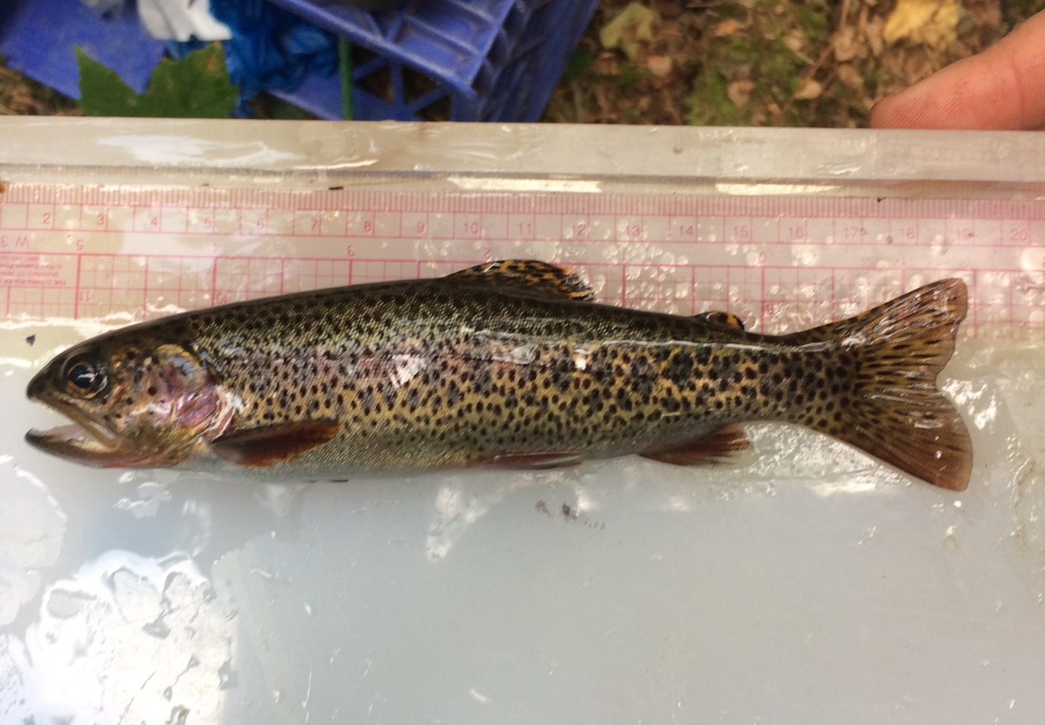
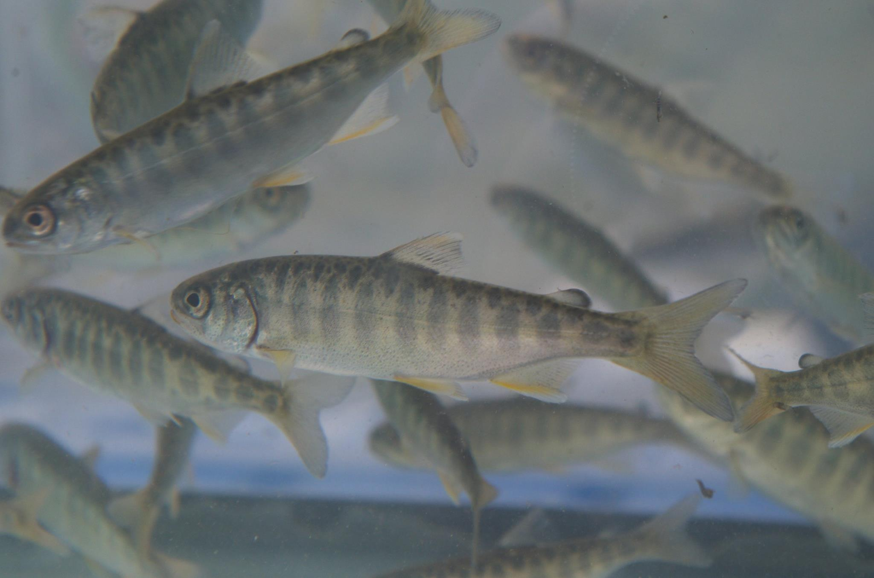
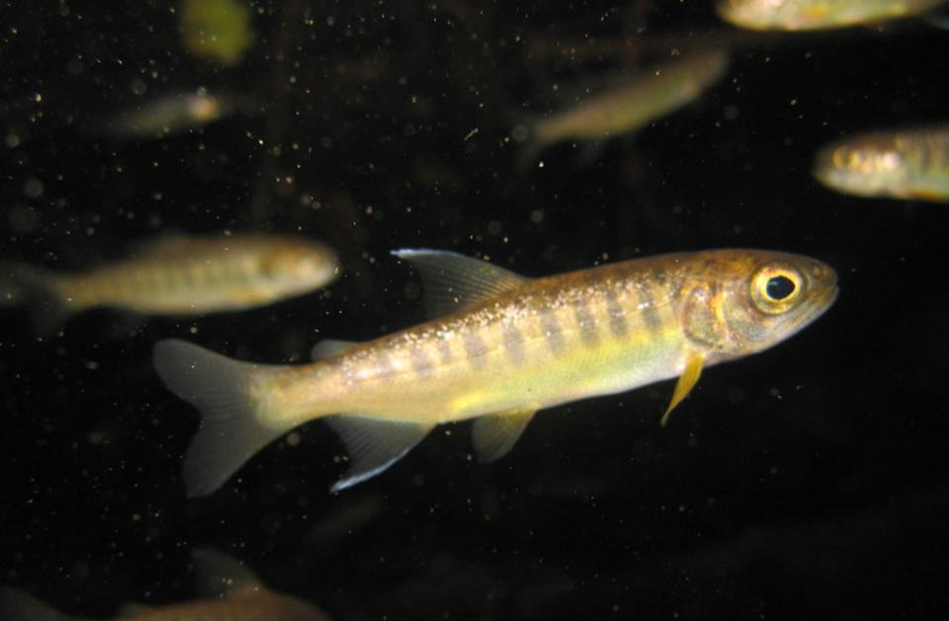
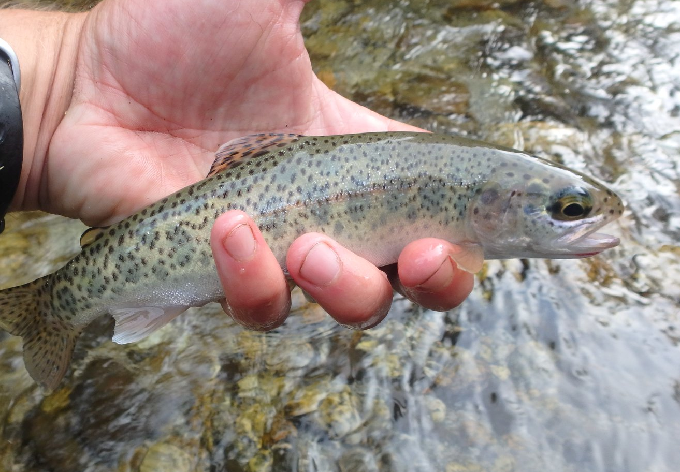
Multiple salmonid species will benefit
Spring Chinook
Coho Salmon
Rainbow Trout
Cutthroat Trout
Status: Mid-Columbia River Life Stages: Juveniles Trend: Declining
Status: Unidentified Life Stages: Juveniles Trend: Rising
Status: Non-ESU Resident Life Stages: All stages Trend: --
Status: Non-ESU Resident Life Stages: All stages Trend: --
CC #1: Yakama Nation coho releases in Iron Creek benefit from restored habitat
8
Notes:
While steelhead is the primary focus, restoring habitat complexity benefits the entire fish community. Spring Chinook juveniles are present (declining trend). The Yakama Nation has released coho into Iron Creek and they are using the habitat. Rainbow trout serve as an analog for anadromous steelhead - creating habitat suitable for residents is foundational for future reintroduction. Cutthroat trout are also present. Note for CC: Yakama Nation coho releases in Iron Creek directly benefit from restored habitat, supporting Yakama Nation interests beyond just salmon recovery.

Slide 9
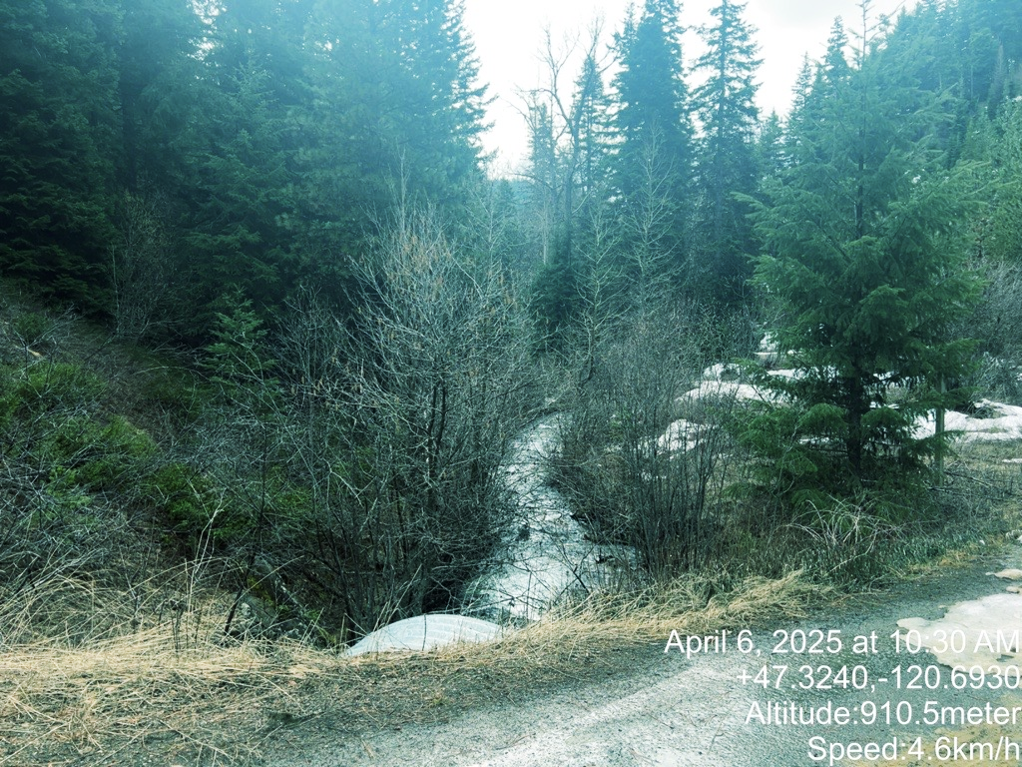
Key limiting factors for salmonids in Iron Creek
Limited spawning habitat due to lack of gravel sorting
Elevated water temperatures from reduced shade and complexity
Egg and alevin scour during high flows
Constrained, ditched channels disconnect floodplains
Reduced habitat complexity = fewer pools, less cover
Low macroinvertebrate productivity from lack of wood
9
Notes:
Walk through the specific limiting factors. Iron Creek, West Fork Iron Creek, and likely Hovey Creek currently limit steelhead spawning, constrain summer rearing due to elevated water temperatures, and cause egg and alevin scour during high flows. The constrained, ditched channels channelize water, exacerbate channel incision, disconnect floodplains, and reduce habitat complexity. Explain how each limiting factor relates to what you can see in the photo - the simplified, wood-depleted channel.

Slide 10
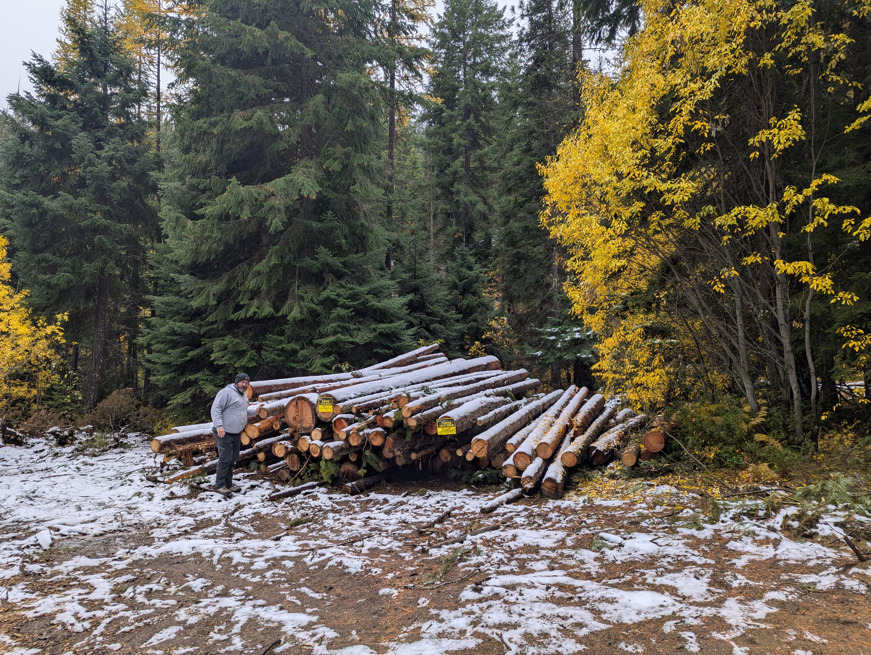
~1,000 logs from the Dry Fly Timber Sale are ready for placement
Trees felled during Labor Mountain Fire suppression & hazard tree removal
Currently decked at 3 locations along Iron Creek Road
Small-diameter logs and slash - ideal for tributary-scale streams
USFS providing material at minimal cost
CC #8: Free wood from USFS maximizes cost-effectiveness | CC #12: USFS is landowner and active project partner
10
Notes:
This is a key slide - the unique opportunity. Approximately 1,000 small-diameter logs and slash are sourced from the U.S. Forest Service Dry Fly Timber Sale. These trees were felled during Labor Mountain Fire suppression and hazard tree removal. They are currently decked at three locations along Iron Creek Road, ready for placement. The USFS is providing the material at no cost, which makes this project exceptionally cost-effective. Small-diameter material is ideal for these tributary-scale streams - lessons from past projects show that a mix of wood sizes, similar to natural recruitment, is more effective than using exclusively large wood in small streams.

Slide 11
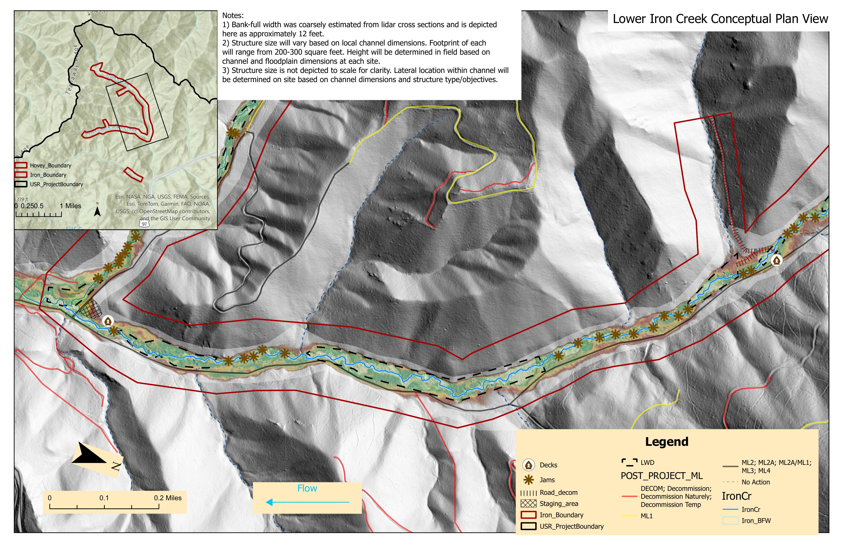
Lower Iron Creek Conceptual Design
2.0 miles of treatment
11
Notes:
Walk through the Lower Iron Creek conceptual plan view on LiDAR imagery. Point out: deck locations (triangle symbols) where wood is currently staged, proposed jam placements (star symbols) at strategic locations along the stream, the road decommissioning area, and staging areas. Explain that 2.0 miles of Iron Creek will receive wood treatment. The LiDAR shows the channel alignment and surrounding topography. Note the bank-full width is estimated at approximately 12 feet from LiDAR cross sections. Structure size will vary based on local channel dimensions with footprints of 200-300 sq ft each.

Slide 12
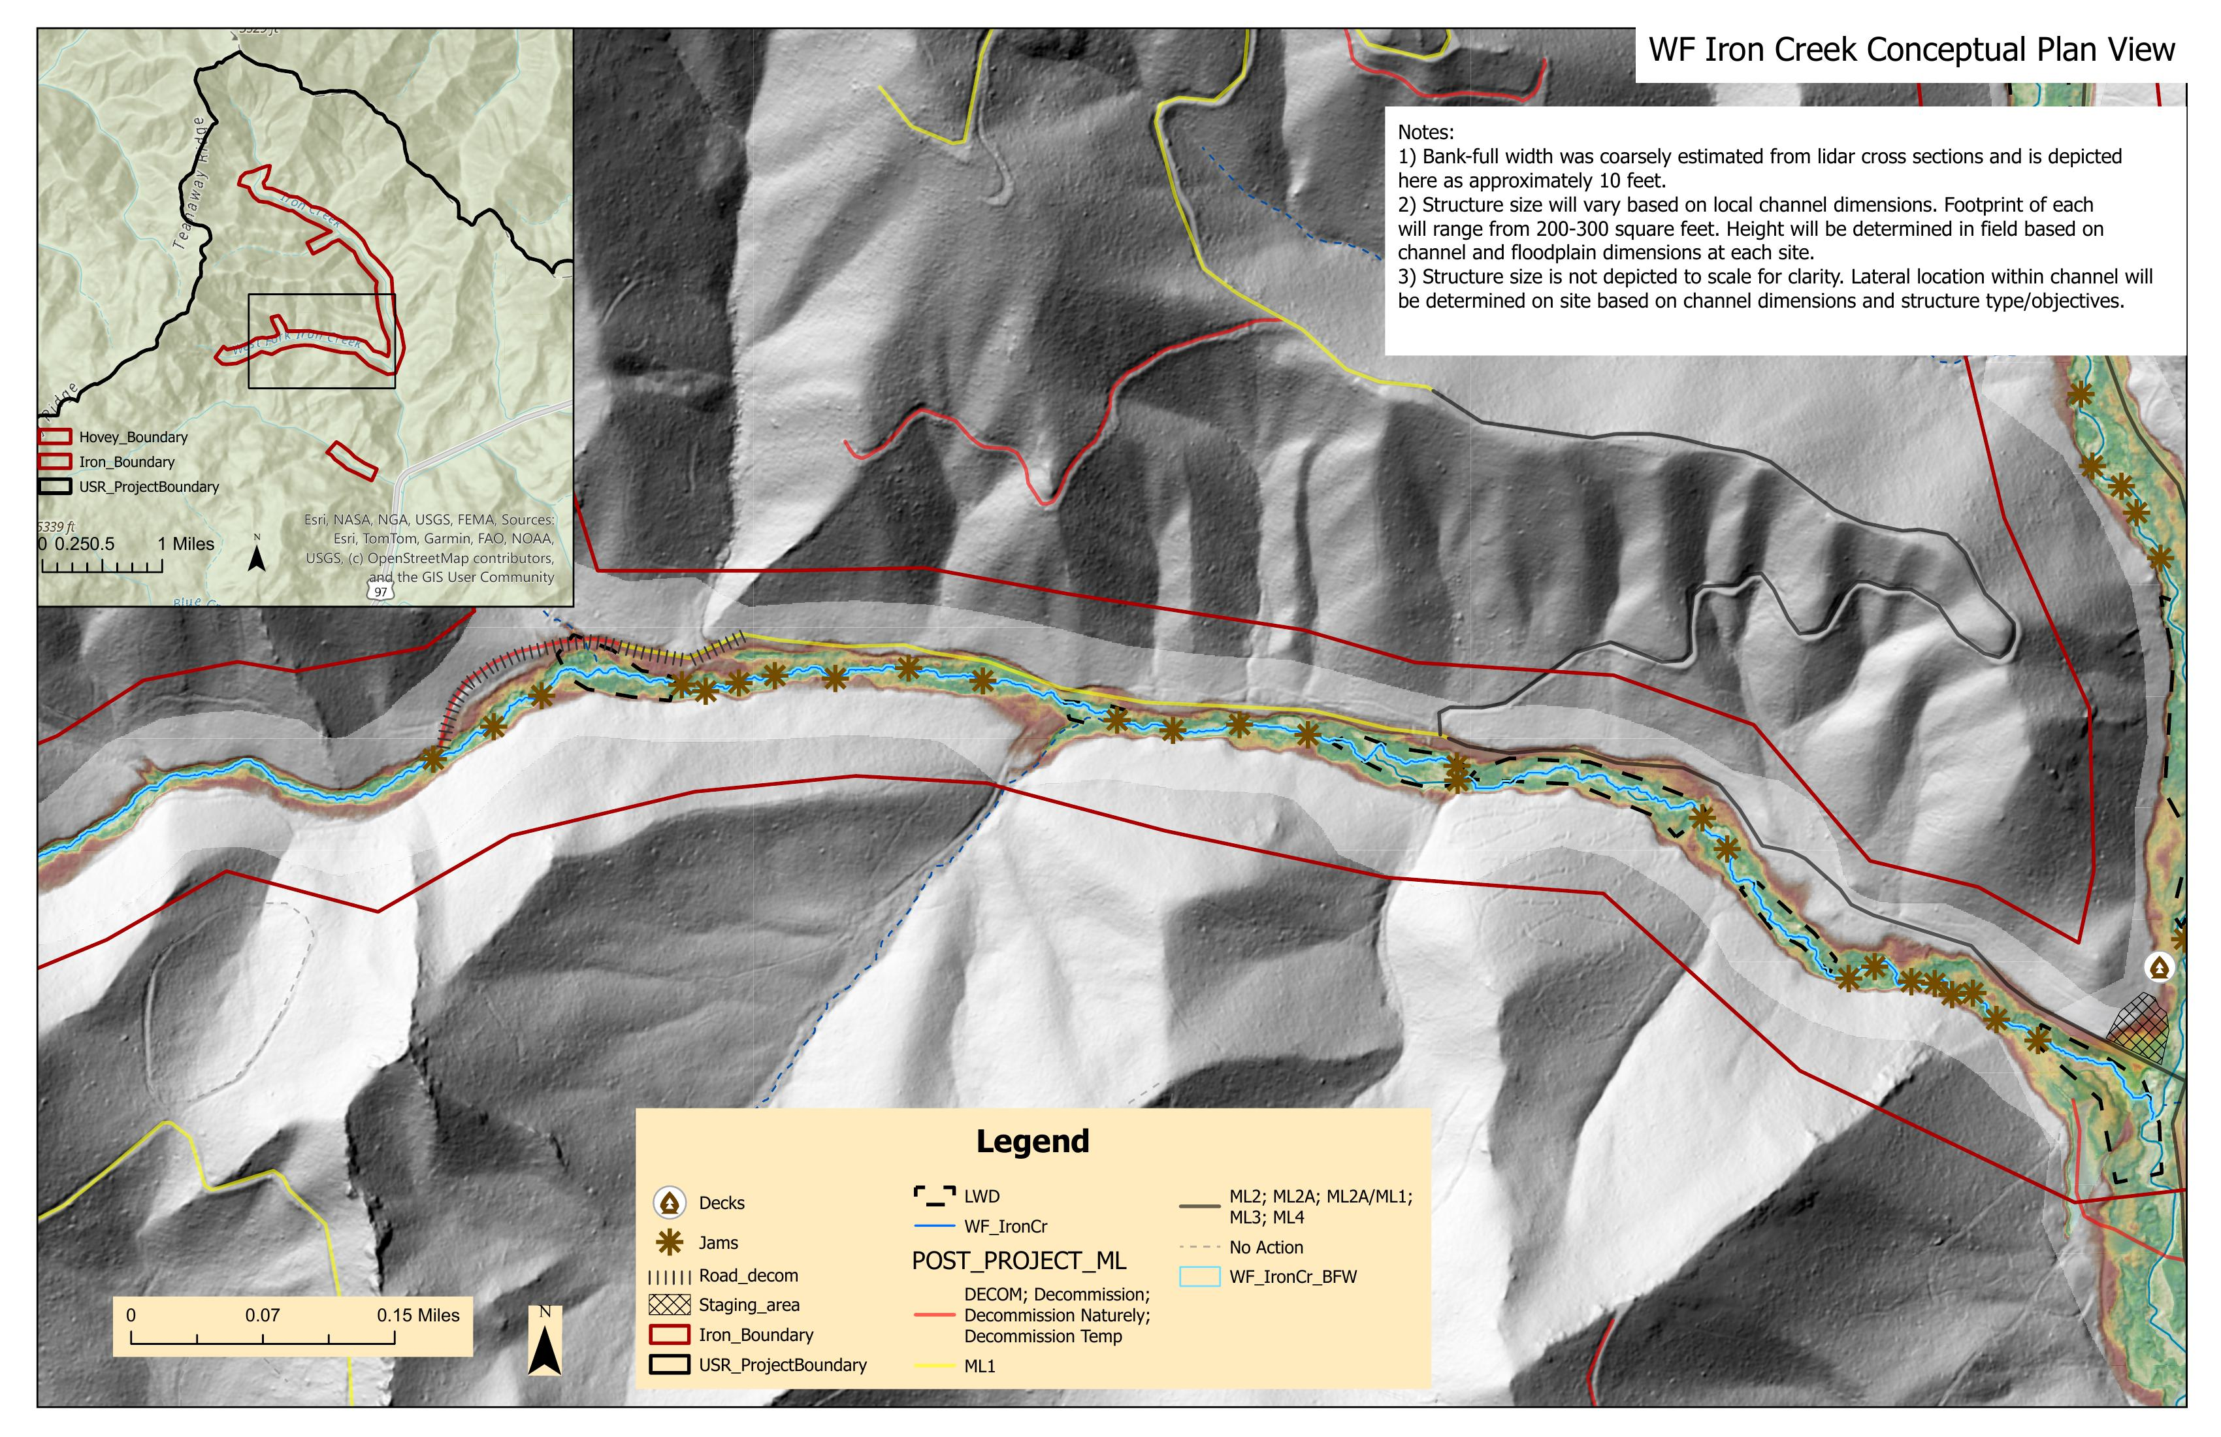
West Fork Iron Creek Conceptual Design
1.0 mile of treatment + 0.25 mile road decommissioning
12
Notes:
Walk through West Fork Iron Creek design on LiDAR. Point out the jam placements, deck locations, and importantly the road decommissioning area (0.25 miles of WF Iron Creek Road). Explain how wood placement and road decommissioning work together - wood restores habitat complexity while road decom reduces sediment delivery and reconnects hydrology. The bank-full width is approximately 10 feet here. This is the reach that also includes the road decommissioning component of the project.

Slide 13
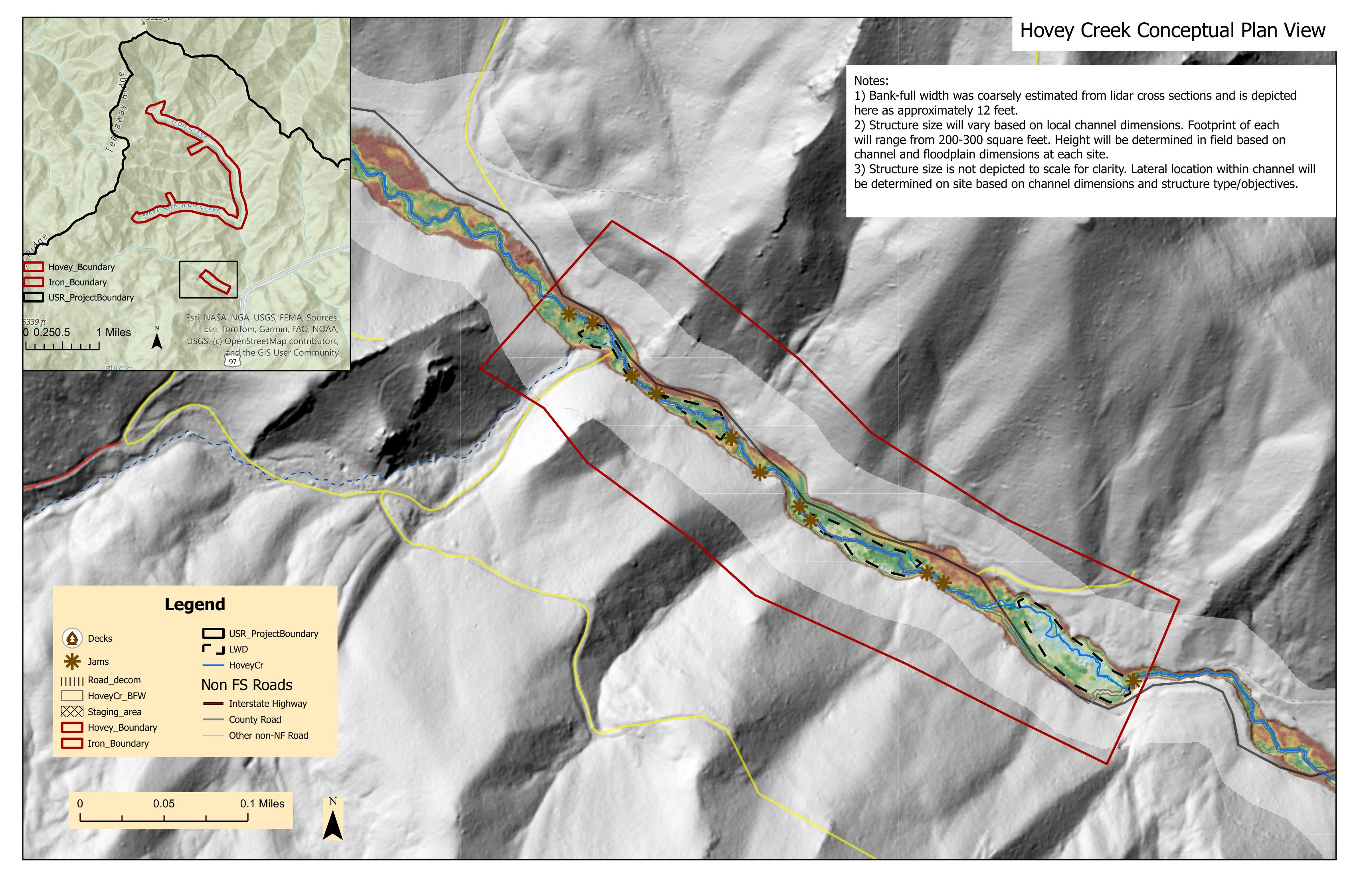
Hovey Creek Conceptual Design
0.5 mile of treatment
13
Notes:
Walk through Hovey Creek design. This is the smallest treatment reach at 0.5 miles but still important tributary habitat. Point out jam placements along the creek. The bank-full width is approximately 12 feet. Note the inset map showing Hovey Creek's location within the larger project area. Hovey Creek is a tributary that contributes to the overall fish habitat network in the Iron Creek subwatershed.

Slide 14
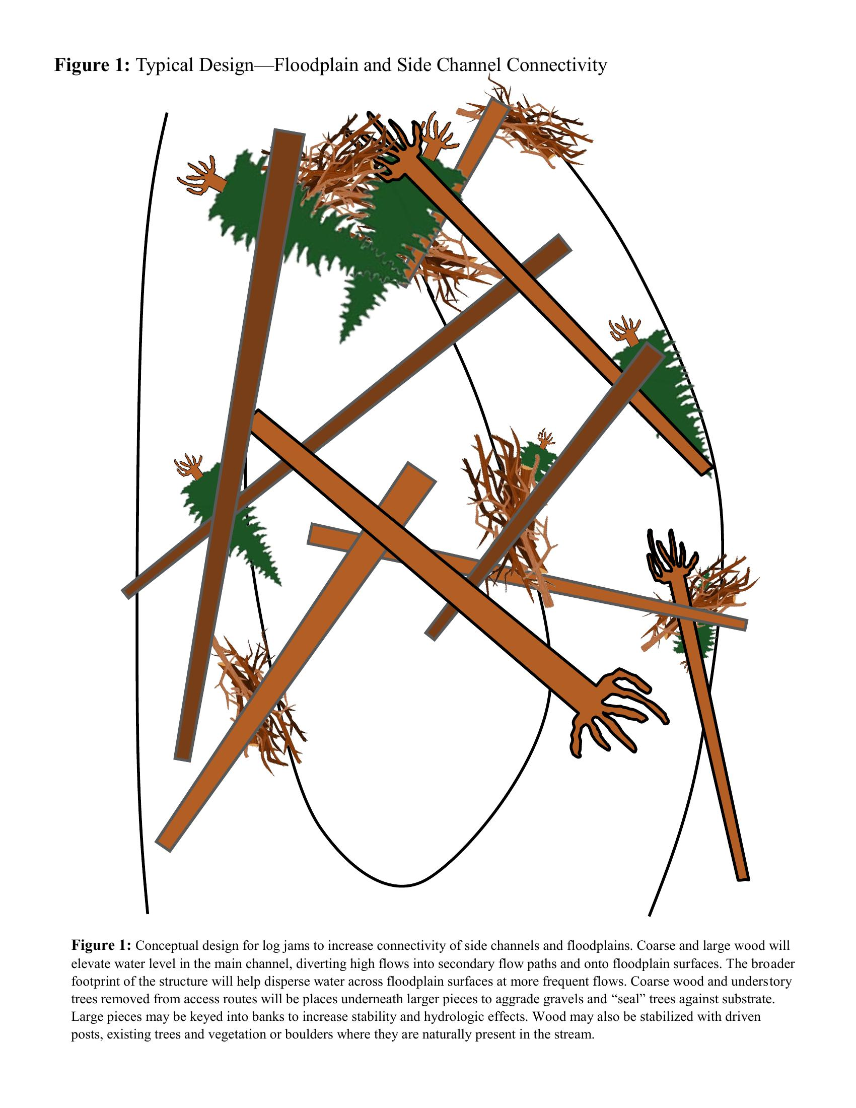
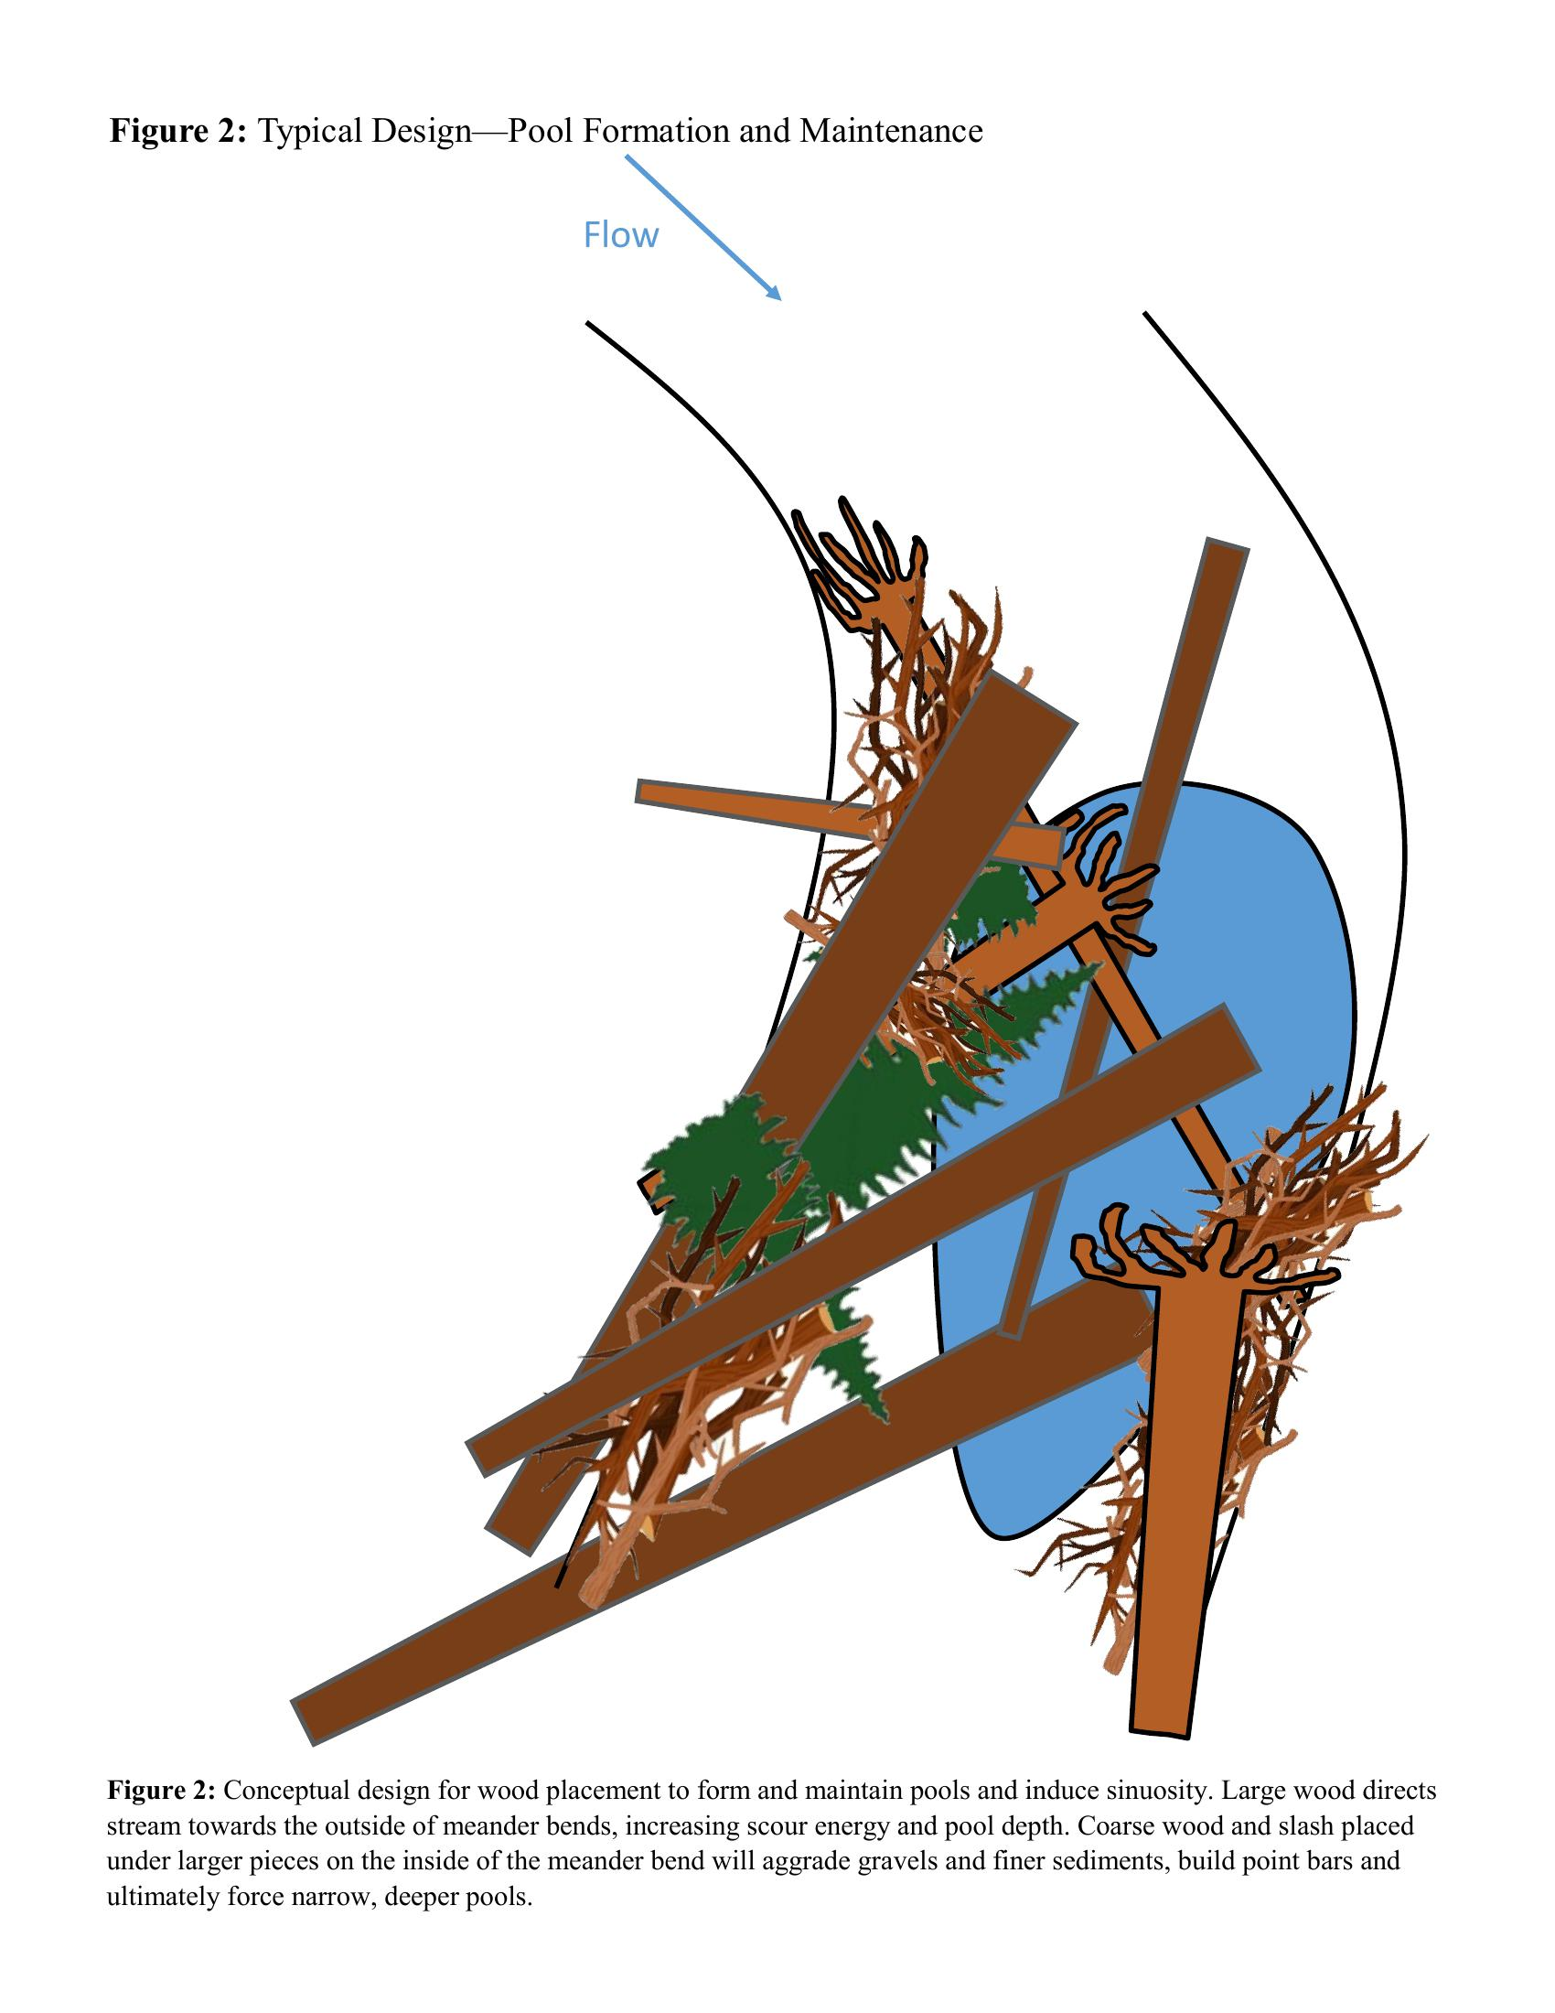
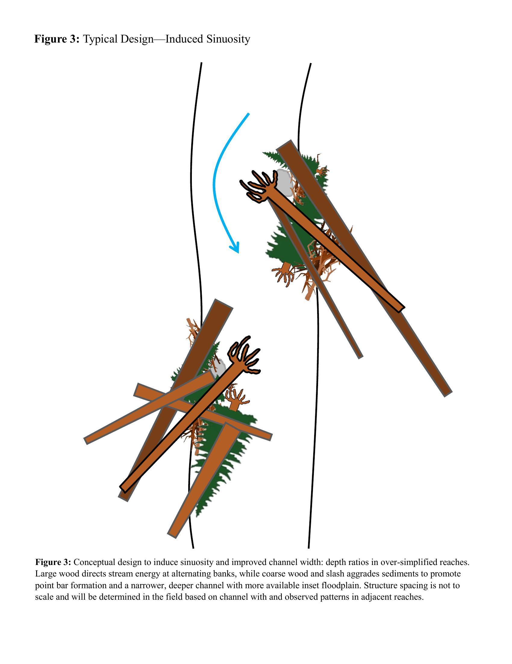
Three wood placement strategies tailored to reach conditions
Floodplain & Side Channel
Connectivity
Pool Formation &
Maintenance
Induced
Sinuosity
CC #10: Design by Jeff Nelson, USFS Fish Bio - 10 yrs experience, 8 similar field-fit wood placement projects
14
Notes:
Three design typicals that will be used depending on reach conditions. Figure 1 (Floodplain & Side Channel Connectivity): Log jams increase connectivity of side channels and floodplains, diverting high flows into secondary flow paths. Figure 2 (Pool Formation & Maintenance): Wood placement at meander bends to form and maintain pools, increasing scour energy and pool depth. Figure 3 (Induced Sinuosity): Wood directs stream energy at alternating banks to promote point bar formation and a narrower, deeper channel. All designs are field-fit - structures will be adapted to local channel conditions during construction. Designed by Jeff Nelson, USFS Fisheries Biologist at the Cle Elum Ranger District, who has 10 years of experience and has led 5 of 8 similar field-fit wood placement projects.

Slide 15
This project directly addresses recovery plan priorities
Yakima Steelhead Recovery Plan
Upper Yakima Action #14: Restore instream and floodplain habitat complexity in Swauk and Taneum creeks (p. 198)
Upper Yakima Action #15: Restore tributary riparian areas (p. 199)
TAG Focus Projects
Focus Project #18 (Action #14)
Focus Project #24 (Action #15)
Building on Prior Work
SRFB project 08-1947: Swauk & Iron Creek Restoration Design (completed)
USFS Upper Swauk Environmental Assessment (in progress)
CC #9: Builds on SRFB 08-1947 and complements the in-progress USFS Upper Swauk EA
15
Notes:
This is a critical slide for the TAG. The project directly addresses two Upper Yakima Actions from the Yakima Steelhead Recovery Plan: Action #14 (restore instream and floodplain habitat complexity in Swauk and Taneum creeks, p.198) and Action #15 (restore tributary riparian areas, p.199). These correspond to TAG Focus Projects #18 and #24 respectively. The project builds on prior SRFB-funded design work (08-1947, Swauk & Iron Creek Restoration Design, completed) and aligns with the USFS Upper Swauk Environmental Assessment currently in progress. The Cle Elum RD of the Okanogan-Wenatchee National Forest is completing this EA, which provides ESA, NEPA, and NHPA consultation for this work.

Slide 16
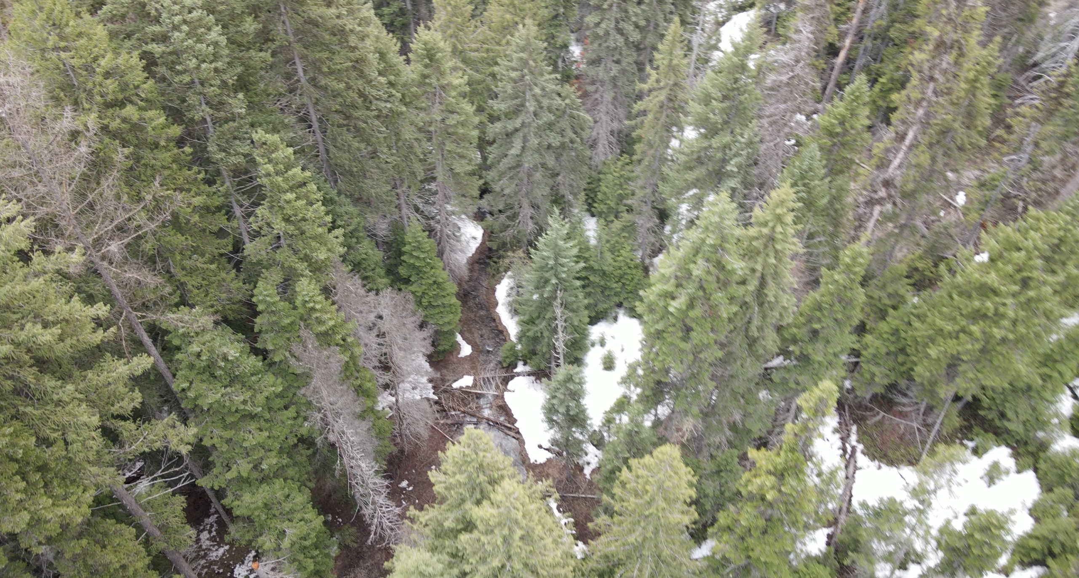
Restoring habitat complexity across 3.5 miles of salmon streams
Increase pool frequency and depth (~20 pools created)
Create thermal refugia for juvenile rearing
Improve spawning gravel retention and sorting
Reconnect floodplains and side channels
Reduce scour of steelhead redds
Boost macroinvertebrate productivity
CC #4: Reduces ESA liability by improving habitat for threatened steelhead | CC #5: Benefits amphibians, macroinvertebrates, and riparian wildlife
16
Notes:
Walk through the specific fish benefits. Approximately 20 pools will be created (assuming about 1/3 of structures will form pools). Thermal refugia will be created for juvenile salmonid rearing during hot summer months. Gravel retention will improve spawning habitat. Floodplain reconnection provides off-channel habitat. Reduced scour protects steelhead redds (eggs). Benefits are year-round: key gains in winter/spring for spawning and summer for juvenile rearing. Increased complexity reduces thermal stress and provides refugia during high flows. Note for CC: this project also benefits non-target wildlife including amphibians, macroinvertebrates, and riparian wildlife species.

Slide 17
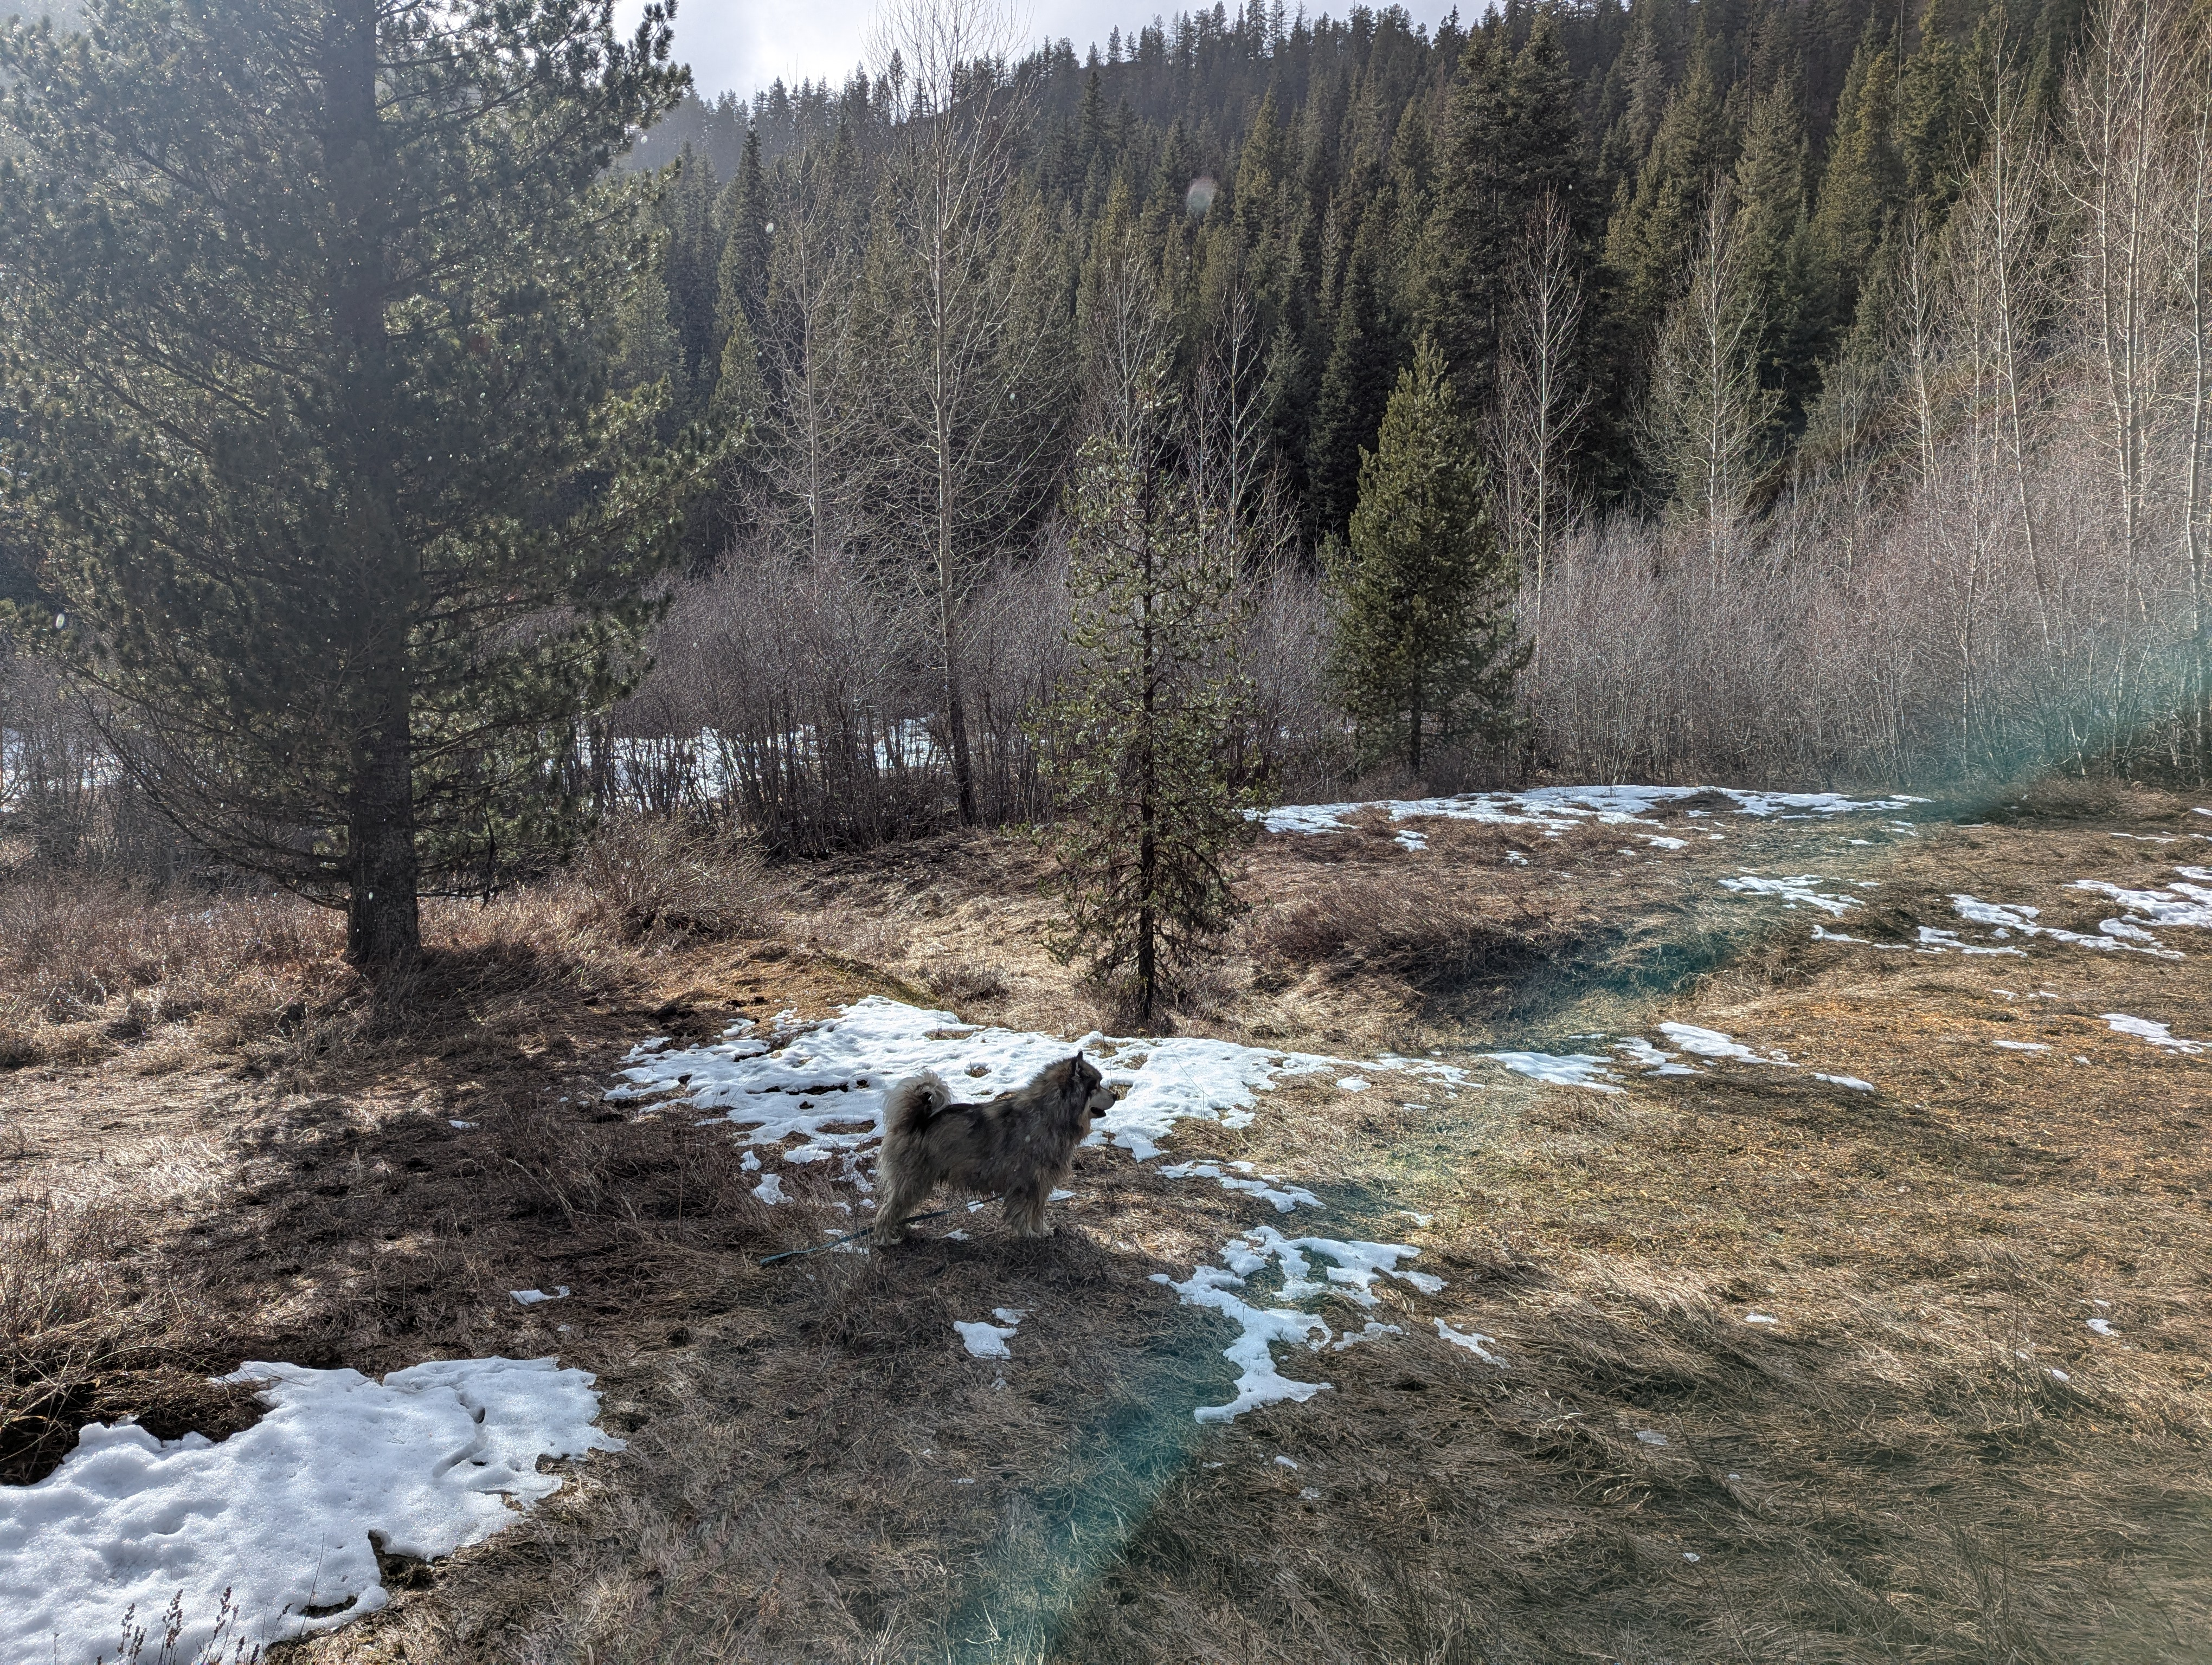
Building climate resilience and watershed function
Increased water retention and groundwater storage
Cool-water refugia during drought and high temperatures
0.25 miles of road decommissioned = reduced sediment delivery
Adaptive management allows future adjustments
Sets foundation for future restoration in Swauk watershed
CC #2: Improved water retention supports downstream agricultural water management
17
Notes:
Climate resilience angle. This project enhances climate resilience by restoring natural stream processes and habitat complexity. Reconnecting floodplains, increasing riparian shade and roughness, and improving water retention through wood placement will help manage streamflow variability, enhance groundwater storage, and support floodplain connectivity. Improvements to riffle/pool ratios and habitat diversity will create cool-water refugia for juvenile salmonids during high temperatures and drought. Road decommissioning (0.25 miles) improves watershed hydrology by reducing sediment delivery. The adaptive management approach allows adjustments as conditions change. Note for CC: improved water retention supports downstream agricultural water management in the Yakima Basin.

Slide 18
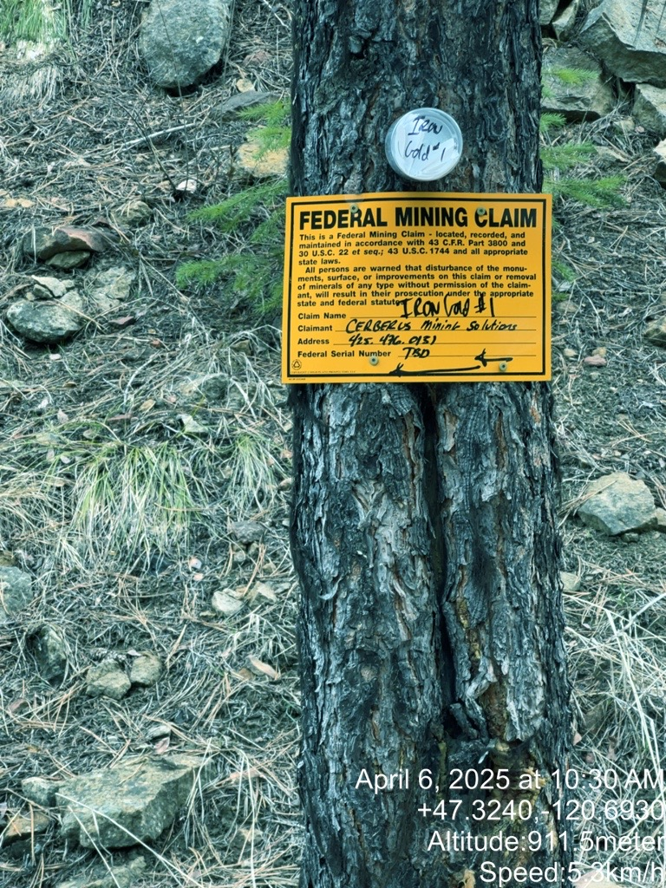
Anticipated challenges and our approach
Fire/smoke restrictions
Built 2027 backup into 24-month schedule
Stakeholder concerns
(recreationists, mining claims)
Early outreach, transparent communication, collaborative problem-solving
USFS staffing / government
shutdown risk
Close coordination with USFS staff, flexible timeline, synchronized efforts
Ecological uncertainty
Adaptive field-fit design approach; lessons from 8 similar projects
Federal mining claims in the project area
CC #3: Minimal recreational impact; construction on federal land | CC #11: Proactive stakeholder engagement with recreationists, miners, and public
18
Notes:
Per best practices, proactively raise challenges before the committee asks. Fire or smoke restrictions and unforeseen logistical barriers may affect timing - the 24-month schedule includes 2027 as backup. Stakeholder concerns from recreationists and mining claim holders may arise - early outreach, transparent communication, and collaborative problem-solving are essential. USFS staffing and potential government shutdowns may impact timelines - MCF will maintain close communication with USFS staff. Ecological uncertainty (streamflow, sediment dynamics) is addressed through the adaptive field-fit design approach informed by 8 similar past projects. The mining claim sign photo provides context for the stakeholder landscape. Note for CC: construction occurs on federal land during a limited window with minimal recreational impact, and proactive stakeholder engagement is planned.

Slide 19
SRFB Request: $135,921
Category | Amount
Channel structure placement | $88,067
Grant & project management | $12,600
Public education & outreach | $5,000
Road decommissioning | $7,200
Cultural resources monitoring | $5,000
Permits | $325
Estimated MCF indirect (15%) | $17,729
Cost-Effective Wood material provided by USFS from Labor Mountain Fire Activities
Additional Support $4,080 USFS in-kind staff time
Cost estimates based on quotes from local contractors
CC #6: $5,000 for education & outreach in A&E budget | CC #7: Local contractor employment | CC #8: Almost free wood maximizes cost-to-benefit | CC #13: $4,080 USFS in-kind + donated wood
19
Notes:
Budget slide. Total SRFB request is $135,921. The largest cost is channel structure placement at $88,067 (65%) - this covers wood transport, staging, and placement by contractors. A&E at $17,600 includes $5,000 for education and outreach. Agency indirect at 15% ($17,729). Road decommissioning is $7,200. Cultural resources monitoring is $5,000 (if required). Permits total just $325. Key cost-effectiveness point: the wood material itself is provided free by USFS from the Dry Fly Timber Sale. Additionally, $4,080 in USFS in-kind staff time supports the project. Cost estimates are based on quotes received from two local contractors. Note for CC: project creates local contractor employment, the free wood maximizes cost-to-benefit ratio, and USFS provides both in-kind support and donated wood material.

Slide 20
Thank You
Questions?
Rebecca Wassell Mid-Columbia Fisheries Enhancement Group becca@midcolumbiafisheries.org | (509) 281-1311
20
Notes:
Thank you slide. Open for Q&A. Margaret Neuman (Project Contact) is also available for questions at fish@midcolumbiafisheries.org or (509) 281-1322. Remind the audience that the Lead Entity Coordinator will upload this PPT to PRISM after the presentation. The state review panel will also be reviewing this presentation as part of their preparation for site tours.

