Slide 1
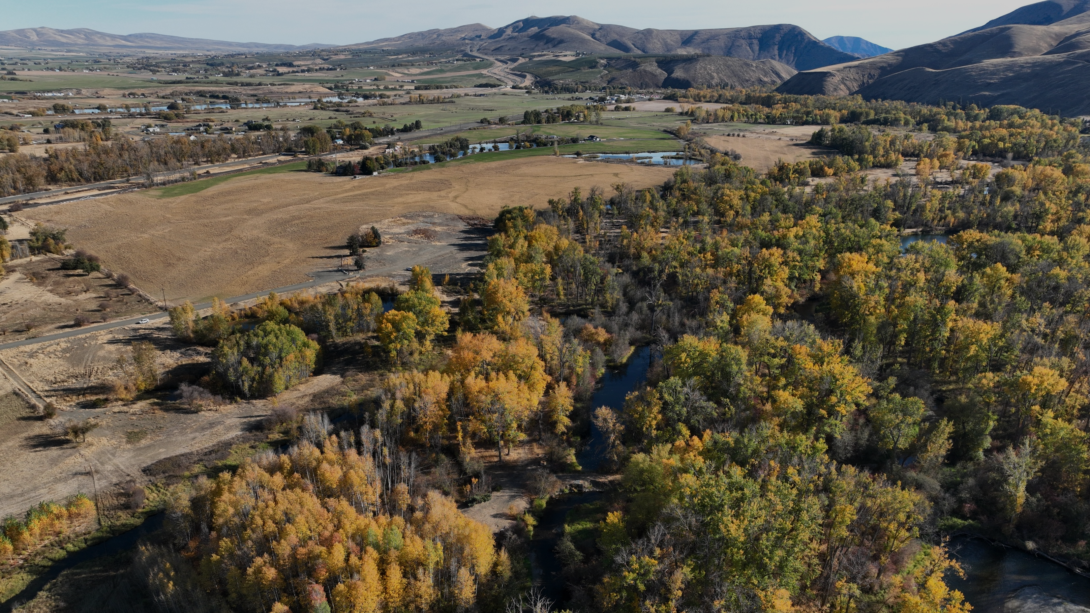
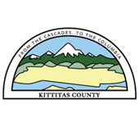
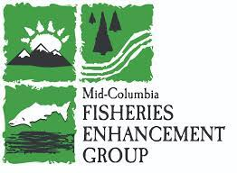
Lower Kittitas Yakima River Floodplain Reconnection
Yakima Basin Salmon Recovery Funding Board
April 14, 2026
Notes:
Arden and Kat both introduce themselves

Slide 2
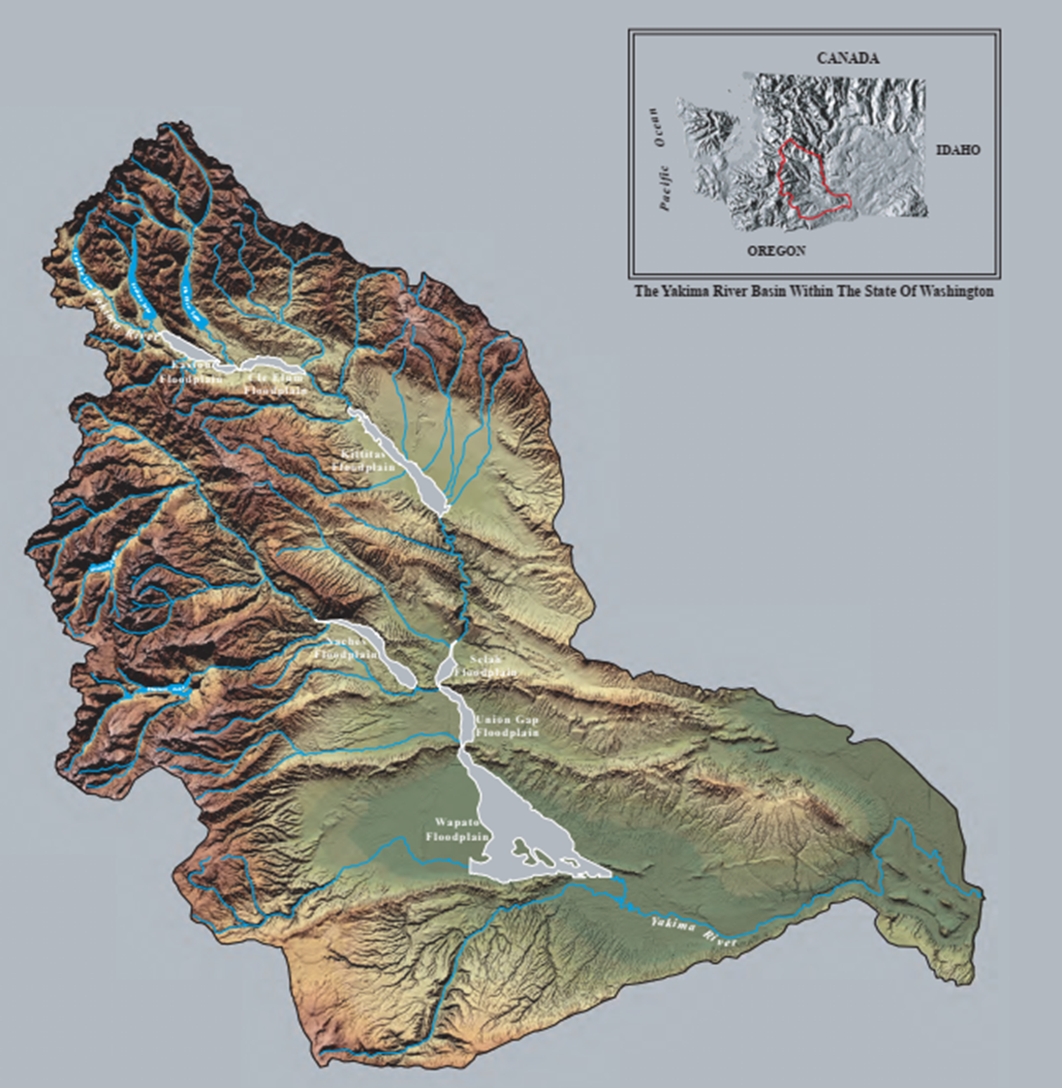
Basin Context
How this project(s) or actions fit into a watershed or basin scale vision for integrated floodplain management
2001 Reaches Project:
Identification of Priority Alluvial Floodplain Reaches
Pearls on a String
Notes:
ARDEN Looking at the Yakima Basin, there was foundational work funded by the Bureau of Reclamation, identifying how critical broad, alluvial, floodplain areas are to fisheries. Alluvial, are areas where rock and sediment are deposited. Ecologically, these are highly productive areas, the riparian vegetation and interaction between groundwater and surface water result in highly productive areas., especially rearing areas for juvenile fish. The focus of this research was on fisheries, given both tribal trust and Endangered Species Act responsibilities – but these areas are important and support and broader range of fish, bird, and other wildlife species.
Pearls on a string: Broad areas between narrow canyons, areas of sediment deposition and groundwater upwelling.

Slide 3
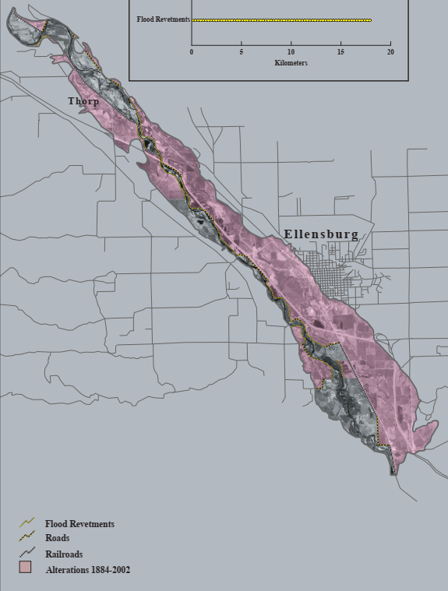

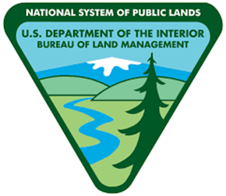
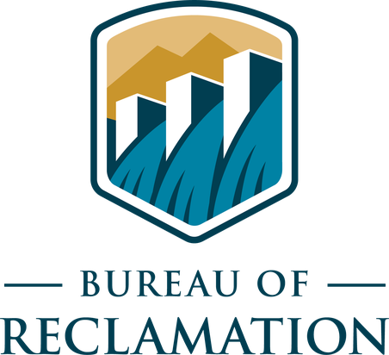
Comprehensive, Integrated Initiative in a Priority Reach
Project Scale
2.7 river miles, 595-acre project area
Ownership:
Reach Scale
6 miles, over 1,200 acres in public ownership
Schaake Project
Lower Kittitas Reach
Build on upstream Schaake Floodplain Restoration project
Project Area
Notes:
ARDEN

Slide 4
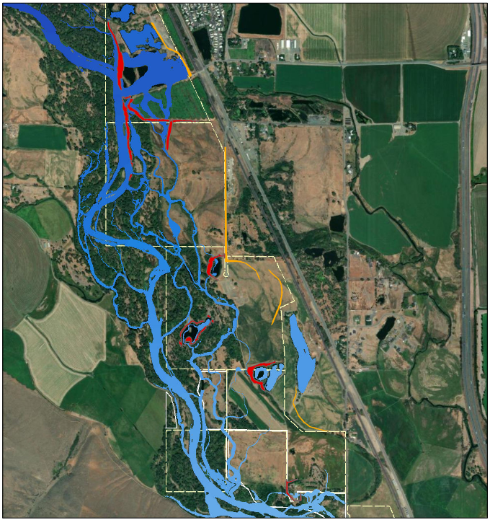
Project Site & Approach
Integrated Design
Earth movement
Engineered wood structures
Revegetation
Project Management and Contracting
Earth movement
Engineered wood structures
Revegetation
Notes:
Arden – add , we are asking to fill a funding need

Slide 5
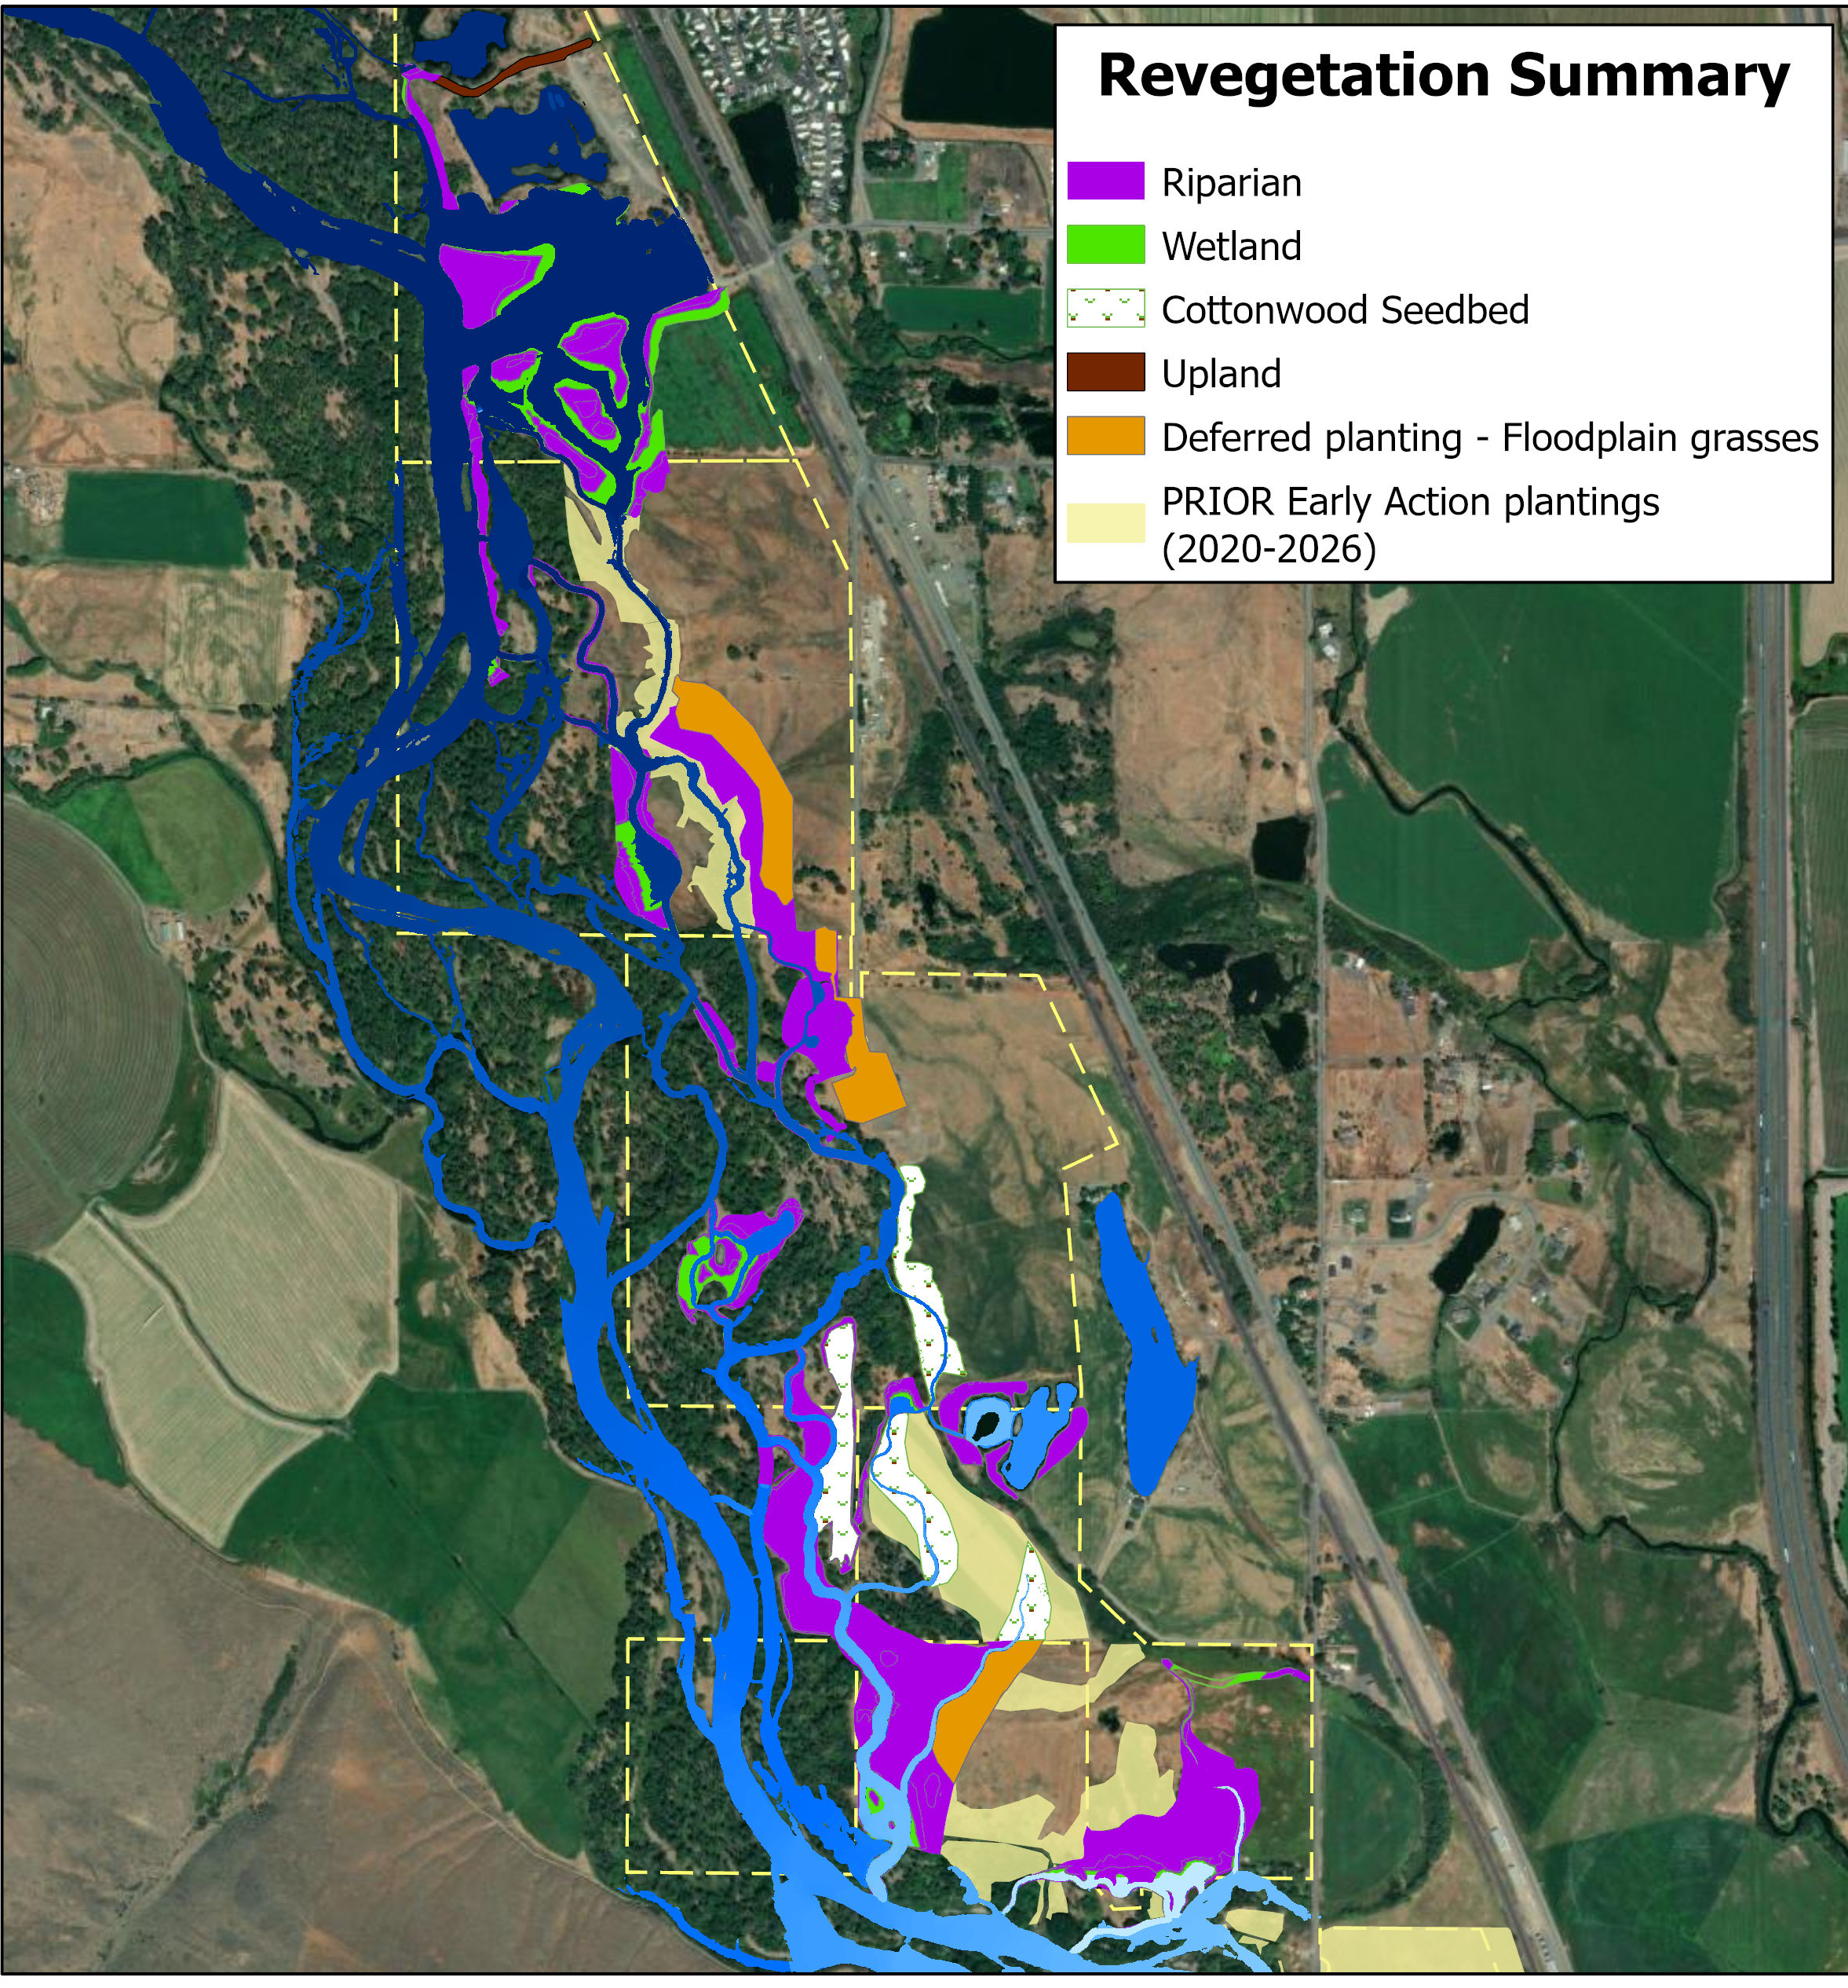
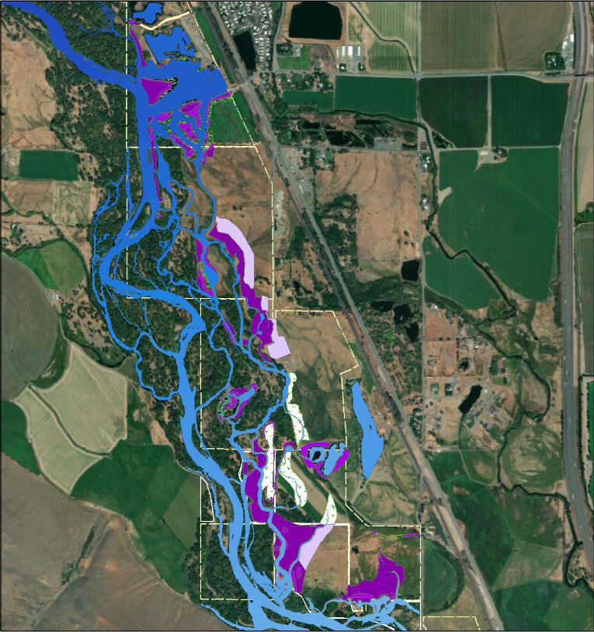
Project Site & Approach
Integrated Design
Earth movement
Engineered wood structures
Revegetation
Project Management and Contracting
Earth movement
Engineered wood structures
Revegetation
Notes:
KAT
Revegetation approach
Phased
42 early action plantings installed since 2020
105 additional riparian acres during construction
Of those, approx. 14 acres deferred planting (seed floodplain grasses)
Proven techniques as well as innovation
Higher survival = greater stem density and canopy more rapidly
Proven techniques based on experience in Yakima Basin
Ie, Deep-planting and conventional planting
Innovation
Cottonwood seedbed
Short-term 3-yr stewardship to establishment
Temporary Weed mgmt., herbivory-deterrent fencing and irrigation
Until plants are above browse & competition height, and roots can access groundwater >3 ft depth

Slide 6
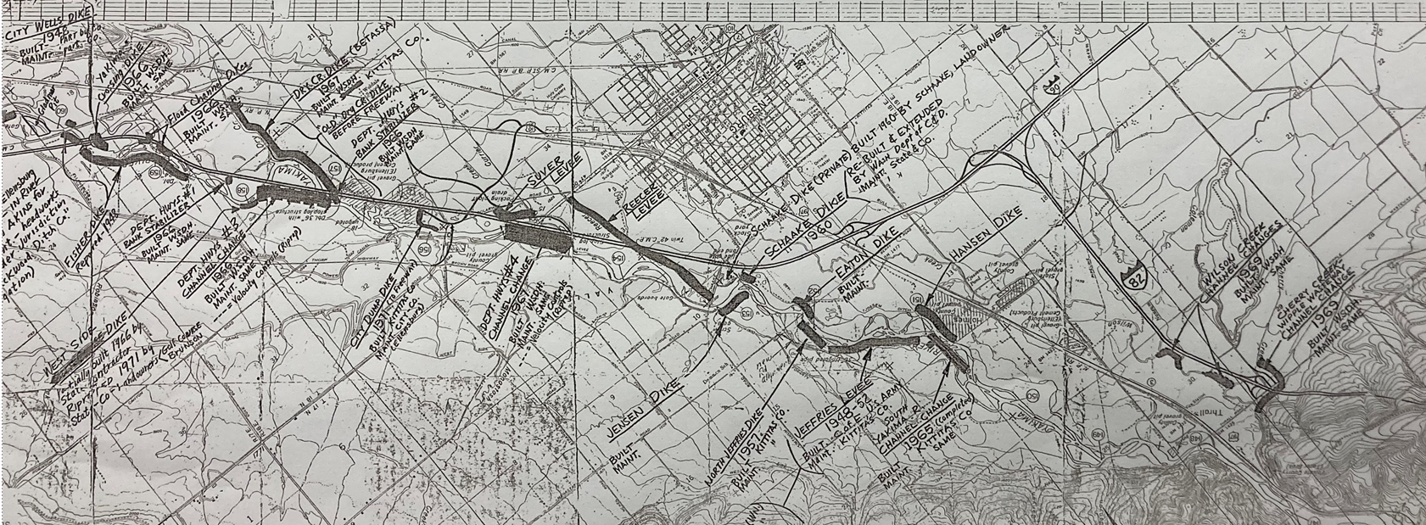
The Problem
Legacy of Floodplain Disconnection and Channel Modifications
Notes:
ARDEN: In the 40-90s, flood control was largely associated with levee construction and maintenance. Orient everybody: point out Ellensburg, South of Ellensburg, between Ellensburg and the Yakima Canyon

Slide 7
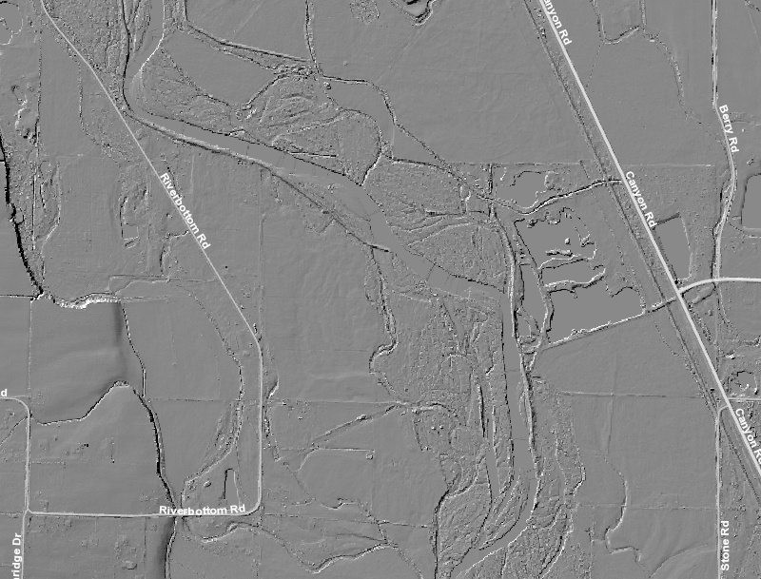
Notes:
ARDEN: Point out levee, channel straightening, breach. The worst of both worlds

Slide 8
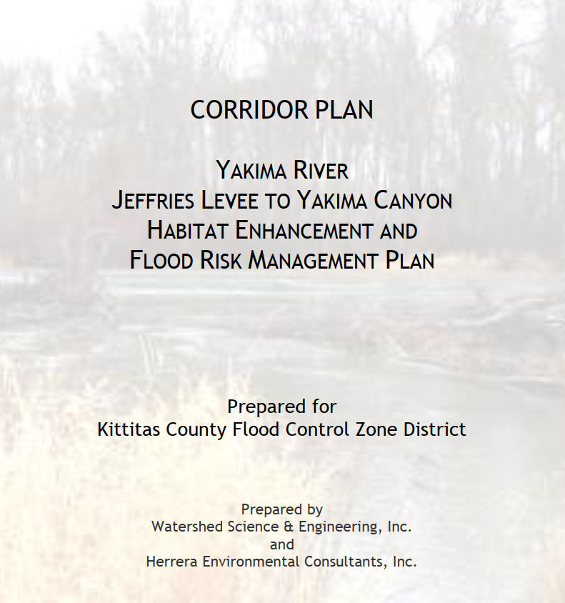
Habitat Limiting Factors
Access to Floodplain, Side Channel and Pond Habitat:
Multiple levees and small-scale channel filling/diversions within the study reach.
Many cutoff areas have potential to be highly productive due to groundwater upwelling.
Prioritize reconnecting and restoring cutoff side channels and ponds.
SRFB Funded: #12-1358
Notes:
ARDEN: This earlier, SRFB-funded effort resulted in the Yakima River Jeffries Levee to Yakima Canyon Corridor plan, which idented that conserving, protecting, and restoring floodplain and off-channel habitat, and increasing side channel connectivity by addressing, levees and historic channel filling were priorities for salmonid habitat.

Slide 9
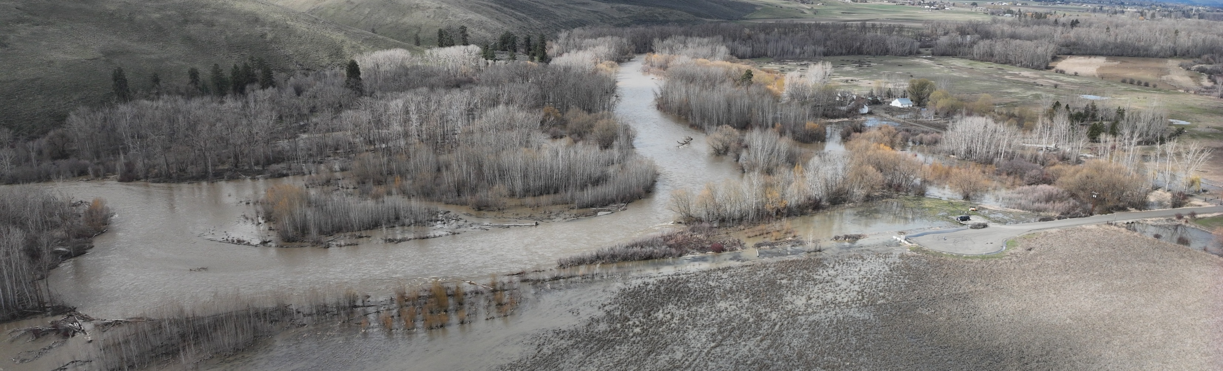
Limiting Factors: Focus on Riparian Forest
Historic riparian forest clearing and current management
Floodplain disconnection
Managed flows inhibit new stand creation
Spring freshet flow ≤ average summer irrigation flow inundates germinating trees.
Large habitat-forming flows are moderated by water storage.
Notes:
KAT
Historic riparian clearing and current management for agriculture
Floodplain disconnection
Managed flows inhibit new stand creation
Spring freshet flow (timed with cottonwood seed release in May-June) is often the same stage or lower than the average summer irrigation flow, inundating germinating trees.
Large habitat-forming flows that create regeneration sites are moderated by water storage and not as extensive as in historic conditions.

Slide 10
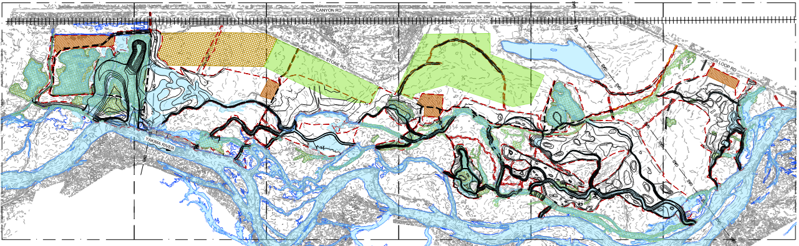
Restoration Approach
Levee removal: floodplain connection at the Q 1.5 and side channel reconnection
Address historic gravel pits:
Highest priority – Hansen Pits
Targeted investments: also address “Camel Pond” and Guinea Pit Pond
Floodplain Recontouring
Gravel Pit restoration
Target elevations suitable for riparian restoration
Additional Side-Channel Habitat
Large Wood
Direct flow, create scour pools, promote bedload deposition, increase channel complexity
Notes:
ARDEN The creation of multi-threaded conditions is also supported by the geomorphology analysis, which suggests that the system is capable of supporting multiple side-channel features without detrimental impacts to overall channel competence or sediment transport dynamics.
In the southern portion of the site,
they are anticipated to interact with groundwater-fed zones identified through site observations and
groundwater monitoring station data. Flow sourced from surface and ground water contributions
will create resilient, cool-water habitats that can serve as thermal refugia for salmonids during
summer months. Enhanced side-channel networks will also promote cottonwood recruitment.
Numerous culverts identified in the design drawings will be removed to restore natural hydrologic
connectivity across the site, reducing flow constrictions and improving aquatic organism passage.

Slide 11
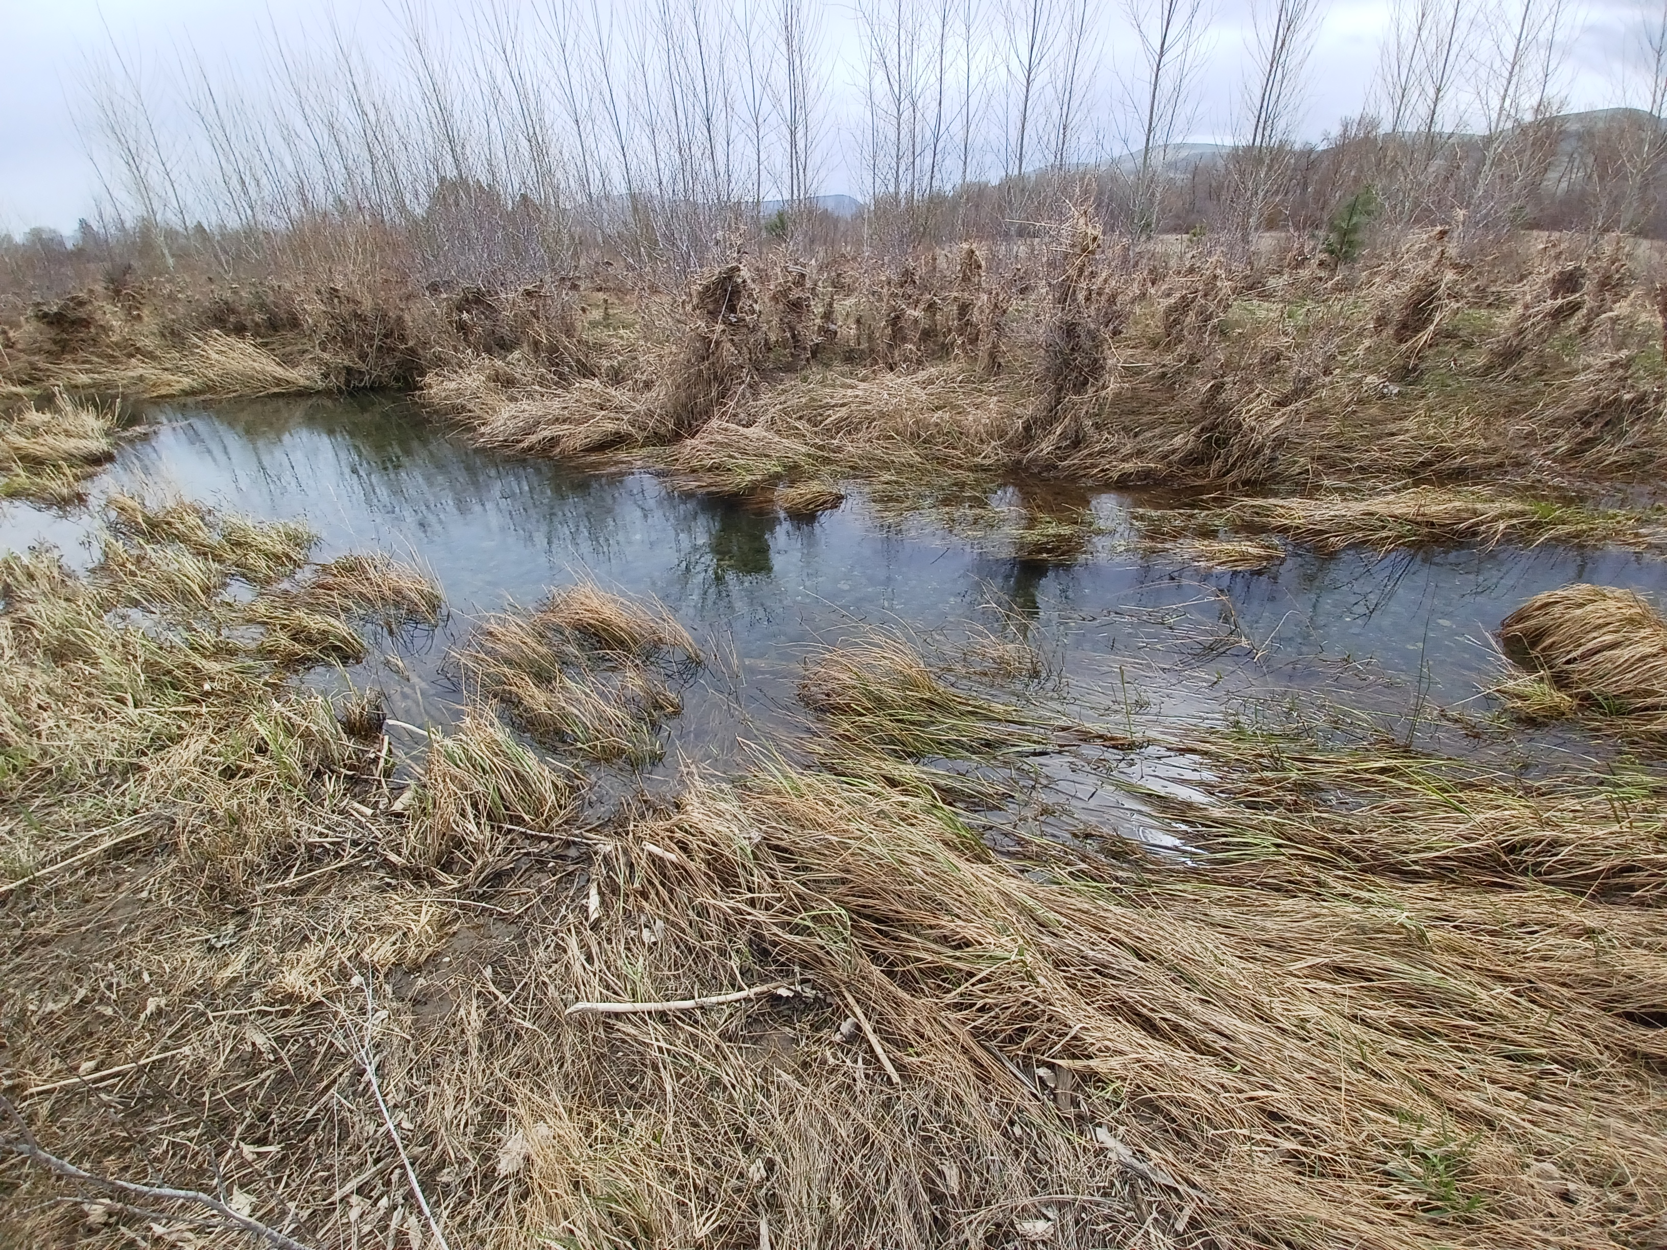
Restoration Approach
Roughness and shade
Wide riparian buffer
Target key elevations
Allow plants to access groundwater
Increase likelihood of regeneration in years with adequately high and well-timed spring freshet
Diverse planting methods: Based on soil moisture, inundation, likelihood of success and cost.
Phasing: 147 total riparian acres 2020-2029
Short-term stewardship: Protect investment of implementation
Notes:
KAT.
Riparian is integrally related to overall floodplain connection design
Riparian forest hydrologic requirements related to groundwater depth and inundation duration are informing design.
Riparian restoration will
Provide long-term source of roughness and shade reconnected and new side channels
Create wide riparian buffer
Average 1400 ft width from Yakima River
Targeting key elevations
Allow plants to access groundwater
Increase likelihood of regeneration in years with adequately high and well-timed spring freshet
Diverse planting methods based on
soil moisture,
inundation frequency and duration,
likelihood of success and
cost.
Phasing 147 total riparian acres
2020-2026 – 42 acres planted
2028-2029 -- 105 riparian acres to initiate riparian revegetation
Short-term 3-yr stewardship to establishment
Temporary Weed mgmt., herbivory-deterrent fencing and irrigation
Until plants are above browse & competition height, and roots can access groundwater >3 ft depth

Slide 12
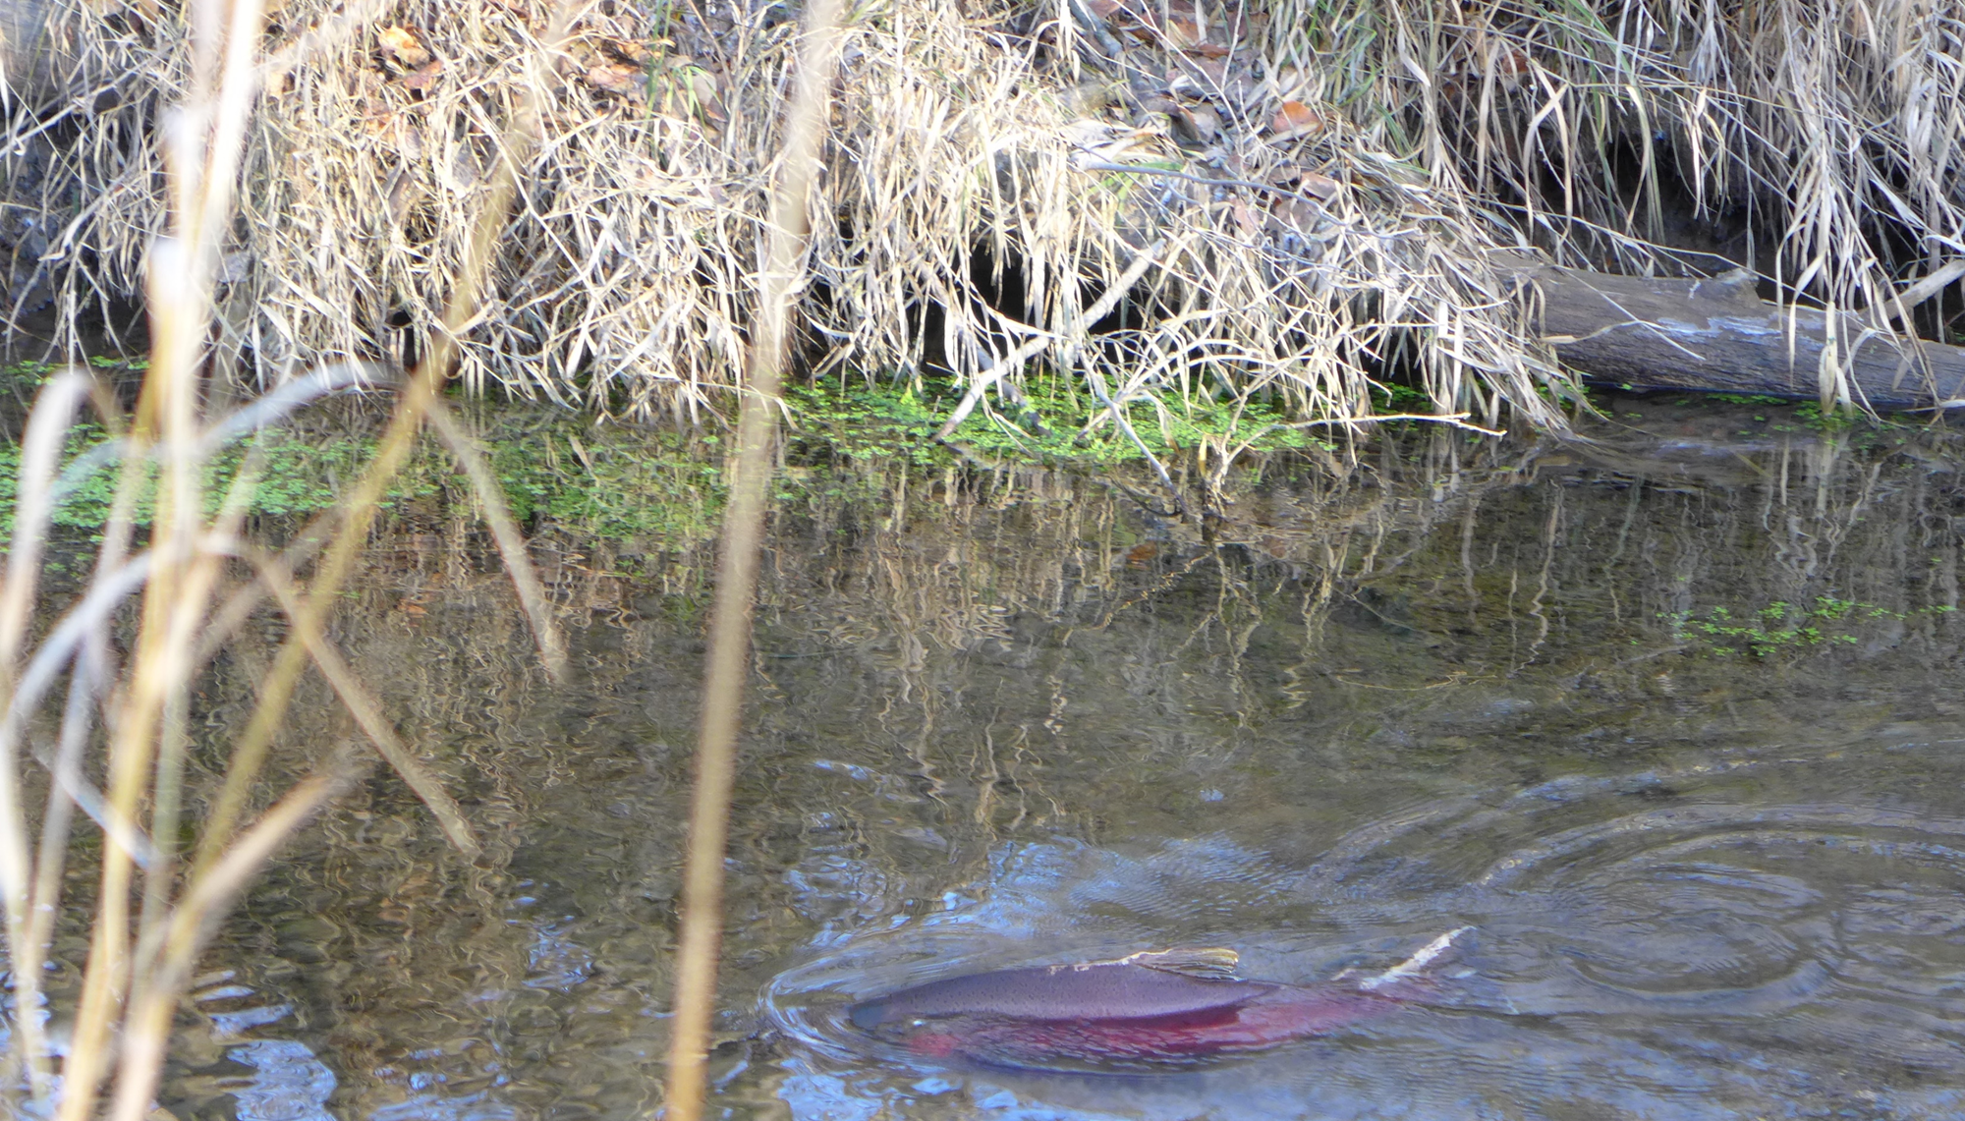
Species | Life Stages Benefited | Key Habitat Benefits
ESA-listed Middle Columbia River Steelhead | Primary: Juvenile summer and winter rearing Also: spawning (flexible use of side-channels), smolt outmigration | Increased survival and productivity from flow and temperature refugia, increased cover, increased food and growth
Spring Chinook | Primary: Fry, juvenile summer and winter rearing Also: spawning (supplemental use of side-channels), smolt outmigration | Increased survival and productivity from shallow, low velocity margins, stable, thermally buffered habitat, increased food and growth
Coho | Juvenile summer and winter rearing, spawning, egg fry survival | Low-gradient side channels, high oxygen, stable incubation,
Sockeye | Migratory adults and smolts | Velocity refugia and holding areas
ESA-listed Bull Trout | FMO habitat: migratory adults | Foraging and thermal refuge
Notes:
ARDEN: In addition to floodplain disconnection, several process-based limiting factors affect salmonid productivity in the project reach. Legacy gravel mining pits contribute to elevated water temperatures, increased predation risk from warm-water species, and fish stranding, while also functioning as sediment sinks that reduce downstream gravel recruitment and channel complexity. Altered flow regimes associated with reservoir operations and irrigation deliveries create non-normative high summer flows and reduced overbank flooding, limiting access to off-channel rearing habitat and increasing risks to juvenile life stages. The loss of large wood recruitment and degraded riparian conditions further reduce habitat complexity, cover, and thermal regulation. These factors collectively constrain key life stages, particularly juvenile rearing and overwintering, as well as spawning and incubation for species including steelhead, spring Chinook, and coho, while limiting access to cold-water refugia critical for bull trout and migratory sockeye.

Slide 13
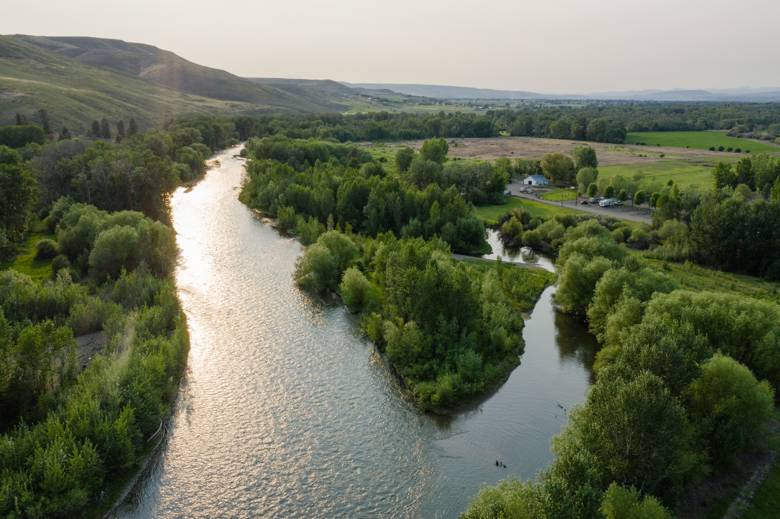
Priority Restoration Actions in a Priority Reach
Steelhead Recovery Plan:
Upper Yakima Action #12
Reduce confinement of Upper Yakima River
Upper Yakima Action #13
Protect and restore floodplain, riparian, and in-channel habitats in the Kittitas Reach
Basin-wide Action #12
Improve cottonwood recruitment
SRFB Focused Project No. 21
Upper Yakima Floodplain & Side Channel Restoration Dike setbacks and other projects that increase connectivity between the channel and its floodplain or between the channel and existing off-channel habitat.
Yakima Basin Integrated Plan Habitat Priority
Notes:
KAT The Ringer Restoration Area is the lower section of the Kittitas Reach, located just upstream of the Yakima Canyon. Our proposal implements several priority actions, including:
Upper Yakima Action #12: Reduce confinement of Upper Yakima River
Upper Yakima Action #13: Protect and restore floodplain, riparian, and in-channel habitats in the Kittitas Reach
Basinwide Action #12: Improve recruitment of cottonwoods
SRFB Focused project No. 21: Upper Yakima Floodplain & Side Channel Restoration Dike setbacks and other projects that increase connectivity between the channel and its floodplain or between the channel and existing off-channel habitat. Does not include digging artificial channels or the installation of large woody debris that does not significantly reconnect specific side channels as demonstrated in the proposal

Slide 14
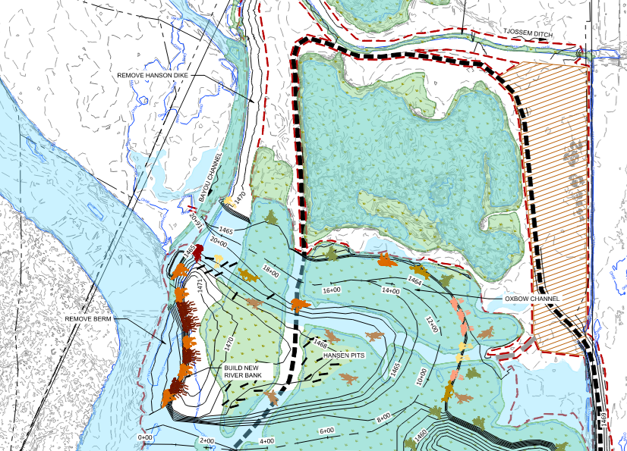
Challenges
Flip-flop (summer irrigation flow approaches Q 1.25)
Current approach results in large areas of shallow water through summer
Revegetation cost escalator
Site is too wet to support additional land use goals*
PSE Natural Gas Pipeline Concerns
Actively considering Hansen Pits Redesign
*on property acquired with Floodplains by Design Funding
Notes:
ARDEN
A significant design revision moving from conceptual to 30 percent was to advance a disconnected oxbow feature in the lower 3 cells of Hansen Pits, with the goal if mimicking historical fluvial processes. During the 60 percent design stage, the challenges with this approach are apparent.

Slide 15
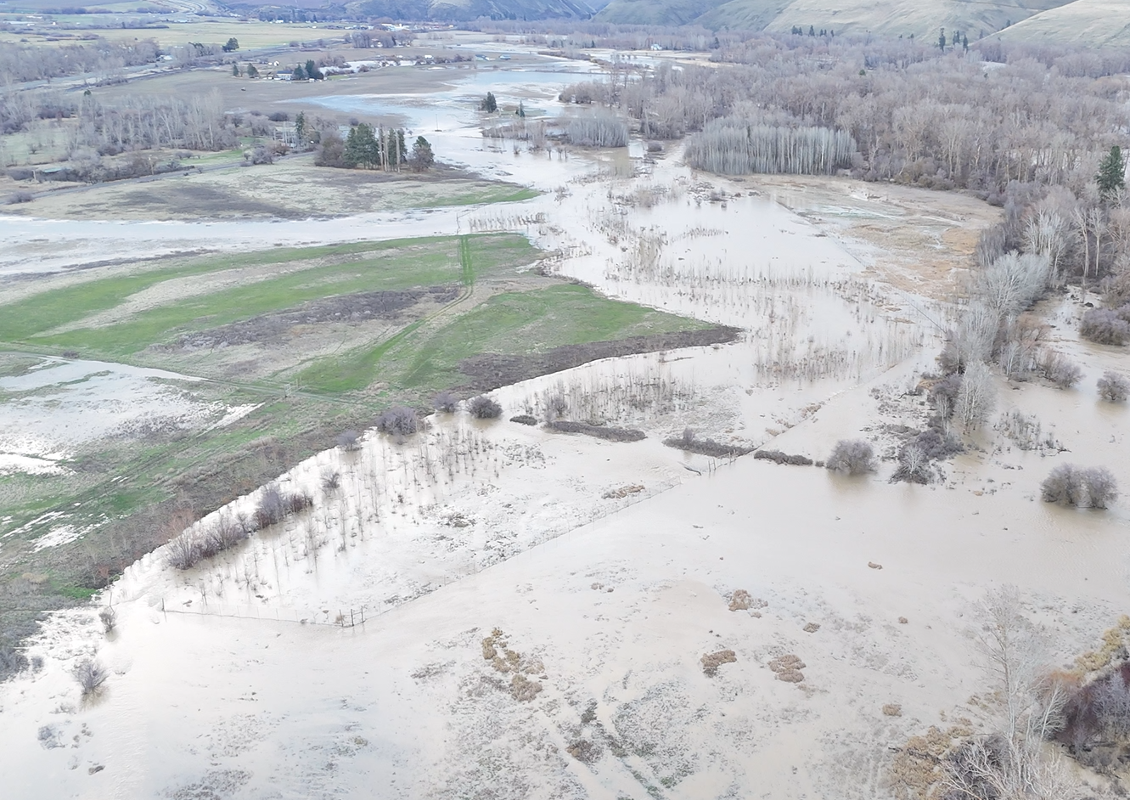
Culmination
Development of strategic plan
Early Action Investment
Acquisition of 425 acres
Conceptual Design
Preliminary Design
Final Design
#12-1358 P
#20-1391 R
#25-1183 R
#22-1961 C

Slide 16
Funding Picture
 | 2028 | 2029 | 2030 | 2031
Earthwork and Wood Structures | 14,804,000
SRFB Targeted Investment Request | (1,903,000)
Floodplains by Design | (9,900,000)
Yakima Basin Integrated Plan | (3,000,000)
Riparian Restoration | 2,955,743 | 896,690 | 728,658 | 514,908
SRFB Targeted Investment Request | (2,955,743) | (896,690) | (728,658) | (514,908)
Total SRFB Request: $7 M
Total Project Cost: $19.9 M
Notes:
KAT

Slide 17
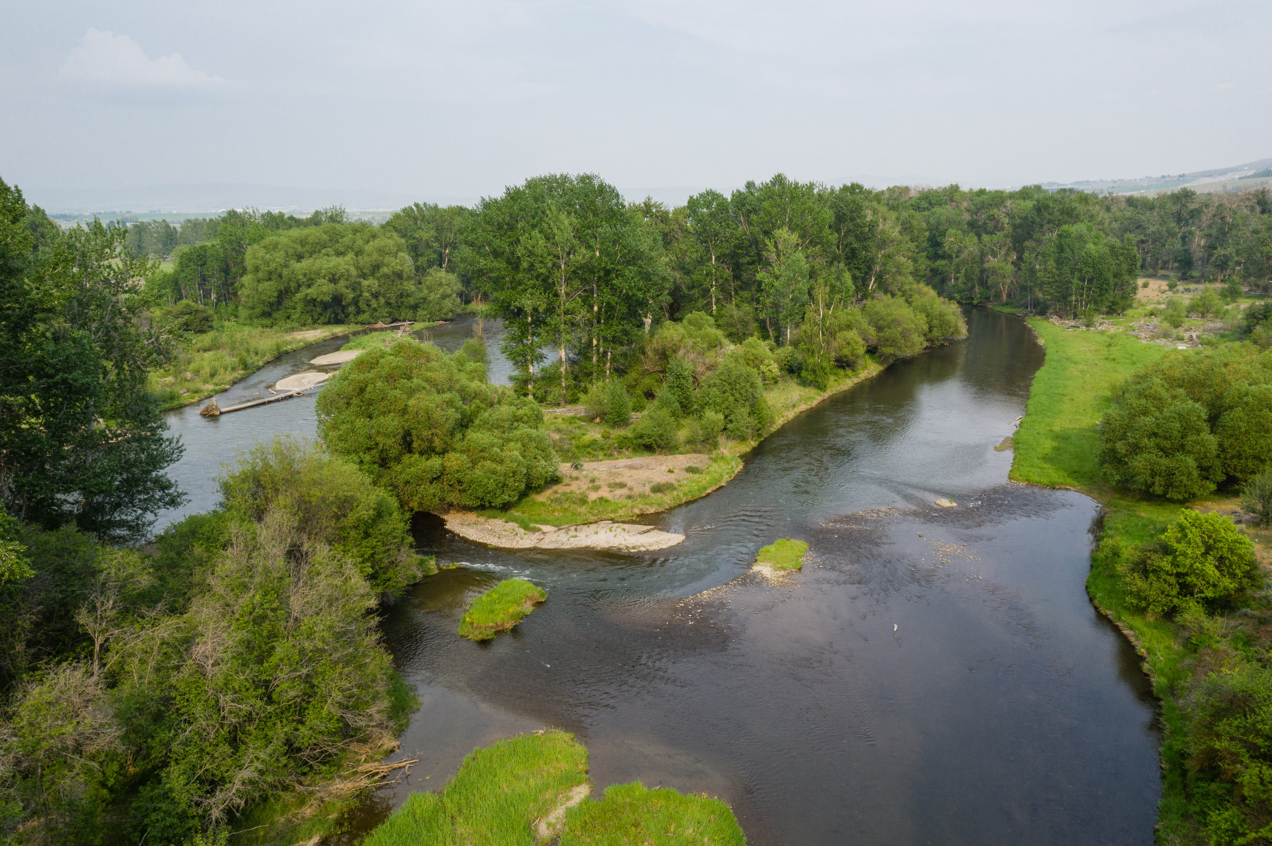
Targeted Investment Impact
Implement the entire project rather than advancing a project scaled to available funding
Increases feasibility of riparian restoration due to access and soil moisture
Increases functional value of floodplain restoration
Floodplain connection at this scale, and in this system with barriers to natural regeneration, requires revegetation
Improves cost-effectiveness
Decreases phased access, weed management, and challenging saturated soils implementation costs
Increases certainty the entire project will be implemented
Notes:
KAT

Slide 18
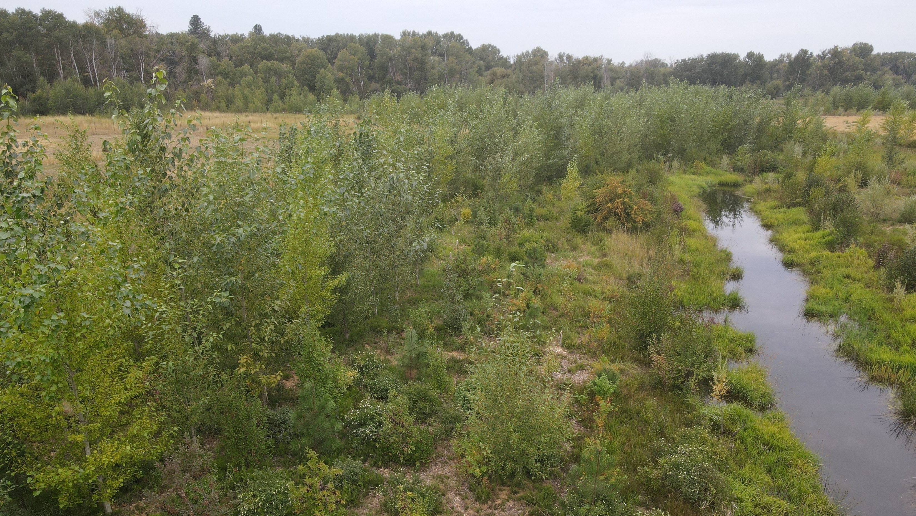
Questions

