Slide 1
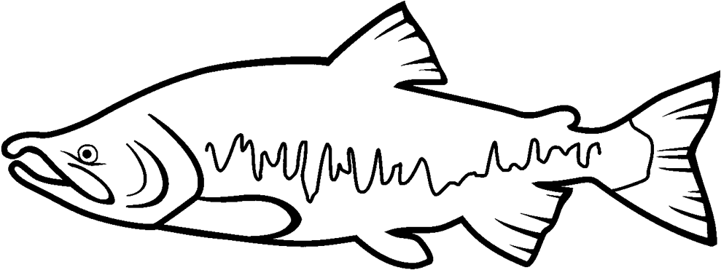
Lower Naches River Floodplain Application Project
Yakima County Public Services
Kory Graafstra and Troy Havens
In partnership with the Yakima Greenway Foundation
Notes:
Mention Troy is present to help answer questions at the end

Slide 2
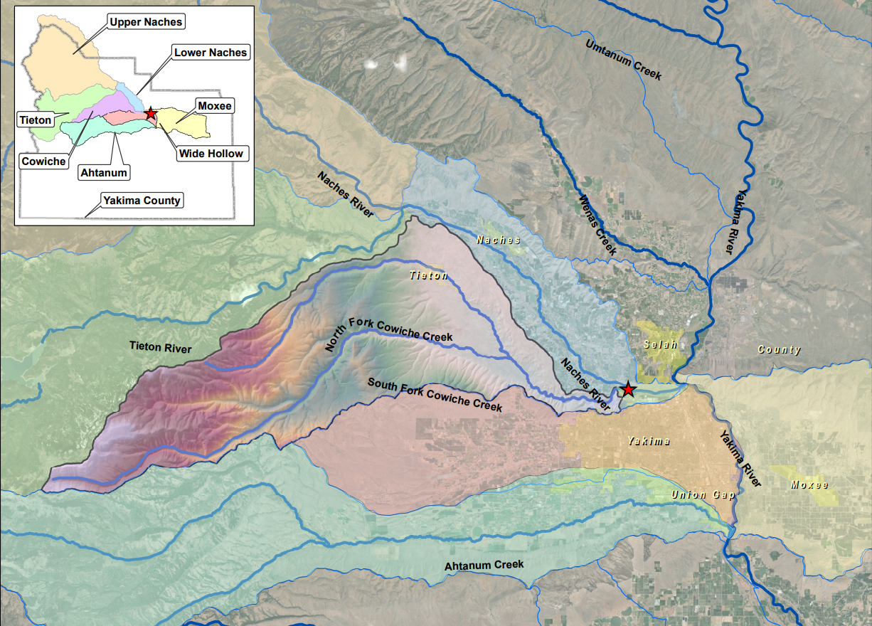
Notes:
Map showing regional geography and watersheds.

Slide 3
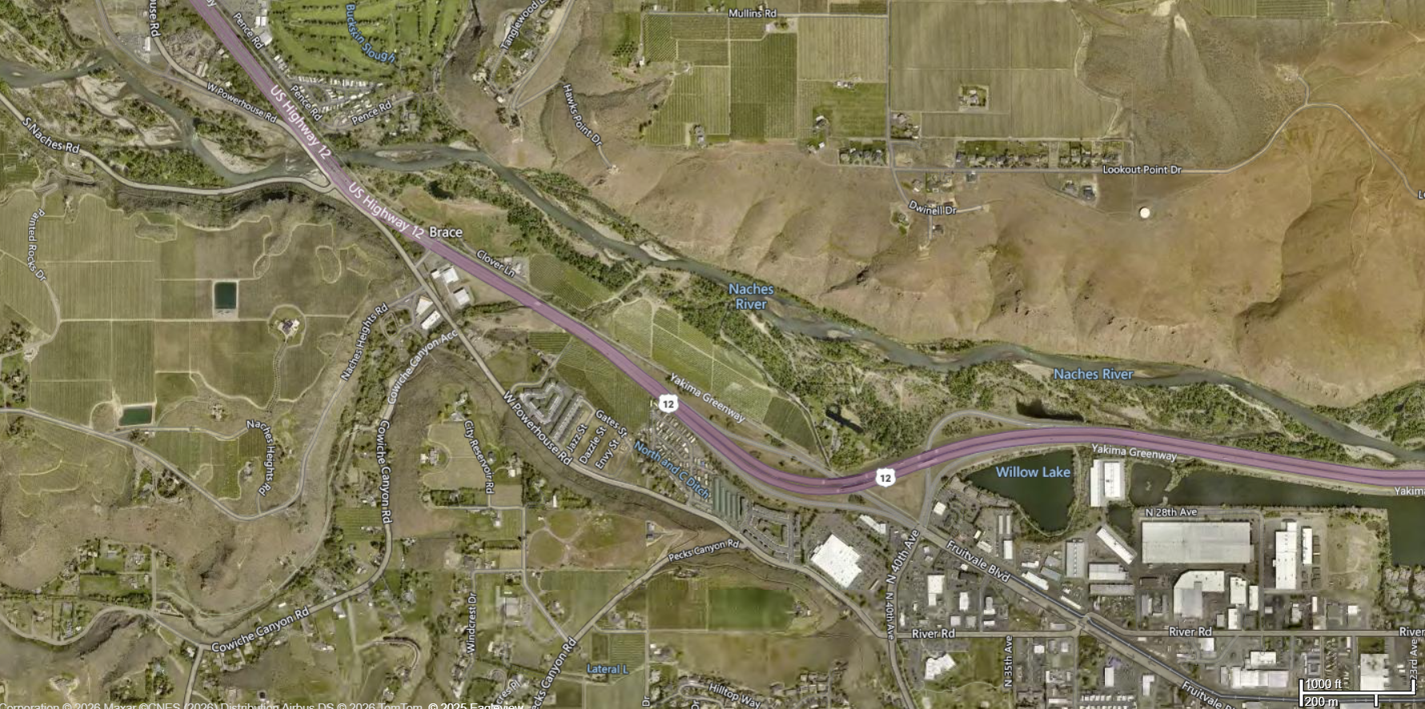
Project Site
Naches River and Cowiche Creek Confluence
Notes:
Naches River and Cowiche Confluence. Northwest edge of Yakima, Fruitvale interchange off HWY12.

Slide 4
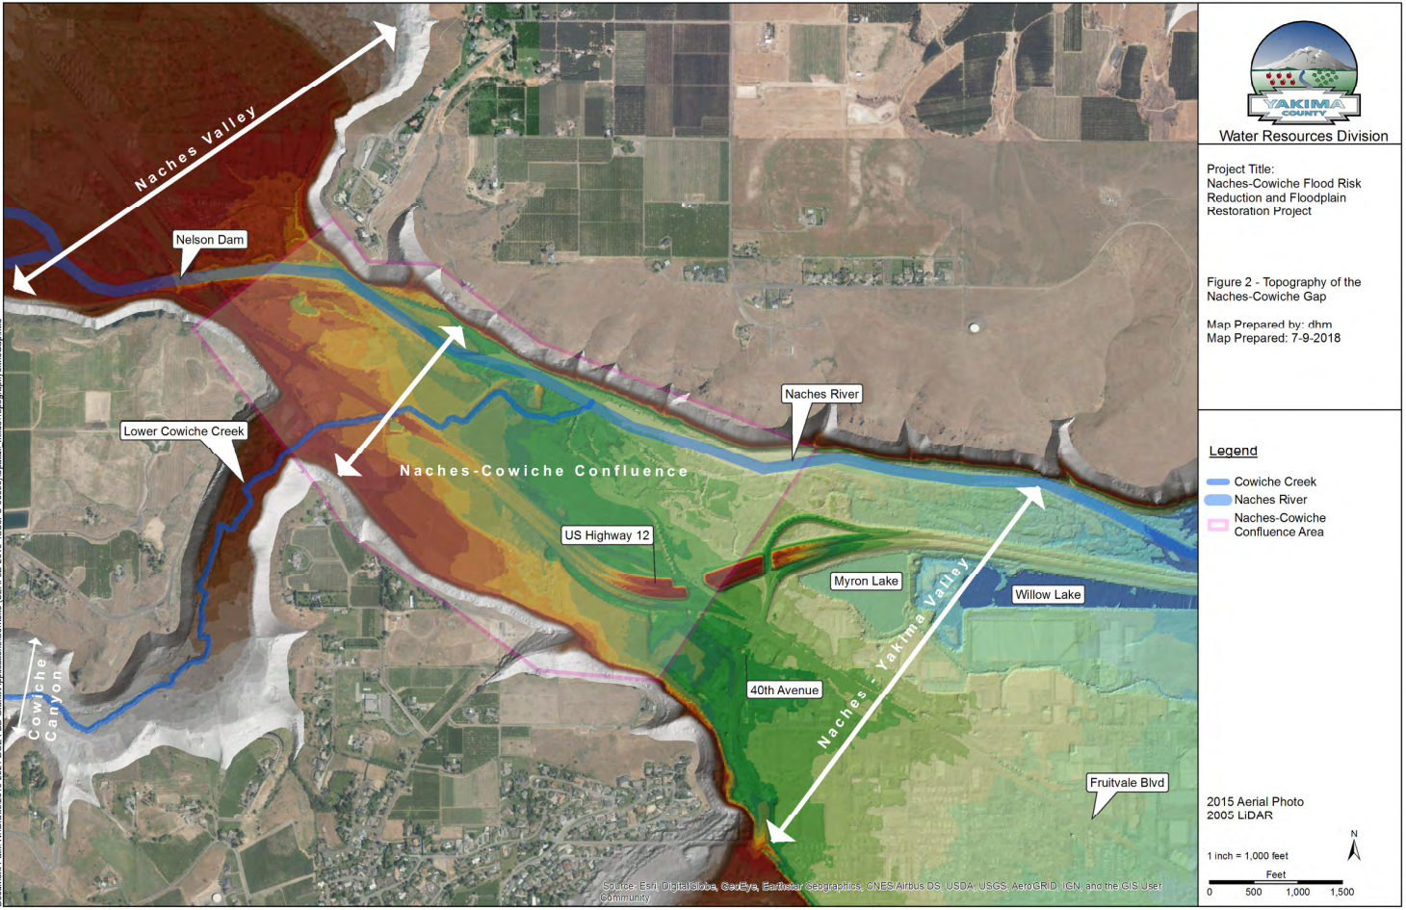
Notes:
Hydrogeography – narrow gap between Naches and Yakima Valley. Complex situation with irrigation, hwy12, Cowiche creek. Lots of interrelated pieces of uncoordinated infrastructure and agriculture over the past 120 years. Project goal is to unwind some of these actions and consolidate infrastructure.

Slide 5
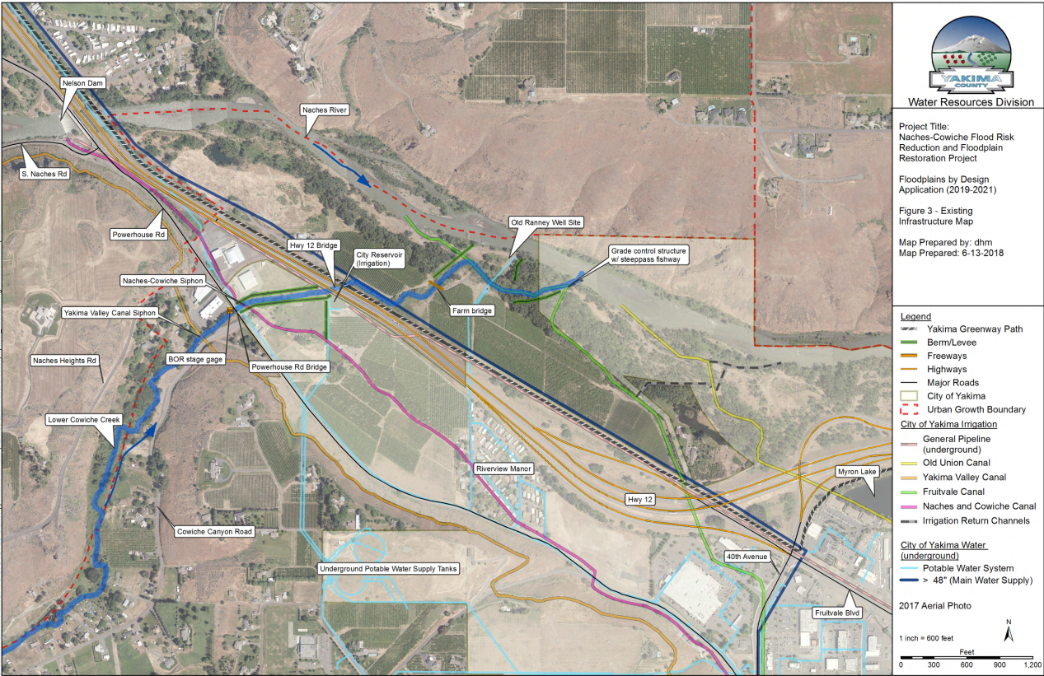
Notes:
Area overview, highlight infrastructure, city limits, urban growth area boundary,

Slide 6
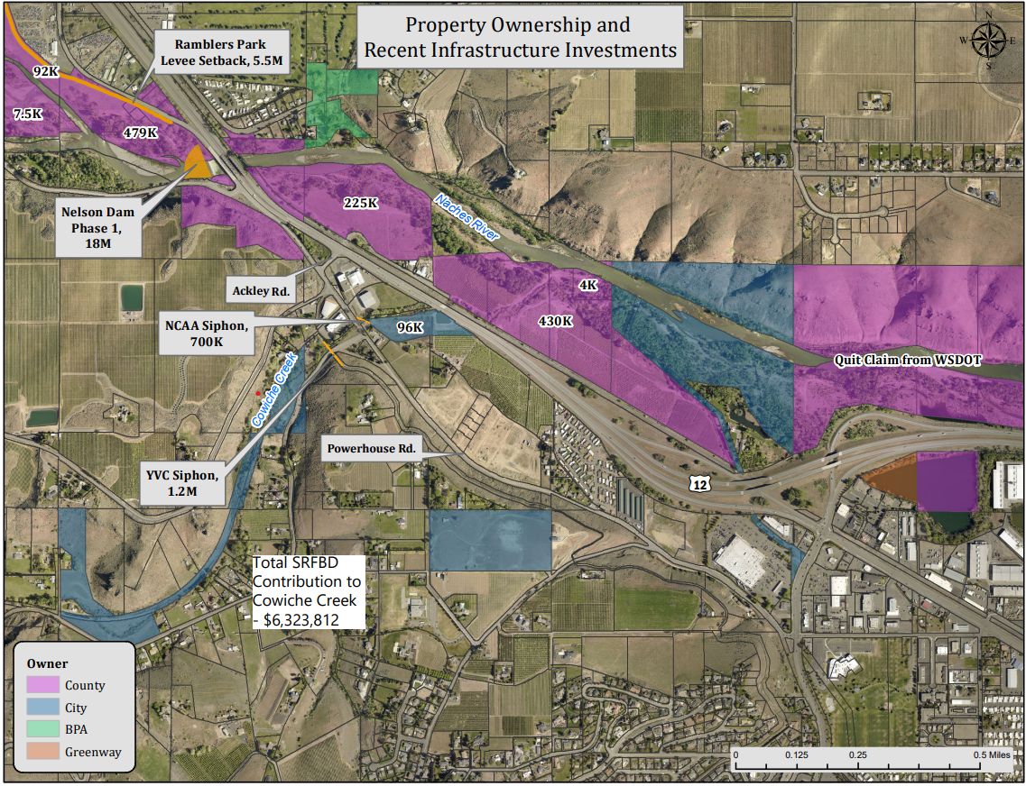
Notes:
Property ownership map – highlight investments into area.

Slide 7
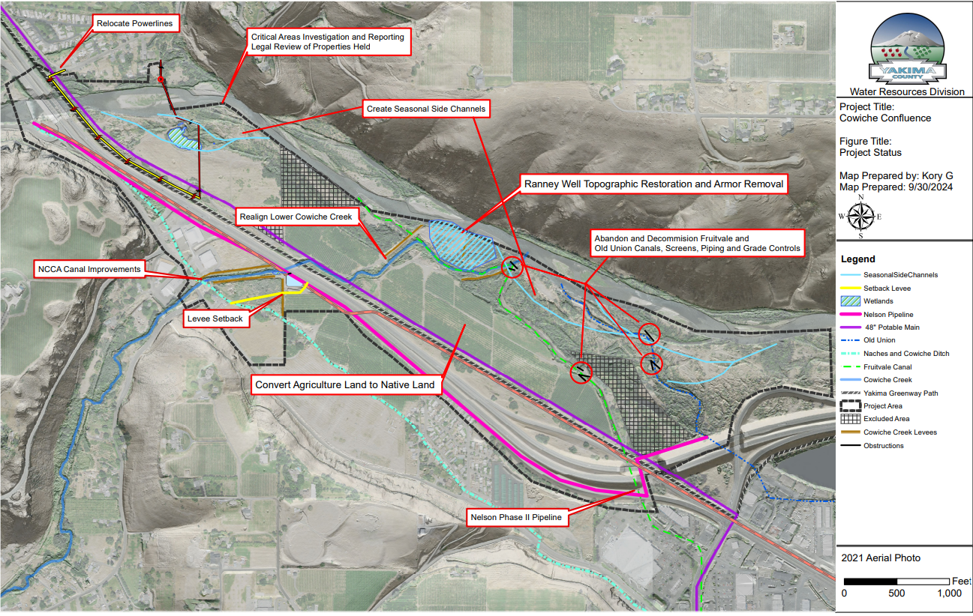
Notes:
Cowiche confluence complex project – USBR and YBIP funded design and USBR funded construction. Currently in alternatives design phase.

Slide 8
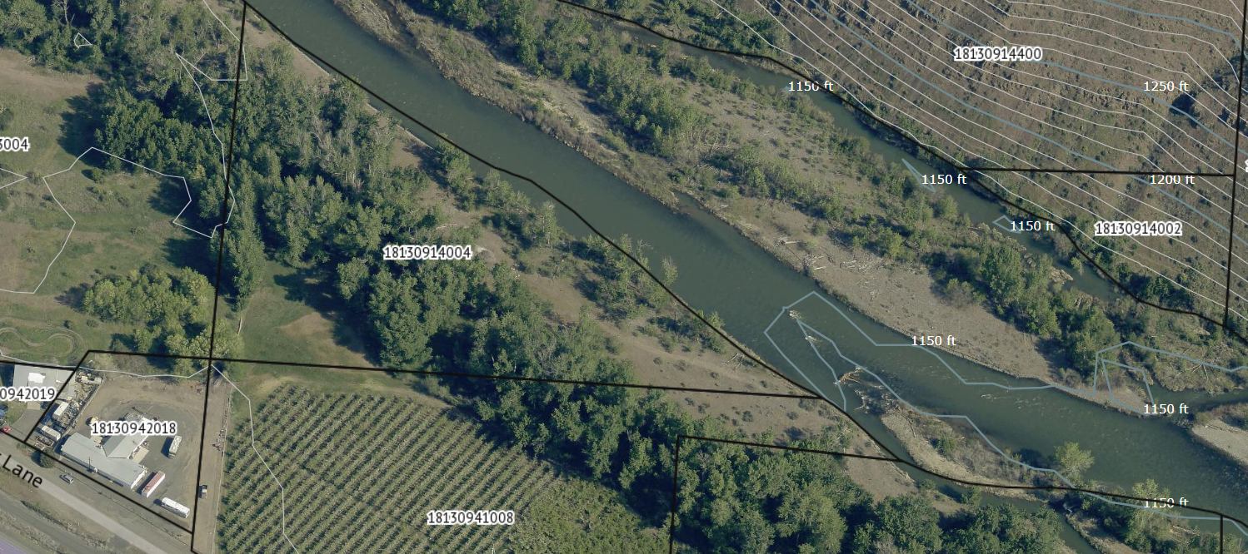
Notes:
Outlined area in red and yellow is all one property. Project application is to acquire parcels outlined in Red if seller is willing. They may want to sell the entire property which would include the yellow parcel. We would work with the Greenway to secure that property separately.

Slide 9
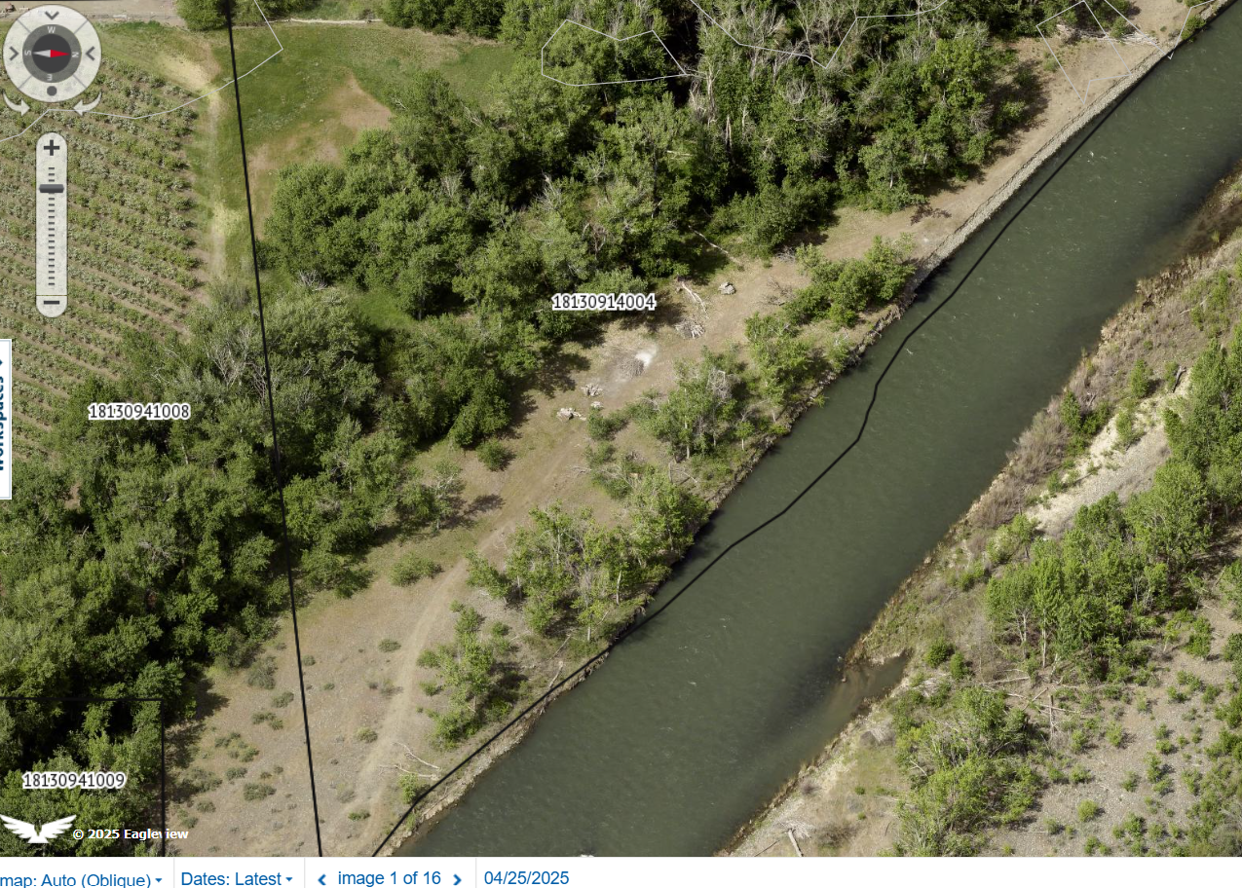
Notes:
Right bank of Naches River – relatively high bank along property edge. Good strip of riparian vegetation. Partially in floodway and floodplain but small area is developable based on current code. Goal is to keep development out of the floodplain and incorporate this area into the current designs. Likely topographic lowering of floodplain for better connection to Naches river. Potential channel opportunities coming from upstream.

Slide 10
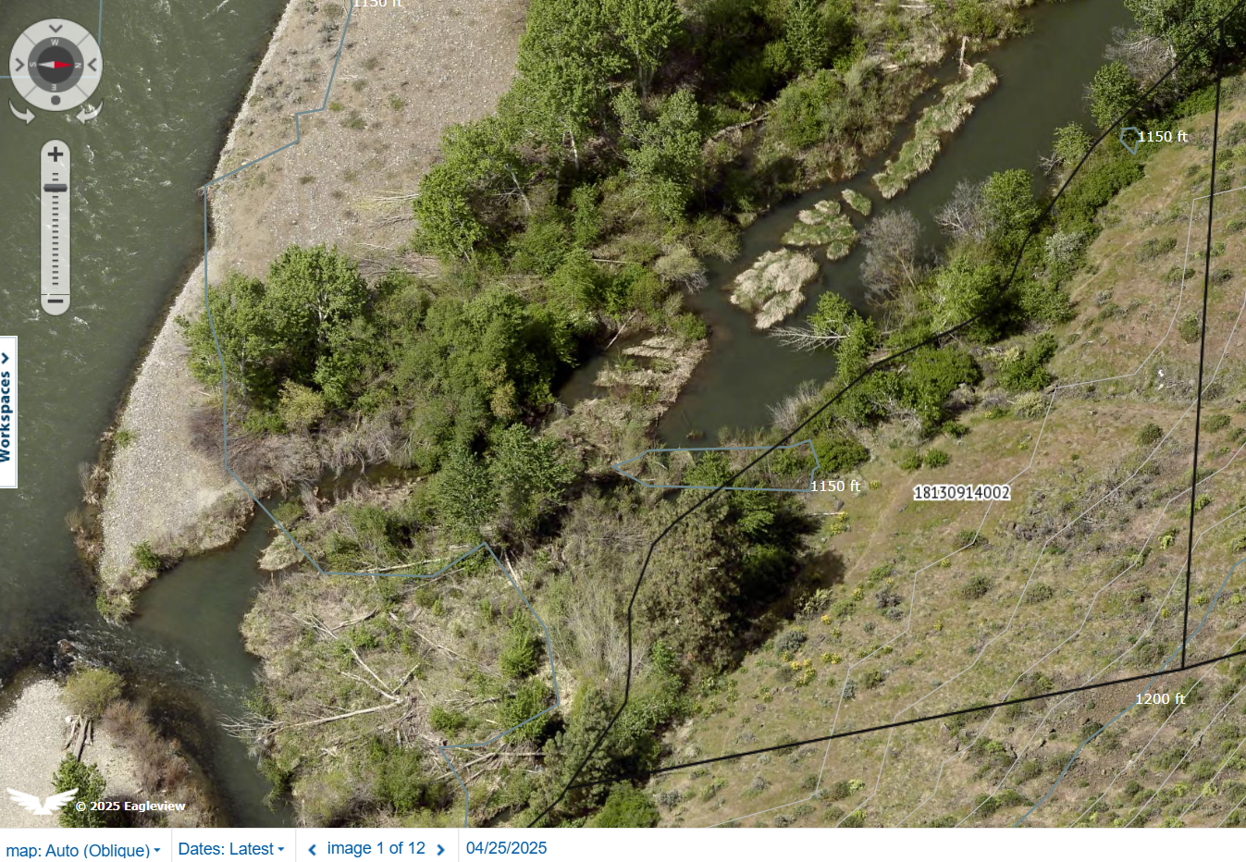
Notes:
Left bank of Naches River. Site is small strip of riparian vegetation and the rest is steep hillslope. Not much of the property is in floodway floodplain but could potentially be developed based on code.

Slide 11
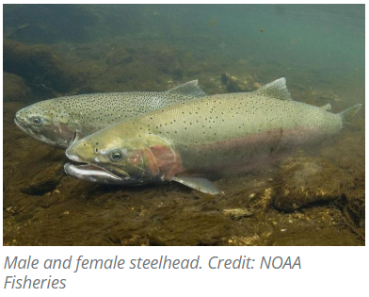
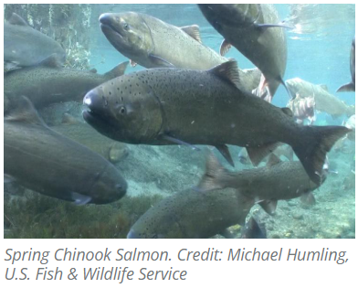
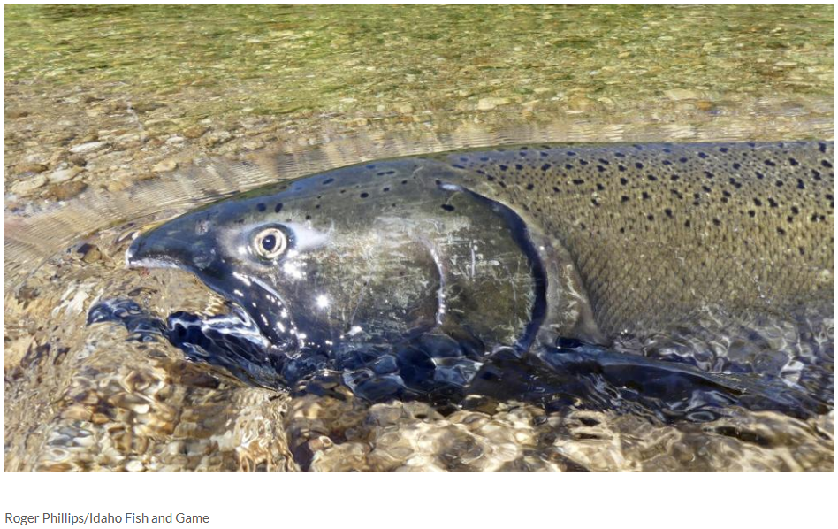
Spring Chinook – Documented Presence in Naches River and Documented Rearing in Cowiche Creek
Summer Steelhead - Documented Spawning in Naches River
Fall Chinook – Documented Spawning in Naches River
Notes:
Importance of the stream for fish (including species and life stages, as well as how the stream is currently used by fish)
· Limiting factors and/or ecological concerns for fish (species and life stages) and how your project will help to address them
All ESA listed species – biggest limiting factors are fish passage into Cowiche Creek and irrigation diversions causing false attraction flows and confusion. Reach has been historically starved of sediment due to Nelson Dam. Poor habitat as reach has been constrained by lack of access into floodplain, lack of off channel habitat and agricultural land fill.

Slide 12
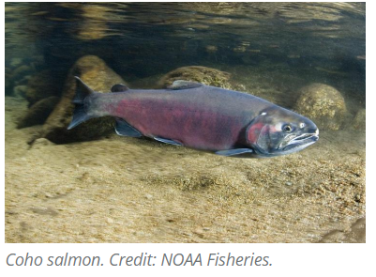
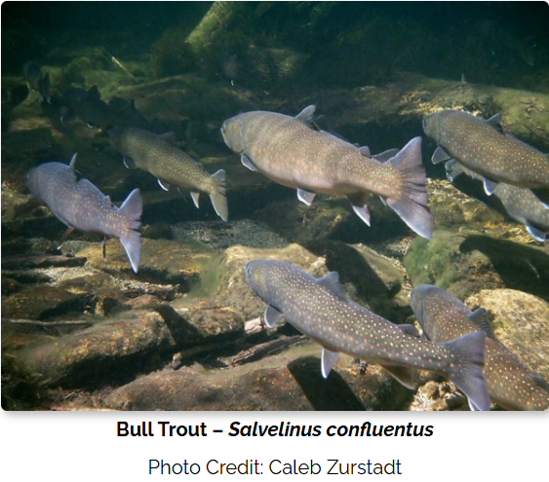
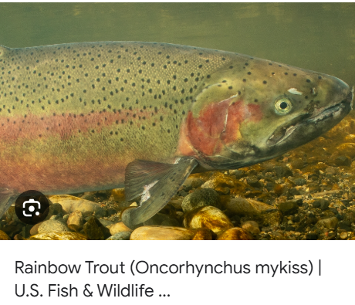
Coho– Documented Presence in Naches River and Documented Spawning in Cowiche Creek
Native Char\Dolly Varden\Bull Trout – Documented Presence in Naches River, Presumed Presence in Cowiche Creek
Rainbow and Mountain Whitefish - Documented Presence in Naches River
Notes:
Importance of the stream for fish (including species and life stages, as well as how the stream is currently used by fish)
· Limiting factors and/or ecological concerns for fish (species and life stages) and how your project will help to address them
Coho and bulltrout also ESA listed

Slide 13
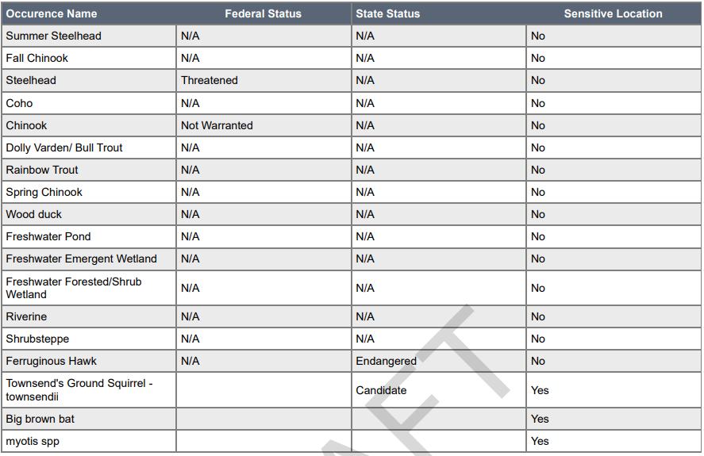
Priority Habitats and Species - WDFW

Slide 14
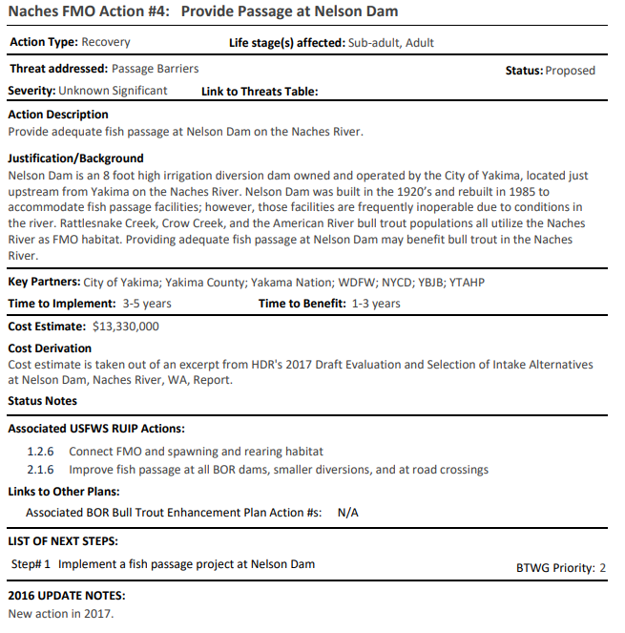
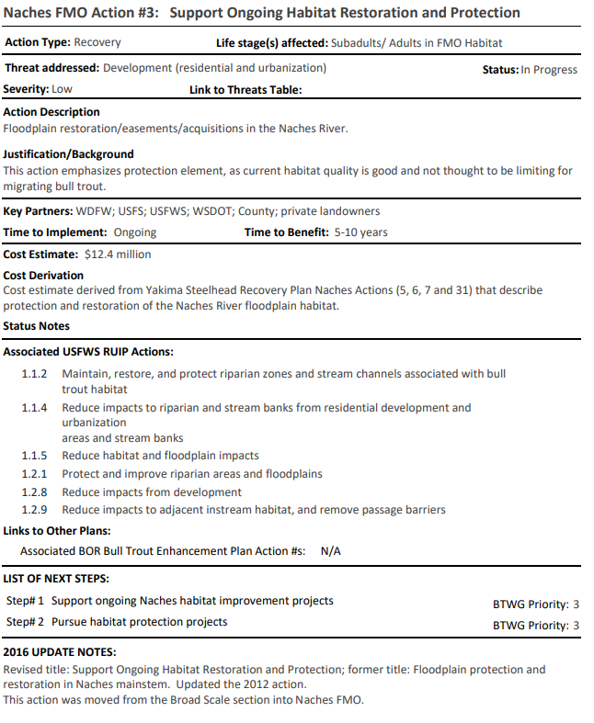
Naches FMO Action #3: Support Ongoing Habitat
Restoration and Protection
Naches FMO Action #4: Provide Passage at Nelson Dam
Notes:
Bull Trout action plan

Slide 15
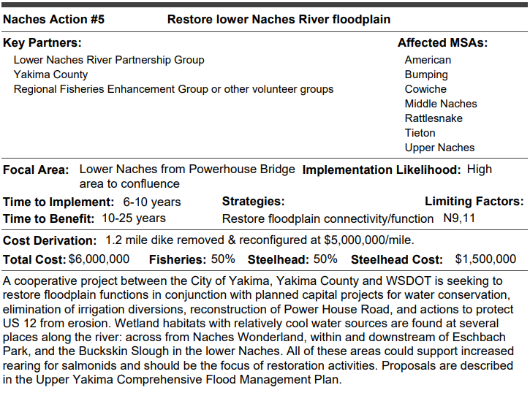
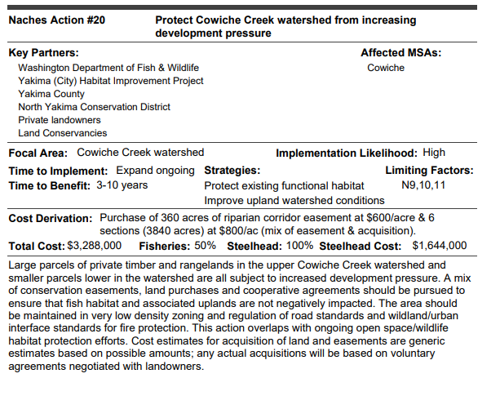
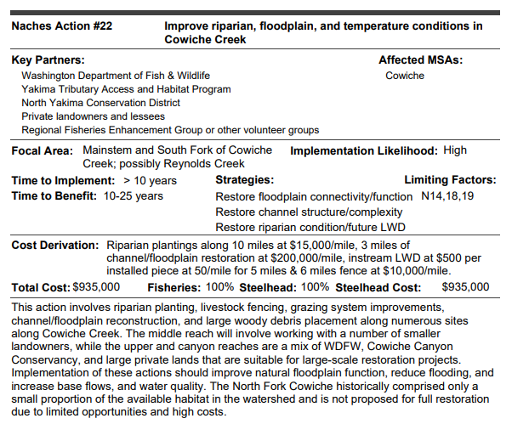
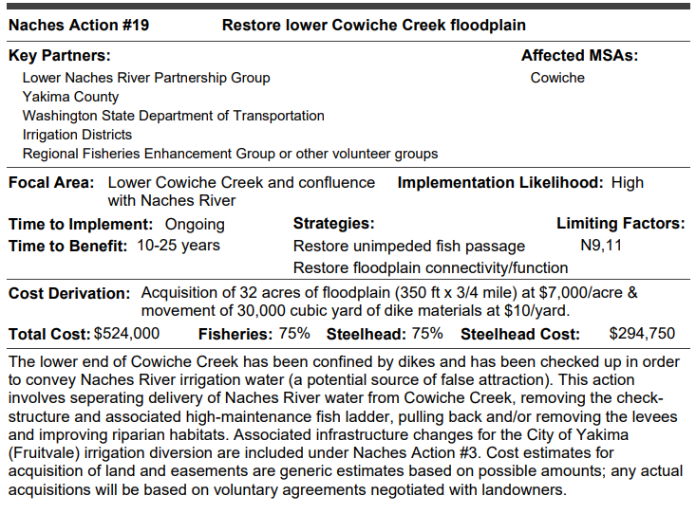
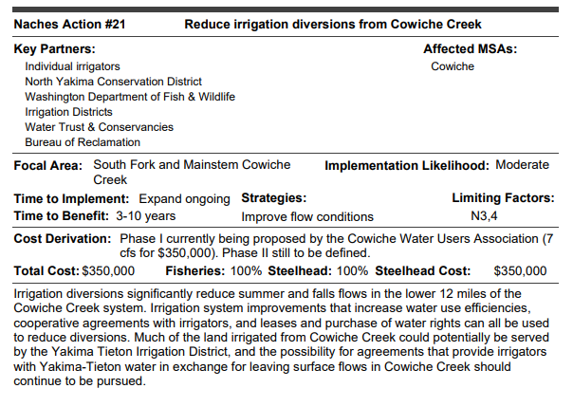
#5: Restore lower Naches River floodplain
#19: Restore lower Cowiche Creek floodplain
#20: Protect Cowiche Creek Watershed from Increasing Development Pressure
#21: Reduce Irrigation Diversions from Cowiche Creek #22: Improve riparian, floodplain, and temperature conditions in Cowiche Creek
Notes:
Steelhead recovery plan

Slide 16
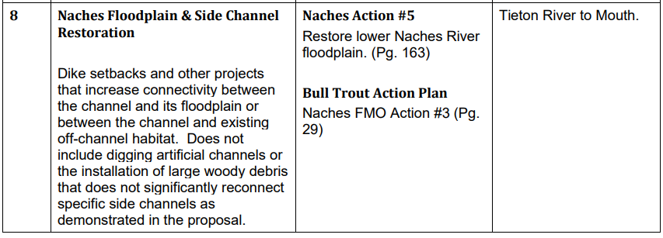
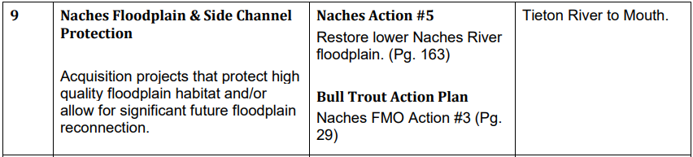
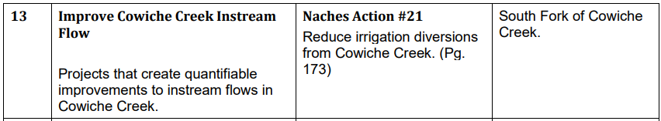
TAG Focus List #8
TAG Focus List #9
TAG Focus List #13

Slide 17
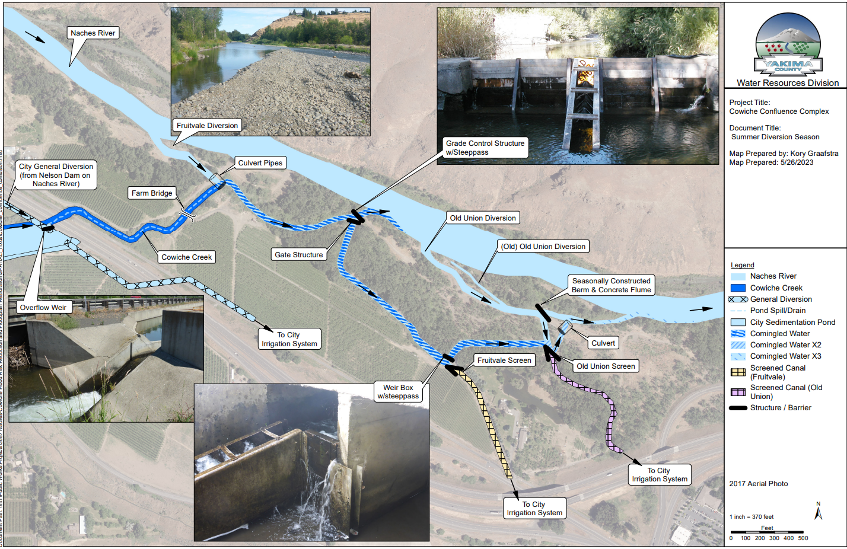
Notes:
Biggest limiting factor – fish passage, false attraction flows, co mingled water.

Slide 18
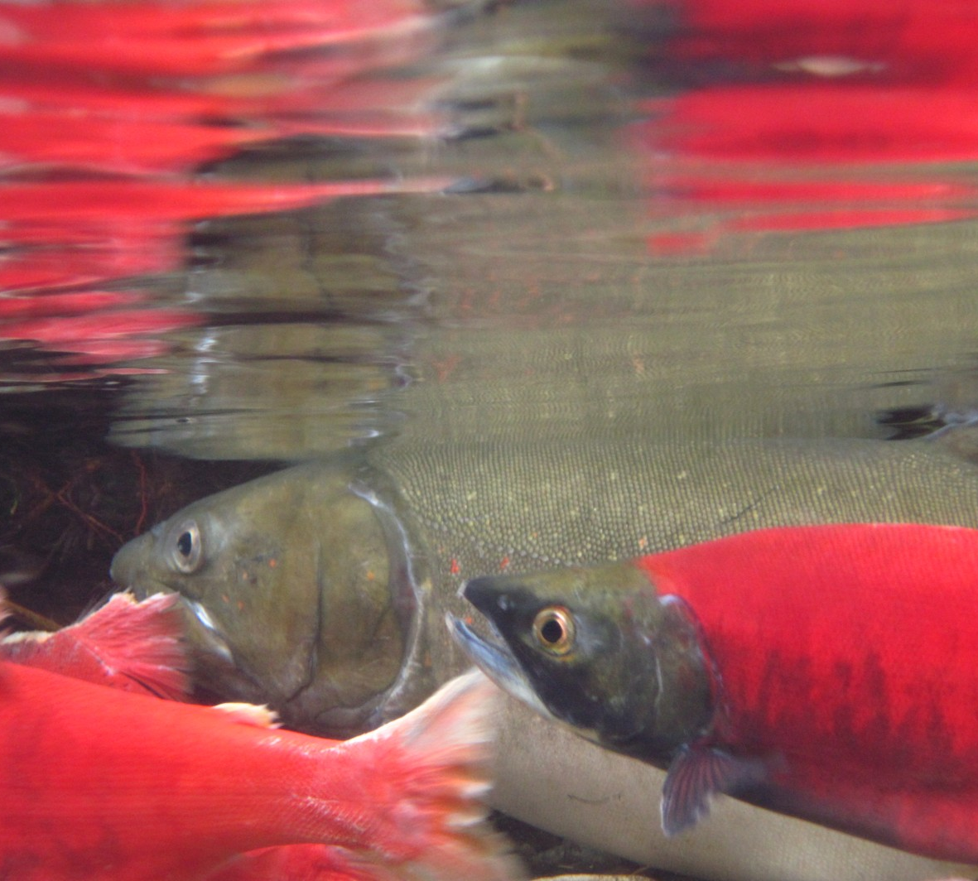
Benefits For Fish
Greatly improved habitat quality
Expanded riparian buffer and floodplain function
Creation of side channels and off‑channel rearing habitat
Improved spawning habitat
Restored fish passage
Support for ESA‑listed species
High certainty of success
Notes:
Greatly improved habitat quality
Cowiche Creek is currently straightened and confined, which limits habitat value. The project will realign the channel and add natural wood and rock structures, improving habitat complexity and ecological function for multiple life stages of salmonids.
• Expanded riparian buffer and floodplain function
Increasing riparian buffer width and restoring floodplain processes will help cool water temperatures, improve nutrient inputs, and create more diverse aquatic and terrestrial habitat.
• Creation of side channels and off‑channel rearing habitat
Side channel and riparian habitat throughout the Naches–Cowiche confluence will provide critical juvenile rearing areas for salmon and steelhead, improving survival.
• Improved spawning habitat
The project will enhance spawning habitat for coho salmon and lamprey through channel complexity, natural substrates, and restored geomorphic processes.
• Restored fish passage
Removing canal diversion structures, ladders, headgates, and filling abandoned canals eliminates barriers that have historically limited migration into Cowiche Creek.
• Support for ESA‑listed species
Benefits directly support recovery needs for ESA‑listed steelhead, as well as Chinook and coho salmon, by addressing limiting factors in an important tributary and confluence area.
• High certainty of success

Slide 19
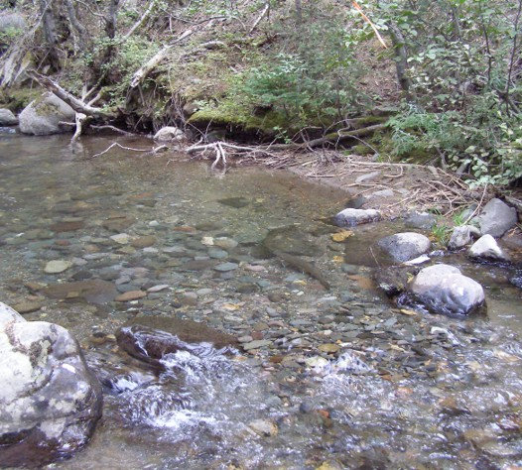
Other Benefits
Open space creation and recreation potential
Flood risk reduction
Water use efficiency
Creation of a continuous public land corridor
Stronger foundation for future restoration actions
Photo by William Meyer
Notes:
• Open space creation and recreation potential
The project increases protected open space and supports future connectivity to the Yakima Greenway trail system, enhancing public access and recreation opportunities.
• Flood risk reduction
Restoring floodplain function and removing confining infrastructure helps reduce flood hazards for the surrounding area.
• Water use efficiency
Consolidating irrigation diversions and eliminating canals improves irrigation system efficiency and reduces water loss.
• Creation of a continuous public land corridor
Acquisition completes a publicly owned shoreline corridor from 1 mile upstream of Powerhouse Road to the Yakima River confluence, improving long‑term management, restoration potential, and public access.
• Stronger foundation for future restoration actions
Securing the remaining parcels opens up larger restoration design options, including future side channels, riparian improvements, and compatible land uses.

Slide 20
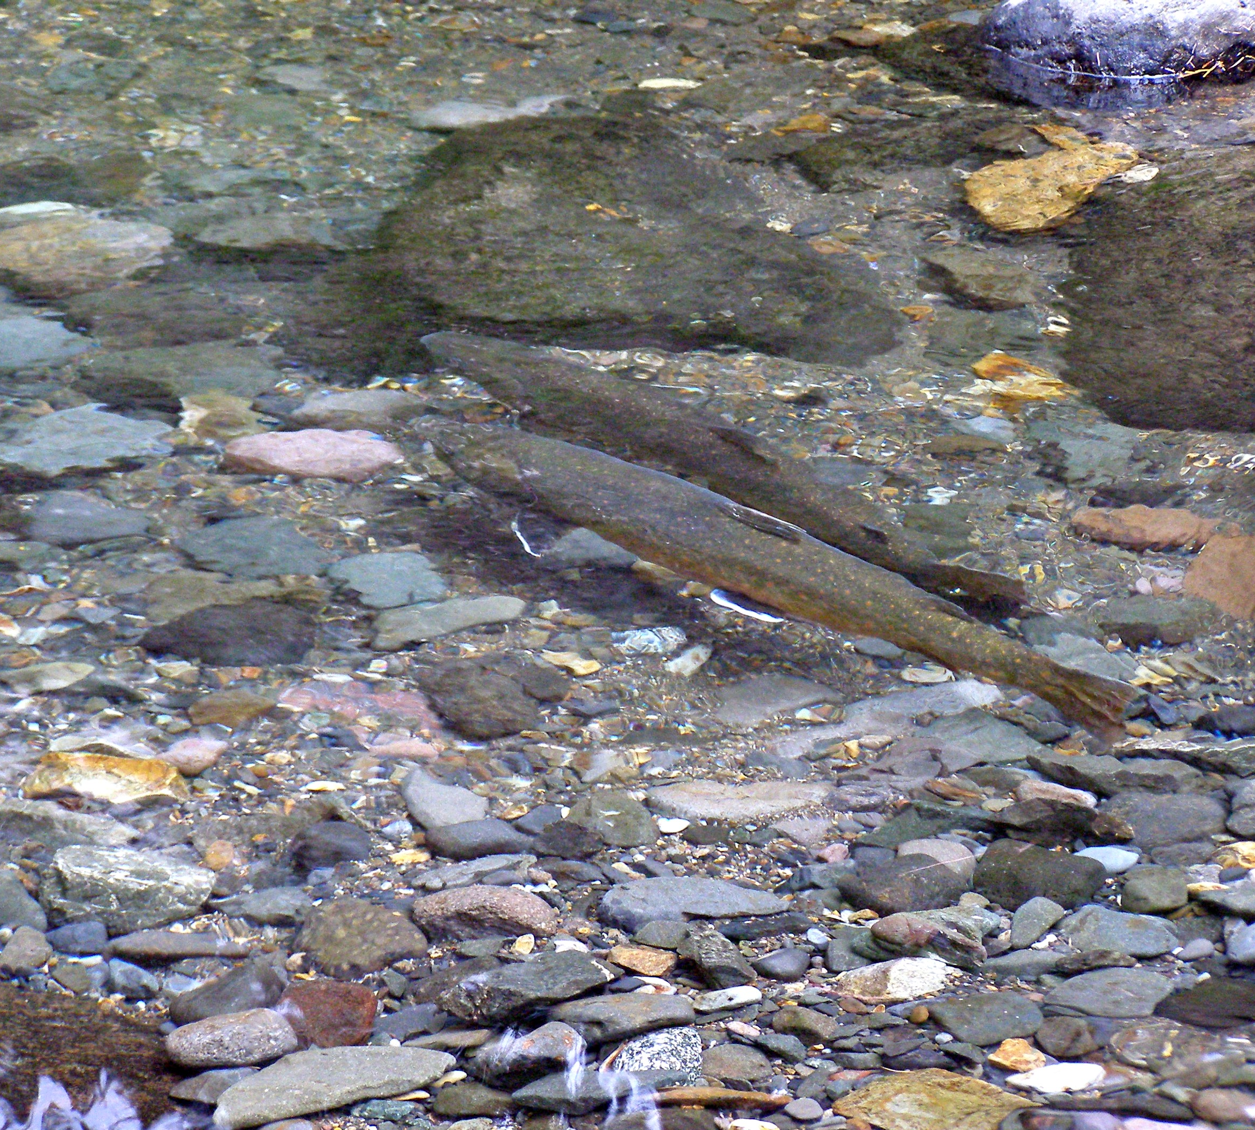
Long-Range Benefits
Permanent protection for the Naches Cowiche Confluence
Public ownership of entire shoreline
Increase long-term flood resilience
Sustained water use efficiency for agriculture and municipalities
Photo by William Meyer

Slide 21
Salmon Recovery Funding Board Budget
Alternative:
Working on a funding strategy for if seller wants to sell entire property including the shop.
SRFB budget would be the appraised value + incidentals and admin.
Greenway foundation $135,000* in match for shop.
YBIP 25-27 contingency funding to cover rest.
Our current ask is $162,100** (Assessed Value + Incidentals + Admin)
  Assessed value = $140,600
  Appraisal estimate = $5000
  Appraisal review = $2000
  Baseline documentation = $2000
  Closing, Recording, Taxes, Title = $3000
  Cultural Resources = $3000
  Survey = $2500
  Administration = $4000
Current steps:
Title Report
  Delivered and under review
Appraiser under contract –
  Developing scope of work
  They committed to having an appraisal by early June.

