Slide 1
Rattlesnake Cr Streamflow Phase 2A--Design/Build Project No. 26-1494 Design
Justin Bezold, Project Manager
April 13, 2026

Slide 2
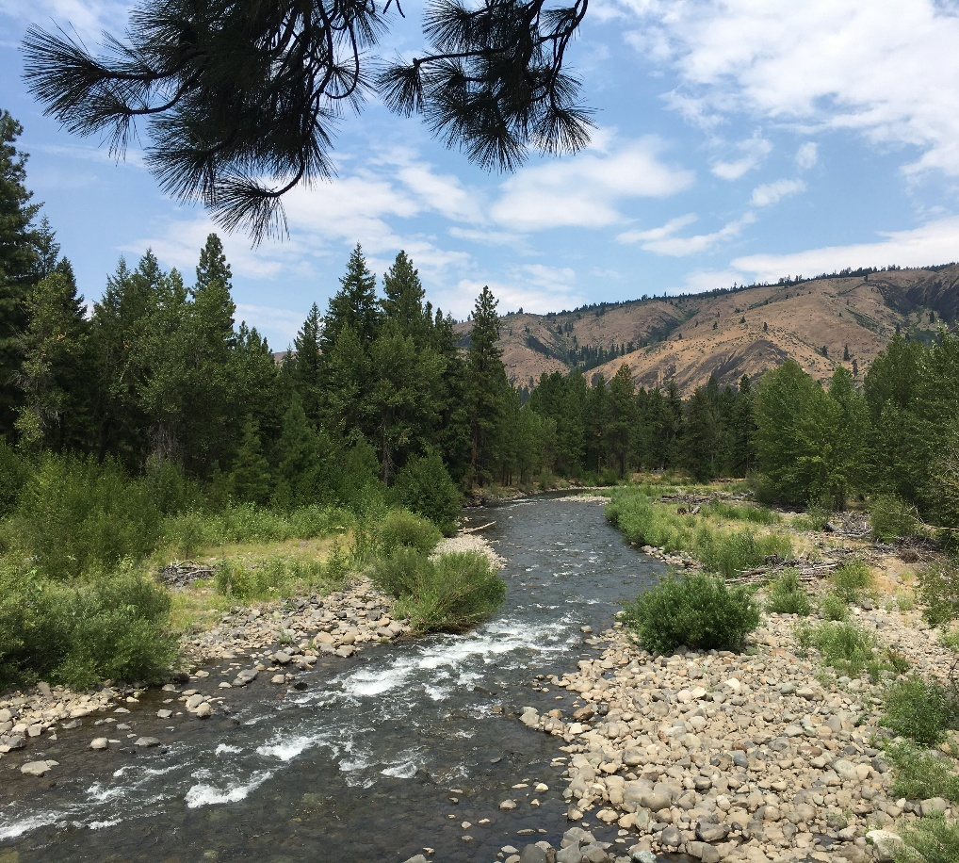
Roadmap
The Project
Rattlesnake Creek and its fish
Limiting factors
Project fit with Recovery Plan actions
Constraints / Concerns
Budget and timeline
Questions

Slide 3
The Overall Project + The 2026 SRFB
TU plans to convert 5 water users from a common, single surface-water diversion from Rattlesnake Creek to individual wells located on each water user’s property. The project will improve flows in Rattlesnake Creek by up to 1.55 cfs and improve habitat quantity and quality and passage conditions in the downstream most ~1.75 miles of the creek from the point of diversion to the confluence with the Naches River.
The 2026 SRFB proposal is to reduce surface water diversions from Rattlesnake Creek by approx. 0.44 cfs and deliver the water from two (2) wells for two (2) water users for irrigation and stockwater within 18 months of grant contract execution.

Slide 4
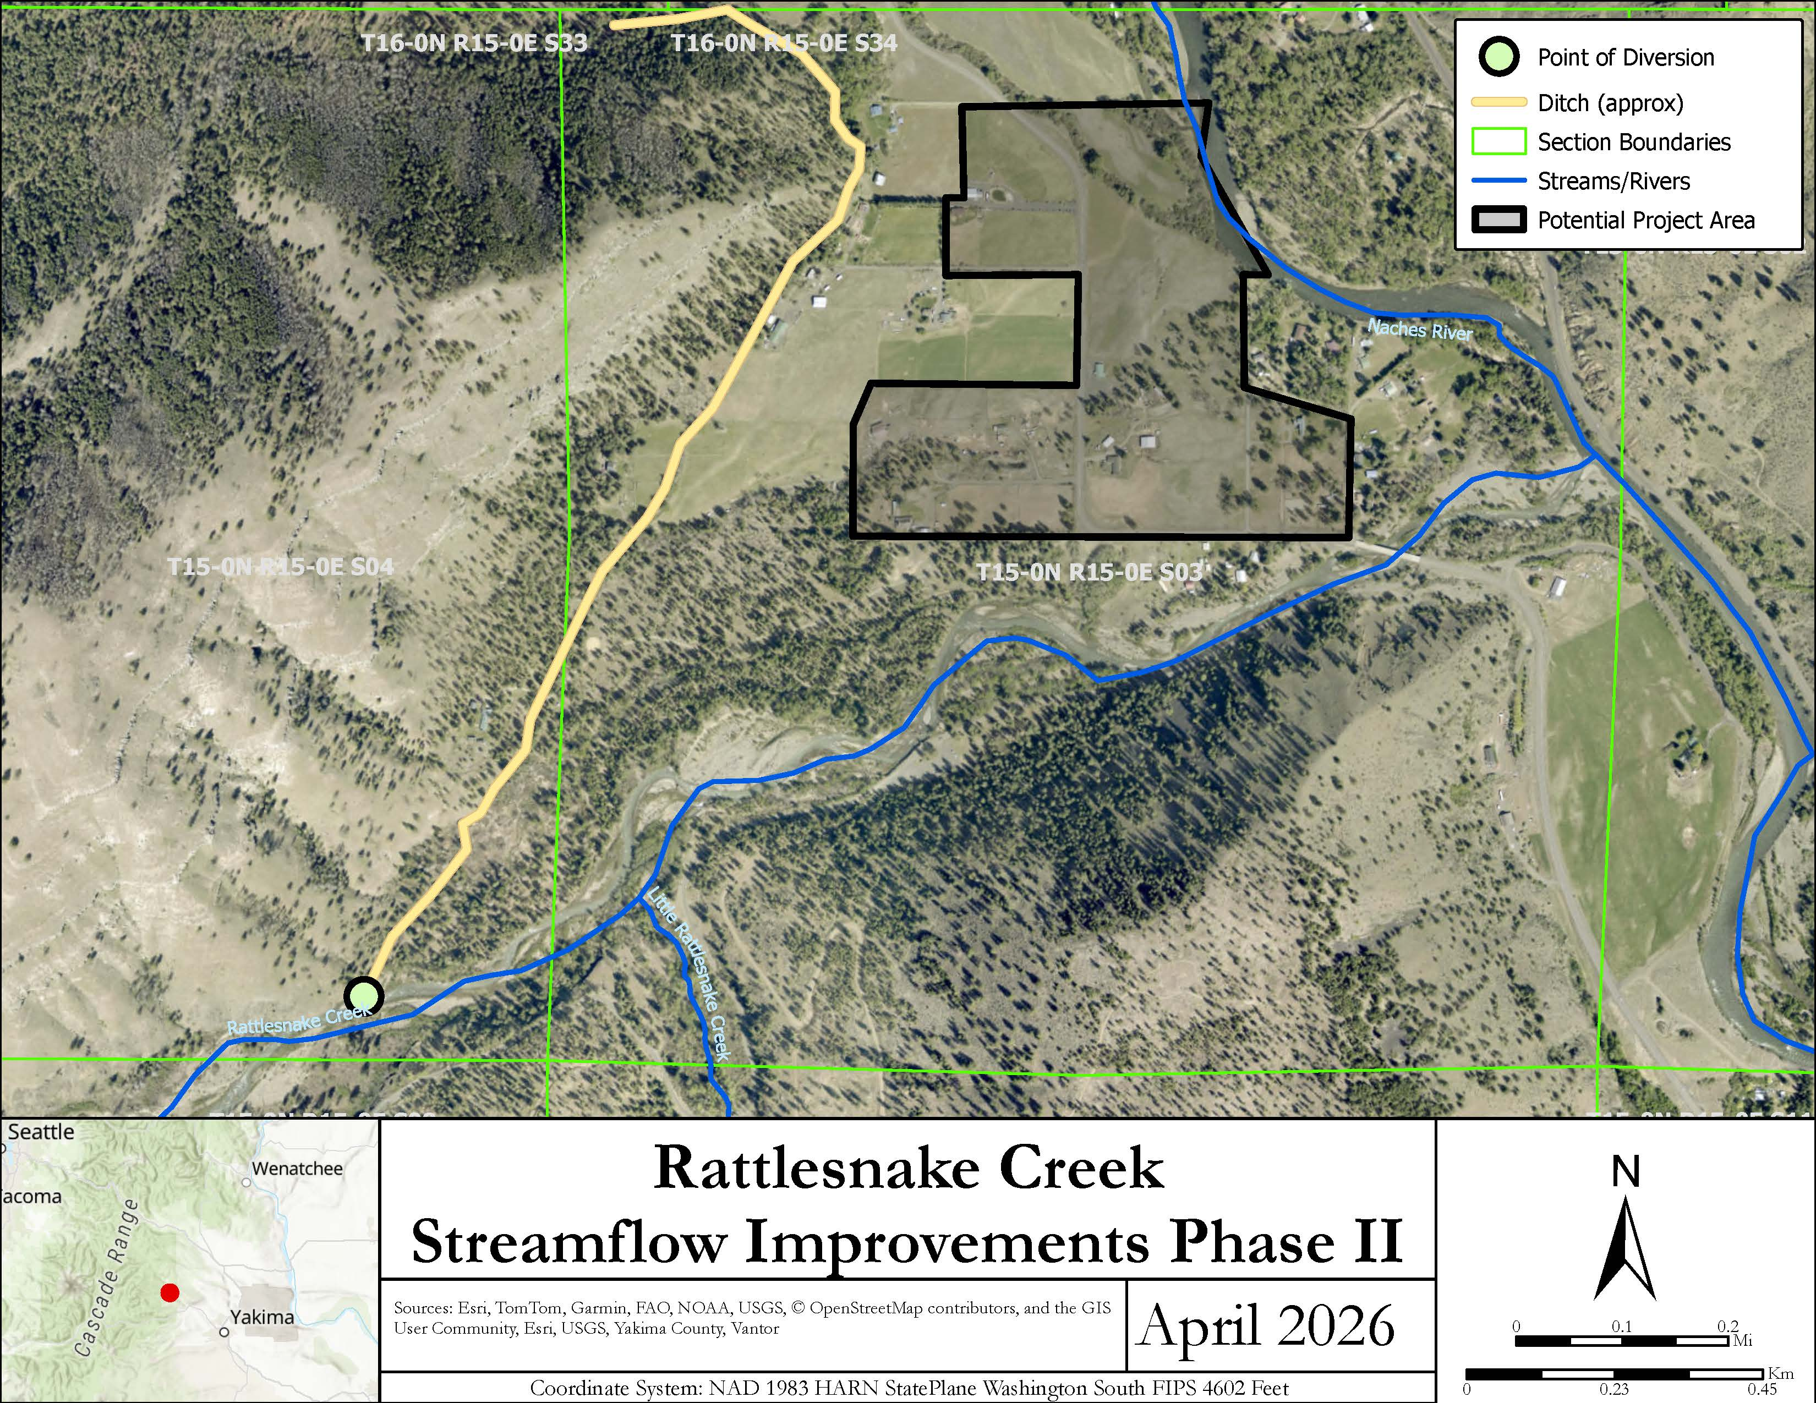

Slide 5
Why Rattlesnake Creek?
Valuable rearing and spawning habitat for adults and juveniles:
ESA-threatened Steelhead and Bull trout,
non-listed Chinook and Coho salmon, and
Rainbow and Westslope Cutthroat trout
Low flows from mid-August through October—seasonally dependent
Willing landowners and limited number of diverters on one primary diversion
Improved flows should improve stream processes (reduce impairments)

Slide 6
Limiting Factors (2001)
2001 Limiting Factors Analysis suggests actions to “restore floodplain functionality.” (page 213)
Analysis states that “instream flow recommendations were developed in the mid-1980s (see Instream Flow section at beginning of this chapter), but the TAG does not support implementation of those recommendations at this time. Rather, the TAG supports continued work to develop and implement a normative flow regime that combines "the goal of sustaining ecological integrity of the watershed, while also maximizing use of water resources by humans" (SOAC 1999).” (Page 213, Water Quantity)

Slide 7
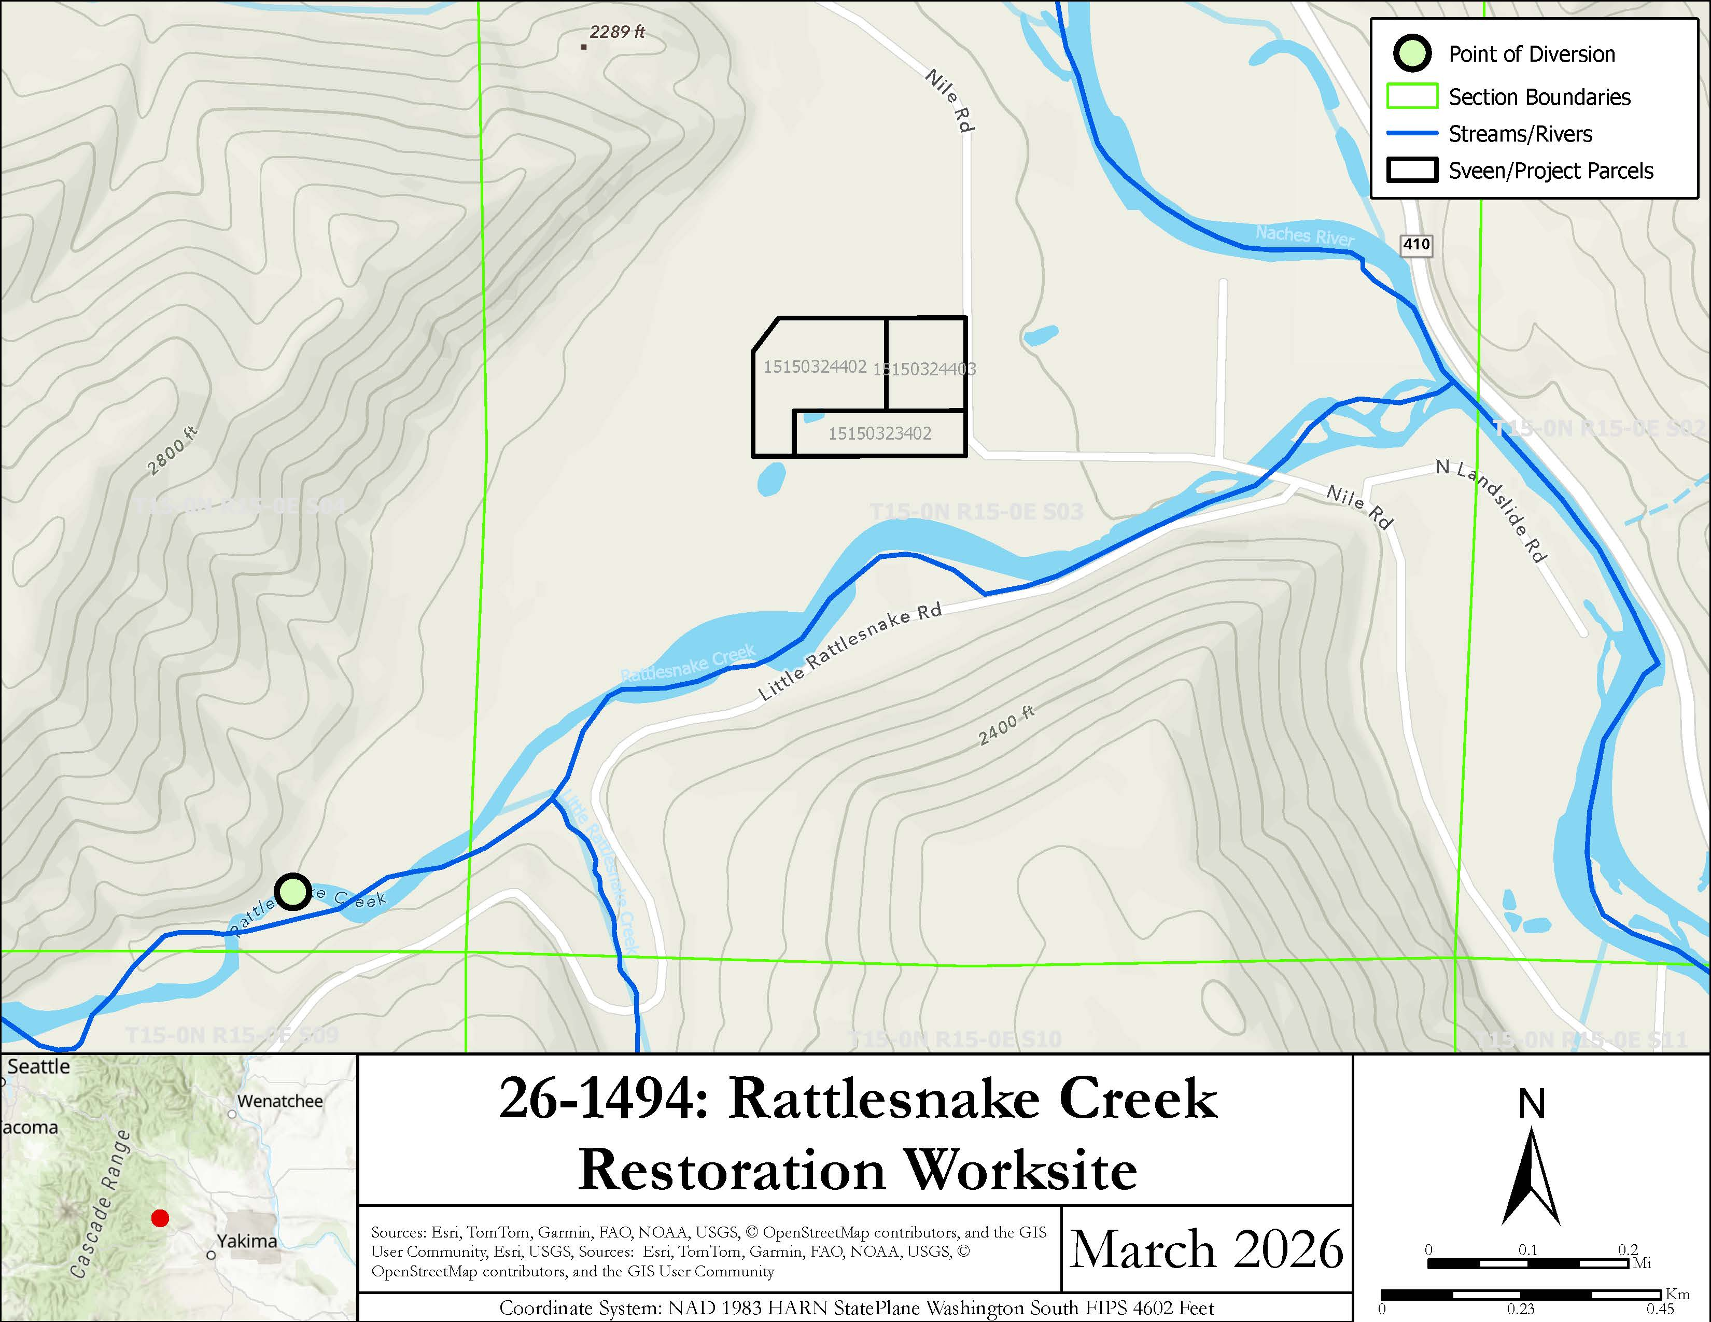

Slide 8
Project Goals
Overall Goal:
Reduce the diversion of surface water from Rattlesnake Creek.
AKA – Improve streamflows for fish in Rattlesnake Creek
Implementation Goal:
Complete implementation of wells on property owned by participating water users and associated water right changes + agreements
Phase 2A: implement two wells for selected water users

Slide 9
Project Objectives
Complete permitting and water right changes within 12 months of contracting
Secure necessary construction contractors for implementation and hookup of wells + electrical
Implement wells and bring them “online” by 2028 irrigation season
Secure water management agreements to further limit impacts (if possible)

Slide 10
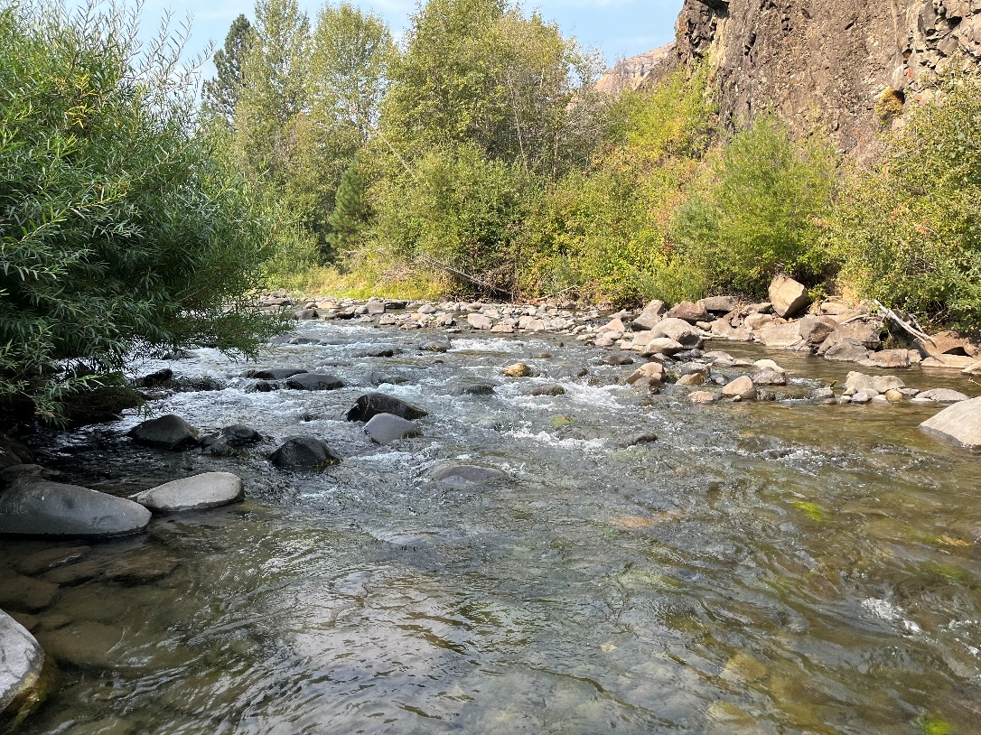
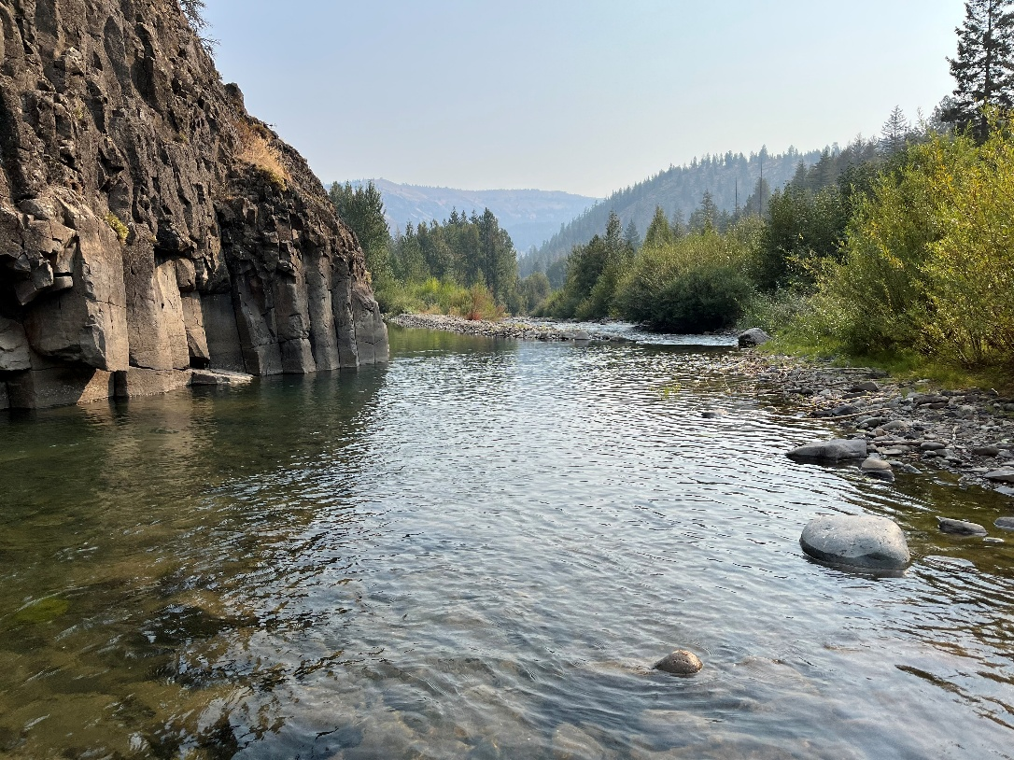
Existing Conditions ~22 cfs (September 2025)

Slide 11
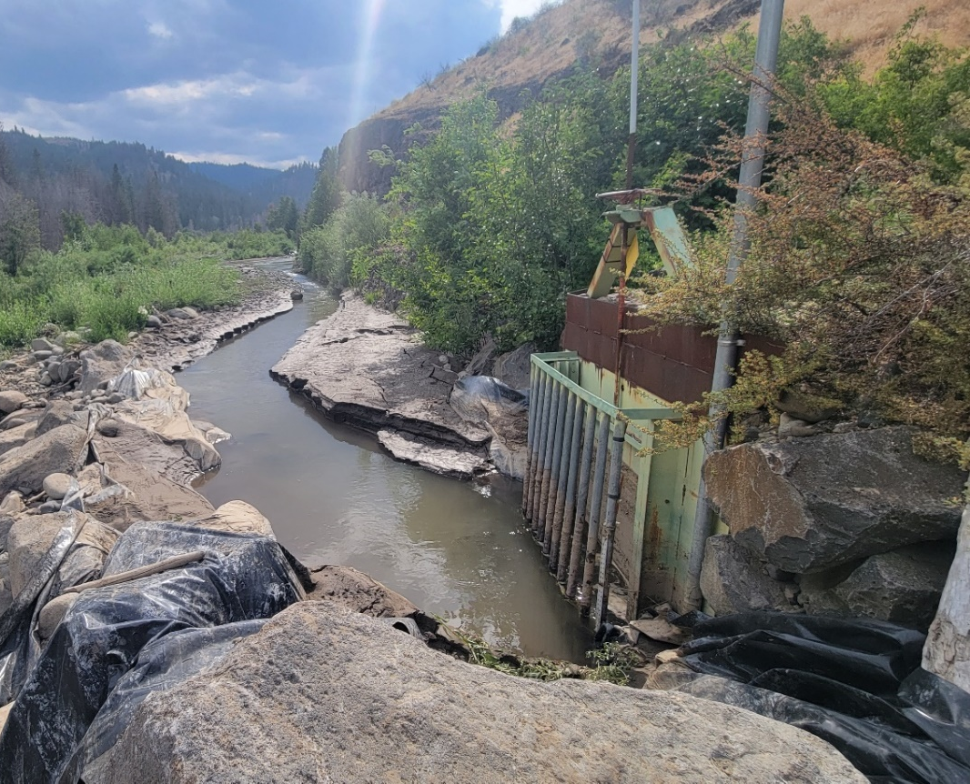
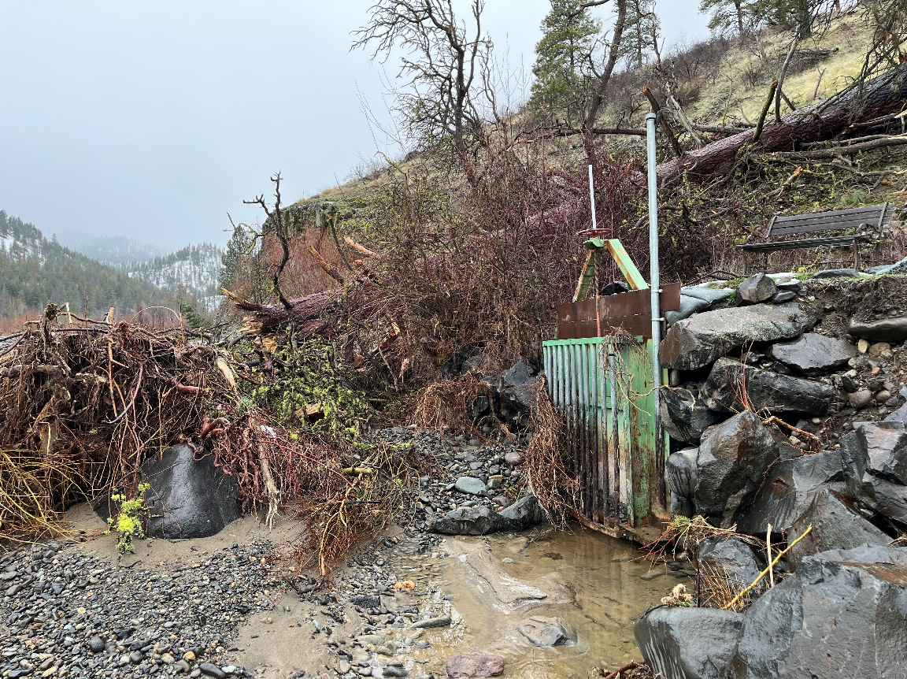
Headgate + Diversion Channel (2018 and 2026)

Slide 12
Measured Flows
Downstream of RDA Diversion

Slide 13
Specific Recovery Actions Addressed
YSRP Action #17: Increase instream flows in lower Rattlesnake Creek.
Focal area: lower Rattlesnake Creek
“irrigation diversions from Rattlesnake Creek can dewater the lower creek. . . [and] improving irrigation and conveyance efficiencies, switching water users to shallow groundwater wells, leasing water rights and ensuring diversions are limited to legal rights can all be used to reduce diversions.” (p. 170)
YSRP Action #18: Improve sediment transport at Rattlesnake Creek/Naches confluence.
Focal area: confluence of Rattlesnake Creek and Naches River.
“the unstable alluvial fan at the mouth of Rattlesnake Creek creates a passage barrier in low-flow years. The configuration of the irrigation diversion, the Nile Road bridge, and levees. . . combine to reduce sediment transport. . . . [R]eduction in the impact of the diversion upstream of the bridge and improvements to floodplain connectivity would improve sediment transport out of the Rattlesnake, improving habitat quality in both systems.” (p. 170)
BTAP Rattlesnake Action #1: Address Impacts of Diversions on Bull Trout.
Action addresses entrainment of Bull trout from the shared point of diversion
“this is one of the few populations where there are irrigation diversions within the known spawning and rearing reach. Entrainment of juveniles and sub-adults could negatively impact the population.” (p. 186)

Slide 14
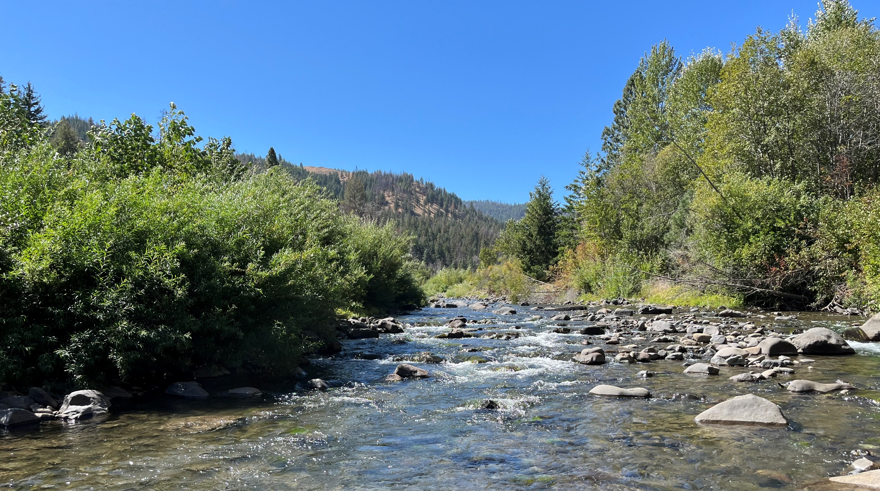
Constraints / Concerns
Landowner willingness to follow-through with water right changes
Physical availability of water for wells (limited concern; potential)
Funding availability to complete the implementation
Potential challenges to water right changes
DROUGHT

Slide 15
Budget and Timeline
Total Cost: $349,888
Key dates
Permitting—ESA, Sec 106, NEPA, etc.: fall 2026 – summer 2027
Water right changes: fall 2026 – fall 2027
Contractor procurement: fall 2026 – winter 2027
Site prep + mobilization: winter 2027 – spring 2028
Well implementation and testing: spring 2028 – summer 2028
As-built designs (water use begins): summer 2028

Slide 16
Questions?

