Slide 1

Toppenish Wood Supplementation Phase II
Tim Resseguie-Yakama Nation Fisheries Biologist

Slide 2
Background: Toppenish Creek is located in south central Washington and the entire watershed is situated within the boundary of the Yakama Reservation. Toppenish Creek is also a major tributary of the Yakima River with nearly as large a watershed area (622 mi²) as Satus Creek. The headwaters of Toppenish Creek are located on Lost Horse Plateau at a maximum elevation of 5200 feet.
Steelhead and Pacific Lamprey reside in the watershed.

Slide 3
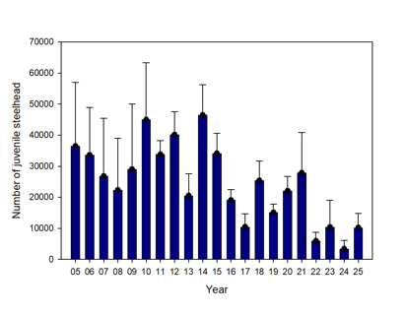
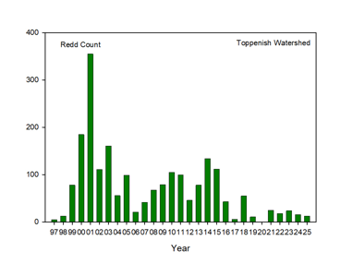
Problem: Toppenish creek steelhead population is declining
Adult steelhead redds for Toppenish Watershed
Estimated juvenile steelhead out-migrants at Unit 2 (river mile 27) screw trap

Slide 4
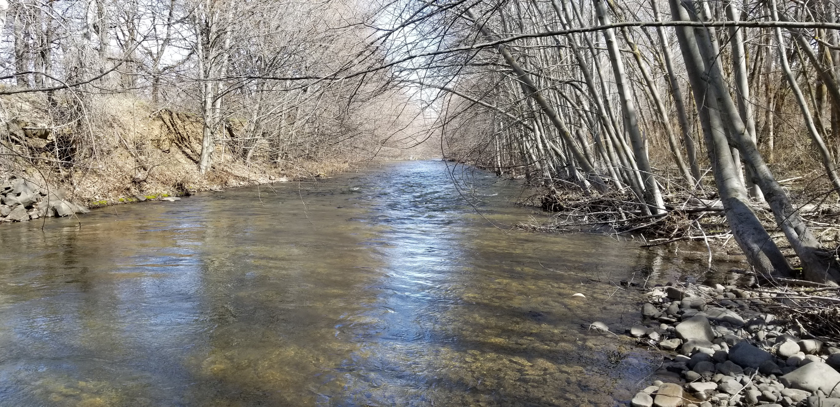
Long Straight Sections of Channel

Slide 5
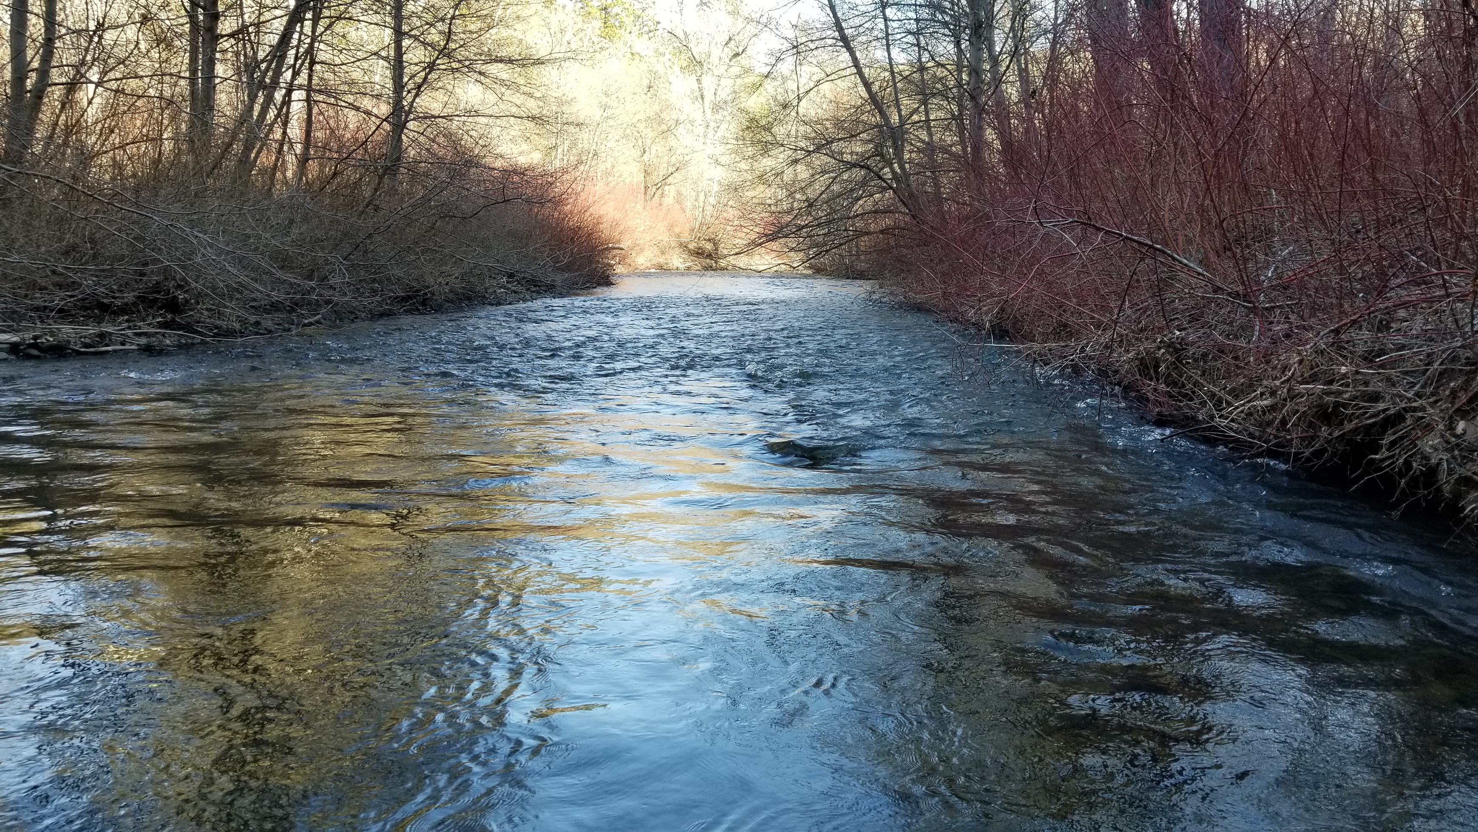

Slide 6
 | Total No.
Reach | Pieces/mile
Toppenish basin 2001
S.F. Simcoe post 14 | 526
S.F. Simcoe 7.4 | 300
S.F. Simcoe 4.7 | 202
Upper Whatum | 488
Middle Whatum | 569
Agency Cr. | 21
Upper M.S. Toppenish | 923
M.S. Topp Elbow | 54
N.F. Toppenish above con. | 38
Panther Cr. | 150
N.F. Simcoe 1.5 up rd. | 418
Upper N.F. Simcoe Cr. | 107
60th percentile | 394.4

Slide 7
Possible Solutions: Wood supplementation, Riparian forest development, beaver reintroduction and promotion

Slide 8
Goal is to improve steelhead production in the lower canyon and upper alluvial fan.
Objective is to supplement a 4-mile reach of Toppenish Creek with ELJs (engineered log jams) to achieve an instream large wood density comparable with other parts of the watershed.

Slide 9
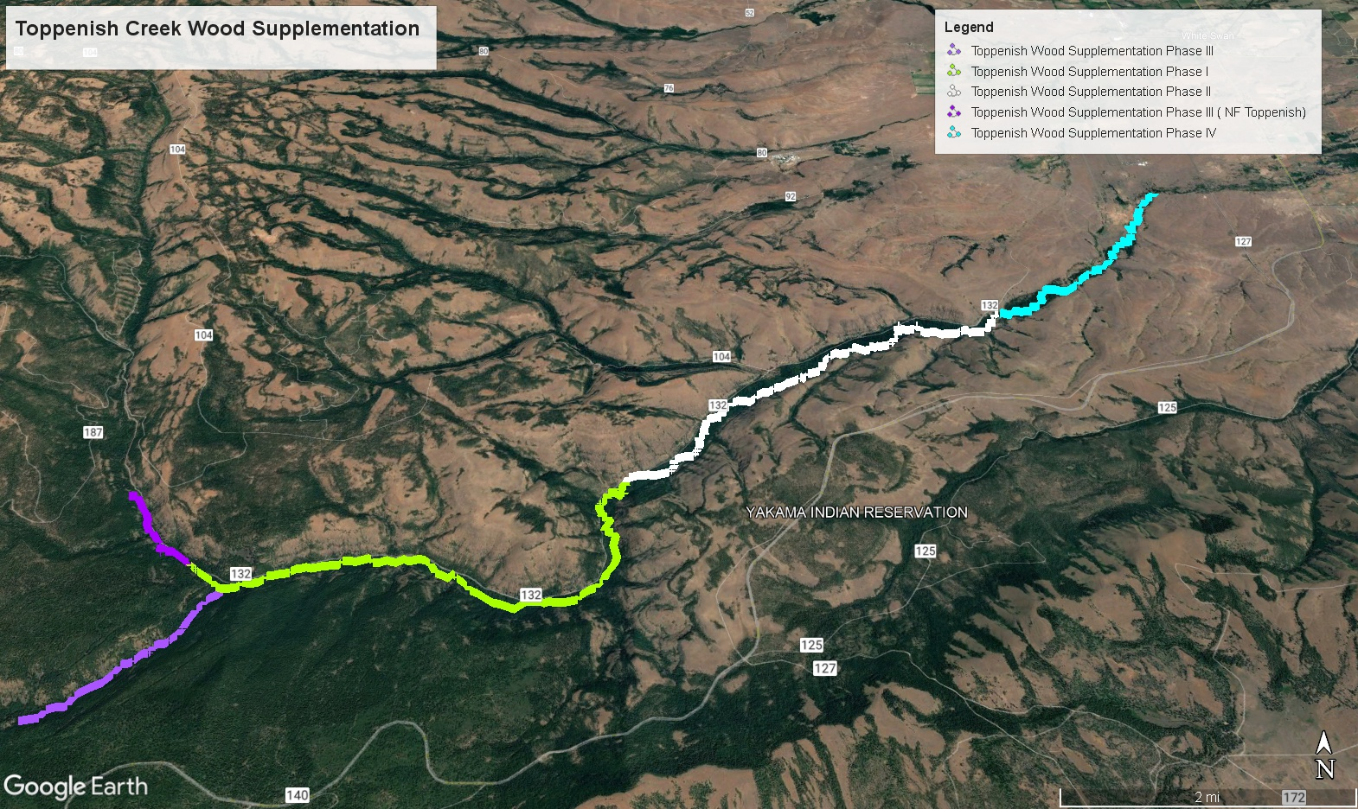

Slide 10
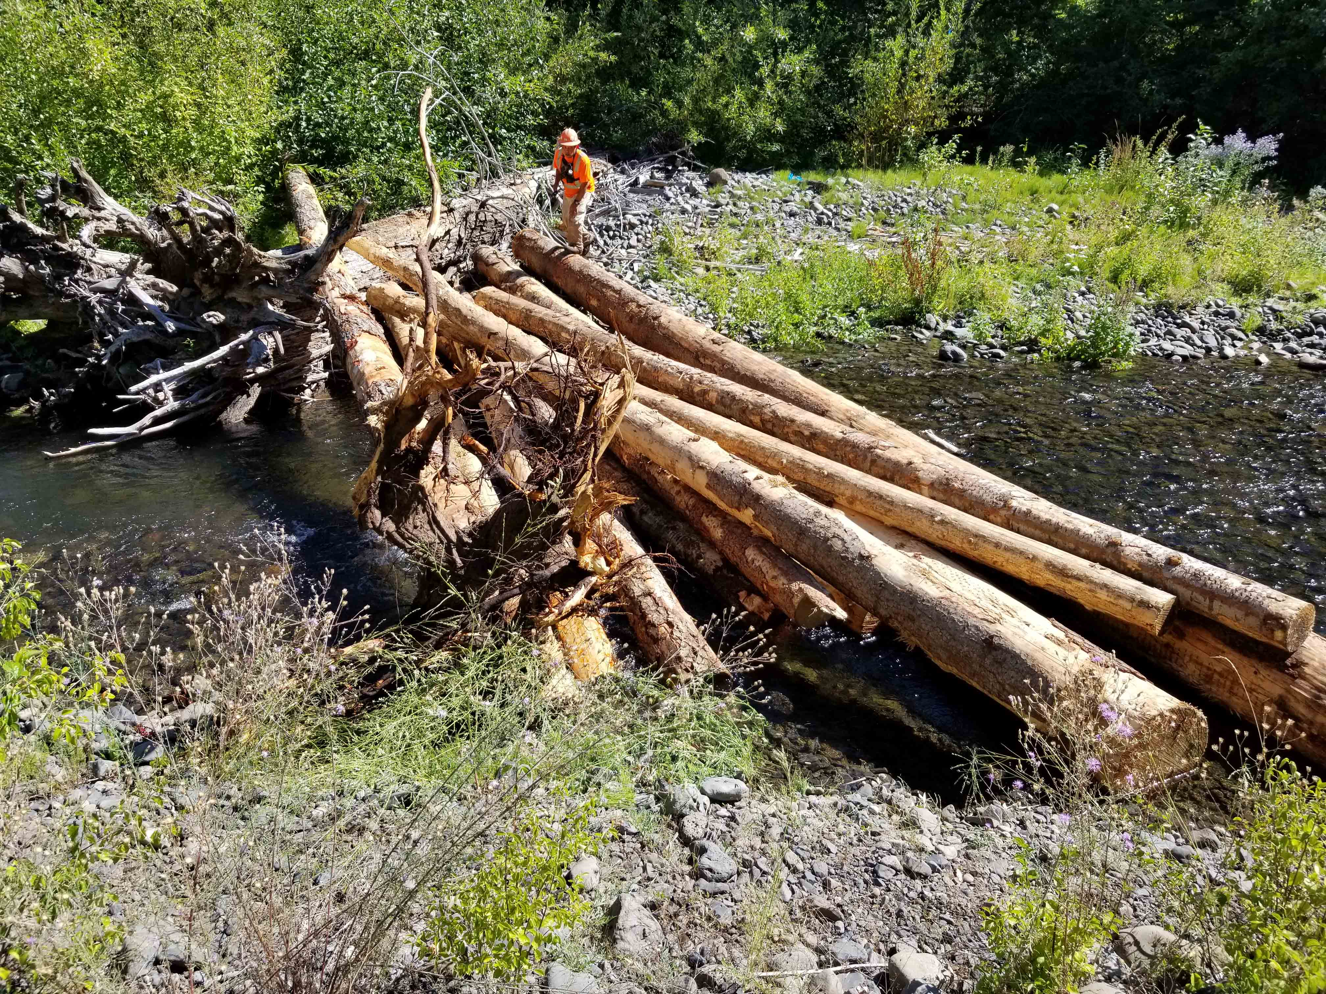
Phase I
800 Root wads and logs
36 Fit in the field log jams
Completed in 2019

Slide 11
Phase II

Slide 12
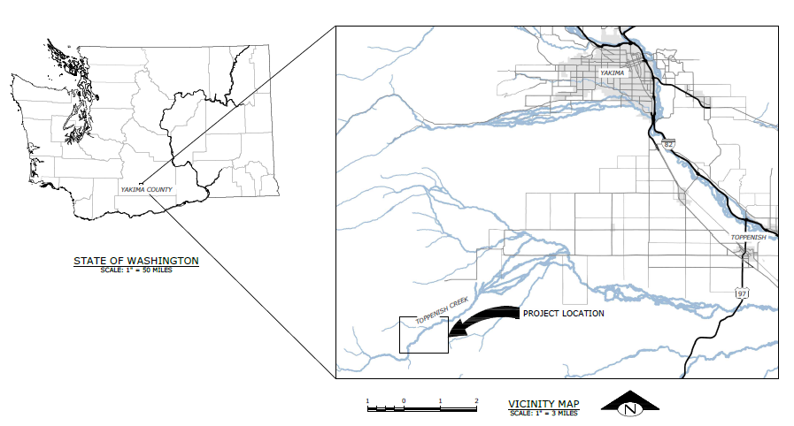

Slide 13
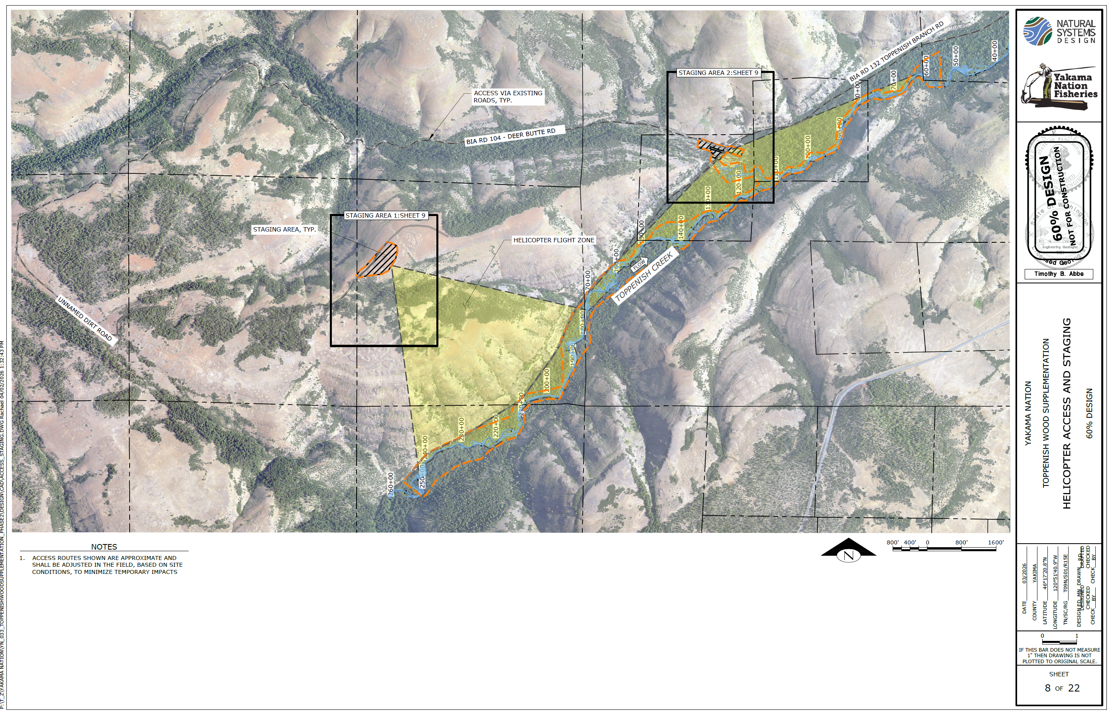

Slide 14
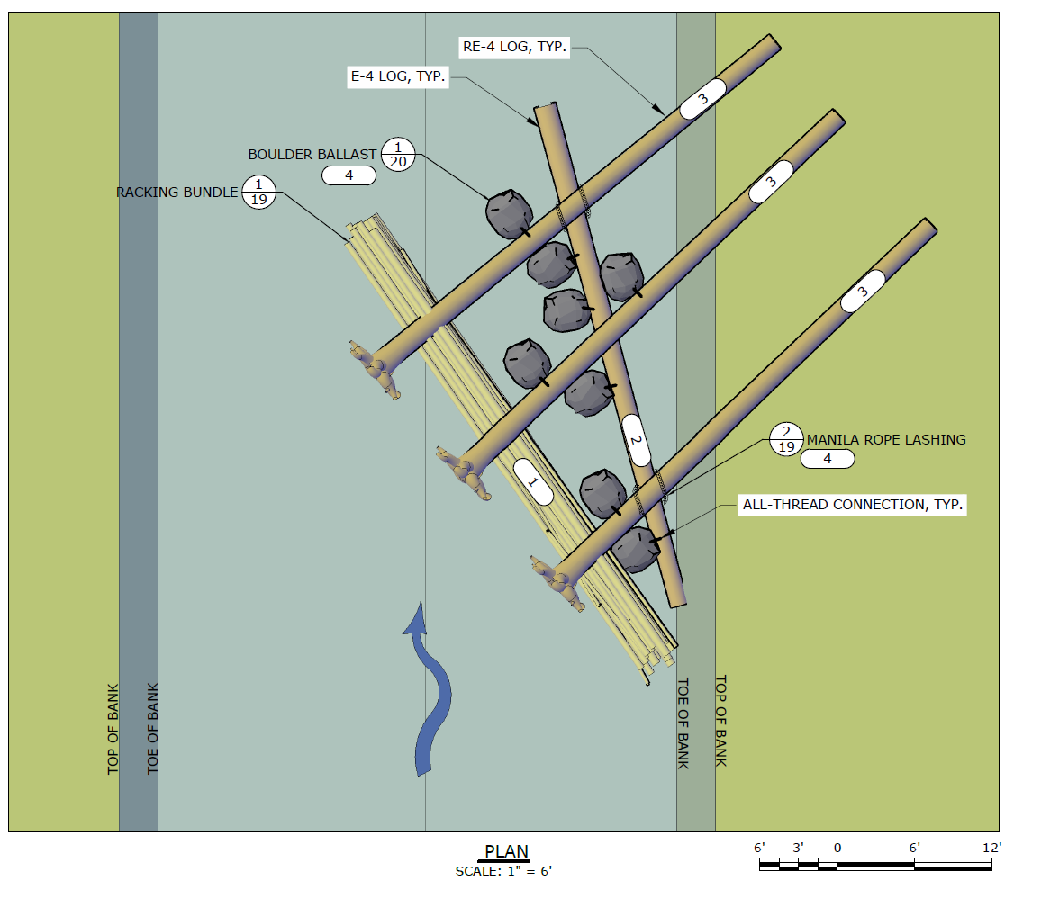
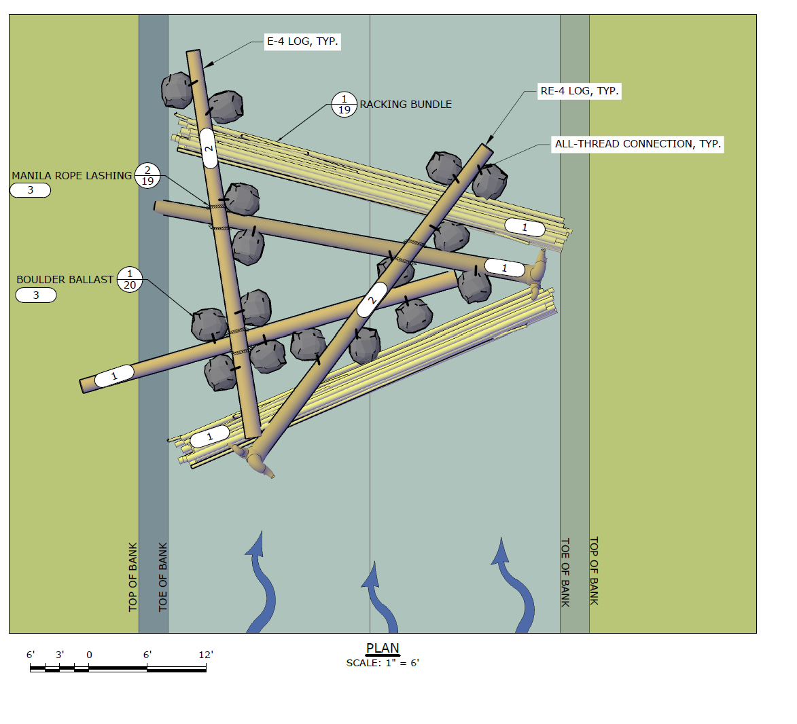
13 Deflector Type 1 ELJs
46 Channel Spanning Type 2 ELJs

Slide 15
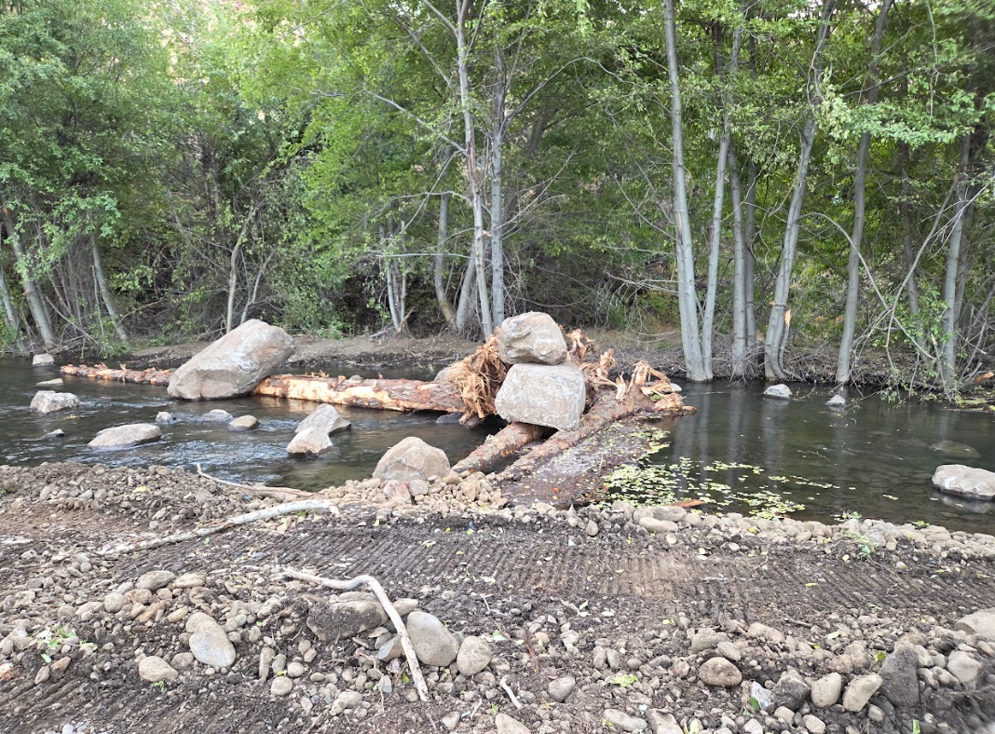

Slide 16
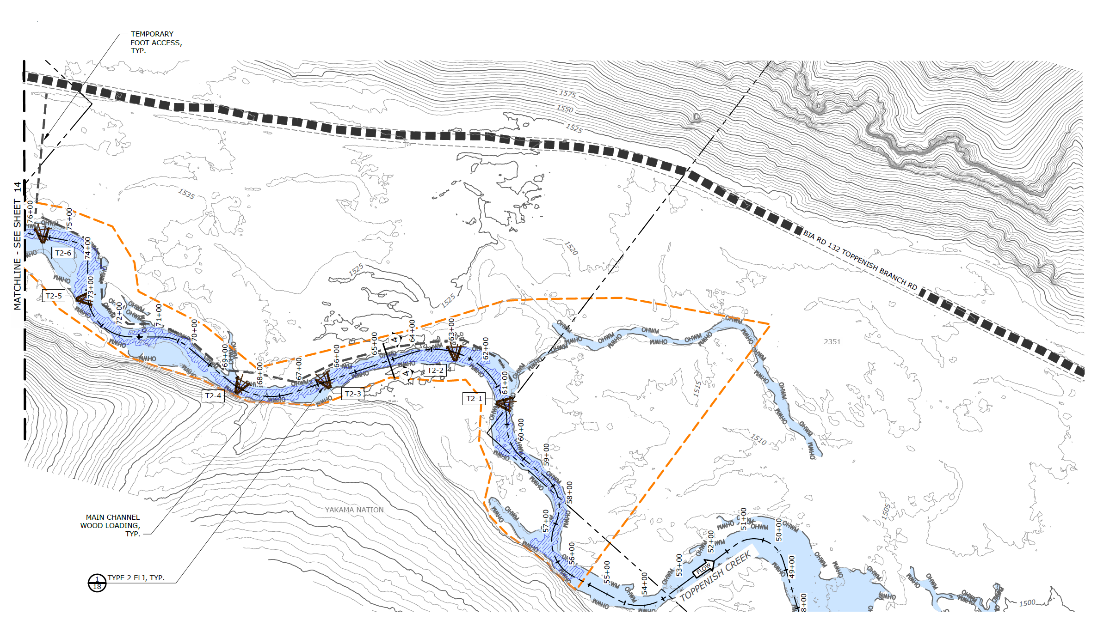

Slide 17
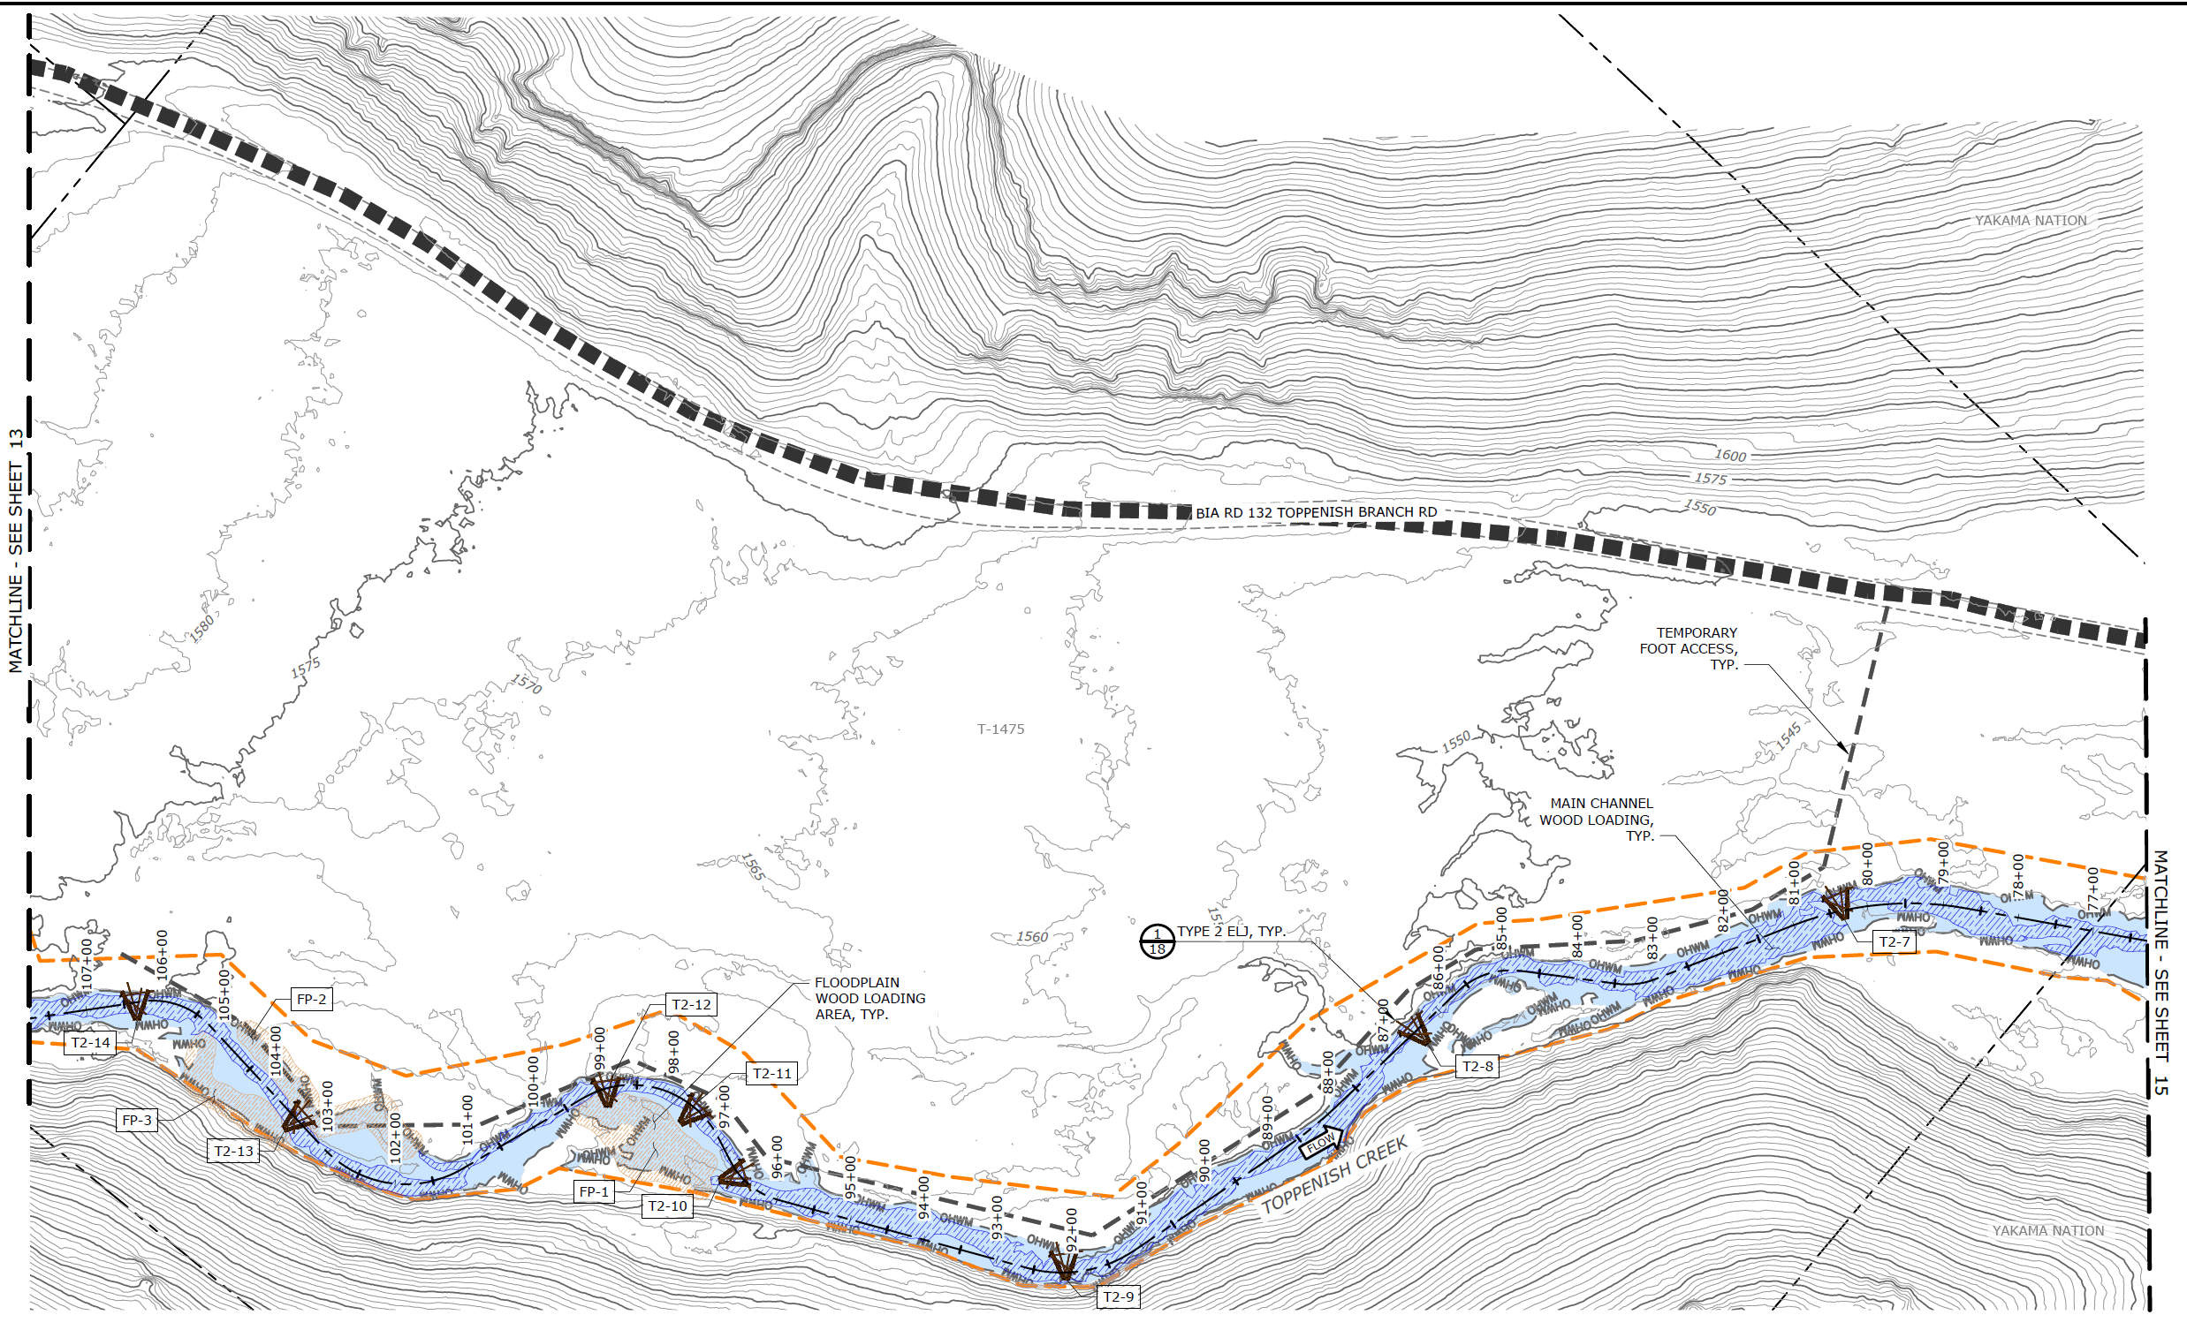

Slide 18
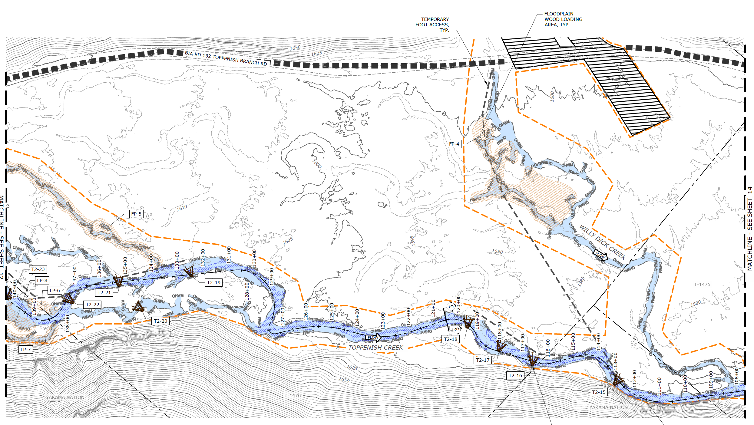

Slide 19
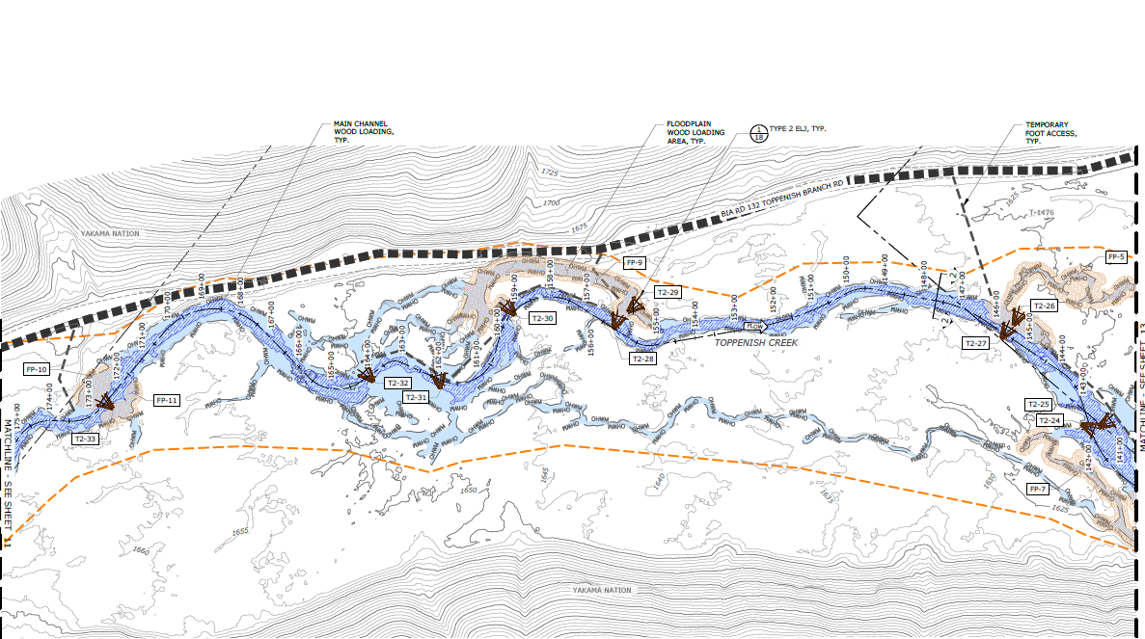

Slide 20
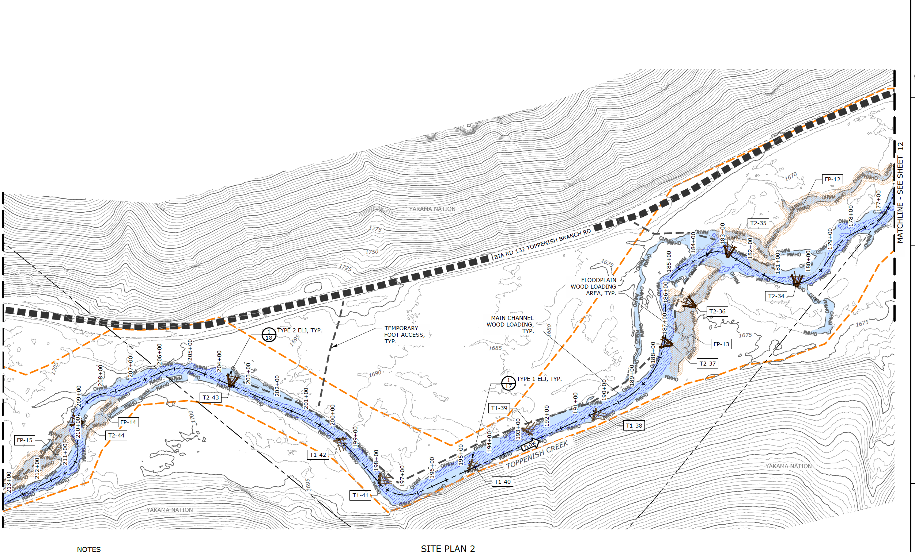

Slide 21
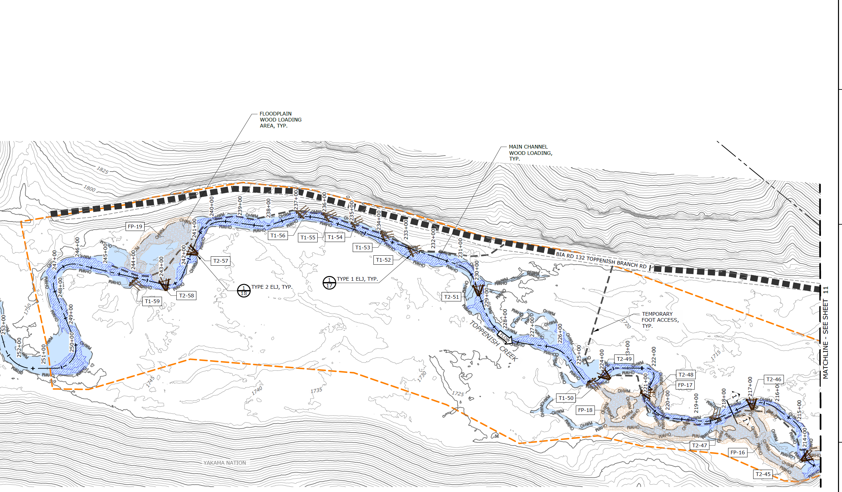

Slide 22
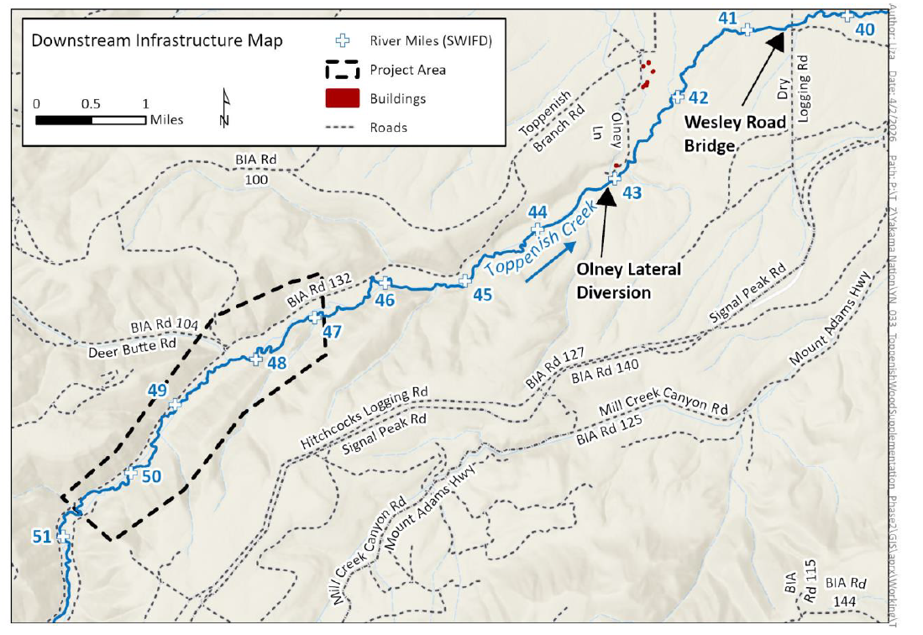

Slide 23
Timeline
Conceptual Designs- July 2025
Preliminary Designs – March 2026
Final Designs-June 2026
Permits May-2027
Construction Bids -October 2026
Construction 10 days-September 2027

Slide 24
Funding Sources
SRFB $250,000
Bureau of Reclamation $400,000 *
Bonneville Power Administration $80,000 *
NRCS $300,000 *
McNary $250,000
* secured
Total $1,280,000 to complete a portion of the project starting from the lower end.

Slide 25
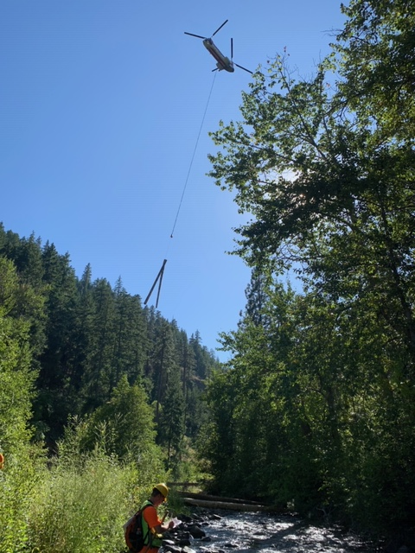
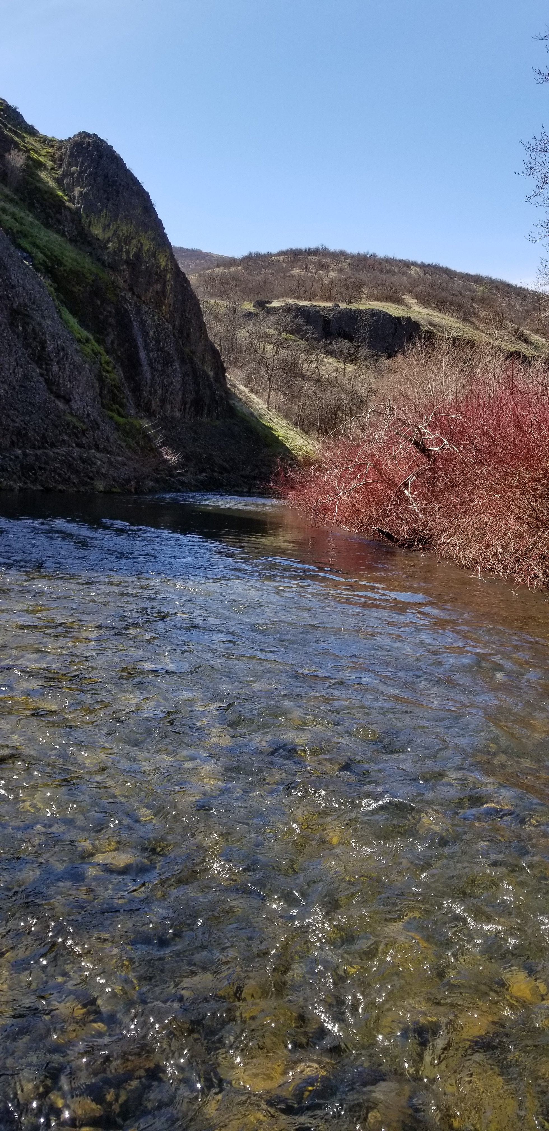
Thank You For Your Consideration

