Slide 1
Yakima RM 153 Side Channel Implementation
Project 26-1647
Kittitas County Conservation District

Slide 2
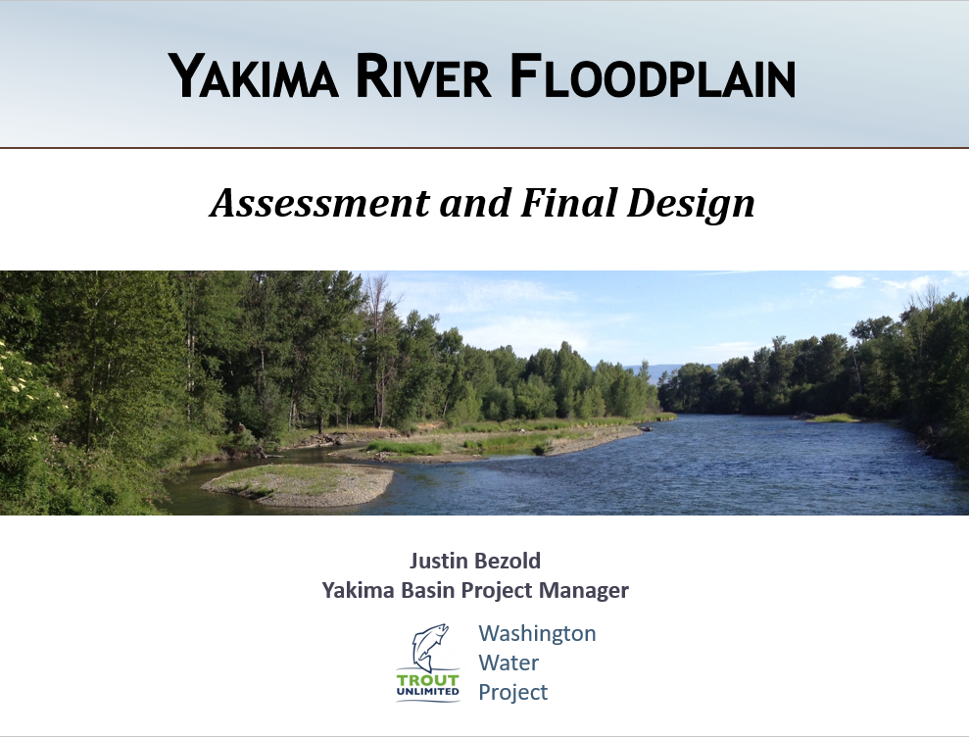
Background
Project Assessment and Design Completed in 2018 (Project 15-1147)
Led by Trout Unlimited Washington Water Project
Design Engineers: Herrera Environmental Consultants
Construction not pursued
December 2025 and February 2026
flood events

Slide 3
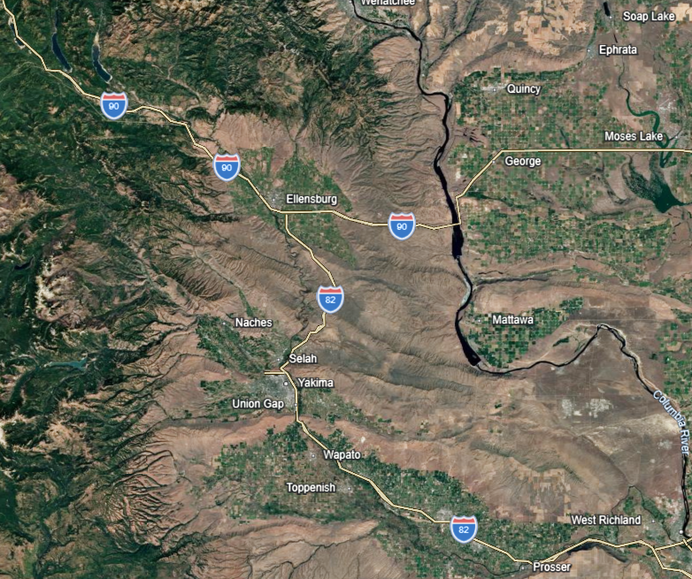
Yakima RM 153 Side Channel Implementation
The project site is in the Upper Yakima River watershed in Kittitas County, immediately south of Ellensburg.

Slide 4
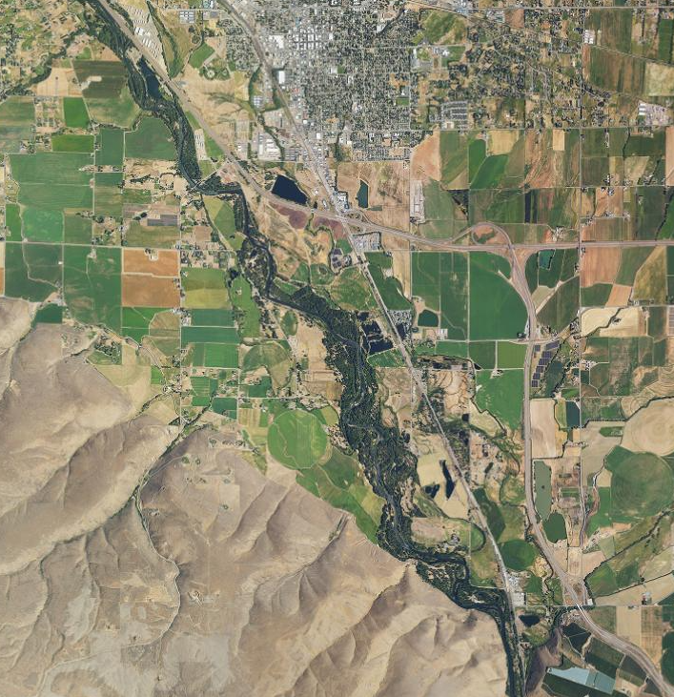
Yakima RM 153 Side Channel Implementation
The project site is located along the Yakima River’s west bank between river miles 151.7 – 153.0

Slide 5
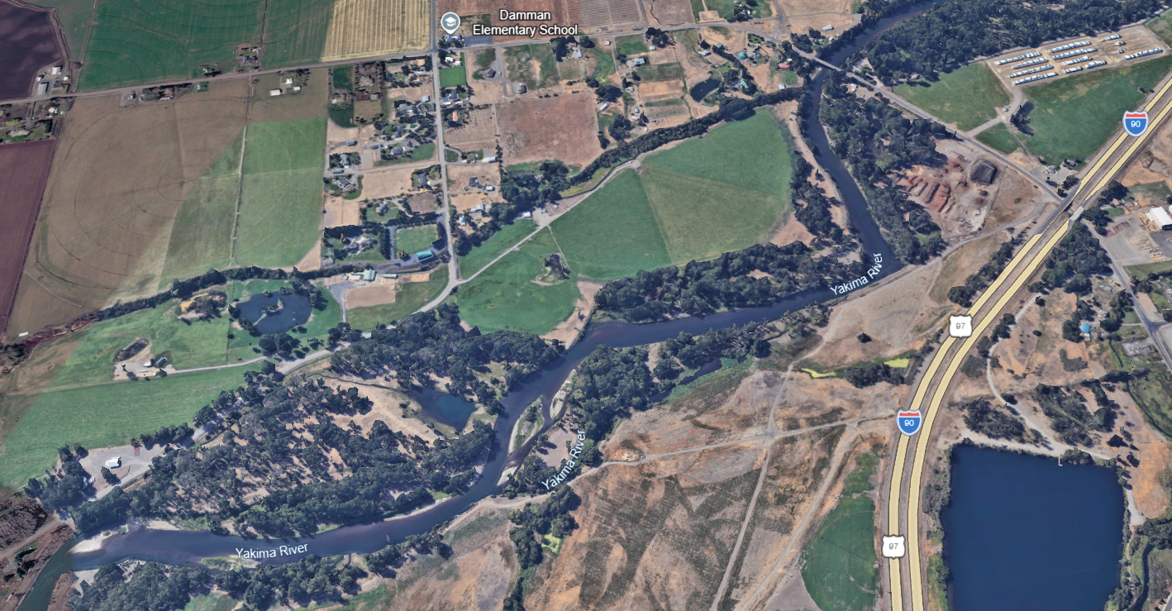
Yakima RM 153 Side Channel Implementation

Slide 6
Adult and Juvenile Timing
Species (Adult/Juvenile) | Jan | Feb | Mar | Apr | May | Jun | Jul | Aug | Sep | Oct | Nov | Dec
Westslope Cutthroat (A/J)
Resident O. mykiss (A/J)
Sockeye (A)
Sockeye (J) |  |  |  | • | • | •
Summer steelhead (A)
Summer steelhead (J) |  |  | • | • | • | •
Spring Chinook (A)
Spring Chinook (J) |  |  | • | • | • | •
Coho (A)
Coho (J) |  |  | • | • | • | •
Denotes outmigration period

Slide 7
Design Development by TU
Design project aimed to improve natural river processes, enhance fish habitat, and address past ecological damage while supporting agriculture of the Kittitas Valley.
Key problems:
Levees: Two levees on the project site restrict the river's natural interaction with the floodplain, leading to channel incision, coarser bed material, and reduced side-channel habitat for salmonids. ​
Spring Channels: Historical irrigation and land use have degraded small spring channels, creating barriers like culverts and irrigation structures that block fish passage. ​ Juvenile salmonids use these channels seasonally but face risks of stranding and mortality due to disconnection during low flows. ​
Unnatural Pond: A former gravel pit pond receives river inflows at high flows, allowing juvenile salmonids to enter but often stranding them when flows drop. ​ This exposes them to predation and poor water quality.

Slide 8
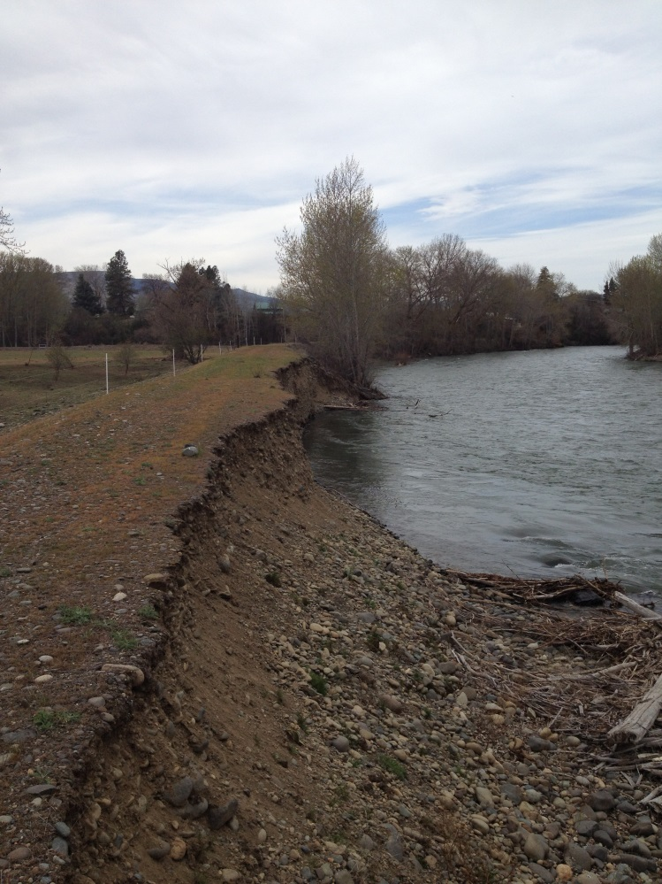
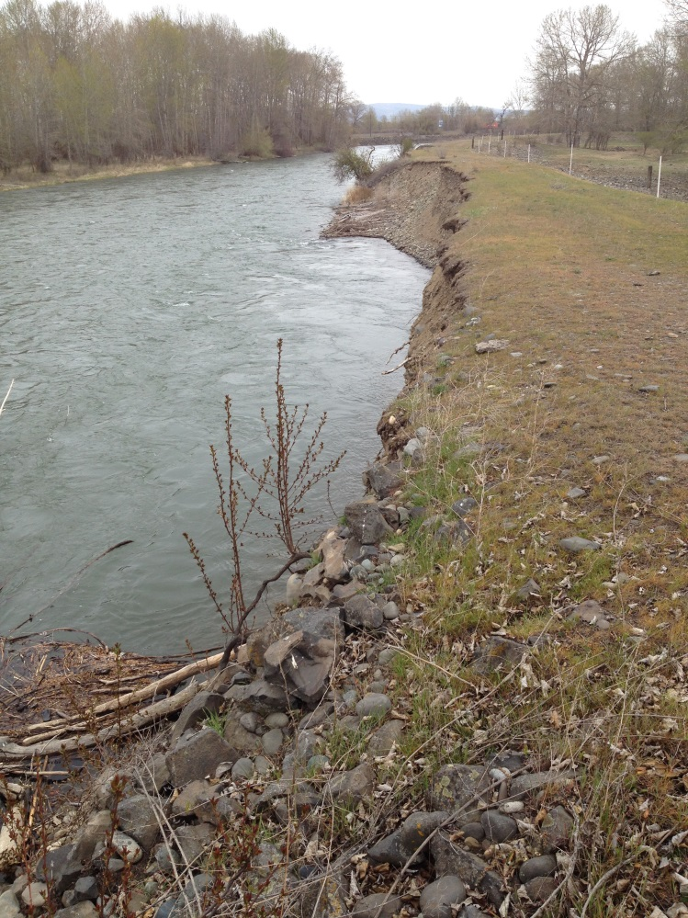
Levee Photos (courtesy of TU)

Slide 9
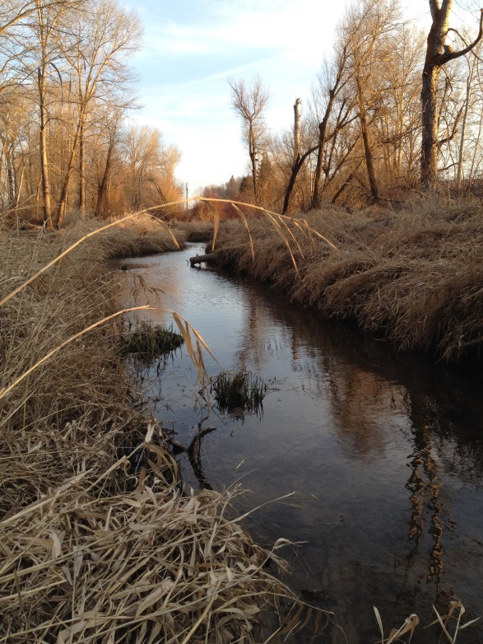
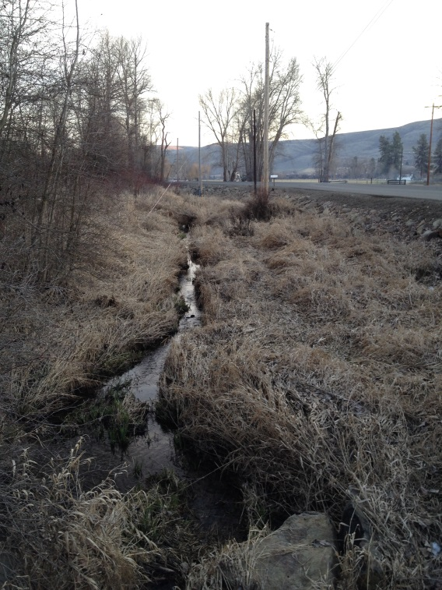
Spring Channels (photos courtesy of TU)
Year-round flow, higher in summer
Over 2000’ on the property
Culverts and irrigation structures restrict access
Established riparian forest protects about 800’
Minimal fish presence

Slide 10
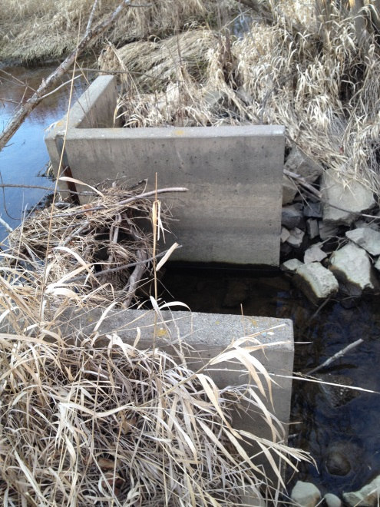
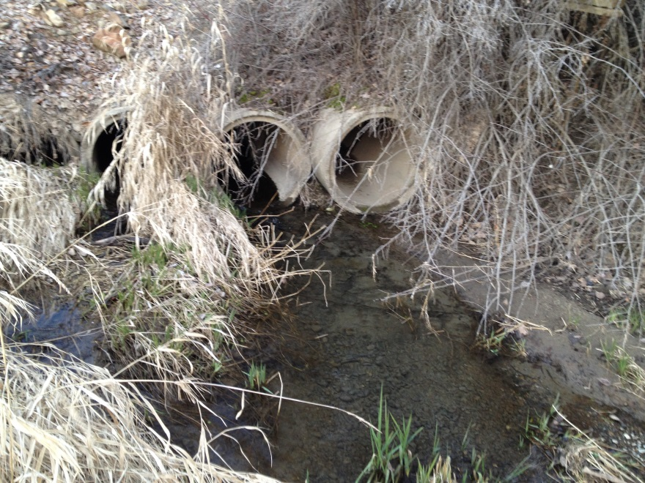
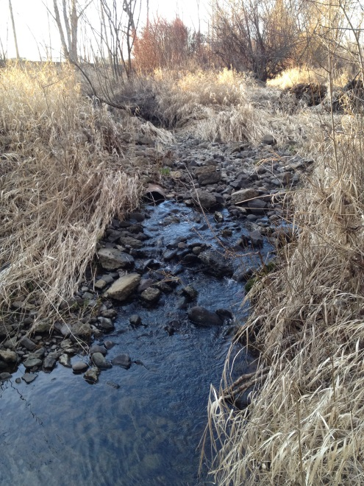
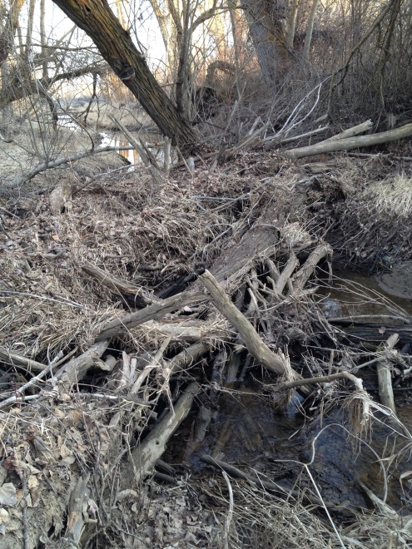
Passage Barriers (photos courtesy of TU)

Slide 11
Design Development
Technical Advisory Group
National Marine Fisheries Service
U.S. Fish and Wildlife Service
U.S. Bureau of Reclamation
Washington Department of Fish and Wildlife
Washington Department of Ecology
Kittitas County Conservation District
Mid-Columbia Fisheries Enhancement Group
Washington Department of Natural Resources
Washington Department of Transportation
Yakama Nation.

Slide 12
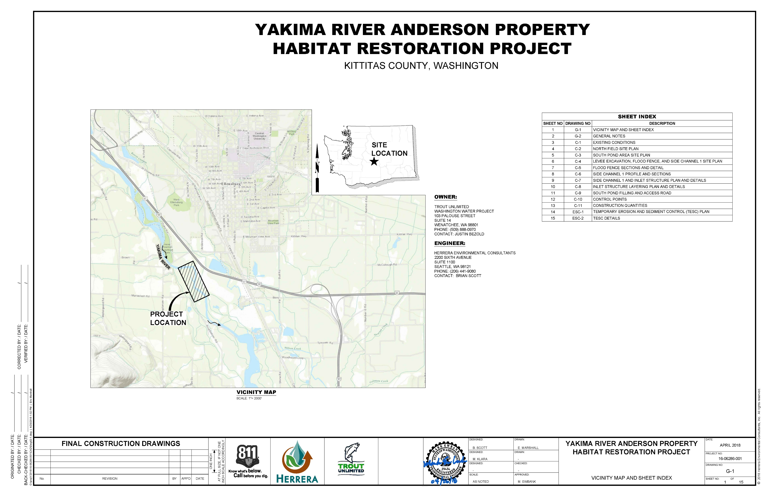

Slide 13
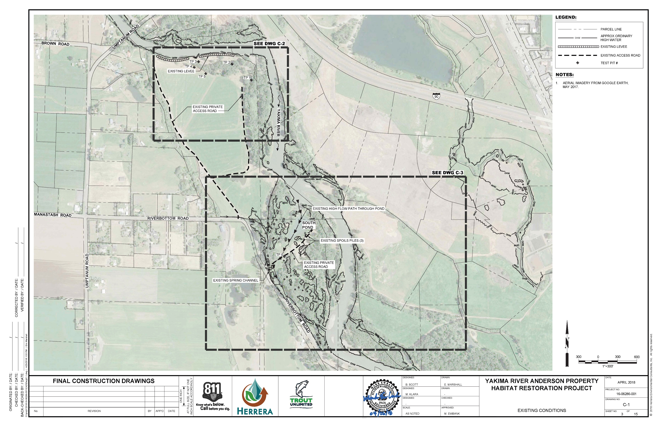

Slide 14
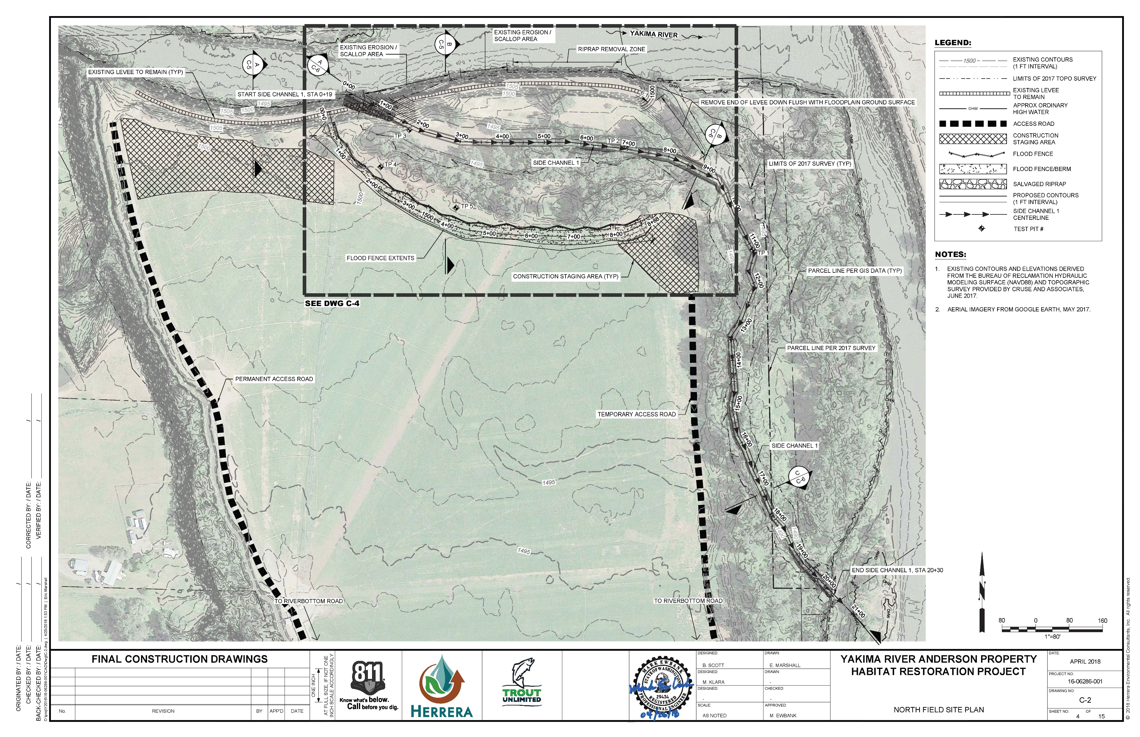

Slide 15
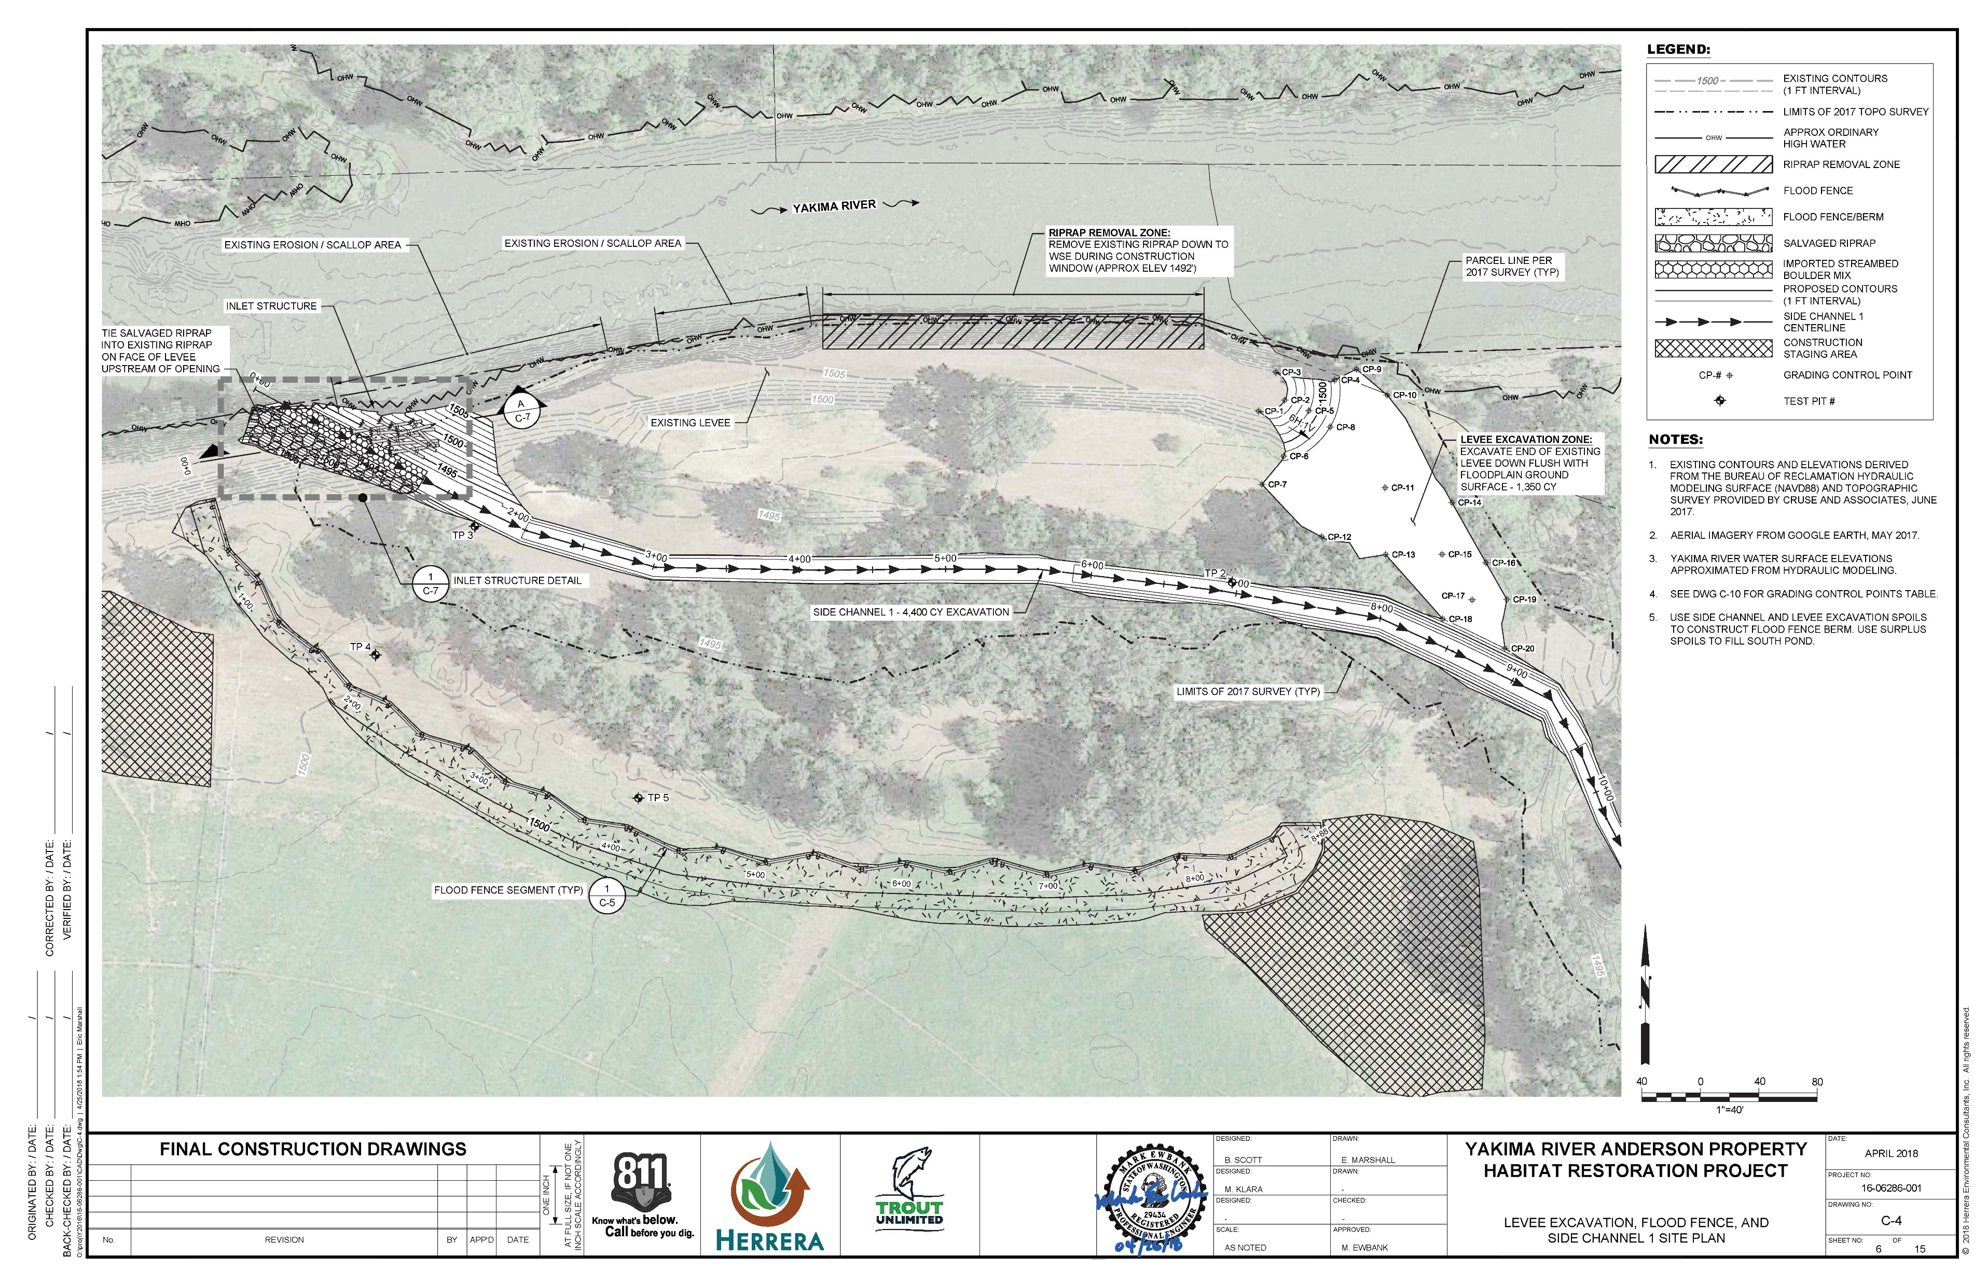

Slide 16
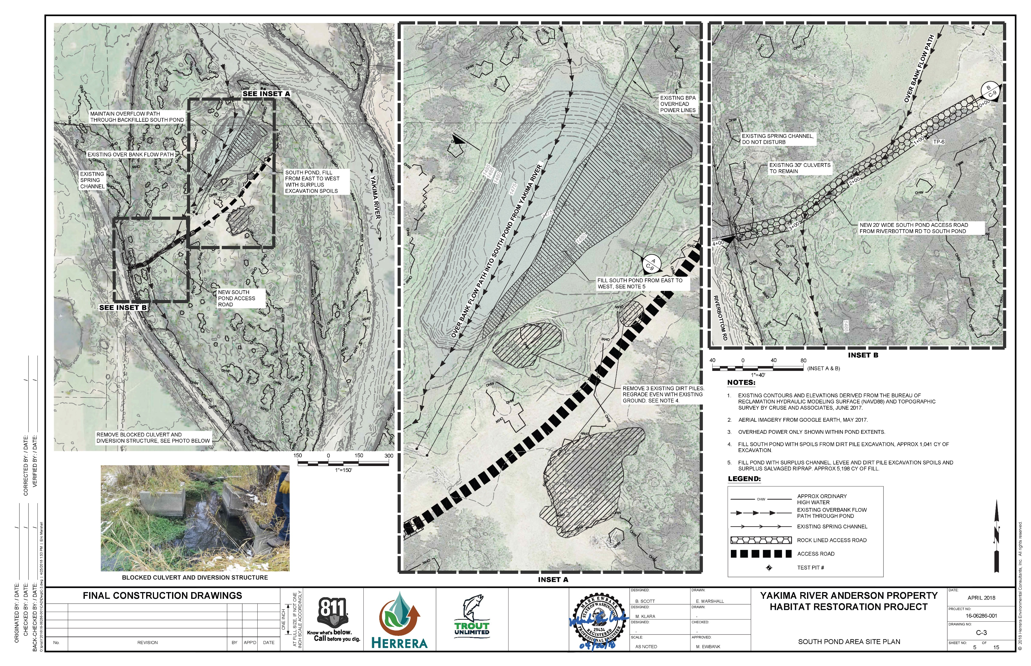

Slide 17
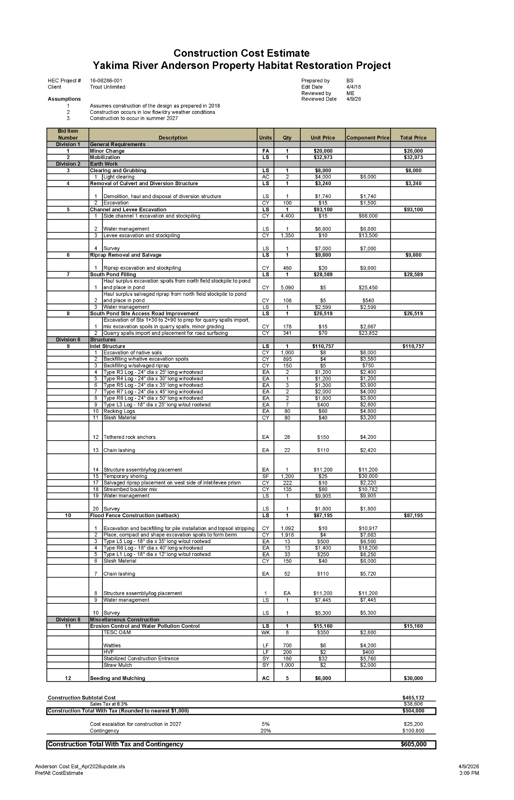

Slide 18




Slide 20
Limitations and Constraints
Property owner may want changes in the design and/or have different goals
Meeting April 16, 2026; Participation in Site Visit
Erosion of the levee adjacent to the property may necessitate redesign work which could need involvement of a geotechnical engineer and a surveyor to update the site topo and increase costs
Utilize Emergency Watershed Protection (EWP) Program funding for at least upper end of Jensen Levee site conditions update; Seeking immediate additional funding for site evaluation of entire levee area and for construction
Reconvene Technical Work Group to review project

